Slide 1
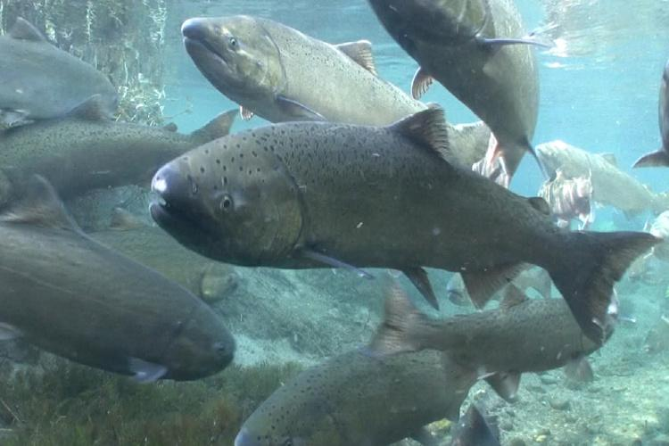
Human Impacts on the Environment: The Salmon Population in Oregon
Photo source: Oregon Department of Fish and Wildlife:https://www.dfw.state.or.us/resources/fishing/salmon_steelhead.asp
Notes:
Today we will be learning about how humans can impact the environment, specifically the salmon population in Oregon.

Slide 2
Notes:
Have students add ideas to the What I Know and What I Want to Know categories. At the end of the lesson, students can fill in the What I learned category.

Slide 3
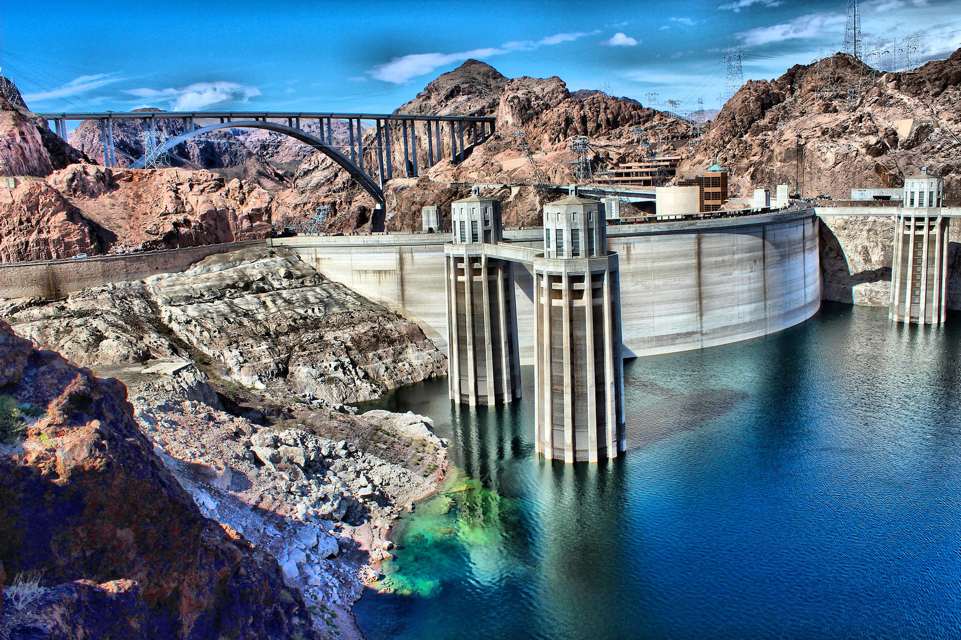
Discussion Questions
Why do you think dams have been utilized in the past and continue to be today?
What kind of implications do you think this has on our ecosystems, and cultures (historically and currently today)?
Notes:
Note: You may lead this discussion in a whole class setting, or in a breakout session.
Say: Why do you think dams have been utilized in the past and continue to be today? (Wait for student responses and discussion) They say: What kind of implications do you think this has on our ecosystems, and cultures (historically and currently today). You may lead this discussion in a whole class setting, or in pairs or groups (via in class or in a breakout session format through an online platform).
Photo source: https://earth.stanford.edu/news/hydropower-dams-threaten-fish-habitats-worldwide#gs.fpao2k

Slide 4
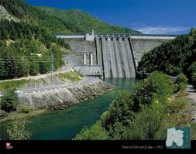
Dams and Their Impact on Earth Systems
“Dams have been used extensively throughout the United States for a variety of purposes, including navigation, flood control, and power generation. While well-designed and properly managed dams can provide many benefits, they drastically alter natural river communities. The natural flow of water and sediment is impeded, and populations of native fish, mussels, and other aquatic animals are damaged”
Notes:
(U.S. Fish & Wildlife Service: https://www.fws.gov/southeast/pdf/fact-sheet/dam-removal.pdf)
Photo source: https://www.nwp.usace.army.mil/Locations/Willamette-Valley/Detroit/

Slide 5
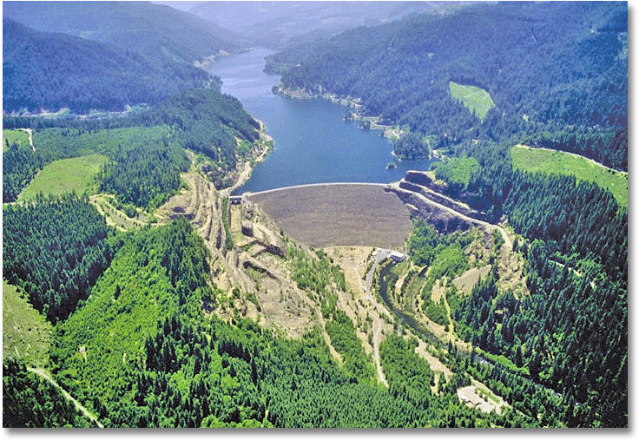
*Dams can block or impede migration and have created deep pools of water that in some cases have inundated important spawning habitat or blocked access to it.
*Dams change the character of rivers, creating slow-moving, warm water pools that are ideal for predators of salmon.
*Low water velocities in large reservoirs also can delay salmon migration and expose fish to high water temperatures and disease.
*Some dams have fish ladders; however, they still impede the successful migration of salmon.
Notes:
Note: Slide Title: Dams and Their Impact Continued
Source: https://www.fws.gov/salmonofthewest/dams.htm
Photo source: https://www.usgs.gov/media/images/a-dam-and-reservoir-can-alter-temperature-characteristics-a-river

Slide 6
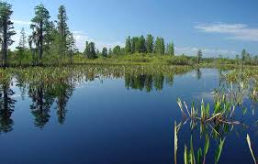
Why it Matters
Salmon are a profound component of the Northwest's economy and identity.
They have been and continue to be a spiritual and cultural center of importance and meaning to tribes in Oregon since time immemorial.
The possibility that wild salmon may become extinct indicates that our waterways are in such bad shape they can no longer support a species that has been in our rivers and streams for eons and once numbered in the millions. And ultimately, human health also is dependent on healthy rivers.
Once a wild run is lost it will not return. Extinction is forever.
Notes:
Say: The land currently known as Oregon was fully inhabited by Indigenous groups since time immemorial. These groups were and are intimately connected to the land and water.
Source: https://www.fws.gov/salmonofthewest/care.htm
Photo source: https://www.fws.gov/

Slide 7
Dam Removal
The removal of dams restores a river’s natural flow and helps to restore vegetation and habitat.
By returning the natural flow of water and sediment, the salmon population as well as other aquatic animals can begin to be restored.
Notes:
Photo/news source: https://www.eenews.net/stories/1062829919

Slide 8
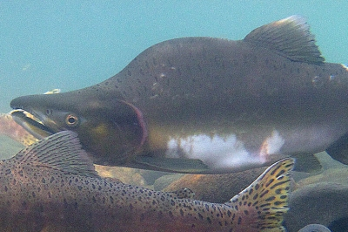
Through tireless advocacy efforts, the largest dam removal and salmon-restoration proposal was approved. Communities that depend on a healthy Klamath River for food, jobs, recreation and cultural survival have accomplished what once seemed impossible to most outside observers. “With continued dedication, the world will witness the largest dam-removal and salmon restoration project in history by 2020.”
Advocacy for Salmon Restoration
Notes:
Source: https://waterkeeper.org/magazines/volume-13-issue-1/klamath-river-dam-removal/
Photo source: https://myodfw.com/fishing/species/pink-salmon

Slide 9
Check for understanding:
Which tribe in Oregon was involved in the advocation efforts for the removal of (4) dams?

Slide 11
National Geographic: Small Tribe Thinks Big About Their Ocean Space
The Indigenous people living on the southern Oregon coast have always understood that the ocean and its creatures must be respected. According to the tribal lore of the Confederated Tribes of the Coos, Lower Umpqua and Siuslaw, Thunderbird was the chief of the ocean, and of all the ocean’s creatures, salmon was most beloved. When the people treated salmon carelessly, by dropping it on the ground or burning it, Thunderbird became angry and created powerful storms. The people burned tobacco in their fires and pleaded with Thunderbird to go north.
Notes:
Source: https://blog.nationalgeographic.org/2014/05/07/a-small-tribe-thinks-big-about-their-ocean-space/

Slide 12
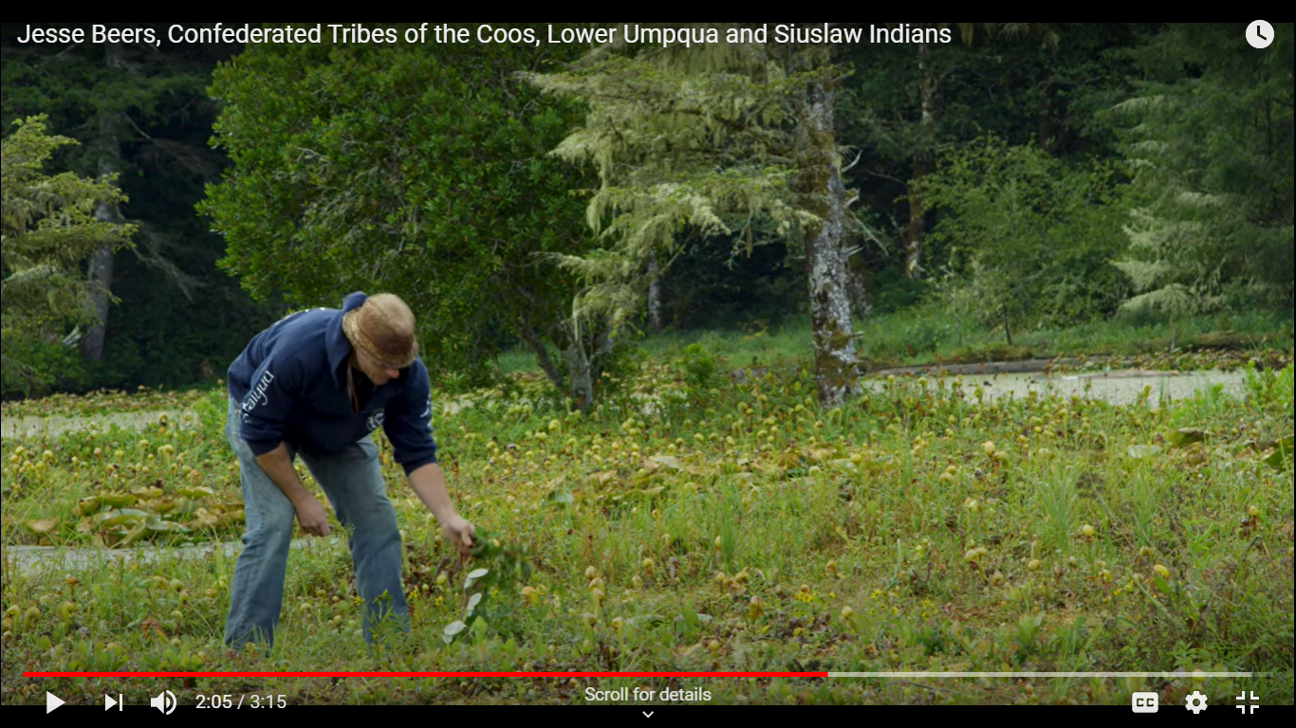
Questions for upcoming video
As you are watching the video of Jesse Beers of the Confederated Tribes of Coos, Lower Umpqua and Siuslaw Indians, think about the following questions:
What do you notice? What do you wonder?
Notes:
Photo source: https://www.youtube.com/watch?v=gSwWEdlhiBg
(Siuslaw Watershed Council, Filmmaker Brian Kelley, & The Confederated Tribes of Coos, Lower Umpqua and Siuslaw Indians
Play video

Slide 13
Reflection Question:
How can we utilize Indigenous traditional ecological knowledge in order to have a meaningful impact on caring for the environment?

Slide 14
First Salmon Ceremony: The Cultural Importance and Efforts to Restore the Salmon Population in Oregon
Video
Video source: Oregon Public Broadcasting (OPB)
Draw or write as you are listening and watching the video.
What do you notice or wonder about the life of salmon as it moves from the ocean to the rivers?
What is unique about the life of the salmon?
What challenges do the salmon have from human impacts on the environment?
Notes:
MJ or AC to post the questions to be thinking about during the video in the chat area. (What do you notice or wonder about the life of salmon as it moves from the ocean to the rivers? What is unique about the life of the salmon? What challenges do the salmon have from human impacts on the environment?

Slide 15
Reflection Questions
What was the significance of Agnes Pilgrim, Confederated Tribes of Siletz Indians Takelma Elder, bringing back the First Salmon Ceremony?
From your point of view, were her efforts important to salmon and the environment?
What sounds and images from the environment stood out to you the most in the video?
How did removing the dams in the video help the salmon habitat and population?
What can you do to ensure habitat restoration efforts keep occuring and salmon are in existence for future generations?
Notes:
Students can write thoughts, questions, reflections and responses to each prompt, then discuss with a partner or group (breakout room). Once complete, ask for volunteers to share out answers to the whole class.

Slide 16
Read: Dam Removal: An Opportunity for Our Rivers
Notes:
Have students read independently or read aloud as a class via pdf.

Slide 17
Construct an argument supported by evidence for how dams impact Earth’s systems.
Notes:
Examples of sources for evidence are provided on the Resources section of the lesson plan.

