Slide 1
Traditional Housing Styles of Native Americans in Oregon
Notes:
Say: One of the primary purposes of mathematics is to solve real-world problems. For example, people in all parts of the world have used mathematics to help them build structures that could provide shelter and safety, and this includes Native American tribes in Oregon. Today, we’re going to look at some of the traditional housing styles used by tribes in Oregon, while also looking at how math can be used to address one of the most essential needs of human beings. In order to build structures that can withstand the various natural elements, it’s important to build strong frames and use high-quality materials. The triangle shape provides one of the strongest frames because any added force is evenly distributed across all three sides. The more stable the triangle, the more stable the building. Many Native American tribes in Oregon practiced a seasonal lifestyle, moving from one area to another based on the availability of resources. This gave them a deep understanding of the housing needs and available materials in different areas of Oregon and in different seasons. They knew how to use the resources that were available in the area they were in and how to build shelters that provided the most protection and comfort. In this lesson we’ll practice using math concepts such as surface area and the Pythagorean Theorem while learning about a few of the traditional housing styles of Native Americans tribes in Oregon.
Display and discuss slides 1 through 5. Explain that even today housing decisions are often based on weather, available materials, and whether a structure needs to be permanent or not.

Slide 2
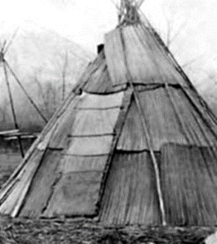
Mat Houses
Mats were typically made of tule (pronounced TWO-lee), a tall, grass-like plant that grows along rivers and streams and is similar to cattails
Tule were woven together into large mats that were placed over a frame made of poles
The frame was usually cone-shaped, although sometimes it was a more elongated, lodge-type shape or even a dome shape
Tule mats were layered to make the houses water and wind resistant

Slide 3
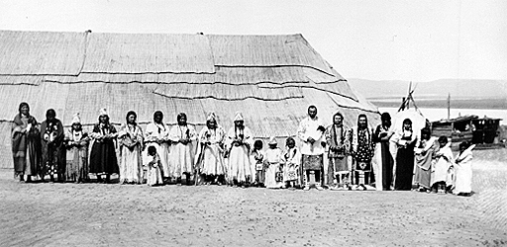
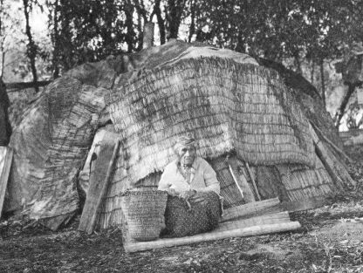
More Mat Houses
Mat house of the Umatilla Tribe
Klamath mat house with domed roof

Slide 4
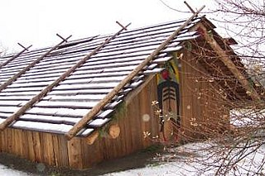
Plank Houses
Good style for cold climates with a lot of tall trees
Common throughout the Pacific Northwest for coastal tribes
Many plank houses included art as part of the design
Common style of winter housing
Typically made from red cedar wood
Chinook plank house
Image from: https://oregonencyclopedia.org/articles/chinookan_plank_houses/#.XhU-8shKiUk

Slide 5
More Plank Houses
Plank houses are still built today
This is a plank house built by the Coquille Indian Tribe
Built of long, flat planks of cedar
Sides and roof can be removed to open the building
Image from: https://www.usda.gov/media/blog/2010/10/08/oregons-coquille-indian-tribe-hosts-usda-consultation-traditional-native

Slide 6
Chinookan Plank Houses: Native American Domestic Architecture & Culture video
Native American tribes in Oregon were experts at problem solving and at using the natural resources available to them for purposes such as food, clothing, housing, tools, storage, and cultural practices.
Natural resources include plants, animals, trees, grasses, and stone.
You can see these natural resources in traditional Native housing styles, some of which are still constructed today.
Notes:
Have students view the Chinookan Plank Houses: Native American Domestic Architecture & Culture video (Linked in slide). Ask them to take note of the natural resources that are used and to think about any mathematical questions that come to mind while watching the video. After viewing, ask students to work in pairs and share two facts they learned while watching the video and one question it raised for them.

Slide 7
What kind of housing could you make if you only had the materials available in this classroom?
Traditional Native American housing was based on a deep knowledge of the natural environment and its available materials, as well as a keen understanding of structural requirements
Notes:
Say: I want you to think about the materials that are available to you in this classroom. If you had to construct a house using only the materials in this room, what would you build? First, think about what materials would be most durable. Next, think about which materials would be the quickest to assemble and take down. May do this in small groups in breakout rooms. Allow time for students to discuss and then ask a few volunteers to share their ideas

Slide 8
Pythagorean Theorem
Describes the relationship between three sides of a right triangle
C is the hypotenuse
A and B are the sides of the triangle that form a right angle
c
a
b
Notes:
This lesson provides a quick review of the Pythagorean Theorem. If this is a new concept for your classroom, you may need to provide a more in-depth overview before beginning this activity.

Slide 9
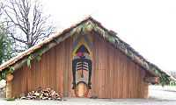
Pythagorean Theorem in Use
How could you use the Pythagorean Theorem when building a plank house like this?
Notes:
Ask students how the Pythagorean Theorem could be used when building a plank house, reflecting on the video they previously watched.

Slide 10
Can you figure out how to make a right triangle?
6 inches
6 inches
6 inches
Notes:
Show how students can bisect a triangle to find the right angle in order to calculate the length of a missing side. Have students determine the height of the triangle by using the formula and appropriate variables.
${\text{a}}^{2}$ + ${\text{b}}^{2}$ = ${\text{c}}^{2}$
32 + ${\text{b}}^{2}$ = 62
9 + ${\text{b}}^{2}$ = 36
${\text{b}}^{2}$ = 36 - 9
${\text{b}}^{2}$ = 27
b≈ 5.2 inches

Slide 11
Practice Time!
Notes:
Distribute the Pythagorean Theorem: In Practice worksheet and instruct students to solve the problem on the page. When students have solved the problem, tell them to follow the instructions on the bottom of the page (create a problem that requires the Pythagorean Theorem to solve). Students will then exchange worksheets with a peer and solve each other’s problem.

