Slide 1
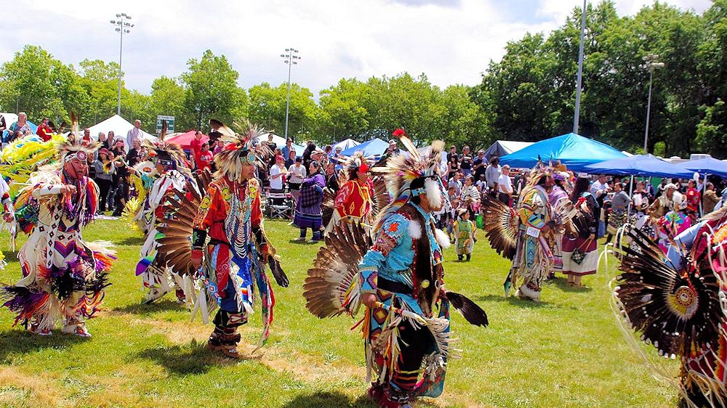
Are We Going to Make It to the Pow Wow?
How does one plan for adventures with the biggest payoffs?

Slide 2
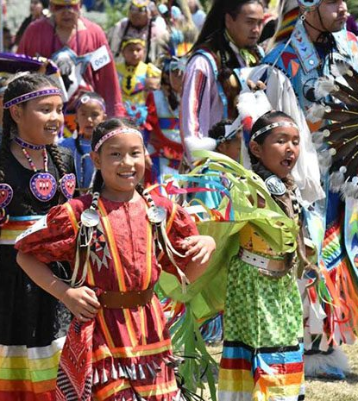
This math lesson introduces us to an important element of Native American culture: the pow wow. These are public events in which Native people celebrate and share their culture; honor friends, family members, elders, and military veterans; participate in singing and dancing; and display traditional skills and crafts. There are more than a dozen pow wows held in Oregon each year, from early spring to early fall, in all regions of the state. Most pow wows are also open to non-Native people.

Slide 3
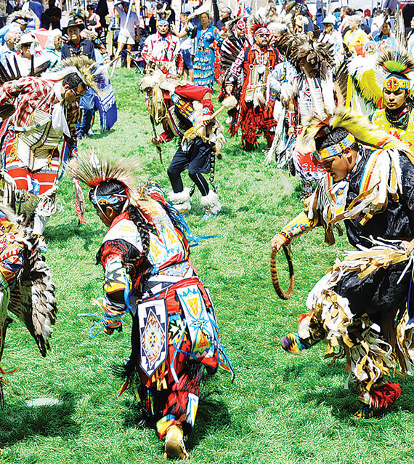
For many Native people, pow wows are a time of gathering and connecting with friends and relatives. These celebrations, which typically take place from spring to early fall, are a way to share knowledge and traditions with others and a time to honor veterans, friends and relatives who have died, recent graduates, toddlers learning to dance, and more.

Slide 4
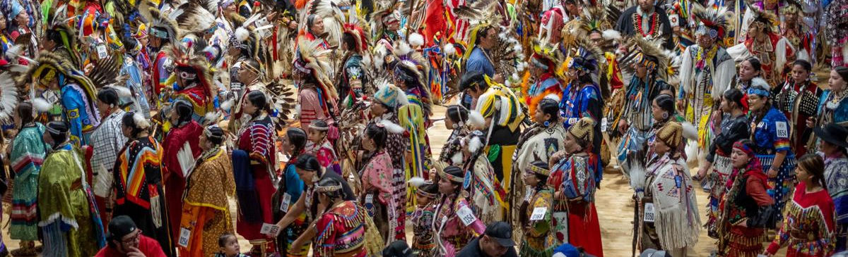
Are We Going to Make It to the Pow Wow?
In this lesson, each of you will choose which pow wow to attend and then calculate the related expenses.
STANDARDS
Oregon mathematical practice standards HS.MP.1 Make sense of problems and persevere in solving them. HS.MP.3 Construct viable arguments and critique the reasoning of others. HS.MP.4 Model with mathematics. Oregon math standards S.MD.5 Weigh the possible outcomes of a decision by assigning probabilities to payoff values and finding expected values. b. Evaluate and compare strategies on the basis of expected values.

Slide 5
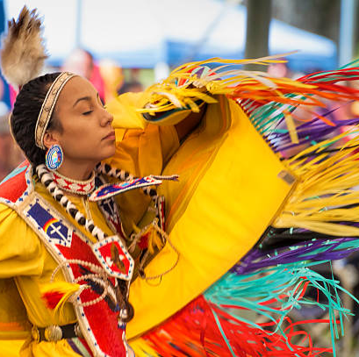
Introduction to Pow Wows in Oregon
Southern Oregon University Pow Wow in Ashland, Oregon
Rogue Valley powwow honors veterans
Notes:
Say: Pow wows are social gatherings that are held all across Oregon and the United States in celebration of Native American heritage and culture. They are a chance for people to gather; see friends, family members, and neighbors; wish good intentions for others; and share cultural heritage with each other. Pow wows are held in various locations and often have different meanings and purposes depending on the time and place they are held. We’re going to watch two different newscasts that highlight two very different settings and two very different purposes. In the videos you will see a variety of dancers and notice what they are wearing. These outfits are called regalia, and it’s important to understand that they are not costumes. They are specific to the type of dance and are also meant to reflect the personality and identity of the dancer. Many are passed down from generation to generation. You will notice the many different colors, materials, and styles of regalia. For our lesson today we’re going use pow wows as the context for a problem-solving activity. You’re going to choose three pow wows you would like to visit and then create detailed travel plans for each one. You have an exact budget that you will have to work with, and you will need to plan for gas, food, and lodging. As you watch the videos, I want you to think about what specific things you would be interested in seeing while traveling to the pow wows. I want you to pay attention to, the music, the drums, the regalia, the purpose, and even the environment in which the pow wow is held.
After each video, have students share for 2 to 5 minutes about things they noticed and would like to see in a pow wow trip.

Slide 6
Pow Wow Trail Planning Chart
Notes:
Have students complete the Pow Wow Trail Planning Chart by researching topics specific to pow wows and tribes in Oregon by going to tribal websites, college and university sites or other appropriate websites. Students can also use the Pow Wow Descriptions handout. Teachers may choose to allow students to work in teams, but each student should complete the assignment.

Slide 7
Pow Wow Trail Planning Sheet
Notes:
Students will apply the information from the Pow Wow Trails Task Set to determine and justify their choices using a mileage chart. Teachers may choose to allow students to work in teams, but each student should complete the assignment.
Say: So, you have done some preplanning and have an idea about which pow wows you might want to visit, how far you can go on a tank of gas, and how much it will cost to fill it up again. You know how long you can travel before you have to attend the pow wow or get some sleep and how much it could cost for food and lodging. Now you are going to use this mileage chart to determine and finalize which pow wows to go to and how much each one will actually cost. Remember, you have a specific budget and some guidelines you have to follow. [Refer back to the Pow Wow Trails Task Sheet.] You have to leave from here and end up back here, with enough gas left in your tank.

