Slide 1
Oregon Poet Laureate 2016-2018 Elizabeth Woody
Notes:
Activity 1 Introducing Elizabeth Woody Time: 30 minutes
Introduce the learning objectives for the lesson. Acknowledge that some students may feel intimidated about reading poetry. Reassure students that the class will work collaboratively to better understand the key elements of poetry and to identify themes. Say: Poetry is a form of writing that evokes feeling and thoughts and conveys meaning beyond what is written. The sound of the words, the rhythm of the lines, even the style of the poem itself all tell us more about what is being written. Songs are similar to poems, except they are set to music. In a poem, the music and rhythm come from the words themselves. Ask student to share types of poetry they have learned about. This can be a brief three- to five-minute discussion. Note: Examples that most grade 10 students have encountered may include Shakespearean sonnets, found poetry, spoken word, or rap.

Slide 2
Oregon Poet Laureate
Serves as a state ambassador of poetry
Appointed by the governor of Oregon
Travels the state to share the power of reading and writing poetry
Notes:
Show slides 1-2 and provide students with an overview of the Oregon Poet Laureate. Say: The Oregon Poet Laureate serves as a state ambassador of poetry. Oregon poets laureate are appointed by the governor and travel the state sharing the power of reading and writing poetry. Most serve a two-year term.

Slide 3
Elizabeth Woody
Elizabeth Woody is a poet and educator of Navajo, Wasco, and Yakama descent. She is an enrolled tribal member of the Confederated Tribes of Warm Springs.
Woody’s subject matter includes the histories of her ancestors, the rich Pacific Northwest landscape, and the experience of being a tribal member, an American, and a woman in contemporary society.
Woody is the winner of the American Book Award.
In 2017, she was named the eighth poet laureate of Oregon.
She is the first person of American Indian heritage to be named poet laureate of Oregon.
Notes:
Show slides 3-4 and provide a brief overview of Elizabeth Woody’s work. Say: Elizabeth Woody is a poet and educator of Navajo, Warm Springs, Wasco, and Yakama descent. Her poetry includes many themes that we will discuss in depth. Woody is the winner of the American Book Award and in 2017 she was named the eighth poet laureate of Oregon. She is the first Native American to hold that honor in Oregon. We will begin learning about Elizabeth Woody by listening to her share some of her personal story and her poetic work.

Slide 4
Elizabeth Woody’s Books of Poetry
Luminaries of the Humble, (Sun Tracks, Vol 30), University of Arizona Press
Seven Hands Seven Hearts, Eighth Mountain Press
Hand into Stone: Poems, Contact II Publications

Slide 5
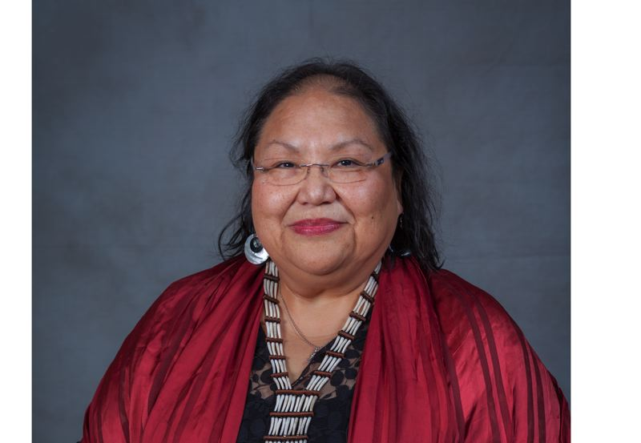
Elizabeth Woody: Transcending Chaos Through Art PLAY VIDEO
Notes:
Show the video on slide 5, “Elizabeth Woody: Transcending Chaos Through Art,” from Oregon Public Broadcasting. The video is approximately 10 minutes long. Ask students to refrain from taking notes and to give their full attention to the video. [Link to video: https://www.opb.org/television/programs/artbeat/segment/oregon-poet-laureate-elizabeth-woody-warm-springs-poetry/]
Pass out the Elizabeth Woody Quotations handout (this activity can also be done in pairs or small groups in breakout rooms). Give students approximately 10 to 15 minutes to discuss and respond in writing to each quotation. As a means of exploring these quotations, they should consider the following questions: How does Elizabeth Woody define poetry? Why does Elizabeth Woody write poetry? What might she want her poetry to achieve?
As a whole class, ask students to share their written impressions.

Slide 6
A theme in poetry is…
The central thought or underlying meaning of the poem
NOT the same as the subject or topic of the poem
A statement the poem makes about the topic
Notes:
Activity 2: Analyzing “She-Who-Watches, The Names Are Prayer” Time: 60 minutes
Step 1: Distribute a copy of the Poetry Analysis Graphic Organizer. Provide one copy to each student. Display a copy of the graphic organizer
Say: “What is a theme in poetry?” Say: A theme in poetry is the central thought or underlying meaning of the poem. A theme in poetry is not the same as the subject or topic of the poem, but it is a statement the poem makes about the topic. We are going to analyze Elizabeth Woody’s poem, “She-Who-Watches, The Names Are Prayer” and identify poetic theme using a process called TPCASTT.

Slide 7
TPCASTT Poetry Analysis
T- Title
P- Paraphrase
C- Connotation
A- Attitude
S- Shift
T- Title Revisited
T- Theme
Notes:
Using slides 7-14, walk students through each element of TPCASTT

Slide 8
Title
Before you read the poem, consider the title and its possible meaning.
Questions:
What ideas does the title evoke?
What images does the title suggest?
Can you make any predictions about the poem?

Slide 9
Paraphrase
Put the poem in your own words. Begin by highlighting or underlining words, phrases, and images that stand out for you. Write your paraphrase next to the poem.
Questions:
What is the surface meaning of the poem?
What is the topic/subject of the poem?

Slide 10
Connotation
Consider what you highlighted/underlined. Think about the “under surface” meanings of these words or phrases.
Questions:
What could these words or images tell you?
What could the author be saying?

Slide 11
Attitude
The attitude of the poem can be thought of as the perspective or tone of the poem. Reflect on who is the speaker of the poem and the feelings projected through word choice and figurative language.
Questions:
What is the speaker’s attitude? What is the tone of the poem?
What is the author’s attitude/tone? Does it differ from that of the speaker?

Slide 12
Shift
Shift refers to changes or progression from one idea to another in the poem. Look for changes in time, tone, or speaker. This should always be noted as it will affect meaning.
Questions:
Are there changes in key words (but, yet, however, although)?
Are there dramatic changes in punctuation such as dashes, periods, or colons?
Are there changes in the level of diction (for example, from more formal to more informal)?

Slide 13
Title – Again!
Return to the title of the poem. Take a few minutes to reflect on its meaning.
Questions:
Did the interpretation change?
What does the title tell us about the poem?

Slide 14
Theme
A theme in poetry is the central thought or underlying meaning of the poem. Look at the other parts of TPCASTT. The theme is communicated through use of connotation, attitude/tone, and the progression of ideas.
Questions:
What is the poem saying?
What message or idea is the author trying to get across?
Notes:
Begin to model the TPCASTT strategy by facilitating a whole-class discussion on how to complete the first row “title” on the graphic organizer. Write the title of the poem on the projected teacher copy of the Poetry Analysis Graphic Organizer. Ask students, “What ideas/images does this title evoke? What do you think the title means? Facilitate a classroom discussion for two to three minutes. Record student responses on the first row “title” on the graphic organizer.

Slide 15
Celilo Falls (Wy-am)
For thousands of years, Celilo Falls (Wy-am) was one of history’s great market places
Northwest tribes fished for the salmon that struggled to make their way upstream
There were permanent villages between the falls and where the city of The Dalles now stands
As many as 5,000 people would gather to trade, feast, and participate in games and religious ceremonies
In 1957, the opening of the Dalles Dam formed a lake that flooded Celilo Falls
Notes:
BEFORE listening to Woody’s reading of “She-Who-Watches, The Names Are Prayer” share slides 15-16 and provide students with background information on Celilo Falls (Wy-am), the She Who Watches petroglyph/pictograph, and activist David Sohappy, to whom this poem is dedicated.
https://www.critfc.org/salmon-culture/tribal-salmon-culture/celilo-falls/

Slide 16
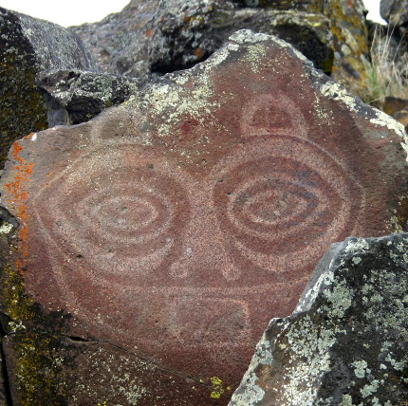
She-Who-Watches, the Names Are Prayer For David Sohappy, April 25, 1925 – May 7, 1991
Woody dedicated this poem to David Sohappy, a Yakama religious leader who led the fight to restore fishing rights to American Indian tribes along the Columbia River
The speaker of this poem is a petroglyph (a rock carving) on the Columbia River
Woody explains that, “She was originally a woman chief, the last, before Coyote changed her into rock to watch over her people and the male chiefs who followed her” (notes to poems in Seven Hands Seven Hearts 123)

Slide 17
Elizabeth Woody: Transcending Chaos Through Art
Notes:
https://www.youtube.com/watch?v=iXIYMabj4m0
Show the video. Ask students to complete the “paraphrase” row of their graphic organizer by adding words, phrases, and images that stand out as they listen. Continue to help students paraphrase by listening to the reading as a whole class once or twice more, but this time PAUSE after every two or three lines and ask students to write down the meaning of each set of lines (sentences) in their own words.
Ask students to turn to a partner and share how they paraphrased Woody’s poem. Then ask for a few volunteers to share with the whole class.

