Slide 1
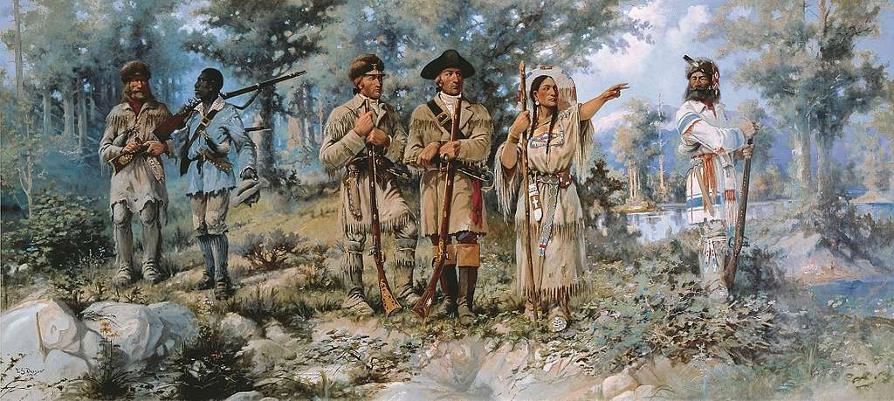
GRADE 8 Lewis and Clark: A Native American View
Notes:
Confirm that students are familiar with the general outlines and main events and people involved in the Lewis and Clark Expedition. Review if necessary. Ask students to share their pre-knowledge on the topic, or what they think they know or remember about the expedition.

Slide 2
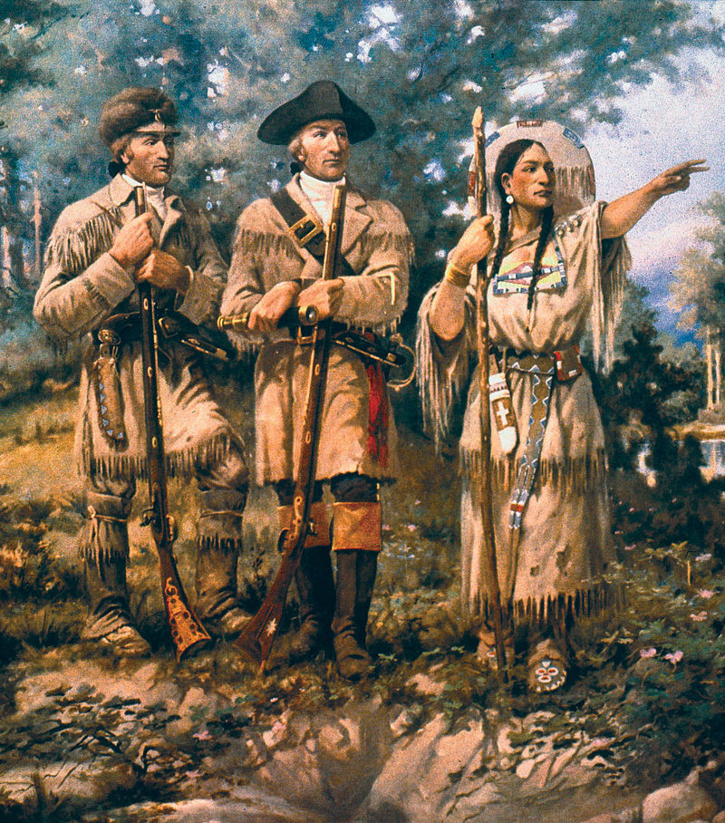
Background
In 1804, Meriwether Lewis and William Clark left St. Louis to explore land west of the Mississippi River. The U.S. had recently acquired the land as part of the Louisiana Purchase. Lewis and Clark kept journals and made maps during their journey. They returned to St. Louis on September 23, 1806. That day, Lewis wrote a letter to President Jefferson describing the journey.
Notes:
Image Source: Edgar Samuel Paxson [Public domain]. How do we know what we think we know about the Lewis and Clark expedition? It is important to point out any inaccuracies or misinformation in the narrative students share. [Possible answers: textbooks, history classes/lessons in school, field trips, websites, books, movies.]

Slide 3
What are Primary and Secondary Sources?
Notes:
Introduce the terms “primary source” and “secondary source”. Begin by asking students to explain or guess what the terms mean based on their prior knowledge. Record their definitions

Slide 4
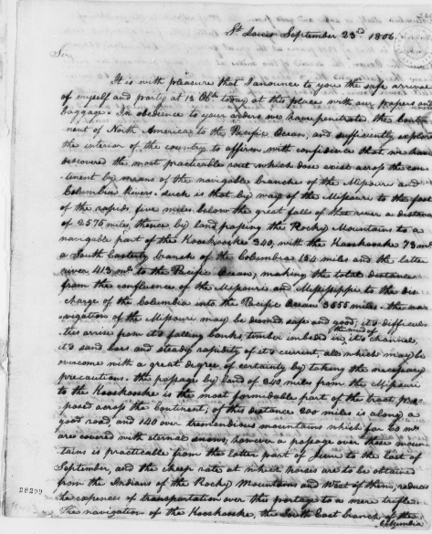
Primary Sources
The letter from Lewis to Jefferson is a primary source. A primary source is a source of information that comes from someone who was there when an event took place. Letters, journals, photographs, newspapers, interviews, oral histories, and government documents are examples of primary sources.
Notes:
Image Source: (1806) Meriwether Lewis to Thomas Jefferson. -09-23. [Manuscript/Mixed Material] Retrieved from the Library of Congress, https://www.loc.gov/item/mtjbib016499/.

Slide 5
Secondary Sources
This excerpt from an encyclopedia article about the expedition is a secondary source. A secondary source is a source of information that comes from someone who was not present when an event took place. They are created after an event. Textbooks, biographies, general history books, and documentary videos are examples of secondary sources.
The group crossed half the continent of North America, traveling through a largely unknown wilderness on foot, on horseback and by boat.”
– World Book Encyclopedia, 2007, Vol. 12, p.222
Notes:
Distribute the Primary and Secondary Sources Worksheet, if you have not already. Give students several minutes to fill out the worksheet by responding to the prompts provided. They can work individually, in pairs, or in breakout groups. When finished, ask volunteers to share how they, their pair, or group responded to the prompts. Record their responses.

Slide 6
Benefits and Challenges
Primary Sources | Secondary Sources
Benefits
Evidence of what happened in the past. Bits of history that reveal how people from the time lived and what they thought about the world. | Help us interpret or make sense of primary sources. Tell how an event fits into history. Can include related facts about other events that happened at the same time or at other times.
Challenges
May be difficult to read or understand. May only tell one point of view. | May tell a story from only one point of view. May be a biased representation of the story.
Notes:
Review the slides discussing the benefits and challenges of primary and secondary sources and use them to confirm or expand on student understanding.

Slide 7
Point of View (Perspective)
The position or attitude from which something or someone is observed. Everyone has a point of view. Sometimes in history one person’s or one group’s point of view is judged to be more accurate or important than other points of view. Different points of view can be misunderstood, forgotten, or intentionally left out. History can be missing “the other side of the story.”
Notes:
Image Source: Pixabay (https://pixabay.com/photos/glasses-reading-glasses-spectacles-1246611/). Review the slides discussing the benefits and challenges of primary and secondary sources and use them to confirm or expand on student understanding

Slide 8
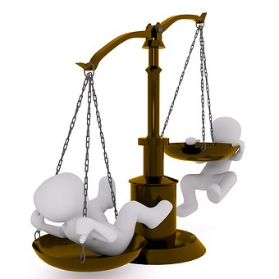
Bias
Prejudice in favor of or against one thing, person, or group compared to another. Sometimes people who observe or interpret an event in history make judgments that are based on their own biases.
Notes:
Image Source: Pixabay (https://pixabay.com/illustrations/horizontal-pan-balance-weigh-2071320/). Review the slides discussing the benefits and challenges of primary and secondary sources and use them to confirm or expand on student understanding

Slide 9
Historical Perspective
Historical Perspective Video

Slide 10
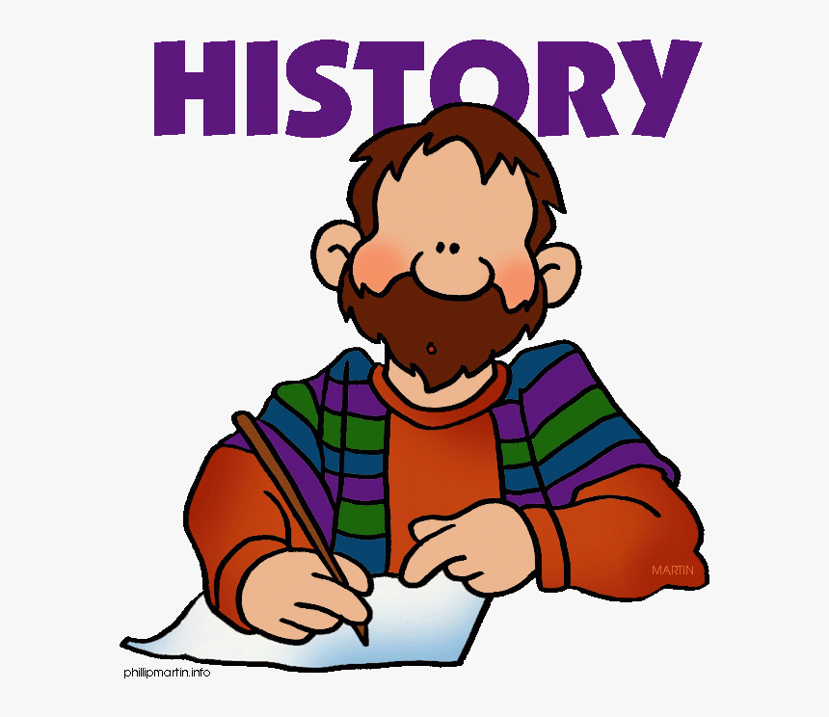
Incident at Umatilla (Reading and Reflection Activities)
Notes:
Wrap up by telling students that they will be putting on their historian hats and looking at an incident that happened in Oregon during the Lewis and Clark Expedition. Prepare them to ask critical questions about what happened and about how people might see and understand it differently, both then and now.

Slide 11
Incident at Umatilla Reading 1 Instructions: On October 19, 1805, the Lewis and Clark Expedition encountered a group of Native Americans near the Umatilla River in Oregon. Read the following passages describing their interaction and answer the questions that follow.
Journal of William Clark – October 19th Saturday 18051
I Delayed at the foot of the rapid about 2 hours for the Canoes which I could See met with much difficuelty in passing down the rapid on the oposit Side maney places the men were obliged to get into the water and haul the canoes over Sholes—while Setting on a rock wateing for Capt Lewis I Shot a Crain which was flying over of the common kind. I observed a great number of Lodges on the opposit Side at Some distance below and Several Indians on the opposit bank passing up to where Capt. Lewis was with the Canoes, others I Saw on a knob nearly opposit to me at which place they delayed but a Short time before they returned to their Lodges as fast as they could run, I was fearfull that those people might not be informed of us, I deturmined to take the little Canoe which was with me and proceed with the three men in it to the Lodges, on my aproach not one person was to be Seen except three men off in the plains, and they Sheared off as I aproached near the Shore, I landed in front of five Lodges which was at no great distance from each other, Saw no person the enteranc or Dores of the Lodges wer Shut with the Same materials of which they were built a mat, I approached one with a pipe in my hand entered a lodge which was the nearest to me found 32 persons men, women and a few children Setting permiscuesly in the Lodg, Some in the greatest agutation, Some crying and ringing there hands, others hanging their heads. I gave my hand to them all and made Signs of my friendly dispotion and offered the men my pipe to Smok and distributed a fiew Small articles which I had in my pockets,—this measure passified those distressed people verry much, I then Sent one man into each lodge and entered a Second myself the inhabitants of which I found more fritened than those of the first lodge I destributed Sundrey Small articles amongst them, and Smoked with the men, I then entered the third 4h & fifth Lodge which I found Somewhat passified, the three men Drewer Jo. & R. Fields, haveing useed everey means in their power to convince them of our friendly disposition to them, I then formd Set my Self on a rock and made Signs to the men to come and Smoke with me not one Come out untill the Canoes arrived with Some five Came out of each Lodge and Set by me and Smoked Capt Lewis at the 2 Chiefs, one of whom spoke aloud, and as was their Custom to all we had passed the Indians came out & Set by me and Smoked They said we came from the clouds &c &c which the and were not men &c. &c. this time Capt. Lewis came down with the Canoes rear in which the Indians, as Soon as they Saw the Squar wife of the interperters wife [Sacagawea] they pointed to her and informed those who continued yet in the Same position I first found them, they imediately all came out and appeared to assume new life, the sight of This Indian woman, wife to one of our interprs. confirmed those people of our friendly intentions, as no woman ever accompanies a war party of Indians in this quarter
Notes:
Distribute the Incident at Umatilla hard copy (if needed) reading packet to students and provide the following overview.
Say: We’re going to read three passages describing an incident that happened between Lewis and Clark and Native Americans near the Umatilla River in Oregon. After each, we’re going to answer some questions that help us determine whether it is from a primary or secondary source, what the perspective of the author might be, and what it tells us about how the people involved might have seen or understood it differently. The first reading is from William Clark’s journal for October 19, 1805. The second reading is from a book written by an historian and published in 1984. The third is from an author who is descended from the tribe that was involved in the incident.

Slide 12
Reflection Questions
What do you know (or what can you infer) about the source and author of this reading?
2. Is this a primary or secondary source of information about the incident? How do you know?
3. Whose point of view is it written from?
4. Is it easy or difficult to understand? Why?
5. How helpful (or unhelpful) is it for understanding what happened?

Slide 13
Reading 2 Ronda, J. P. (1984). Lewis & Clark among the Indians. Lincoln, NE: University of Nebraska Press.Pages 167–168.
As the expedition continued down the Columbia and neared the mouth of the Umatilla River, Indian reactions began to change dramatically. The welcomes offered by Cutssahnem and Yelleppit vanished and were replaced first by fear and then by ill-concealed hostility. That fear became evident during the afternoon of October 19 as the explorers left Walula territory and entered that occupied by Umatillas. Throughout the afternoon, the men saw hastily abandoned villages and frightened Indians. “At our approach,” said Clark, “they hid themselves in their Lodges and not one was to be seen until we passed.” Although the expedition’s records offer no straightforward explanation for this sudden shift in native attitudes, an event later in that afternoon does suggest how Indians with little or no contact with whites
responded to the expedition. As Clark was walking on shore with a small party that included Charbonneau, Sacagawea, and the Nez Perce guides, he idly shot a crane. Clark thought no more about the incident. A cluster of mat lodges in the distance seemed more worthy of attention. Indians from those lodges were spotted running in terror back to their village. Anxious to quiet the Umatillas’ fears, Clark decided to take Drouillard and the Field brothers on a visit. Once at the settlement, they found five mat houses with their doors firmly shut. Pipe in hand, Clark pushed his way into the first lodge and found thirty-two men, women, and children “in the greatest agutation.” As the Indians cried, wrung their hands, and lowered their heads in preparation for death, Clark struggled to allay their fears. Handshaking, a proffered pipe, and gifts eventually soothed them. He repeated the performance at the other lodges and, with the help of the Nez Perce chiefs and the presence of Sacagawea, terror passed into what he claimed was “greatest friendship.” Then the Umatillas spilled out the reason for their fear. As Clark explained it later to Nicholas Biddle, “The alarm was occasioned by their thinking that we were supernatural and came down from the clouds.” The Umatilla perception of Lewis and Clark as sky gods had been sparked by Clark’s random killing of the crane. “These shots (having never heard a gun), a few light clouds passing, the fall of the birds and our immediately landing and coming towards them convinced them we were from above.” As the expedition moved closer to Celilo Falls and The Dalles, the Indians continued to show signs of fear and distrust. Perhaps the outsiders were identified with Paiute warriors who frequently raided in the region. For whatever reason, the river people traded warily with Lewis and Clark. Ordway recalled that these Indians acted “as if they were in fear of us.”

Slide 14
Reflection Questions
What do you know (or what can you infer) about the source and author of this reading?
2. Is this a primary or secondary source of information about the incident? How do you know?
3. Whose point of view is it written from?
4. Is it easy or difficult to understand? Why?
5. How helpful (or unhelpful) is it for understanding what happened?

Slide 15
Reading 3 Connor, R. (2006). “Our people have always been here.” In A. M. Josephy (ed.), Lewis and Clark through Indian eyes. New York, NY: Alfred A. Knopf. Pages 89–90.
This place in the Columbia River Plateau is our home. Our people have always been here in what are now northeastern Oregon and southeastern Washington. How long is always? As far back as our oral histories recall. Back to when the landforms were created, back to the end of the cold times, back to the floods, back to the time when the mountains hurled rocks and fire at each other, back to when the animals held council and taught us how to live here. Our covenants on how to exist in this homeland are ancient. From the animals, plants, waterways and the cycles provided by the seasons, we learned what to eat, where to live at different times of the year, how to heal ourselves and take care of one another. Our traditional laws, still in place, never replaced or superceded, tell us how to take care of the gifts from the Creator. In our cultures, children are sacred as are all the beings made by the creator. That is the age-old context into which Lewis and Clark arrived in 1805. By virtue of their saying so, these newcomers proclaimed we were children to their Great Father. Not so. We were and are children of this landscape that sustains us and upon which we have depended for eons. They did not speak our languages. They shot a crane flying by for no reason apparent to onlookers. They entered a closed door without seeking permission. Then, Clark writes that we said, undoubtedly by way of signs, they came from the clouds and are other than men—godlike? Perhaps Clark’s own sense of superiority and dominance has run away with his imagination.

Slide 16
Reflection Questions
What do you know (or what can you infer) about the source and author of this reading?
2. Is this a primary or secondary source of information about the incident? How do you know?
3. Whose point of view is it written from?
4. Is it easy or difficult to understand? Why?
5. How helpful (or unhelpful) is it for understanding what happened?

