Slide 1
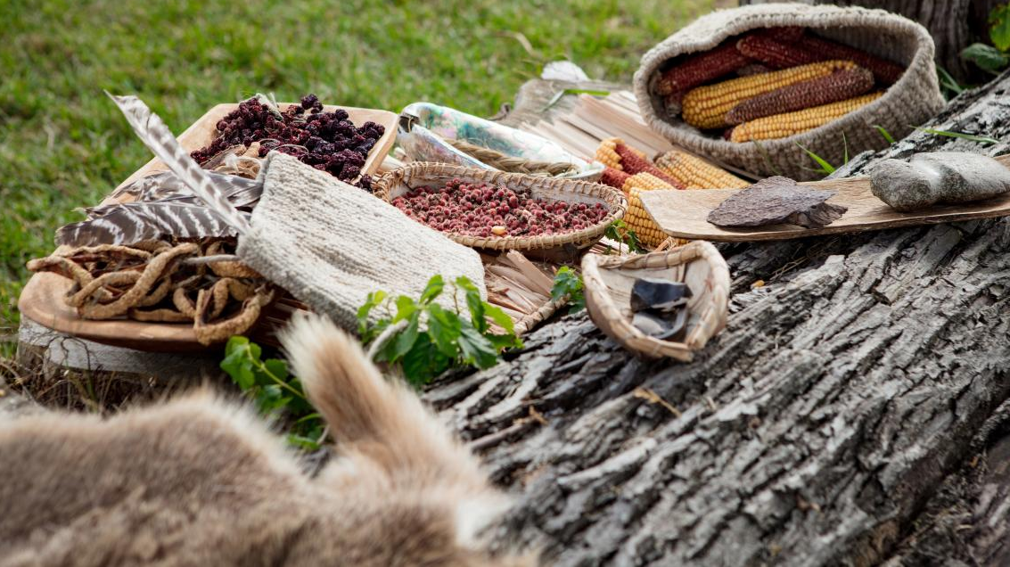
Seasonal Rounds and the Relationship between Food and Energy
OREGON DEPARTMENT OF EDUCATION | GRADE 5

Slide 2
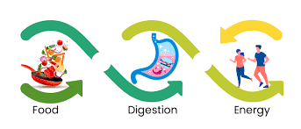
Introduction to Nutrition, Energy, and Food

Slide 3

What is energy?
Notes:
Introduce the topic of energy and give the definition of energy as: “the strength needed for physical or mental activity”. Using a scale of 1-5 (1 being the least and 5 being the most), ask students to pick a number that represents their level of energy right now. Ask students where we (human beings) get energy from. Allow a couple minutes for answers and discussion. Allow for answers that are not related to food. Next, ask students for examples of when they feel a lot of energy. Allow a couple minutes for answers and discussion.

Slide 4
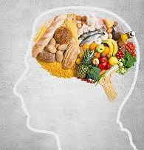
What is Nutrition
Scientists believe the huge effort to get food is programmed into us (and all animals) at the most basic level. We need food to grow, to move, and to think; without food we die. They actually believe that our natural state is to be hungry. By eating, we only “turn off” hunger for a limited period of time—it always comes back.
For scientists, nutrition is the study of how food and eating habits impact health.
Notes:
You’ve probably noticed that there are times in your life when you feel a lot of energy. This might be after you eat sugar or when you’re playing with friends or when you’re outside. You’ve probably also noticed that there are times in your life when you feel energy is missing. This might be when you first wake up, or after a stressful event, or after a big meal, or after physical activity. It’s normal for your energy levels to go up and down during the day depending on how active you are, what is happening around you, how much sleep you’re getting, and what types of foods you’re eating. Today we’re going to talk about the energy we get from food. Food is one of the main ways humans get energy. Some foods are really good at giving us energy, and other foods do not give us much energy at all.

Slide 5
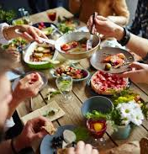
What is Nutrition
• What foods make you feel energetic and active?
• What foods make you feel slow or tired?
Notes:
Ask students the following questions and allow time for answers and discussion: • What foods make you feel energetic and active? • What foods make you feel slow or tired?

Slide 6
Seasonal Foods

Slide 7
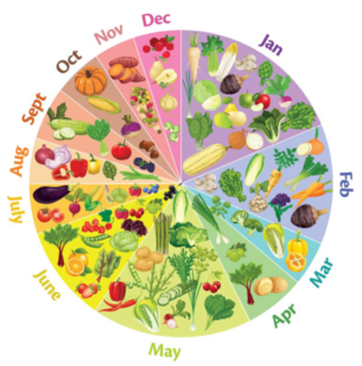
Seasonal Foods
Even though humans need food every day of the year, the types of foods that are available can change depending on the season. Some foods are best to eat in winter, and other foods are best to eat in spring or summer. I know many of you may eat the same kinds of food throughout the entire year, but long ago there were no supermarkets where you could get food and no refrigerators and freezers that could keep that food fresh. People had to eat what was available in nature, right where they lived.

Slide 8
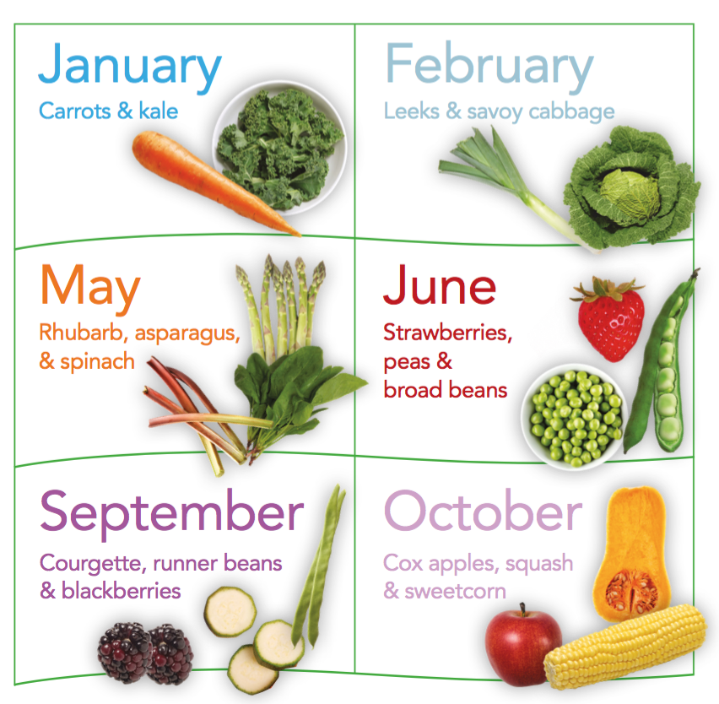
Seasonal Foods
Name any foods that are only grown during certain times of the year.
How have refrigeration and supermarkets changed the seasonal relationship with food?
Notes:
If students are not already in small groups, move them into groups of two to four (Can use breakout rooms). Use a method of grouping that works best for your students and classroom. Say: I’m going to give a Seasonal Foods Worksheet to each group. I want you to work together to think of foods that are best to eat during each season. It’s OK if some foods are listed in more than one season. It’s also OK if your entire group doesn’t agree with every answer. Don’t focus on being “right” or “wrong;” focus on coming up with ideas. Distribute the Seasonal Food Worksheet and allow time for groups to work. As students are working, monitor group activity and refocus students who are off task.

Slide 9
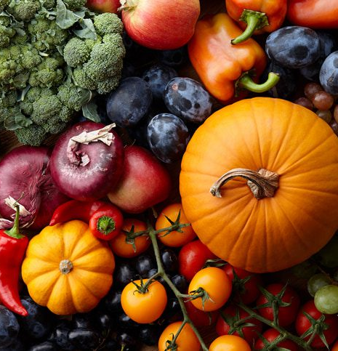
Seasonal Foods
Winter
Spring
Summer
Fall (Autumn)
Notes:
Ask students to wrap up their small-group work and bring their attention back to the whole class. Process the activity by asking a representative from each group to share their group’s entries on the worksheet.

Slide 10
Seasonal Rounds

Slide 11
Winter
In traditional Native American culture, winter was a time for families to gather together in villages. The largest villages could have several hundred people. Winter was a time to celebrate, dance, and sing and to tell stories about family and tribal history and beliefs.
Winter was a time to enjoy fish, berries, meat, and other foods that had been gathered in spring, summer, and fall.
If the weather was nice enough, winter could also be a time to fish in rivers and to hunt for deer, elk, and antelope. Hunting provided meat for food, hides for clothing, and bones and antlers for tools.
Winter was also a time to make traditional crafts and supplies, such as baskets and nets, to help with food gathering during the rest of the year.
At the end of winter, Native people looked forward to new life and new foods. In traditional culture, wild celery was one of the first foods to be harvested in spring. The end of winter and beginning of new life were—and are—a time for celebration.
U-in-mi, Cayuse basket weaver, Umatilla reservation.
Notes:
Winter: How did Native Americans in Oregon traditionally use this season to prepare for the rest of the year?

Slide 12
Spring
In traditional culture, spring is a time to celebrate the return of food. Women would gather roots and men would trap and hunt animals for fur (clothing) and food.
Salmon and other fish were available in the spring. Native Americans in Oregon set up villages near the Columbia River to be closer to the fish. Men would fish using traps, nets, and harpoons. On a good day they could catch 100 fish! Women worked hard to clean and prepare the fish to be eaten.
Native people in Oregon hold a feast in April to celebrate the return of food.
Nancy Jim (left) and Hannah Sohappy Yallup are cleaning the first salmon caught for the traditional Feast of the First Salmon at Celilo village, April 7, 1940
Notes:
Spring: How does nature tell us that spring is near? What signs are there?

Slide 13
Summer
In traditional culture, summer was a time of hard work. Men would continue to fish for salmon, sturgeon, and lamprey eel, and to hunt for sage hens, prairie chickens, and rabbits. Women would continue to dig and gather roots.
Many tribes gathered blue camas in the summer. To get the edible part of the plant, women would dig up the entire plant, take the bulb, and then re-plant the rest so it could continue to grow more food. Women could gather up to 90 pounds of camas every day. Camas was baked into bread or biscuits. Many Native people still follow this tradition.
Summer also meant fruits and berries, including strawberries, raspberries, blackberries, blueberries, huckleberries, chokecherries, and more. Berries were eaten raw or dried.
Summer also brought an edible black lichen on pine and fir trees, which Native people used to make a cheese-like substance.
Indians picking cherries on the J. W. Collins orchard, near Three Mile Creek, south of The Dalles, 1925. Photo by R. A. Brouhard.

Slide 14
Fall
In traditional culture, fall could be more restful and fun than summer.
Intertribal groups gathered for trade, fishing, and games. Friends and family were reunited and shared stories of what happened during the summer months.
In high elevations, huckleberries continued to ripen and were ready for eating. Women and children gathered berries and roots in the mountains while men continued to hunt deer, elk, and other large animals.
Each family would need 20 to 30 large animals to provide food for the winter. Women worked hard to prepare the meat for storage and to turn the hides into clothing, shoes, and shelter.
As the early signs of winter arrived and the snow began to fall in the mountains, families would return to their winter villages and prepare for the cold months ahead.
“Indian Settlement near The Dalles, Ore.” Indian girls near “Tenino”, undated about 1900.
Notes:
• Fall: How did Native Americans in Oregon traditionally use this season to get ready for the winter?

