Slide 1
Oregon’s First Geologists
Grade 4
Notes:
Confirm that students are familiar with relevant earth science concepts, such as Oregon landforms, the rock cycle, plate tectonics, and earthquakes and tsunamis. Review if necessary.

Slide 2
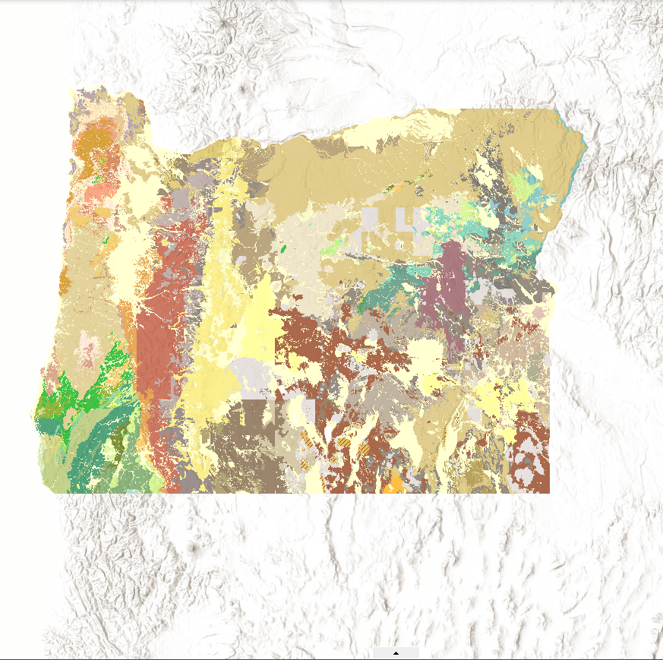
VOCABULARY
Geology – The study of the earth and what it is made of.
Geologist – A person who studies the Earth, what it is made of, and how it was formed.
Petroglyphs – Rock carvings used for communication, recordkeeping, and/or artistic purposes (rock paintings are called pictographs).
Tsunami – A large ocean wave usually caused by an underwater earthquake or a volcanic explosion.
Notes:
Review the definition of a geologist with students. Invite them to “put on their geologist hats” for a minute and think about why people study rocks. Invite students to give “popcorn” responses and record those responses on the classroom writing surface. Supply one or more of the following prompts (or others you can think) if students get stuck or are slow to respond. Possible responses: • To understand and plan for hazards such as volcanoes, earthquakes, tsunamis, and landslides • To find useful minerals and metals • To find the best place to build things • To find the best place to grow plants and raise animals

Slide 3
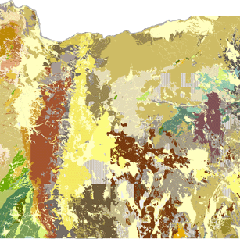
Geologic Map of Oregon
https://gis.dogami.oregon.gov/maps/geologicmap/
Notes:
Display the online geologic map of Oregon: https://gis.dogami.oregon.gov/ maps/geologicmap/ (Also provided in the “Resources” section above.) Pause a few moments to let students take in the entirety of the map. Have students take in what they see. (Note: The map is highly technical, so you might want to familiarize yourself with it prior to delivering the less. Students are unlikely to understand the terminology and definitions. The purpose of showing it is to highlight the work geologists do to understand the rocks and soils of a particular area.) Ask students to share what they notice or what stands out to them about the map

Slide 4
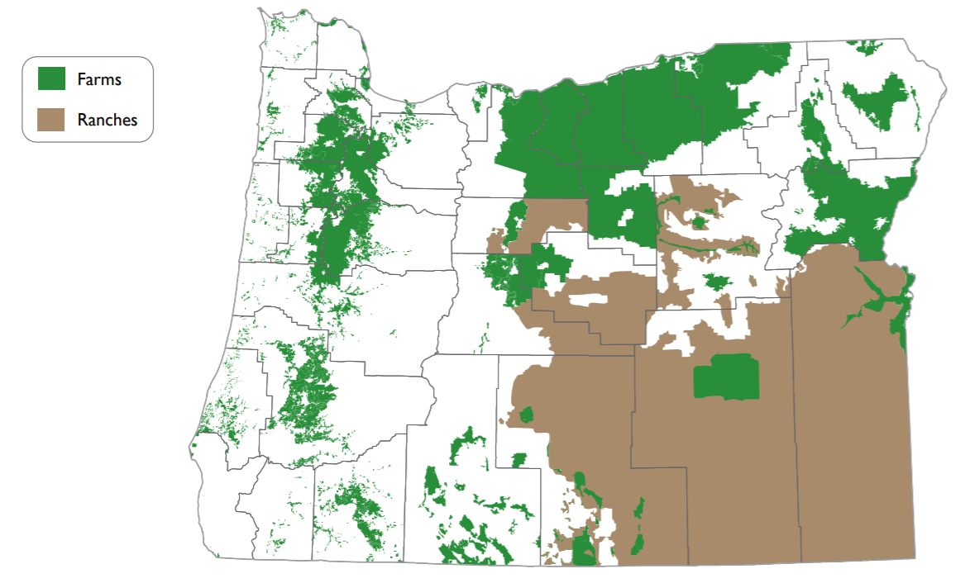
Farm and Ranch Land
Source: Center for Geography Education in Oregon, Portland State University. The Student Atlas of Oregon. Used with permission.
Notes:
Click through and discuss with the class slides 4–8, which contain various geology-related maps from the Student Atlas of Oregon and a picture that illustrates how geology can be used in daily life. For each slide, prompt students to think about and share out loud or with a partner what they think the slide is showing and who might be interested in the information provided.
• The Farm and Ranch Land slide shows the distribution of lands in Oregon used for farming and ranching. People interested in or working in farming or ranching might find this information useful, as might local and state farm bureaus, extension agents, and land use planners.

Slide 5
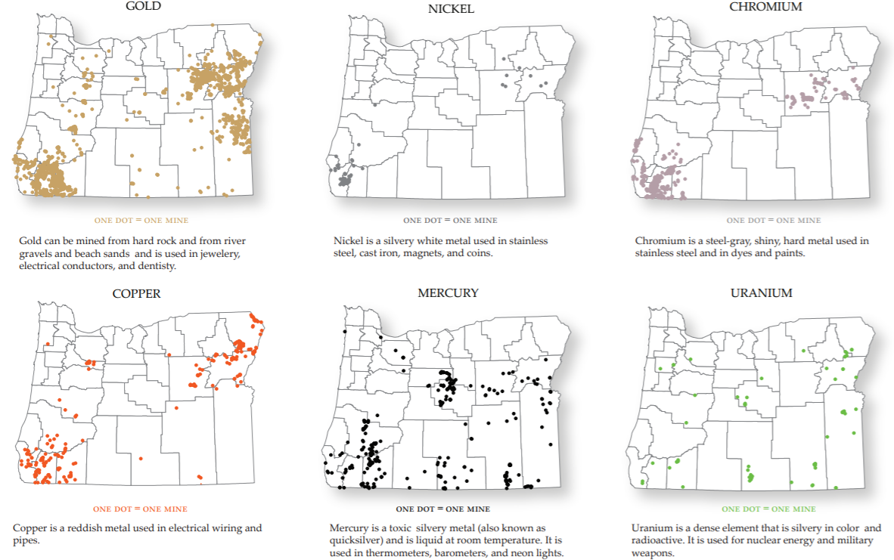
Mineral Deposits (not actively mined)
Source: Center for Geography Education in Oregon, Portland State University. The Student Atlas of Oregon. Used with permission.
Notes:
The Mineral Deposits slide shows where deposits of selected minerals have been mined in the past. This information would be of interest to miners, mining companies, and industries that need specific metals to make their products.

Slide 6
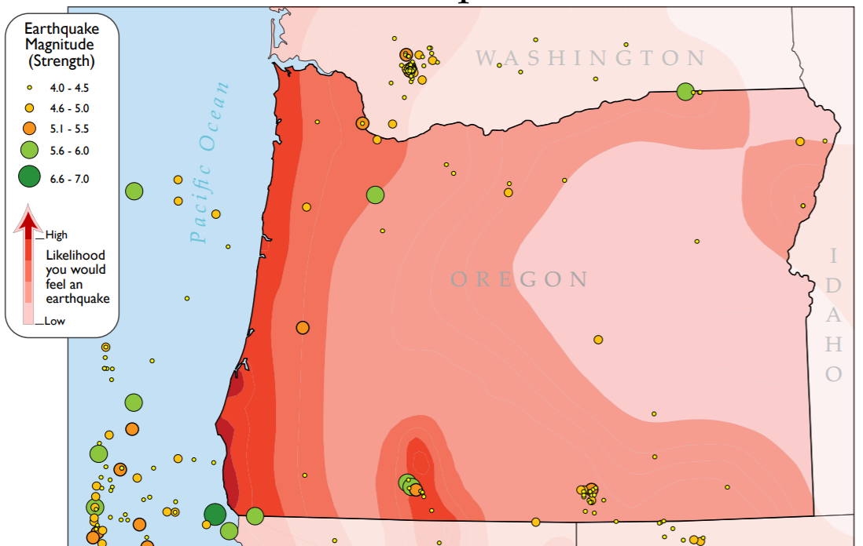
Natural Hazards: Earthquakes
Source: Center for Geography Education in Oregon, Portland State University. The Student Atlas of Oregon. Used with permission.
Notes:
The Natural Hazards: Earthquakes slide shows earthquakes of different magnitudes that have been recorded in Oregon and the likelihood that Oregonians will feel an earthquake based on where they live. This information would be useful for people who are responsible for planning for natural disasters in cities and towns

Slide 7
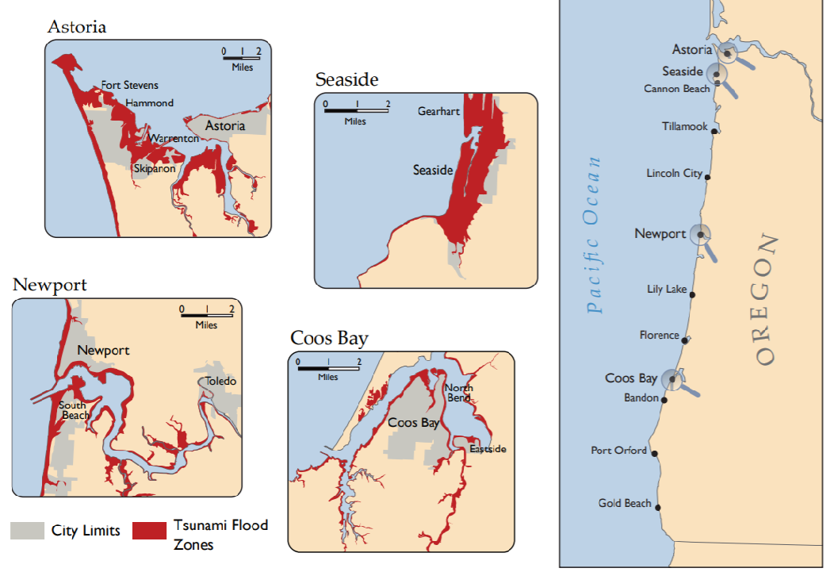
Natural Hazards: Tsunamis
Source: Center for Geography Education in Oregon, Portland State University. The Student Atlas of Oregon. Used with permission.
Notes:
The Natural Hazards: Tsunamis slide shows coastal areas of Oregon that are vulnerable to tsunamis. This information would be useful for emergency planners, as well as people who own land or live in areas susceptible to tsunamis.

Slide 8
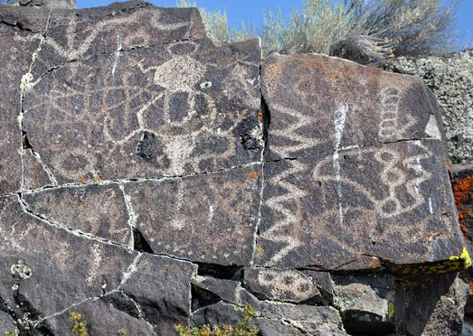
Understanding the physical structure and materials of the earth is important for human life. This was true for Native Americans living in Oregon thousands of years ago, just as it is true for all Oregonians today. Traditionally, Native people studied the earth to discover patterns, locate areas of use or danger, and find things to make life easier or better. Next, we’re going to look at some specific ways that Native Americans used their traditional knowledge of geology.

Slide 9
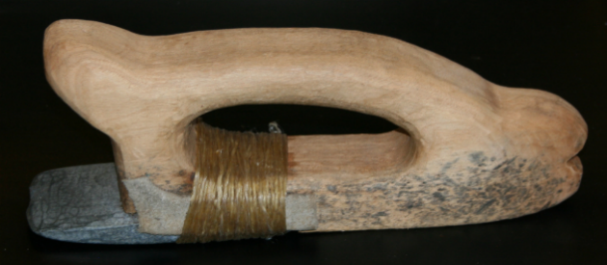
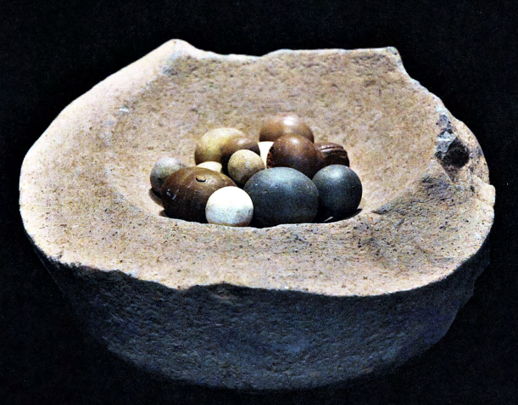
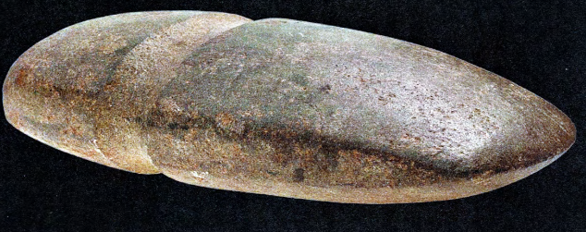
Tools
Projectile points (arrowheads)
Chisel
Axe head
Gaming stones
Sources: Projectile points: ProjectilePoints.net http://www.projectilepoints.net/Search/Oregon_Notched.html Used with permission.
Chisel: Coquille Indian Tribe. | Axe head: Ivy, J., & Norris, N. (2011). Tah’s Tools. North Bend, OR: Coquille Indian Tribe.
Gaming stones: Ivy, J., & Norris, N. (2011). Tah’s Tools. North Bend, OR: Coquille Indian Tribe.
Notes:
This slide provides images of selected Native American tools made of—or incorporating—stone. Native Americans sought out specific types of rock based on their “toughness” (resistance to fracture) and their malleability (how easily they can be chiseled or reshaped) when making tools. For example, the chisel from the Coquille Indian Tribe on the slide is made from blueschist, a particularly hard stone, which made it useful for carving canoes out of cedar logs. Native Americans also used obsidian, chert, and jasper. For thousands of years, Native Americans traveled to special quarries in the Cascade Mountains to locate obsidian needed to make tools.

Slide 10
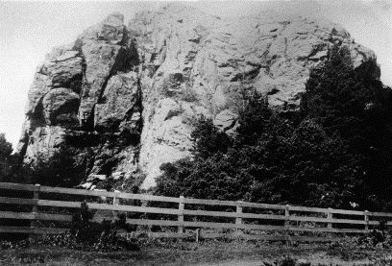
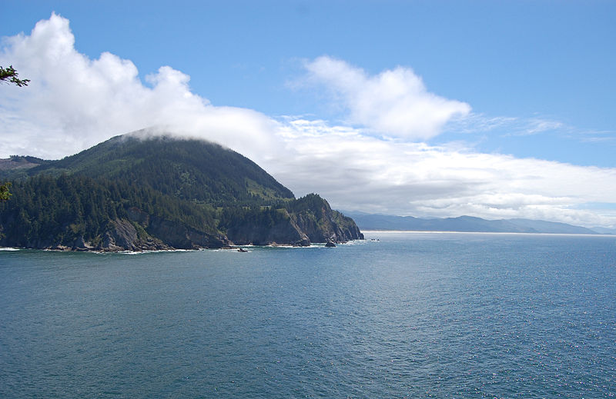
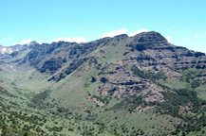
Special Places
Grandmother Rock
Near present-day Bandon
Neahkahnie Mountain
(“Place of the Creator”)
Tillamook County
Steens Mountain
Harney County
Sources: Grandmother Rock: Coquille Indian Tribe | Neahkahnie Mountain: Eric Baetscher (via Wikimedia Commons: https://commons.wikimedia.org/wiki/File:Neahkahnie_Mountain_North.JPG) | Steens Mountain: Wildhorse Gorge, Steens Mountain (prog_rec_orwa_steens_hero_wildhorse.jpg), by the Bureau of Land Management (public domain)
Notes:
The Special Places slide shows rock formations in Oregon that were landmarks and special places for Native Americans. Grandmother Rock, a significant landmark, was a blueschist outcrop on the Oregon Coast near present-day Bandon that was ultimately blasted to pieces by white settlers to build the current-day Bandon jetty. Neahkahnie Mountain in Tillamook County gets its name from a Tillamook word thought to mean “place of the creator.” It features in Tillamook oral histories. Steens Mountain in Harney County is a special place for the Burns Paiute Tribe.

Slide 11
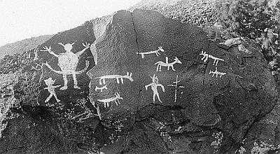
Art
Petroglyphs (Rock Carvings)
Picture Rock Pass (Lake County)
Source: Oregon Historical Society (Catalog Number 94226), https://oregonhistoryproject.org/articles/historical-records/indian-rock-art-picture-rocks-pass/#.XjDNQGhKjcs Used with permission.
Notes:
The Art slide shows a group of petroglyphs (rock carvings) in Lake County, Oregon. (Note: The carvings have been chalked to make them more visible. This is no longer considered appropriate and is, in fact, illegal to do on public lands.) Such rock art marked important places or trails, staked out territorial borders, warded off evil spirits, and recorded important stories or events.

Slide 12
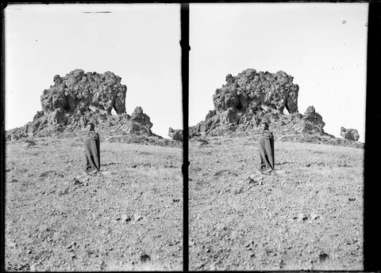
There are many reasons that geologists want to know how the earth behaves. One of these is to keep us safe from natural disasters such as earthquakes, volcanic eruptions, landslides, and tsunamis. Just as we do today, Native Americans in the Pacific Northwest have always looked for ways to explain geological events, identify patterns, and keep their people safe.

Slide 13
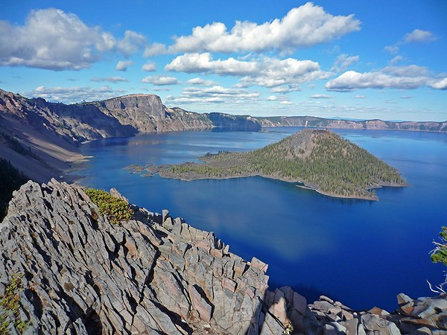
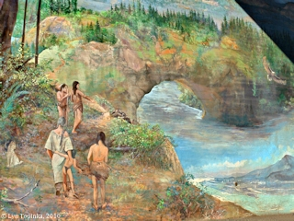
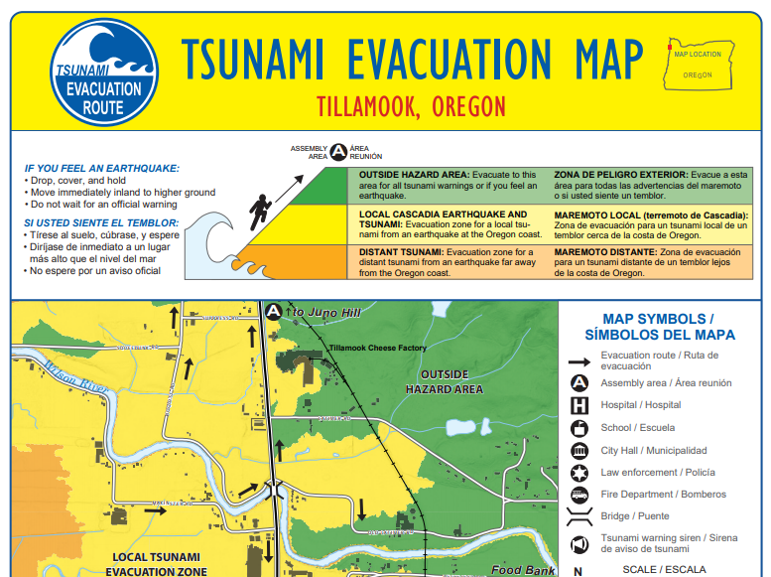
Geologic Events
Mt. Mazama (Crater Lake)
Bridge of the Gods
Earthquakes and Tsunamis
Sources: Crater Lake: National Park Service (https://www.nps.gov/crla/planyourvisit/index.htm) | Bridge of the Gods: Lyn Topinka. (2010). ColumbiaRiverImages.com. Used with permission. (Source: http://columbiariverimages.com/Images10/bridge_of_the_gods_mural_legend_10-18-10.jpg | Earthquakes and Tsunamis: State of Oregon Department of Geology and Mineral Industries, Tillamook, Oregon, Tsunami Evacuation Map 02/22/2012 revision, https://www.oregongeology.org/pubs/tsubrochures/TillamookEvac_onscreen.pdf
Notes:
Display the Geologic Events slide and distribute the Native American Legends and Stories of Geologic History in Oregon reading packet to students (if you have not already).

Slide 14
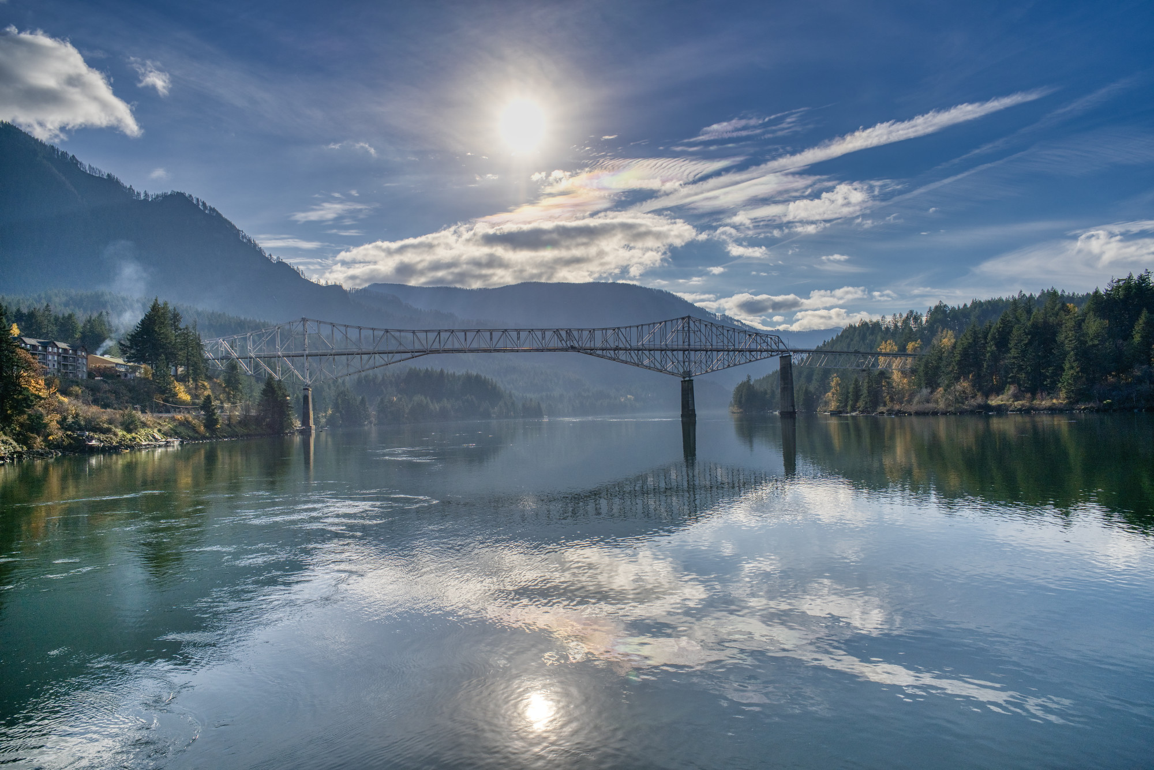
Now we’re going to read three passages that describe how Native Americans experienced major geologic events in Oregon’s past. The first is the formation of Crater Lake from a volcanic eruption 7,000 years ago. The second is a land bridge across the Columbia River near The Dalles that became known as the “Bridge of the Gods.” The third describes a flood experienced by members of the Coos people on the Oregon coast that may have been caused by an earthquake and tsunami.

Slide 15
Native American Legends and Stories of Geologic History in Oregon Reading One: Crater Lake
Scientists think Crater Lake was formed almost 8,000 years ago when a violent eruption caused the volcano Mount Mazama to collapse. Rain and snow later filled the hole to create the deepest lake in the United States. The ancestors of the Klamath Tribes were living in Oregon when Mount Mazama erupted. The following story is adapted from one that Chief Lalek, an 80-year-old Klamath Indian, told William M. Colvig, his 19-year-old visitor in 1865.
One time when Chief of the Below World was on top of Mount Mazama, he saw and fell in love with Loha, a Klamath woman who was cherished by all who knew her. Chief of the Below World told Loha of his love and asked her to return with him to his lodge inside Mazama. There, he said, she would live forever. But the tribal wise men warned Loha that even though they also loved her, she could never, nor should she ever, want to live forever. Following their instruction, she refused Chief of the Below World by hiding from him.
When Chief of the Below World learned that the people had unanimously refused his proposal, he became furious and in a voice like thunder swore that he would destroy all the Klamath with the Curse of Fire.
The mighty form of Chief of the Above World then descended from the sky and the two spirit chiefs began a furious battle on the mountaintop. The mountain shook and crumbled. Red-hot rocks as large as the hills hurtled through the skies. Burning ash fell like rain. Chief of the Below World spewed fire from the mouth of the mountain. Fleeing in terror, the people found refuge in the waters of Klamath Lake.
Then the oldest of the tribal wise men raised his voice so all could hear. Only a living sacrifice will turn away Chief of the Below World’s revenge. But who among us will offer himself as a sacrifice? “No young person will want to make the sacrifice” answered the second oldest wise man. “You and I have but a few more years to live. We should be the ones to throw our torches and ourselves into Chief of the Below World’s fire pit.”
After a period of silence, the two old men lit their pine torches and started toward Mount Mazama. From the waters of Klamath Lake the people watched in astonishment as their torches, brilliant against the night sky, moved to the crest of the volcano. There the old men paused, and then, with their torches high above their heads, jumped into the fiery pit. The generosity of the old men energized Chief of the Above World. Once more the mountains shook and the earth seemed to tremble on its foundation. When Chief of the Below World was finally driven back into his home, Mount Mazama collapsed upon him and after many years rain filled the great crater.
Notes:
Source: McWilliams, R. G. (n.d.). The geology of North America as illustrated by Native American stories. [Online] Retrieved January 22, 2020, from https://www.units.miamioh.edu/cryolab/publications/documents/ McWilliams%20Geology%20NA%20Illus%20NA%20Stories.pdf

Slide 16
Native American Legends and Stories of Geologic History in Oregon Reading Two: Bridge of the Gods
Scientists think that about 1,000 years ago a giant landslide from the north side of the Columbia River blocked the Columbia Gorge and stopped the river from flowing. This created a dam that backed up water all the way into Idaho. Over time, the water eroded the dam and created a natural stone bridge. Eventually this bridge fell, creating the Cascade Rapids. Native American oral histories also speak of the creation and destruction of this natural bridge. One version of the story is given in Katherine Berry Judson’s book, Myths and Legends of the Pacific Northwest, especially of Washington and Oregon.
Long ago, when the world was new, Tyhee [Chief] Sahale with his two sons, came down Great River. They came near where The Dalles now are. The land was very beautiful and each son wanted it. Therefore they quarreled. Then Sahale took his bow and shot two arrows. One he shot to the north; the other he shot to the west. Then Sahale said to his sons, “Go. Find the arrows. Where they lie, you shall have the land.”
One son went north over the plain to the country of the Klickitats. He was the first grandfather of the Klickitats. The other son followed the arrow to the Willamette Valley. He was the first grandfather of the Multnomahs.
Then Sahale raised great mountains between the country of the Klickitats and the country of the Multnomahs. This he did that the tribes might not quarrel. White men call them the Cascade Mountains. But Great River was deep and broad. The river was a sign of peace between the tribes. Therefore Sahale made a great stone bridge over the river, that the tribes might be friends. This was called the Bridge of the Tomanowos [Bridge of the Gods].
The tribes grew, but they did evil things. They displeased Tyhee Sahale. Therefore the sun ceased to shine, and cold and snow appeared. The people were unhappy for they had no fire. Only Loo-wit had fire. Therefore the people sought to steal the fire of Loo-wit.
The Loo-wit fled and because the runners were stiff with cold, they could not catch her. Then Loo-wit told Sahale of the need of the Indians. Loo-wit said the Indians were cold. So Sahale gave fire to the people. Thus Sahale built a fire on the bridge of the gods, and there the people secured fire. Sahale also promised to Loo-wit eternal youth and beauty. Thus Loo-wit became a beautiful maiden.
Then began the chiefs to love Loo-wit. Many chiefs loved her because she was so beautiful. Then came two more chiefs, Klickitat from the north and Wiyeast from the west. To neither would Loo-wit give an answer. Therefore the chiefs fought, and their people also fought. Thus did they anger Sahale. Therefore, because blood was shed and because Great River was no longer a sign of peace, Sahale broke down the [bridge]. Great rocks fell into the river. They are there even to this day. When the water is quiet, buried forests can be seen even to this day. Thus Sahale destroyed the bridge of the gods. Thus the tribes were separated by Great River. Then Sahale made of Loo-wit, Klickitat, and Wiyeast snow peaks. Always they were to be cold and covered with ice and snow. White men call them Mount St. Helens, Mount Adams, and Mount Hood.
Notes:
Sources: Port of Cascade Locks. (n.d.) Bridge of the Gods. [Online] Retrieved January 27, 2020 from https://portofcascadelocks.org/bridge-of-the-gods/ Judson, K.B. (1910). Myths and legends of the Pacific Northwest, especially of Washington and Oregon. Chicago: A.C. McClurg & Co.

Slide 17
Native American Legends and Stories of Geologic History in Oregon Reading Three: Earthquakes and Tsunamis
Scientists have begun using Native American oral histories of earthquakes and floods as evidence to figure out when earthquakes and tsunamis hit the Pacific Northwest and the damage they caused. The following story comes from the Coos people of the Oregon Coast, as adapted by Patricia Whereat Phillips in the summer 2007 issue of Oregon Historical Quarterly. It tells the story of a massive flood that may have been a tsunami caused by an earthquake (note the line where it says “the earth sank into the water”).
When the flood tide came there was no ebb tide. All was full of water. It was wholly filled.
The world was full of people. There were too many people. They looked, when that water reached its fullness.
Some people had large canoes. And some had small canoes. All kinds of people crowded in when they settled down on the earth.
Some people were ready with braided ropes they’d stored away. So they quickly went into the canoes. all people became scared.
The earth sank into the water. Wherever a small bit of land stuck out, that’s where they went.
A small bit of land was sticking out Here the people assembled.
All the animals came there in twos. All small birds came there in twos. All kinds of things came there in that manner.
They were mixed together there with the people. It’s as though they did not know one another, when they were mixed together with the people.

Slide 18
Continued…
Wherever the top of a fir tree was sticking out, there they fastened the canoes. And some people were without braided ropes. Some people drifted far away.
Many people had braided ropes. They no longer knew one another.
The small piece of land kept on floating. The small bit of land’s name was Qalatl (Kentuck). It was sticking out.
There the people were assembling. There all manner of things were assembling. There were many kinds of animals there among the people. All kinds of birds were mixed together there in pairs.
They did not know anyone. Fear was in their hearts.
Nothing was sticking out. They scattered far away, the people drifted far and wide. The water carried them far away.
When night came, the people’s canoes were fastened. They were watching their canoes. They were watching the canoes when they were made fast.
Some of the ropes were short. Suddenly some were loosed, and they drifted away.
Water carried them away. Thus in that manner half the people drifted away. They no longer knew one another.
When it became evening, the water ran down. Everywhere one person had a canoe that was fastened. They did not know how to take care of the canoes when the water went down.

Slide 19
Continued…
Whenever a canoe caught on a tree limb, they freed that canoe. Some people didn’t watch the canoes. They did not watch them, they tipped over.
When ever a canoe got hung up, when it became caught on a tree limb, their canoes tipped over, when evening came.
Thus they worked. They could not sleep, when they watched their canoes.
When the earth again became dry, the people dropped onto the earth with their canoes. So again they returned there.
Everywhere they settled down individually. One man with one woman. Thus they settled.
The animals, they again returned to shore, when the earth dried. Likewise the small birds. Everywhere the small birds went in pairs.
They did not know the place where they dropped down, and the people began to go farther away. They did not know where they dropped down. Thus the people were scattered.
In this manner is the story being told.
Notes:
Source: Phillips, P.W. (Summer 2007). Tsunamis and floods in Coos Bay mythology. Oregon Historical Quarterly, 108(2)

Slide 20
Reflect and Respond:
1. What did you notice about the stories? What do you remember the most? What was most interesting?
2. What can we learn from these stories about how Native Americans made sense of their world?

Slide 21
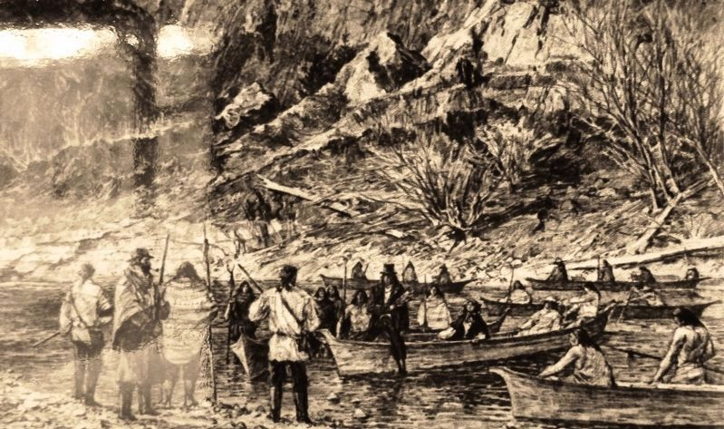
Tsunami preparedness oral history of the Hoh people
Notes:
If time permits, play the video on the tsunami preparedness oral history of the Hoh people. In this video, a Hoh tribal Elder describes experiencing a tsunami resulting from an earthquake in Chile and the tribal knowledge passed down from previous generations to head to high ground when the coastal waters recede dramatically and unexpectedly

