Slide 1
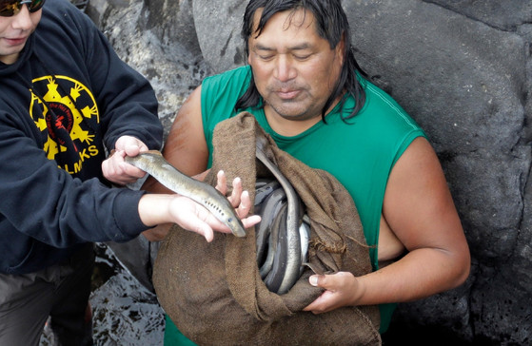
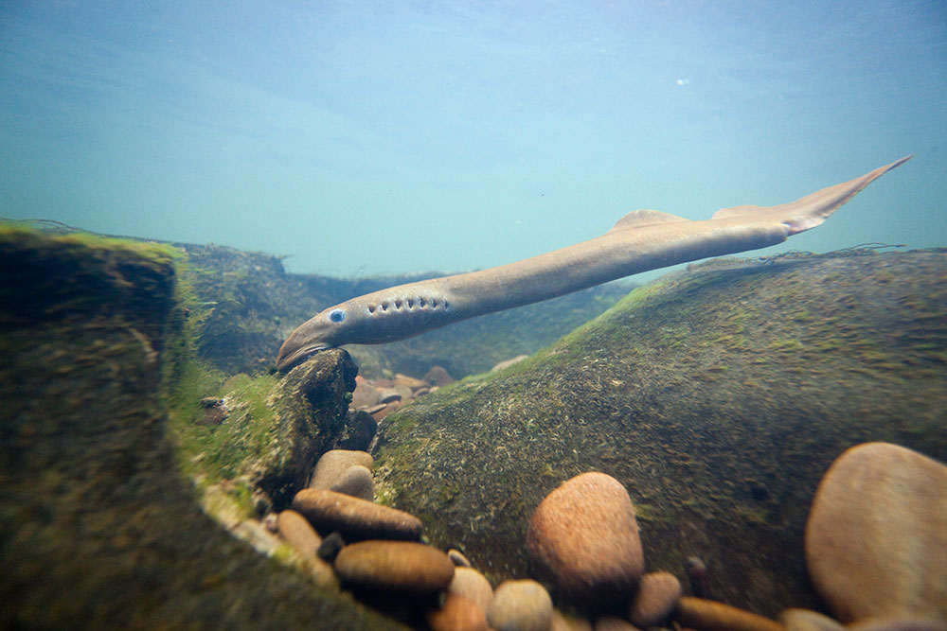
Catching Pacific Lamprey at Willamette Falls
Use decimal notation for fractions with denominators 10 or 100

Slide 2
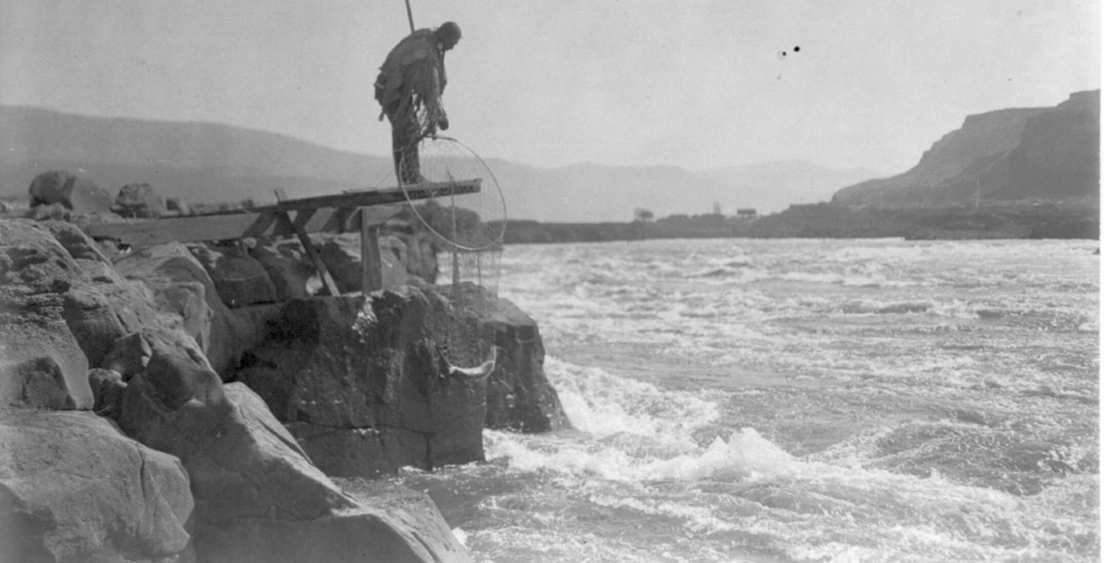
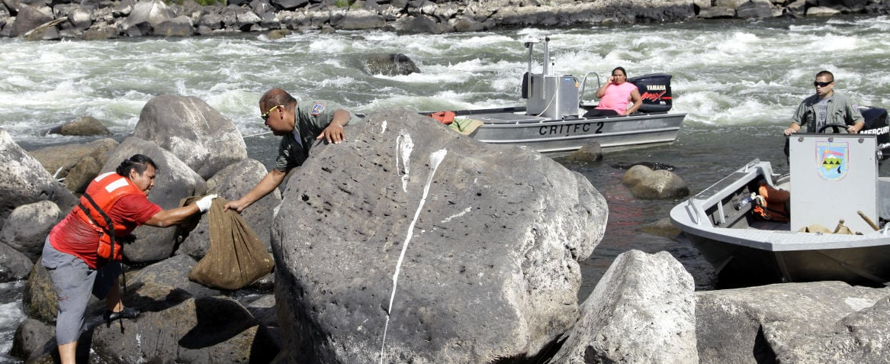
Catching Pacific Lamprey at Willamette Falls
The health and well-being of Native American people in Oregon has always been closely tied to the health of the natural environment—the rivers, streams, ocean, mountains, valleys, and plateaus.
Fishing for salmon and lamprey, which is a type of fish that looks similar to an eel, has always been an important part of Native culture. Some scientists say the lamprey has been here for 500 million years, which is a long time ago!
Native Americans refer to this as “since time immemorial,” which means before recorded history and long predating the arrival of Euro-Americans.

Slide 3
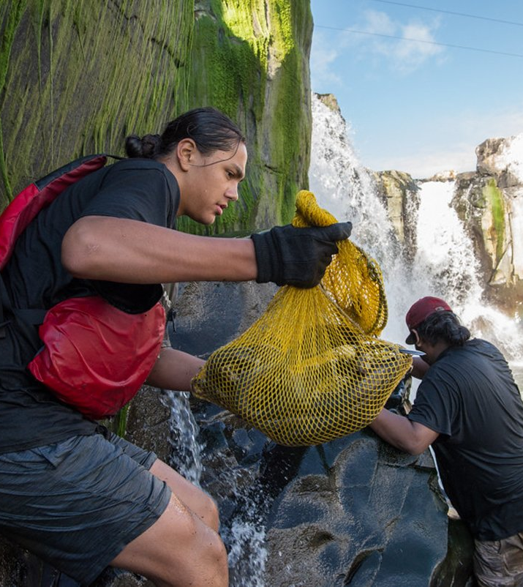
Catching Pacific Lamprey at Willamette Falls
Maintaining a healthy balance between human nutritional needs and the resources of the earth is also important for tribes in Oregon and that includes the harvesting of lamprey. Tribal members only take what they need.
Today, we’re going to learn about the lamprey and its place in tribal culture while also practicing our math skills.
First, we’re going to watch a short video. I want you to watch closely and to think about questions you might have.
Watch the Pacific Lamprey Harvested at Willamette Falls

Slide 4
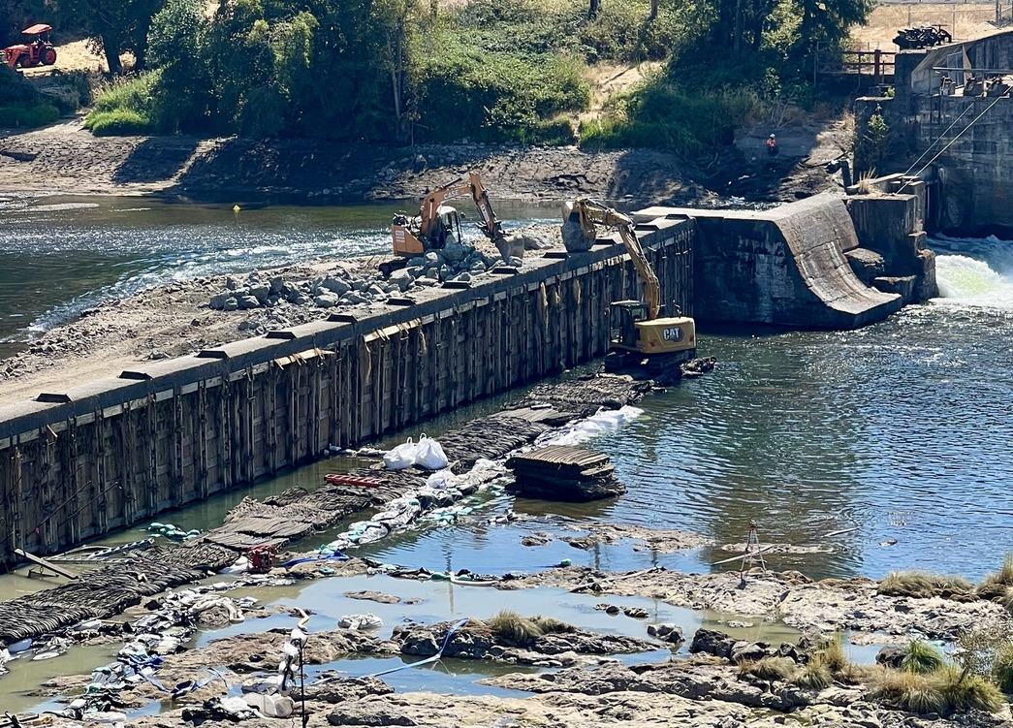
There is a lot of documentation that tells us lamprey were once abundant in Oregon. This began to change with the coming of Euro-Americans in the 1850s. Over time, due to the building of hydroelectric dams, pollution, and the destruction of habitat, the lamprey population—like the salmon population—was drastically reduced. This also had a huge impact on the ability of Native people to live in their traditional ways.

Slide 5
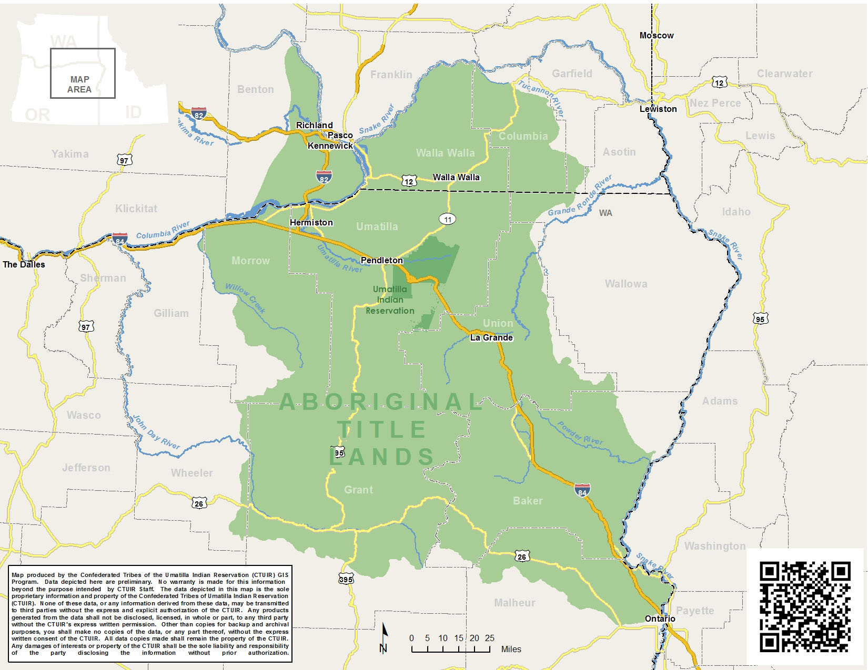
Over time, several tribes began to work with government agencies and other organizations to restore the lamprey population. In 2011, for example, the Bonneville Power Administration provided funds to support the Confederated Tribes of the Umatilla Indian Reservation and their work to make pathways around the dams for the lamprey. When this work began, a tribal biologist believed that getting 129 fish back in the Umatilla River would be a success. Only seven years later, however, in 2018, there were more than 2,600!

Slide 6
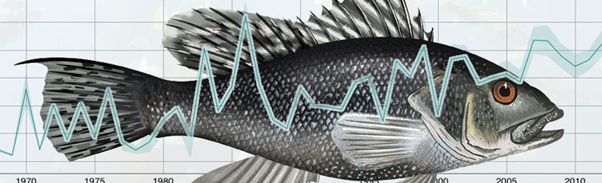
Today, there are regulations that determine when, where, and how many lamprey can be harvested in a given area. This helps protect the lamprey population, which is consistent with traditional Native practices that emphasized sustainability— never take more than you need.
One of the main ways to monitor the fish population in each area is to catch some fish, tag them, release them back into the river, and then repeat that process at different times. In real life, scientists place micro-radio tags on the fish and return them to the river. When they catch them the next time, some have the tags, and some don’t. By comparing those numbers, they can make an estimate about how many fish, in total, are in the river and review the overall data of the fish.

Slide 7
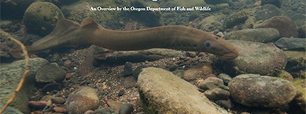
Activity
Today, we’re going to complete a Pacific Lamprey Lesson Worksheet that includes a list of ten tagged lamprey.

