Slide 1
Kindergarten Decoding Routine: CVC Words Letters: m, s, t, p, n, c, a (units 5-8)
Pearson Online Classroom: Live Lesson Companion
Notes:
This routine is designed to be used to reinforce and practice letter-sound correspondence while reading and writing words.
Students in their POC studied the letters m, s, t, p, short a, n, and c in units 5-8.
This lesson is intended to be a companion to this and could be used during or following unit 8, when the first vowel is introduced.
Materials needed: writing utensil and surface, letter cards m, s, t, p, a, n, c (Can use POC letter cards)
The components of this Kindergarten Decoding Routing include the following:
Phonological Awareness – 10 min.
Letter-sound correspondence – 20 min.
High Frequency Words – 2-3 min.
Decodable Text – 8 min.
Sentence Dictation – Additional Practice
Alphabet Arcs – Additional Practice

Slide 2
Phonological Awareness
Notes:
5-10 min. of instruction ---- Progression: Start off with a smaller amount of time, 2-5 min., as students become used to the hand motions and routine.
Option 1: Use the free Heggerty video from youtube.
Option 2: Engage students face-to-face using the resources below (this is ideal as the teacher can also monitor and assess):
Resource 1: https://docs.google.com/spreadsheets/d/16ygrGgr-zO0r5kjQqHW9B9AQOpXRfJwa/edit?usp=share_link&ouid=108083634139011951925&rtpof=true&sd=true
Resource 2: https://drive.google.com/file/d/1EPaYsIngNz_kKwcP9jaVi4zfnzmXG1gx/view?usp=share_link

Slide 3
Letter-Sound Correspondence
Today we will use the letters we have learned to build words. Building words with our letters helps you to become strong readers and spellers.
We will use these letters today: m, s, t, p, n, c, a
Notes:
Read the objective.

Slide 4
Letter-Sound Correspondence: Visual Drill
m
s
t
p
n
c
a
Notes:
Let’s review our letters so far.
This is the letter m. What sound does the letter m spell? M spells /m/ (click for next letter)
This is the letter s. What sound does the letter s spell? S spells /s/ (Click for the next letter)
Continue for each letter.

Slide 5
Letter-Sound Correspondence: Auditory Drill
m
s
t
p
n
c
a
Notes:
This time, I’ll say the sound of a letter and I want you to repeat the sound and tell me what letter spells that sound and we’ll write it in the air. Ready?
The sound is /mmmm/. What is the sound? /mmmmm/ What letter spells the sound? m. Great! Now write the letter (in the air, on paper, however you choose).
The next sound is /ssssssss/. What is the sound? /sssssss/ What letter spells the sound? s. Good! Now write the letter (in the air, on paper, however you choose)
Continue for each letter.

Slide 6
Letter-Sound Correspondence: Word Work
Let’s get ready to build words!
m
s
t
p
n
c
a
Notes:
Building Words Option 1: Ask students to place their letter cards from POC, or letters they have in front of them. Students build words in front of them with you. If students have a letter arc, have them place the letters on the arc and pull them down to the middle, then replace in the letters in the arc as they build.
Building Words Option 2: Ask students to point to the letter on the screen and help you build the words.
Building Words Option 3: Ask students to type the words in the chat to build words with you.
Building Words Option 4: There are surely other avenues to do this. This is not an exhaustive list of approaches.

Slide 7
Letter-Sound Correspondence: Word Work
m
s
t
p
n
c
a
Notes:
Here we go! Let’s work together to build words.
The word is at.
Extend hand to students.
What is the word? (Listen for correct pronunciation)
Watch me tap the sounds in the word. Show how to tap the sounds by extending arm and tapping at the shoulder, elbow, and wrist saying the sounds. (or use fingers to tap)
Extend hand to student.
Tap the sounds of the word with me. Tap sound together.
Now let’s build the word.
The first sound is /a/ and the letter that spells this sound will go in the first box.
Find your letter a.
Let’s move letter a to the first box. (click to move letter)
The next sound is /t/ and the letter that spells this sound will go in the second box.
Find your letter t.
Let’s move letter t to the second box. (click to move letter)
Blend the word with me. /aaaaaa/ /t/, at
Great job! Move your letters back to their spot.
The next sound in the word is /a/.
The sound is second and would go in the second box. (click for arrow)
The vowel letter that spells this sound is the letter a. (click for letters)
The final sound in the word is /p/.
The sound is last and would go in this last box. (click for arrow)
The consonant letter that spells this sound is p. (click for letter)
Now that our letters are placed in the boxes, let’s blend the word.
Model drawing a smile with your finger under the letters in the boxes, saying the sounds and blending sound by sound.
Together, lets zap the sounds of the letters into a word! (click for arrow)

Slide 8
Letter-Sound Correspondence: Word Work
m
s
t
p
n
c
a
Notes:
Let’s work together to build words.
The word is sat.
Extend hand to students.
What is the word? (Listen for correct pronunciation)
Watch me tap the sounds in the word. Show how to tap the sounds by extending arm and tapping at the shoulder, elbow, and wrist saying the sounds. (or use fingers to tap)
Extend hand to student.
Tap the sounds of the word with me. Tap sound together.
Now let’s build the word.
The first sound is /sssss/ and the letter that spells this sound will go in the first box.
Find your letter s.
Let’s move letter s to the first box. (click to move letter)
The next sound is /aaaaa/ and the letter that spells this sound will go in the next box.
Find your letter a.
Let’s move letter a to the next box. (click to move letter)
The final sound is /t/ and the letter that spells this sound will go in the second box.
Find your letter t.
Let’s move letter t to the last box. (click to move letter)
Blend the word with me. /sssss/ /aaaaa/ /t/. sat
Great! Move your letters back to their spot.
The next sound in the word is /a/.
The sound is second and would go in the second box. (click for arrow)
The vowel letter that spells this sound is the letter a. (click for letters)
The final sound in the word is /p/.
The sound is last and would go in this last box. (click for arrow)
The consonant letter that spells this sound is p. (click for letter)
Now that our letters are placed in the boxes, let’s blend the word.
Model drawing a smile with your finger under the letters in the boxes, saying the sounds and blending sound by sound.
Together, lets zap the sounds of the letters into a word! (click for arrow)

Slide 9
Letter-Sound Correspondence: Word Work
m
s
t
p
n
c
a
Notes:
Let’s work together to build words.
The word is mat.
Extend hand to students.
What is the word? (Listen for correct pronunciation)
Watch me tap the sounds in the word. Show how to tap the sounds by extending arm and tapping at the shoulder, elbow, and wrist saying the sounds. (or use fingers to tap)
Extend hand to student.
Tap the sounds of the word with me. Tap sound together.
Now let’s build the word.
The first sound is /mmmm/ and the letter that spells this sound will go in the first box.
Find your letter s.
Let’s move letter s to the first box. (click to move letter)
The next sound is /aaaaa/ and the letter that spells this sound will go in the next box.
Find your letter a.
Let’s move letter a to the next box. (click to move letter)
The final sound is /t/ and the letter that spells this sound will go in the second box.
Find your letter t.
Let’s move letter t to the last box. (click to move letter)
Blend the word with me. /mmmmm/ /aaaaa/ /t/. mat
Great! Move your letters back to their spot.
The next sound in the word is /a/.
The sound is second and would go in the second box. (click for arrow)
The vowel letter that spells this sound is the letter a. (click for letters)
The final sound in the word is /p/.
The sound is last and would go in this last box. (click for arrow)
The consonant letter that spells this sound is p. (click for letter)
Now that our letters are placed in the boxes, let’s blend the word.
Model drawing a smile with your finger under the letters in the boxes, saying the sounds and blending sound by sound.
Together, lets zap the sounds of the letters into a word! (click for arrow)

Slide 10
Letter-Sound Correspondence: Word Work
m
s
t
p
n
c
a
Notes:
Let’s work together to build words.
The word is pat.
Extend hand to students.
What is the word? (Listen for correct pronunciation)
Watch me tap the sounds in the word. Show how to tap the sounds by extending arm and tapping at the shoulder, elbow, and wrist saying the sounds. (or use fingers to tap)
Extend hand to student.
Tap the sounds of the word with me. Tap sound together.
Now let’s build the word.
The first sound is /p/ and the letter that spells this sound will go in the first box.
Find your letter p.
Let’s move letter s to the first box. (click to move letter)
The next sound is /aaaaa/ and the letter that spells this sound will go in the next box.
Find your letter a.
Let’s move letter a to the next box. (click to move letter)
The final sound is /t/ and the letter that spells this sound will go in the second box.
Find your letter t.
Let’s move letter t to the last box. (click to move letter)
Blend the word with me. /p/ /aaaaa/ /t/. pat
Great! Move your letters back to their spot.
The next sound in the word is /a/.
The sound is second and would go in the second box. (click for arrow)
The vowel letter that spells this sound is the letter a. (click for letters)
The final sound in the word is /p/.
The sound is last and would go in this last box. (click for arrow)
The consonant letter that spells this sound is p. (click for letter)
Now that our letters are placed in the boxes, let’s blend the word.
Model drawing a smile with your finger under the letters in the boxes, saying the sounds and blending sound by sound.
Together, lets zap the sounds of the letters into a word! (click for arrow)

Slide 11
Letter-Sound Correspondence: Word Work
m
s
t
p
n
c
a
Notes:
Let’s work together to build words.
The word is pan.
Extend hand to students.
What is the word? (Listen for correct pronunciation)
Watch me tap the sounds in the word. Show how to tap the sounds by extending arm and tapping at the shoulder, elbow, and wrist saying the sounds. (or use fingers to tap)
Extend hand to student.
Tap the sounds of the word with me. Tap sound together.
Now let’s build the word.
The first sound is /p/ and the letter that spells this sound will go in the first box.
Find your letter p.
Let’s move letter s to the first box. (click to move letter)
The next sound is /aaaaa/ and the letter that spells this sound will go in the next box.
Find your letter a.
Let’s move letter a to the next box. (click to move letter)
The final sound is /nnnn/ and the letter that spells this sound will go in the second box.
Find your letter n.
Let’s move letter t to the last box. (click to move letter)
Blend the word with me. /p/ /aaaaa/ /nnnn/. pan
Great! Move your letters back to their spot.
The next sound in the word is /a/.
The sound is second and would go in the second box. (click for arrow)
The vowel letter that spells this sound is the letter a. (click for letters)
The final sound in the word is /p/.
The sound is last and would go in this last box. (click for arrow)
The consonant letter that spells this sound is p. (click for letter)
Now that our letters are placed in the boxes, let’s blend the word.
Model drawing a smile with your finger under the letters in the boxes, saying the sounds and blending sound by sound.
Together, lets zap the sounds of the letters into a word! (click for arrow)

Slide 12
Letter-Sound Correspondence: Word Work
m
s
t
p
n
c
a
Notes:
Let’s work together to build words.
The word is can.
Extend hand to students.
What is the word? (Listen for correct pronunciation)
Watch me tap the sounds in the word. Show how to tap the sounds by extending arm and tapping at the shoulder, elbow, and wrist saying the sounds. (or use fingers to tap)
Extend hand to student.
Tap the sounds of the word with me. Tap sound together.
Now let’s build the word.
The first sound is /k/ and the letter that spells this sound will go in the first box.
Find your letter c.
Let’s move letter c to the first box. (click to move letter)
The next sound is /aaaaa/ and the letter that spells this sound will go in the next box.
Find your letter a.
Let’s move letter a to the next box. (click to move letter)
The final sound is /nnnn/ and the letter that spells this sound will go in the second box.
Find your letter n.
Let’s move letter t to the last box. (click to move letter)
Blend the word with me. /k/ /aaaaa/ /nnnn/. can
Great! Move your letters back to their spot.
The next sound in the word is /a/.
The sound is second and would go in the second box. (click for arrow)
The vowel letter that spells this sound is the letter a. (click for letters)
The final sound in the word is /p/.
The sound is last and would go in this last box. (click for arrow)
The consonant letter that spells this sound is p. (click for letter)
Now that our letters are placed in the boxes, let’s blend the word.
Model drawing a smile with your finger under the letters in the boxes, saying the sounds and blending sound by sound.
Together, lets zap the sounds of the letters into a word! (click for arrow)

Slide 13
High Frequency Words
Next, we are going to review words we often see in print. These are words we have already studied by mapping them.
Now, let’s read and write them.
Notes:
2-3 min.
High frequency words should be introduced using orthographic mapping.
This would have been completed while using the alphabet routines for letters introduced in POC Units 2-8.
Now it is time to review and practice reading these words quickly/fluently.

Slide 14
High Frequency Words
a
Notes:
Word reading routine.
What is the word? a
Spell the word. a
Write the word. (write the word in the air, on a surface, etc.)

Slide 15
High Frequency Words
at
Notes:
Word reading routine.
What is the word? at
Spell the word. at
Write the word. (write the word in the air, on a surface, etc.)

Slide 16
High Frequency Words
I
Notes:
Word reading routine.
What is the word? I
Spell the word. I
Write the word. (write the word in the air, on a surface, etc.)

Slide 17
High Frequency Words
look
Notes:
Word reading routine.
What is the word? look
Spell the word. look
Write the word. (write the word in the air, on a surface, etc.)

Slide 18
High Frequency Words
is
Notes:
Word reading routine.
What is the word? is
Spell the word. is
Write the word. (write the word in the air, on a surface, etc.)

Slide 19
High Frequency Words
we
Notes:
Word reading routine.
What is the word? we
Spell the word. we
Write the word. (write the word in the air, on a surface, etc.)

Slide 20
High Frequency Words
you
Notes:
Word reading routine.
What is the word? you
Spell the word. you
Write the word. (write the word in the air, on a surface, etc.)

Slide 21
High Frequency Words
the
Notes:
Word reading routine.
What is the word? the
Spell the word. the
Write the word. (write the word in the air, on a surface, etc.)

Slide 22
Practice Opportunities: Decodable Text
Now, we will read words in text with the patterns we have studied so far.

Slide 23
Decodable Text: Short a
Look at Sam!
Sam is a cat.
Notes:
6-8 min.
Share the decodable text on the slide deck.
Run your curser under the text. Ask students to say “stop” or use a reaction when you come to the letter you are studying.
Click to highlight the word with the letter, then blend the word together.
Read the sentence together by either asking students to repeat the sentence after you, or choral read together.
After highlighting and reading the sentences, go to the next slide and read a clean copy with the students.

Slide 24
Decodable Text
Look at Sam!
Sam is a cat.
Notes:
Read the clean copy with the students. Echo or choral read together.

Slide 25
Additional Decodable Text
Consonants: p, t, n
Letter p
Letter t
LAS1B4 - Half Pint Kids Decodable Books
Nan
Letter n
LAS2B6 - Half Pint Kids Decodable Books
Vowel: Short a
LAS1B2 - Half Pint Kids Decodable Books
Notes:
Additional Practice Opportunity:
Linked are free decodable texts available on the internet.

Slide 26
Sentence Dictation
Using sentence dictation helps us learn to write words in sentences accurately.
Let’s start writing!
Notes:
Sentence Dictation -- Practice Activity
Use a whiteboard and model/work with students. Students need paper and a pencil.
Follow the script below.
Now we will use our words to write sentences. A sentence is a group of words that tells a complete idea, begins with a capital letter, and ends with punctuation.
Sentence ideas: The cat sat. Look at the cat! We sat on the mat.
Sentence Dictation Routine:
Here is the sentence for you to write. _______________________________
What's the sentence?
Now, let’s write the sentence.
First word ____________
Remember to begin your sentence with a capital letter.
Second word _________________
Etc.
Remember to end your sentence with the correct punctuation.
Let’s read the sentence together.
Note: After students say the sentence, ask them to clap the words and draw a line on their paper for each word before attempting to write the sentence.
After writing, check the sentence. Ask students to put a dot on their paper below each correctly spelled word. If the word is not spelled correctly, ask students to erase and correct the word using the tapping/mapping strategy.

Slide 27
Sentence Dictation
The
cat
sat.
Look
at
the
cat!
Notes:
Sentence Dictation -- Practice Activity
Use a whiteboard and model/work with students. Students need paper and a pencil.
Follow the script below.
Now we will use our words to write sentences. A sentence is a group of words that tells a complete idea, begins with a capital letter, and ends with punctuation.
Sentence ideas: The cat sat. Look at the cat! We sat on the mat.
Sentence Dictation Routine:
Here is the sentence for you to write. _______________________________
What's the sentence?
Now, let’s write the sentence.
First word ____________
Remember to begin your sentence with a capital letter.
Second word _________________
Etc.
Remember to end your sentence with the correct punctuation.
Let’s read the sentence together.
Note: After students say the sentence, ask them to clap the words and draw a line on their paper for each word before attempting to write the sentence.
After writing, check the sentence. Ask students to put a dot on their paper below each correctly spelled word. If the word is not spelled correctly, ask students to erase and correct the word using the tapping/mapping strategy.

Slide 28
Alphabet Arcs
Using Alphabet Arcs helps us learn to recognize and say our letters quickly.
Let’s play a game together!
Notes:
Additional Practice Opportunity: Letter Arcs
The ultimate goal for students utilizing the arc is to be able to quickly and automatically name and place their letters in an arc. The arc itself is a scaffold of support while students learn letters and practice putting them in order.
Students should begin with identifying the uppercase letters.
When students can place cut out Letter Cards in an arc in from of them, and say the names, move to lowercase letters.
Choose a game from the options in the notes. Use more than 1 game as time allows.
Use either the arc on the slide with the game directions or use the virtual arc.
Letter Cards: https://drive.google.com/drive/folders/1Z29axwQvtQheHYdjTW-PFS6-vMoBU9eI?usp=share_link
Virtual Alphabet Arc: Interactive Alphabet Arc | Region 4 (esc4.net)

Slide 29
Notes:
Game 1: Name Those Letters!
Point to the A with me.
Now, let’s name each letter!
I’ll say the letter name and then you repeat it after me. (echo reading)
Game 2: Choo Choo Train!
Point to the A with me.
Now, let’s name each letter and move our train.
I’ll say the letter name and then you repeat it after me. (echo reading)
When we get to Z, we are going to put our train engine in reverse, back to Letter A. (echo reading)
Game 3: How Many Letters?
Point to the A with me.
Now, let’s count the letters together.
How many letters are there? (26)
What is the first letter? (A)
What is the last letter? (Z)
What are the letters in the middle? (M, N)
Let’s say the names of the letters from A to M.
Let’s say the names of the letters from N to Z.
Game 4: ABC Conversations
Point to the A with me.
We are going to point to each letter and say the names like we are asking a question after every other letter.
Point and repeat after me. (AB?CD?EF?GH?IJ?KL?MN?OP?QR?ST?UV?WX?YZ?)
Let’s try this again, only this time we will say the names like we are exclaiming after every fourth letter.
Point and repeat after me. (ABCD!EFGH!IJKL!MNOP!QRST!UVWX!YZ!)
Game 5: Mary Had a Little Lamb
Let’s point to the letters and say their names to the tune of Mary Had a Little Lamb.
Now, follow me as I point and sing. Try to catch me when I say a letter name and point to the wrong letter! (Make this an exaggerated mistake. The goal is to keep student attention on the letter you are pointing to and the name of the letter.)
Game 6: Find the Letter/I Spy
I’m going to say the name of a letter. I spy with my little eye the letter ____.
Point to the letter as quickly as you can!
Now I will point to the letter. Were you correct?
Focus this type of game on the first six letters. Then, as students become proficient, add letters.

Slide 30
Notes:
Game 7: Build Your Own Arc
You will need the Letter Cards from your materials.
Let’s build the arc using your cards!
Do you have an open space in front of you to place the cards?
Let’s go!
Find Letter A and place it in front of you to start the arc.
Find Letter Z and place it at the end of your arc.
Find Letter M and N. Place them at the top of the arc.
Now, let’s fill in your arc!
Focus this type of game on the first six letters. Then, as students become proficient, add letters.

Slide 31
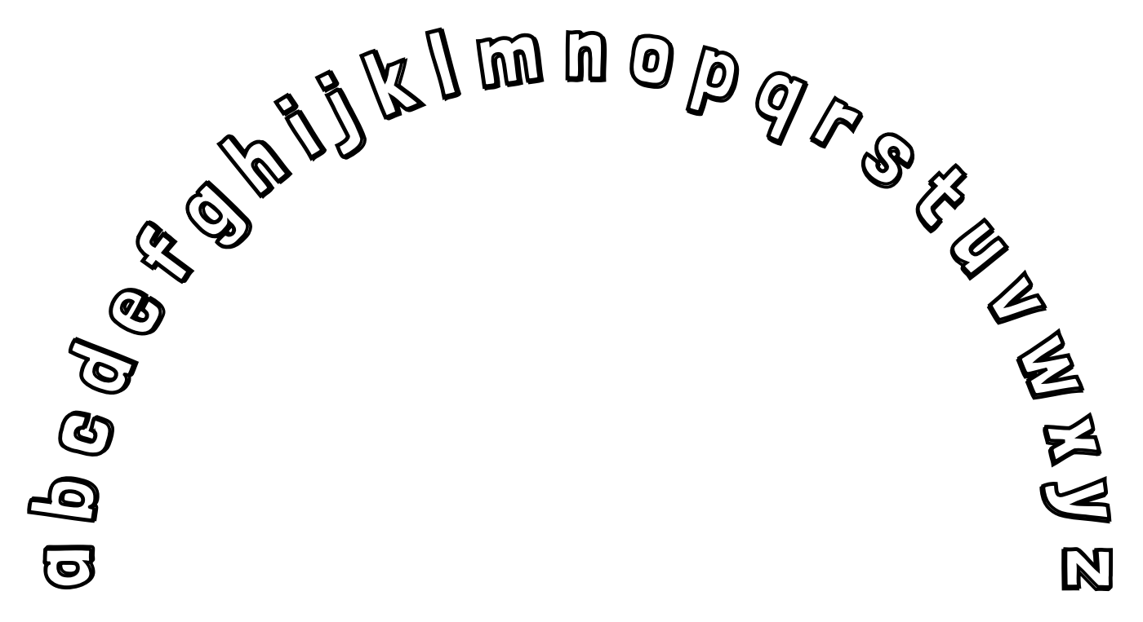
Notes:
Game 1: Name Those Letters!
Point to the A with me.
Now, let’s name each letter!
I’ll say the letter name and then you repeat it after me. (echo reading)
Game 2: Choo Choo Train!
Point to the A with me.
Now, let’s name each letter and move our train.
I’ll say the letter name and then you repeat it after me. (echo reading)
When we get to Z, we are going to put our train engine in reverse, back to Letter A. (echo reading)
Game 3: How Many Letters?
Point to the A with me.
Now, let’s count the letters together.
How many letters are there? (26)
What is the first letter? (A)
What is the last letter? (Z)
What are the letters in the middle? (M, N)
Game 4: ABC Conversations
Point to the A with me.
We are going to point to each letter and say the names like we are asking a question after every other letter.
Point and repeat after me. (AB?CD?EF?GH?IJ?KL?MN?OP?QR?ST?UV?WX?YZ?)
Let’s try this again, only this time we will say the names like we are exclaiming after every fourth letter.
Point and repeat after me. (ABCD!EFGH!IJKL!MNOP!QRST!UVWX!YZ!)
Game 5: Mary Had a Little Lamb
Let’s point to the letters and say their names to the tune of Mary Had a Little Lamb.
Now, follow me as I point and sing. Try to catch me when I say a letter name and point to the wrong letter! (Make this an exaggerated mistake. The goal is to keep student attention on the letter you are pointing to and the name of the letter.)
Game 6: Find the Letter/I Spy
I’m going to say the name of a letter.
Point to the letter as quickly as you can!
Now I will point to the letter. Were you correct?
Focus this type of game on the first six letters. Then, as students become proficient, add letters.

Slide 32
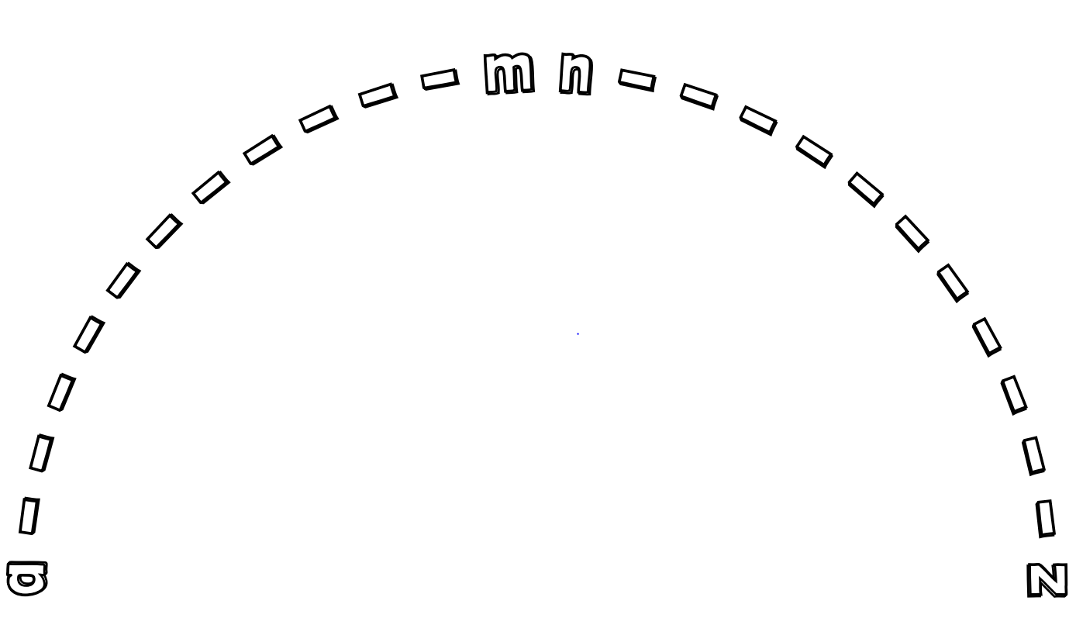
Notes:
Game 7: Build Your Own Arc
You will need the Letter Cards from your materials.
Let’s build the arc using your cards!
Do you have an open space in front of you to place the cards?
Let’s go!
Find Letter A and place it in front of you to start the arc.
Find Letter Z and place it at the end of your arc.
Find Letter M and N. Place them at the top of the arc.
Now, let’s fill in your arc!
Focus this type of game on the first six letters. Then, as students become proficient, add letters.

