Slide 1
Using Trend Lines
Math 8B Unit 7 Lesson 7
Notes:
Welcome to this presentation on understanding linear models. In this presentation, we will look at how to interpret the slope and y-intercept of a linear model in terms of the data.

Slide 2
What is a Linear Model?
A linear model is a nearly straight line that represents a relationship between two variables.
Approximated by a trend line.
It is used to describe how one variable changes in relation to another variable.
The slope and y-intercept of a linear model can help us understand the relationship between the variables.
Notes:
Before we can interpret the slope and y-intercept of a linear model, we need to understand what a linear model is. A linear model is a straight line that represents a relationship between two variables. It is used to describe how one variable changes in relation to another variable. For example, we could use a linear model to describe how the amount of time spent studying affects a student's test scores.

Slide 3
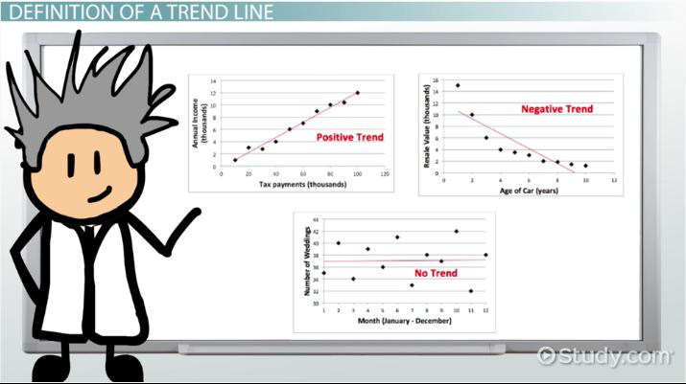
What is a Trend Line?
A trend line is a straight line that shows the overall pattern or trend in a set of data points.
It is used to help us see how the data is changing over time.
Trend lines can be used to make future predictions about the data points in a graph.
Commonly called “Line of best fit.”
Notes:
A trend line is a tool that helps us understand how data is changing over time. It is used to analyze data and make predictions. The line shows the overall pattern or trend in the data points and can be used to make predictions about future data points. By using a trend line, we can better understand the data and what it means.

Slide 4

Interpreting the Slope
The slope of a linear model represents the rate of change of the dependent variable with respect to the independent variable.
A positive slope indicates that the dependent variable increases as the independent variable increases.
A negative slope indicates that the dependent variable decreases as the independent variable increases.
The greater the slope, the steeper the line and the greater the rate of change.
Notes:
The slope of a linear model represents the rate of change of the dependent variable with respect to the independent variable. A positive slope indicates that the dependent variable increases as the independent variable increases. A negative slope indicates that the dependent variable decreases as the independent variable increases. The greater the slope, the steeper the line and the greater the rate of change.

Slide 5
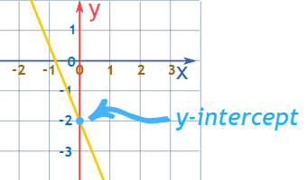
Interpreting the Y-Intercept
The y-intercept of a linear model represents the starting value of the dependent variable when the independent variable is zero.
The y-intercept is the point at which the line crosses the y-axis.
The y-intercept is not always meaningful depending on the context of the model.
Notes:
The y-intercept of a linear model represents the starting value of the dependent variable when the independent variable is zero. The y-intercept is the point at which the line crosses the y-axis. The y-intercept is not always meaningful depending on the context of the model. For example, if we are using a linear model to describe how the temperature outside affects the number of ice cream cones sold, the y-intercept would not be meaningful, because there cannot be negative ice cream cones sold.

Slide 6

Real World Examples
The slope of a linear model can be used to predict how fast something is changing. For example, in a car, the slope of the speedometer tells you how fast you're accelerating.
The y-intercept represents the starting value or initial condition. For example, the y-intercept of a savings account graph represents the initial balance.
Notes:
In real life, slope and y-intercept are used to make predictions. For example, the slope of a line on a graph can be used to predict the future values of the dependent variable. And the y-intercept can be used to find the initial value of the dependent variable. In this slide, we will explore some real life examples of how slope and y-intercept are used to make predictions and understand relationships between variables.

Slide 7
Putting It All Together
Understanding the slope and y-intercept of a linear model can help us interpret the relationship between the variables.
The slope tells us the rate of change of the dependent variable with respect to the independent variable.
The y-intercept tells us the starting value of the dependent variable when the independent variable is zero.
Notes:
Understanding the slope and y-intercept of a linear model can help us interpret the relationship between the variables. The slope tells us the rate of change of the dependent variable with respect to the independent variable. The y-intercept tells us the starting value of the dependent variable when the independent variable is zero. By understanding these concepts, we can make predictions and draw conclusions about the relationship between the variables.

Slide 8
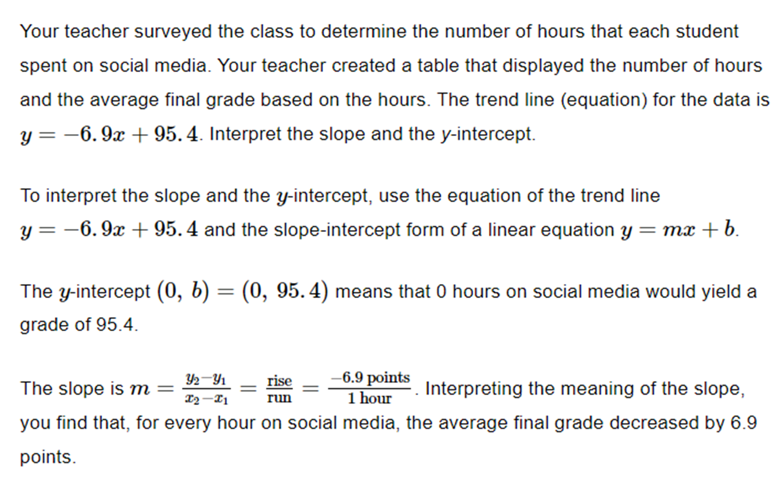
Example

Slide 9
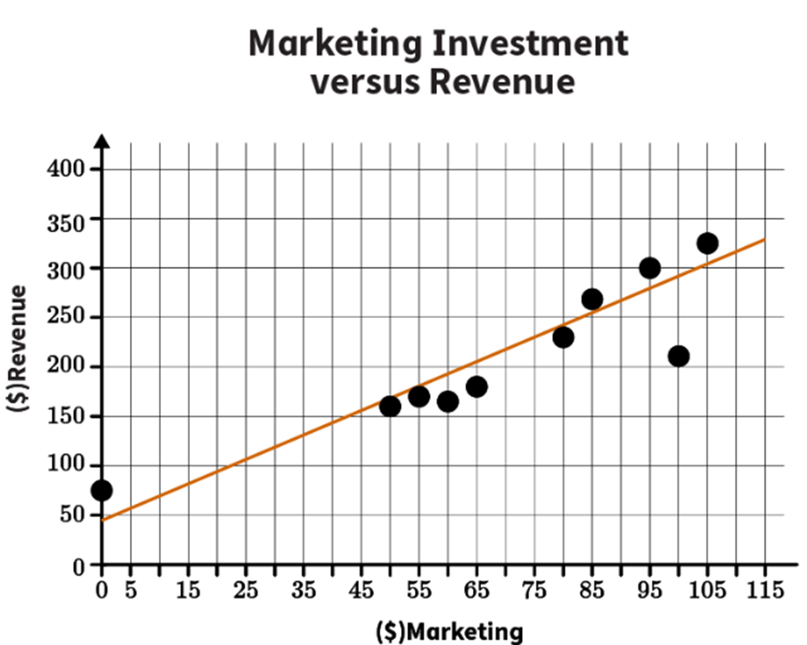
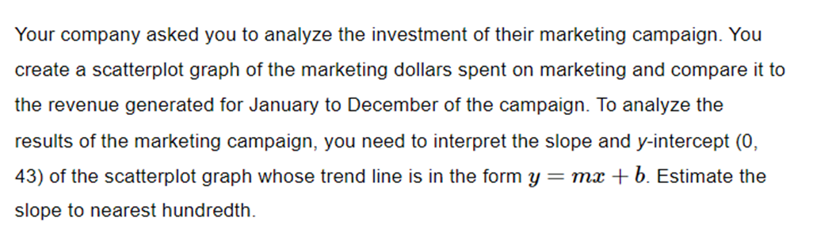
Example

Slide 10
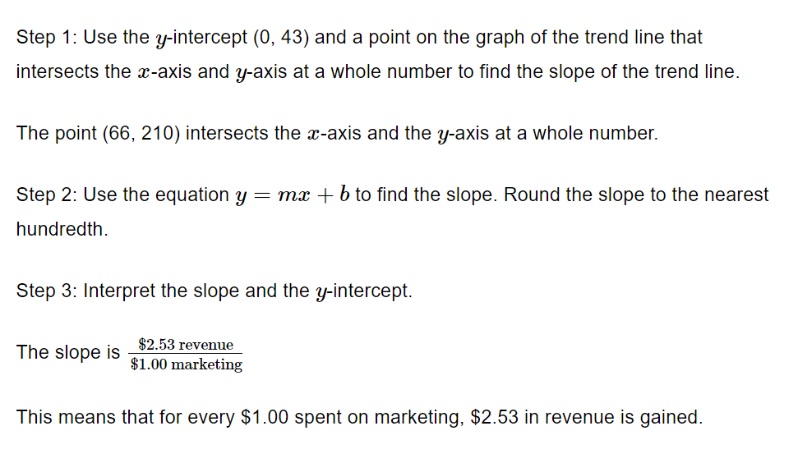
Example

Slide 11
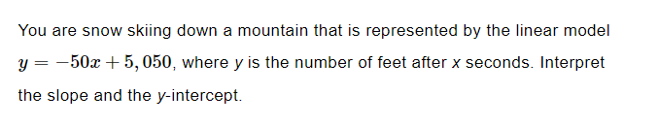
Practice

Slide 12
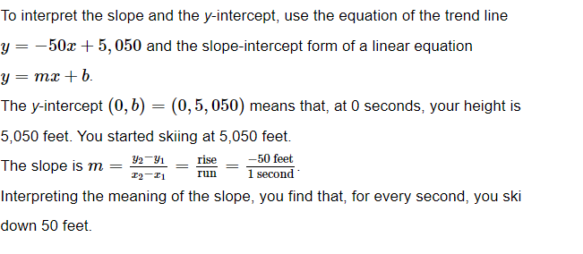
Answer

Slide 13
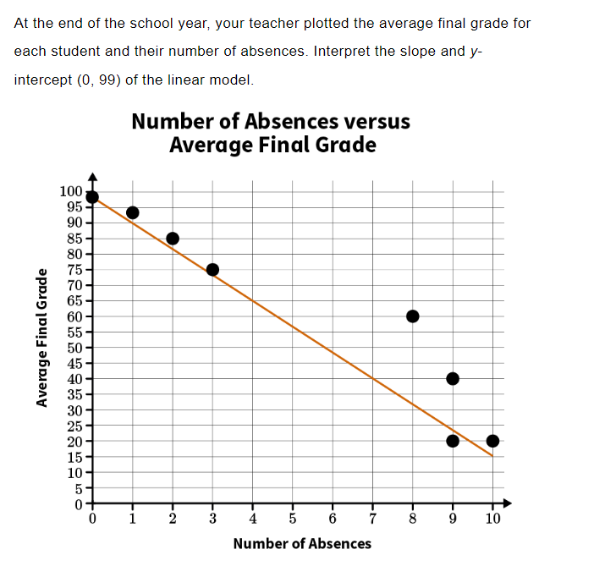
Practice

Slide 14
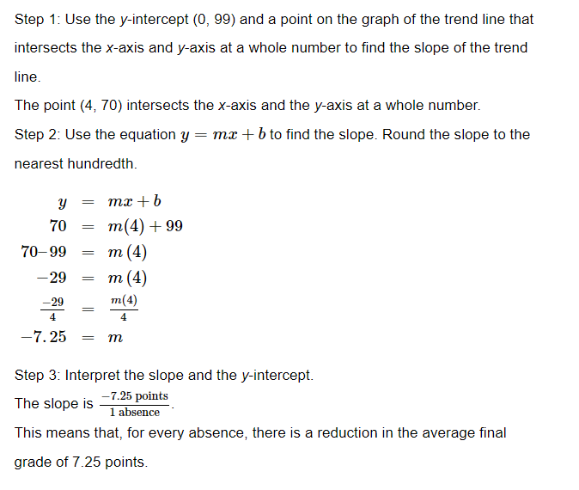
Answer

Slide 15

Practice

Slide 16
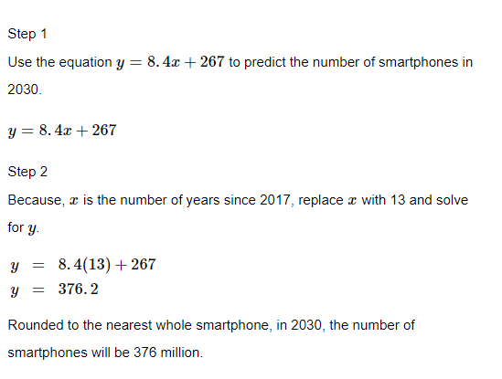
Answer

Slide 17
GeoGebra
Line of best fit activity: https://www.geogebra.org/m/VJ8zmZwn

Slide 18

Key Points
A linear model represents a relationship between two variables, and can be used to describe how one variable changes in relation to another variable.
The slope of a linear model represents the rate of change of the dependent variable with respect to the independent variable.
The y-intercept represents the starting value of the dependent variable when the independent variable is zero.
The greater the slope, the steeper the line and the greater the rate of change.

