Slide 1
Congruent Figures
Math 8B Unit 2 Lesson 8
Notes:
Welcome to this presentation on Exploring Congruence in 2D Figures. In this presentation, we will learn about congruent 2D figures and how to describe them. Let's get started.

Slide 2
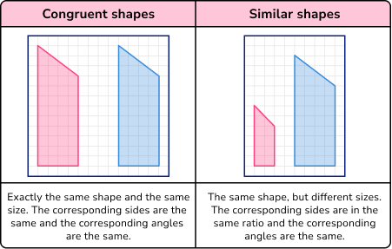
What is Congruence?
Congruence is a term used to describe two figures that have the same size and shape.
To show two figures are congruent, we need to show that one can be transformed into the other by a sequence of rotations, reflections, and translations.
The three types of transformations that can be used to show congruence are rotations, reflections, and translations.
Notes:
Congruent figures are figures that have the same size and shape. To show that two figures are congruent, we need to show that one can be transformed into the other by a sequence of rotations, reflections, and translations. These transformations preserve the size and shape of the figure. In other words, they do not change the appearance of the figure. The three types of transformations that can be used to show congruence are rotations, reflections, and translations. Let's explore each of these transformations in more detail.

Slide 3

Center of Rotations
Fixed point from which a figure is turned.
Notes:
Rotation is a transformation that turns a figure about a fixed point called the center of rotation. A figure can be rotated by any angle about its center of rotation. The direction of rotation can be clockwise or counterclockwise. To show that two figures are congruent, we need to show that one can be transformed into the other by a sequence of rotations. Let's practice some rotations.

Slide 4
Rotations
Rotation is a transformation that turns a figure about a fixed point called the center of rotation.
A figure can be rotated by any angle about its center of rotation.
The direction of rotation can be clockwise or counterclockwise.
Notes:
Rotation is a transformation that turns a figure about a fixed point called the center of rotation. A figure can be rotated by any angle about its center of rotation. The direction of rotation can be clockwise or counterclockwise. To show that two figures are congruent, we need to show that one can be transformed into the other by a sequence of rotations. Let's practice some rotations.

Slide 5
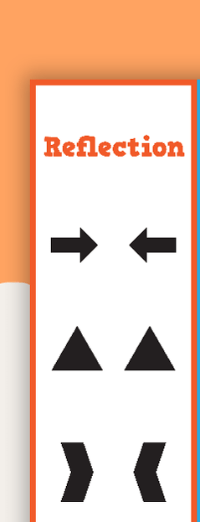
Reflections
Reflection is a transformation that flips a figure over a line called the line of reflection.
The line of reflection can be vertical, horizontal or diagonal.
Reflections preserve the size and shape of a figure.
Notes:
Reflection is a transformation that flips a figure over a line called the line of reflection. The line of reflection can be vertical, horizontal or diagonal. Reflections preserve the size and shape of a figure. To show that two figures are congruent, we need to show that one can be transformed into the other by a sequence of reflections. Let's practice some reflections.

Slide 6
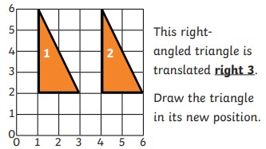
Translations
Translation is a transformation that slides a figure in a straight line without rotating or reflecting it.
The direction of the translation can be up, down, left or right.
The distance of the translation can be any distance.
Notes:
Translation is a transformation that slides a figure in a straight line without rotating or reflecting it. The direction of the translation can be up, down, left or right. The distance of the translation can be any distance. To show that two figures are congruent, we need to show that one can be transformed into the other by a sequence of translations. Let's practice some translations.

Slide 7

Putting It All Together
To show two figures are congruent, we need to show that one can be transformed into the other by a sequence of rotations, reflections, and translations.
We can use a combination of these transformations to show congruence.
Congruent figures have the same size and shape.
Notes:
To show two figures are congruent, we need to show that one can be transformed into the other by a sequence of rotations, reflections, and translations. We can use a combination of these transformations to show congruence. Congruent figures have the same size and shape. Let's look at some examples of congruent figures.

Slide 8
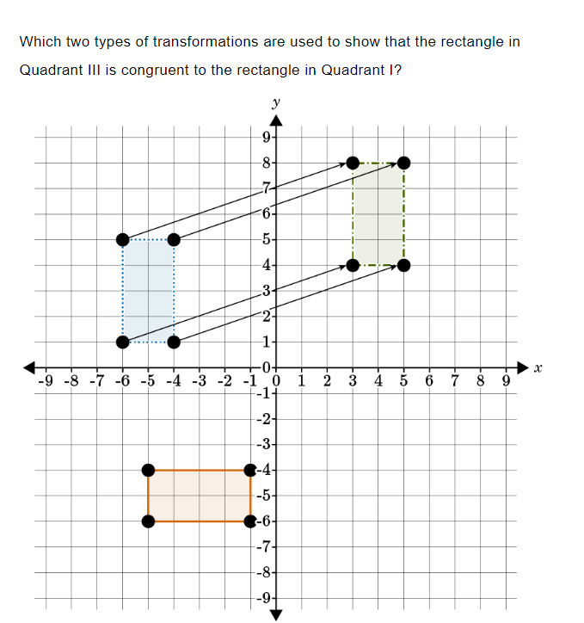
Practice

Slide 9

Answer:

Slide 10
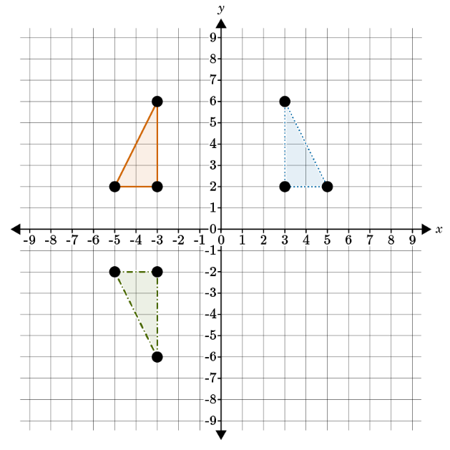
Jia says that there is only one way to transform the triangle in Quadrant II to prove congruence with the triangle in Quadrant III: reflection across the -axis and then a clockwise rotation, as shown. What do you tell her?

Slide 11
Answer:
Jia’s series of transformations does show congruence, but there is often more than one way to demonstrate this. A simpler way would be to reflect the triangle in Quadrant II over the x-axis.

Slide 12

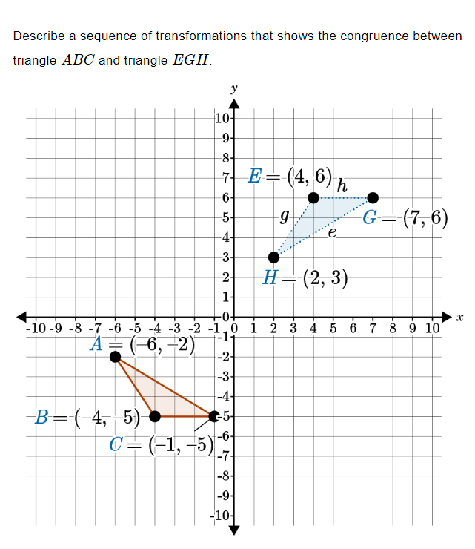
Practice

Slide 13
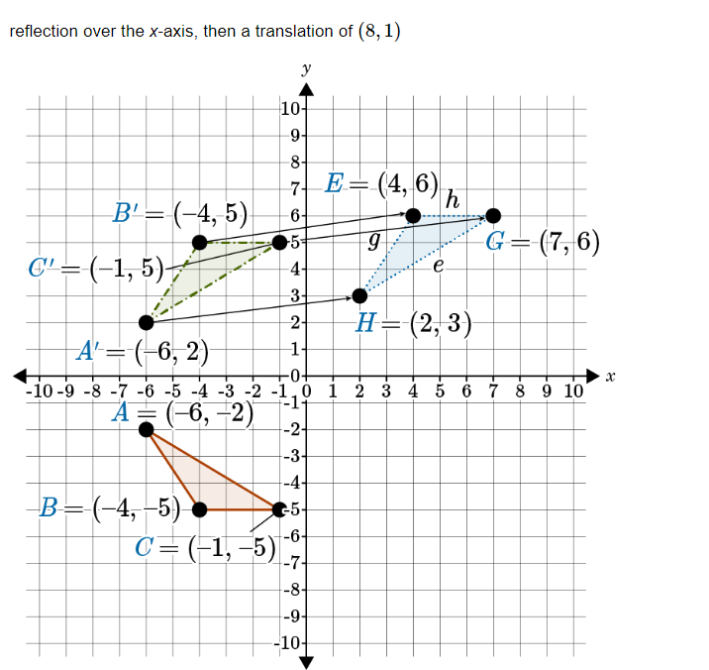
Answer

Slide 14
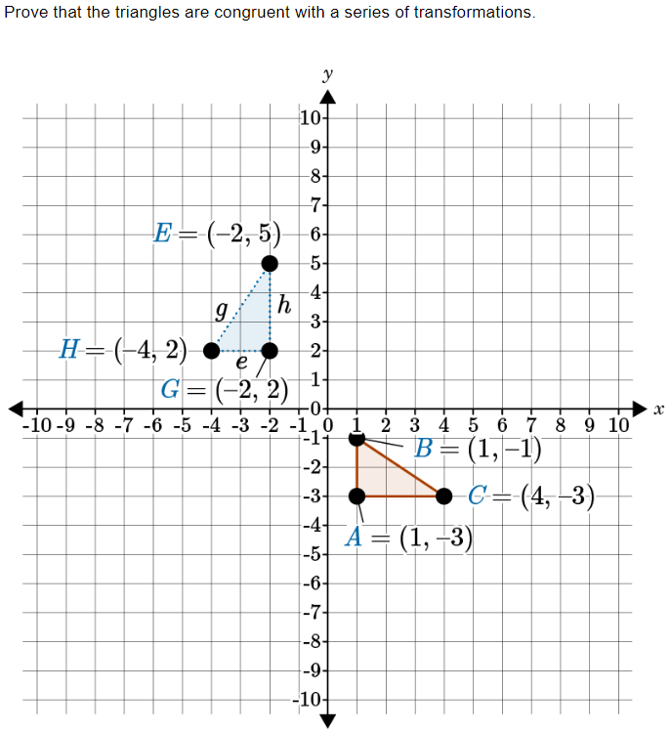
Practice

Slide 15
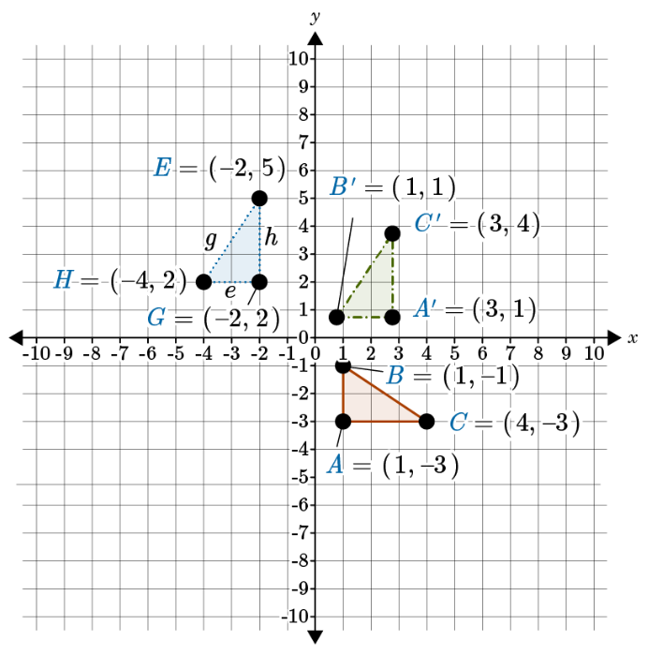
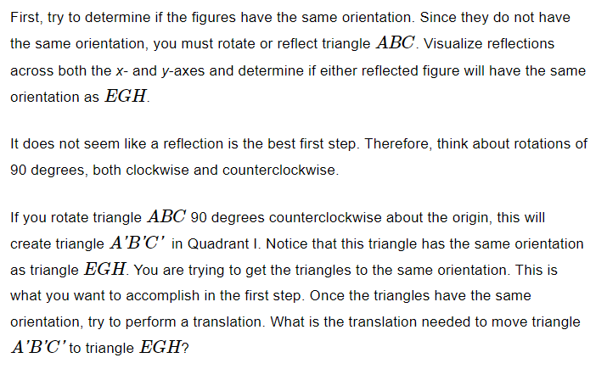

Slide 16
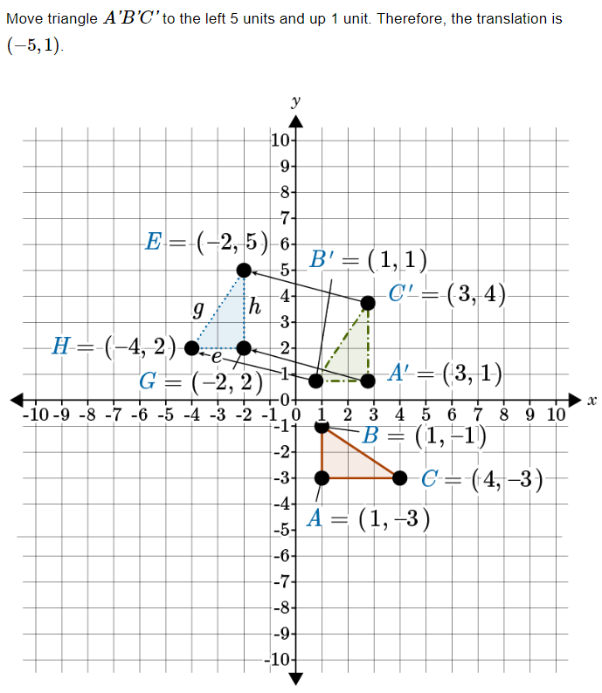
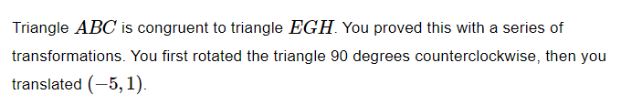

Slide 17
Summary
Congruence is the term used to describe two figures that have the same size and shape.
Rotations are transformations that turn a figure about a fixed point called the center of rotation.
Reflections are transformations that flip a figure over a line called the line of reflection.
Translations are transformations that slide a figure in a straight line without rotating or reflecting it.
To show congruence between two figures, we need to use a sequence of transformations that can be used to change one figure into another.
A sequence of transformations is a series of transformations that can be used to change one figure into another.
Notes:
This summary slide highlights the key points discussed in the presentation on exploring congruence in 2D figures. By using a combination of rotations, reflections, and translations, we can show congruence between two figures. Congruent figures have the same size and shape. It is important to remember that a sequence of transformations is a series of transformations that can be used to change one figure into another.

