Slide 1
Relative Frequency
Math 8B Unit 7 Lesson 9
Notes:
Today, we will learn about how to determine relative frequency in a two-way table. This is an important skill to have as it helps us identify patterns and relationships between different sets of data. By the end of this presentation, you will be able to calculate relative frequency with ease.

Slide 2
What is a Categorical Variable?
Categorical variables are variables with values that are names or labels; qualitative.
They are non-numeric variables that are usually measured in words rather than numbers.
For example, the color of a car, the type of fruit, or the name of a person are all categorical variables.
A categorical variable can be nominal or ordinal.
A nominal variable is one that has no inherent order or ranking, such as colors or names.
An ordinal variable is one that has a natural order or ranking, such as grades or levels of education.
Notes:
In statistics, a variable is an attribute or characteristic that can be measured. A categorical variable is a type of variable that represents characteristics or qualities, such as the color of a car or the type of fruit. These variables are non-numeric and are usually measured in words rather than numbers. One way to visualize categorical data is with a bar chart, which shows the frequency of each category. Understanding the difference between nominal and ordinal variables is important for analyzing data and drawing conclusions.

Slide 3
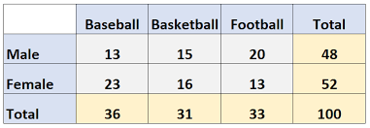
What is a Two-Way Table?
A two-way table is a table that shows the relationship between two sets of data.
It has two categories for each set of data being analyzed.
The rows represent one set of data, and the columns represent the other set of data.
Notes:
A two-way table is a useful tool for analyzing data. It allows us to see how two different sets of data are related to each other. For example, we could use a two-way table to analyze the relationship between gender and favorite color among a group of middle school students.

Slide 4

Calculating Relative Frequency
Relative frequency is the number of times something occurs divided by the total
To calculate relative frequency, we divide the frequency of each category by the total number of observations.
We can express relative frequency as a percentage by multiplying the result by 100.
Notes:
Now that we have calculated the marginal totals for our two-way table, we can calculate the relative frequency for each category. Relative frequency tells us the proportion of observations in a particular category. To calculate relative frequency, we divide the frequency of each category by the total number of observations. We can then express relative frequency as a percentage by multiplying the result by 100.

Slide 5
Calculating Marginal Totals
Marginal totals are the totals found on the margins of a two-way table.
They represent the total number of observations for each category in the table.
To calculate marginal totals, we add up the values in each row and column.
Notes:
Before we can calculate relative frequency, we need to calculate the marginal totals for the two-way table. Marginal totals help us understand the total number of observations for each category. To calculate marginal totals, we simply add up the values in each row and column.

Slide 6

Example Calculation
For example, let's say we have a two-way table that shows the relationship between gender and favorite color.
The table has 2 rows (one for each gender) and 4 columns (one for each color).
If we want to calculate the relative frequency of females who like blue, we would divide the frequency of females who like blue by the total number of observations.
Notes:
Let's go through an example calculation to see how we can use relative frequency to analyze data. Suppose we have a two-way table that shows the relationship between gender and favorite color. If we want to calculate the relative frequency of females who like blue, we would divide the frequency of females who like blue by the total number of observations.

Slide 7
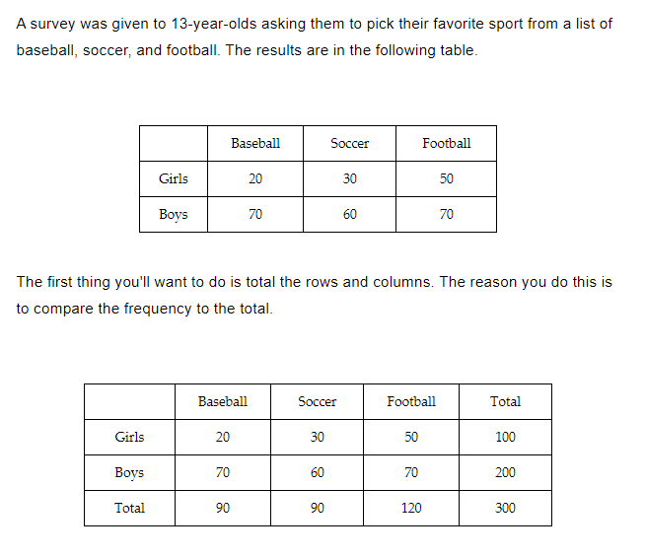
Practice

Slide 8
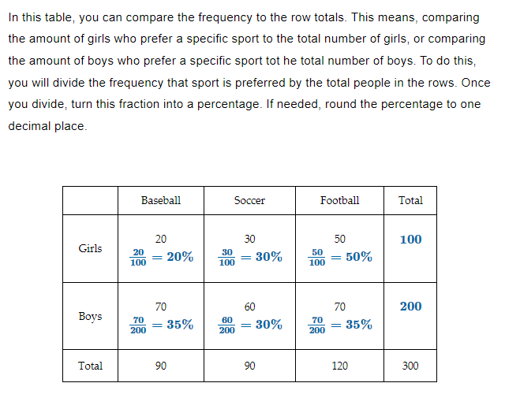
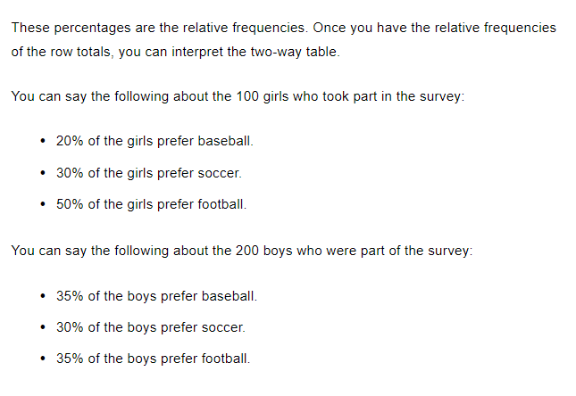
Practice

Slide 9
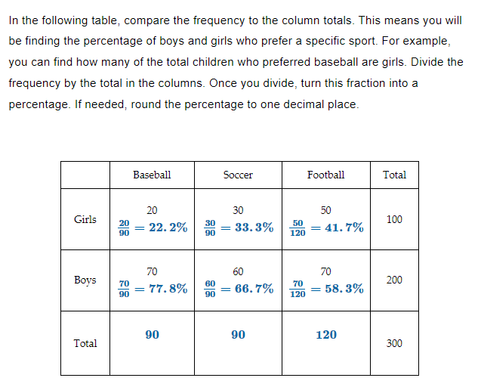
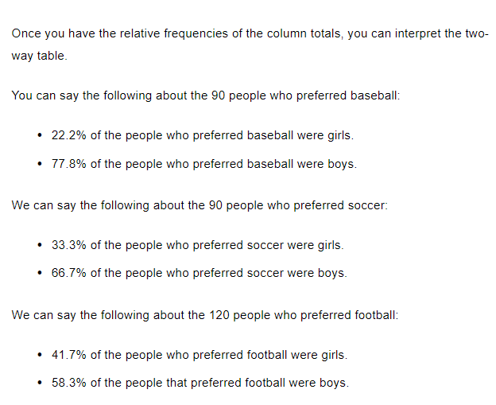
Practice

Slide 10
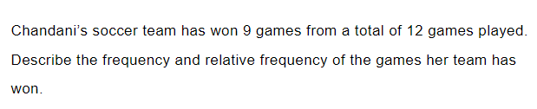
Practice

Slide 11

Answer

Slide 12
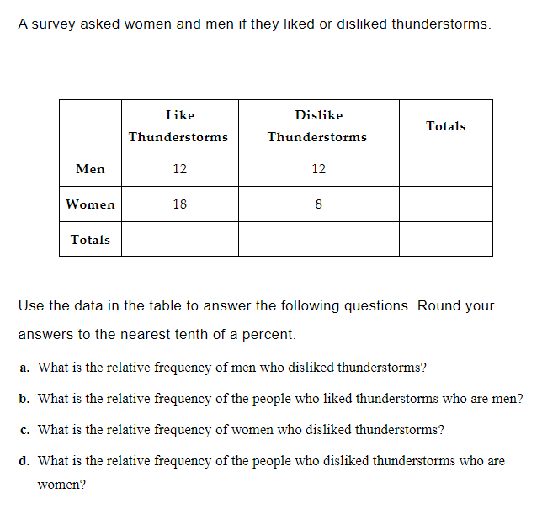
Practice

Slide 13
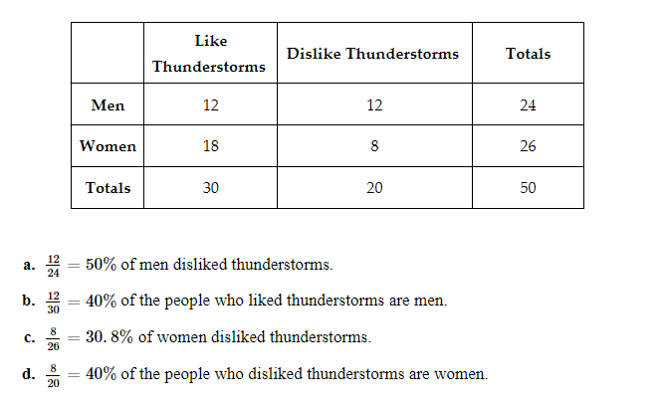
Answer

Slide 14
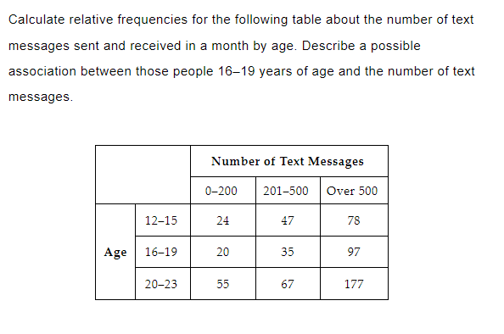
Practice

Slide 15
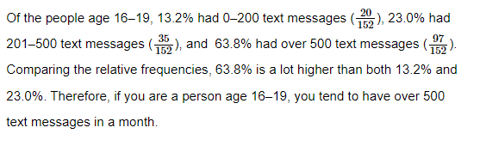
Answer

Slide 16
GeoGebra
Interpreting Two-Way Tables: https://www.geogebra.org/m/a4pxtpux
How do you create a relative frequency table?: https://www.geogebra.org/m/wetwjshf

Slide 17
Two-Way Tables - Step 1
Identify the two variables you want to analyze.
Choose one variable to represent the rows and the other variable to represent the columns.
Label the rows and columns with the categories of each variable.
Notes:
When you are working with two-way tables, you need to have two variables that you want to analyze. Each variable should have at least two categories. One variable will be represented by the rows, and the other variable will be represented by the columns. You should label each row and column with the categories of each variable. If you have numeric data, you can group it into categories.

Slide 18
Two-Way Tables - Step 2
Fill in the table with the data you collected.
Calculate the marginal totals for each row and column.
Calculate the total number of observations in the table.
Notes:
Once you have your table set up, you need to fill it in with the data you have collected. You should then calculate the marginal totals for each row and column. The marginal totals are the totals found on the margins of the table and represent the total number of observations for each category. Finally, you need to calculate the total number of observations in the table.

Slide 19
Two-Way Tables - Step 3
Calculate the relative frequency for each cell in the table.
Interpret the results to describe the association between the two variables.
Draw a conclusion based on your interpretation.
Notes:
To calculate relative frequency for each cell in the table, you need to divide the frequency of each cell by the total number of observations. You can then interpret the results to describe the association between the two variables. For example, if there are more observations in one cell than in another, this may indicate a positive association between the two variables. You should draw a conclusion based on your interpretation of the results.

Slide 20

Conclusion
Relative frequency is a useful tool for analyzing data in a two-way table.
It allows us to see patterns and relationships between different sets of data.
To calculate relative frequency, we divide the frequency of each category by the total number of observations.
We can express relative frequency as a percentage by multiplying the result by 100.
Notes:
In conclusion, relative frequency is a powerful tool for analyzing data in a two-way table. It helps us identify patterns and relationships between different sets of data. With the skills you have learned today, you can now calculate relative frequency and use it to analyze data with confidence.

