Slide 1
Properties of Functions
Math 8B Unit 8 Lesson 8
Notes:
In this presentation, we will learn how to compare properties of two functions that are represented in different ways. This skill is essential for higher-level math classes and real-life problem-solving scenarios.

Slide 2
Algebraic Representation
Linear functions can be represented by…
Functions can be represented using algebraic equations.
We can compare functions by analyzing their algebraic properties.
Examples of algebraic properties include domain, range, and intercepts.
Notes:
One way functions can be represented is through algebraic equations. The algebraic properties of a function can tell us a lot about its behavior.

Slide 3

Graphical Representation
Linear functions can be represented by…
Functions can be represented using graphs.
We can compare functions by analyzing their graphical properties.
Examples of graphical properties include slope, intercepts, and shape.
Notes:
Another way functions can be represented is through graphs. Graphical properties can give us a visual understanding of how functions behave.

Slide 4
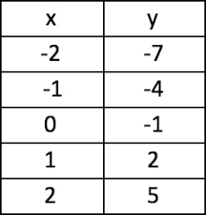
Numerical Representation
Linear functions can be represented by…
Functions can be represented using tables of values.
We can compare functions by analyzing their numerical properties.
Shown as (x,y) values in a table
Notes:
Functions can also be represented using tables of values. These tables can help us identify patterns in the data and calculate important numerical properties.

Slide 5

Verbal Representation
Functions can be described using words.
We can compare functions by analyzing their verbal properties.
Examples of verbal properties include rate of change and direction of change.
Notes:
Finally, functions can be represented using words. Verbal properties can help us understand the meaning and context of the function.

Slide 6
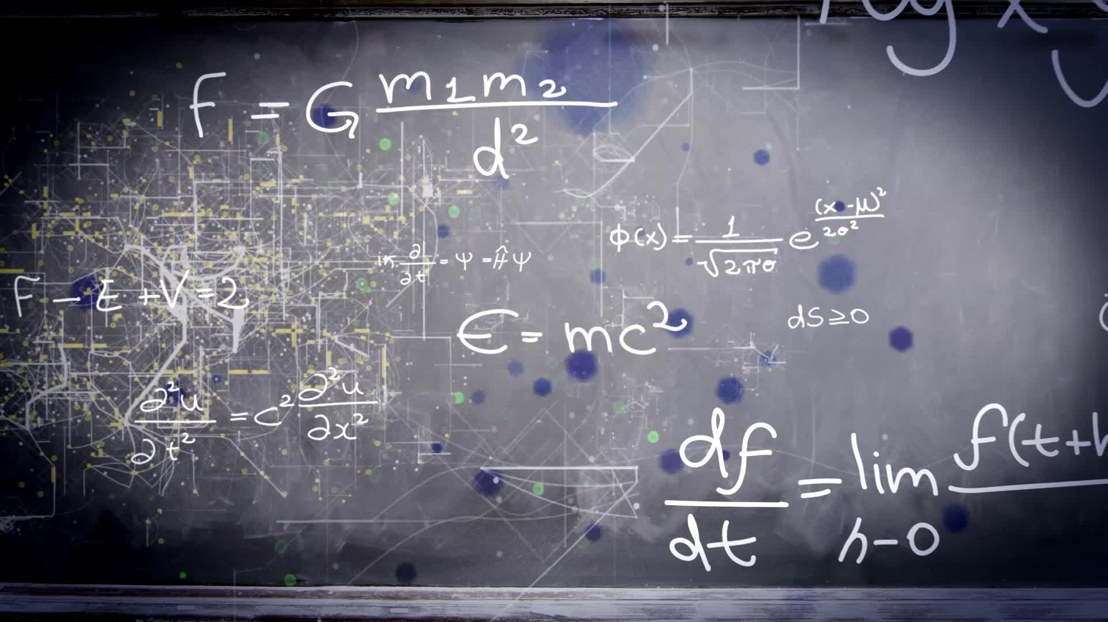
Example: Algebraic vs. Graphical
The equation of a line can be represented algebraically or graphically.
By analyzing the equation or graph, we can compare properties such as slope and y-intercept.
Notes:
Let's look at an example of how we can compare properties of a function that is represented both algebraically and graphically.

Slide 7
Example: Numerical vs. Verbal
A table of values can describe the growth of a plant over time.
By describing the growth verbally, we can compare properties such as rate of change and maximum height.
Notes:
Now let's look at an example of how we can compare properties of a function that is represented numerically and verbally.

Slide 8
Practice: Algebraic Representation
Given two functions represented algebraically, compare their domains and ranges.
Identify the intercepts and determine if they intersect.
Find the slope of each function and compare them.
Notes:
Let's practice comparing properties of functions that are represented algebraically. Try to answer the questions on your own before moving to the next slide.

Slide 9
Practice: Graphical Representation
Given two functions represented graphically, compare their slopes and y-intercepts.
Identify any points of intersection and compare their shapes.
Determine if the functions are increasing, decreasing, or constant.
Notes:
Now let's practice comparing properties of functions that are represented graphically. Try to answer the questions on your own before moving to the next slide.

Slide 10
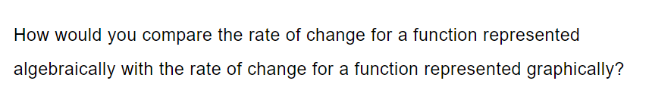
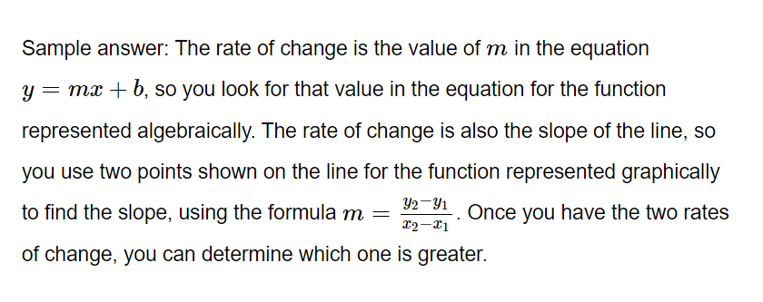
Practice

Slide 11
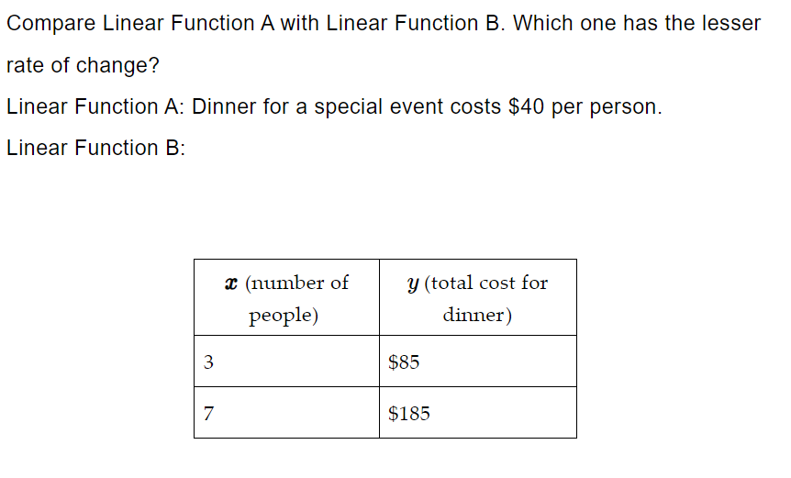
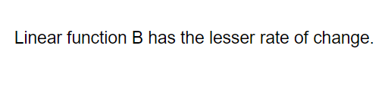
Practice

Slide 12
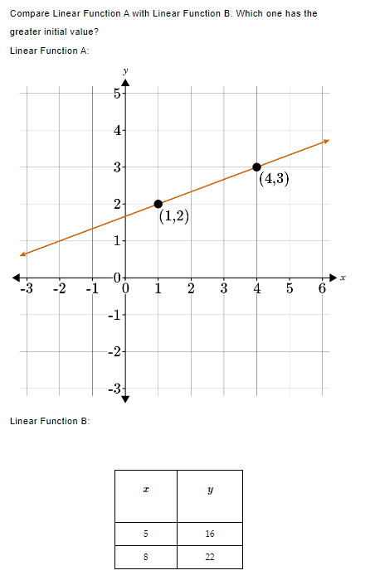
Practice

Slide 13

Practice

Slide 14
Sketching a graph that exhibits the qualitative features of a function
Qualitative features of a function are characteristics of a function that can be identified by looking at its graph.
Some qualitative features include intercepts, end behavior, and symmetry.
To sketch a graph that exhibits these features, we can start by identifying the key points of the function, such as its intercepts and local maxima/minima.
Once we have the key points, we can sketch a general shape of the function, making sure to include any relevant symmetry.
Finally, we can add in any additional features, such as asymptotes or points of inflection.
Notes:
In this slide, we will learn how to sketch a graph that exhibits the qualitative features of a function that has been described verbally. By identifying the key points and general shape of the function, we can better understand its behavior and use it to make predictions.

Slide 15
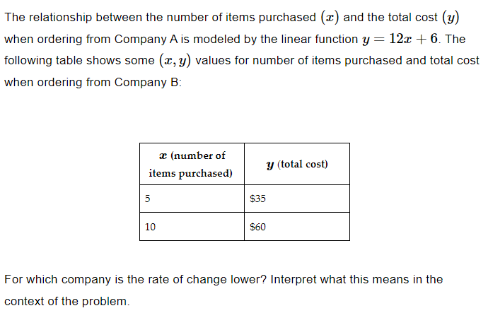
Example

Slide 16
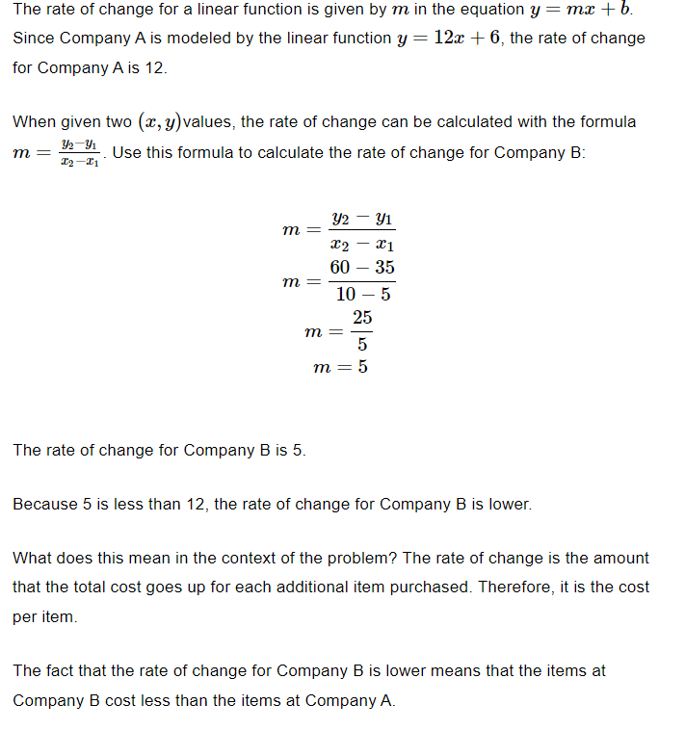
Answer

Slide 17

Practice

Slide 18
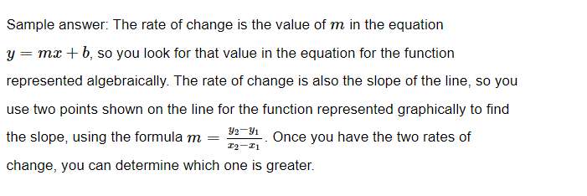
Answer

Slide 19
GeoGebra
Practice: Using Graphs to Compare Relationships: https://www.geogebra.org/m/nqes4rqn#material/uyuazqdc
Practice: Solutions to Linear Equations: https://www.geogebra.org/m/qfb4njtc#material/jb3aypuq
Practice: Representations of Linear Relationships: https://www.geogebra.org/m/xe3efb4e#material/a8brpen3

Slide 20

Wrap Up
Comparing properties of functions is an important math skill.
Functions can be represented in different ways, including algebraically, graphically, numerically, and verbally.
By analyzing the properties of functions, we can better understand their behavior.
Notes:
In this presentation, we learned how to compare the properties of functions that are represented in different ways. Keep practicing this skill to become a math expert!

