Slide 1
Welcome to Linear Equations
Math 8B Unit 6 Lesson 6
Notes:
In this presentation, we will learn how to create linear equations that represent real-world problems.

Slide 2
System Of Linear Equations
Linear equations have two variables: x and y
The equation follows the form y = mx + b
M represents the slope of the line, and b represents the y-intercept
Notes:
Before creating a real-world linear equation, we must understand the basic components of a linear equation and how to graph it in an xy-plane.

Slide 3
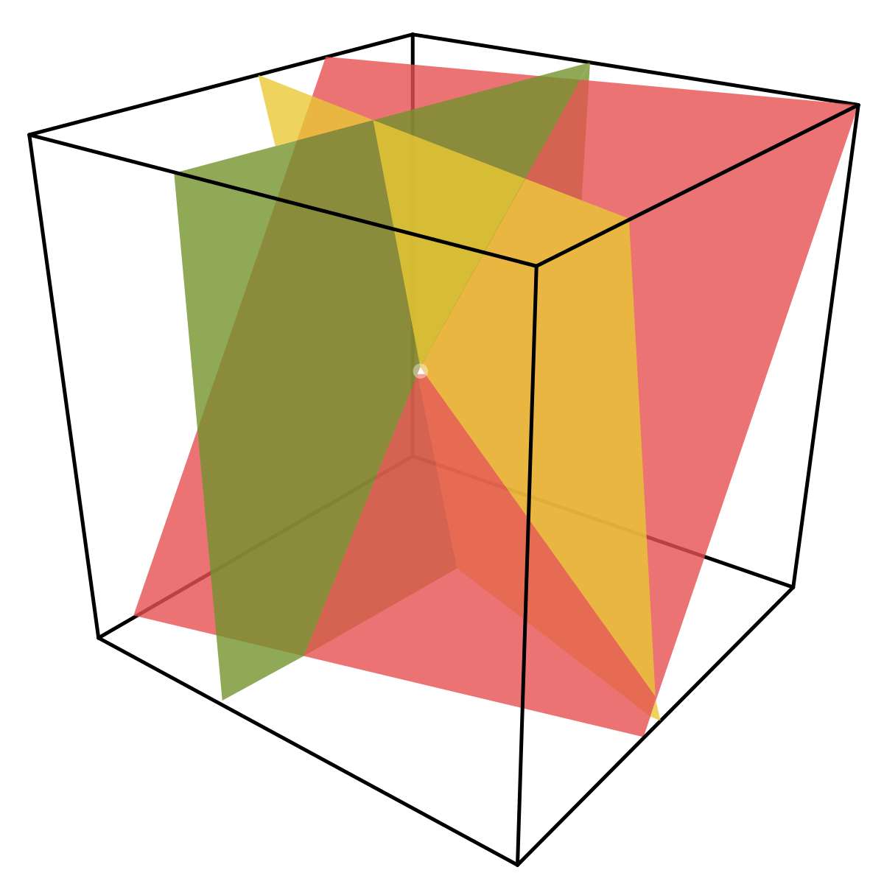
Identifying Variables
Identify the two variables that represent the real-world problem
Assign one variable as x and the other as y
Notes:
To create a linear equation for a real-world problem, we must first identify the two variables that are involved in the problem and assign one variable as x and the other as y.

Slide 4

Finding the Slope and y-Intercept
Use the given information to find the slope
Use the given information to find the y-intercept
Notes:
After identifying the variables, we must use the given information to find the slope and y-intercept. This will allow us to create the equation in y = mx + b form.

Slide 5
Putting it all Together
Write the equation in y = mx + b form
Solve the equation with the given information
Graph the equation to represent the real-world problem
Notes:
Finally, we can put all the pieces together to create the linear equation that represents the real-world problem. Once we have the equation, we can check it with the given information and graph it to represent the problem visually.

Slide 6
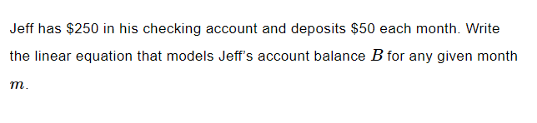
Practice

Slide 7
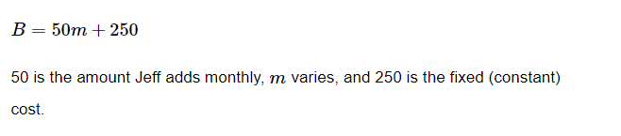
Answer

Slide 8
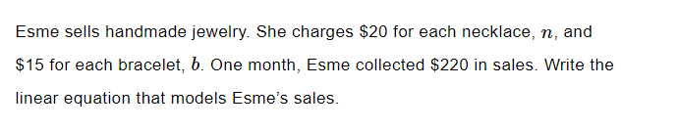
Practice

Slide 9
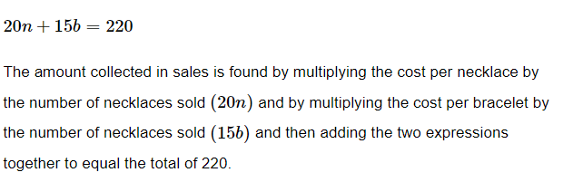
Answer

Slide 10
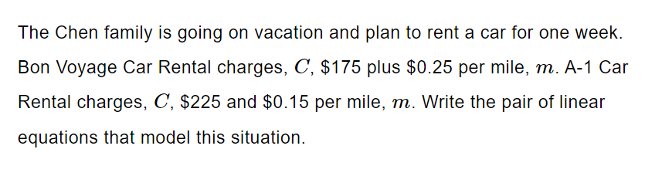
Practice
Notes:
Now that we have gone through the steps, it's time to practice. Let's solve some real-world problems and create two linear equations. Then, we can identify the variables and find the slope and y-intercept. Finally, we can graph the two equations on the same coordinate plane.

Slide 11
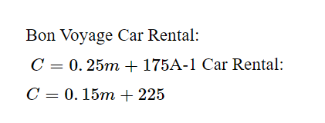
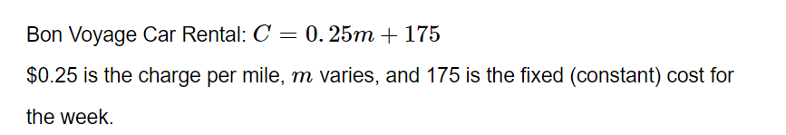
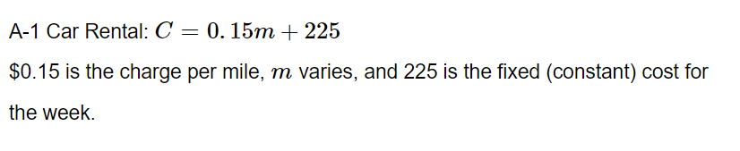
Answer
Notes:
Now that we have gone through the steps, it's time to practice. Let's solve some real-world problems and create two linear equations. Then, we can identify the variables and find the slope and y-intercept. Finally, we can graph the two equations on the same coordinate plane.

Slide 12

Practice
Notes:
Now that we have gone through the steps, it's time to practice. Let's solve some real-world problems and create two linear equations. Then, we can identify the variables and find the slope and y-intercept. Finally, we can graph the two equations on the same coordinate plane.

Slide 13
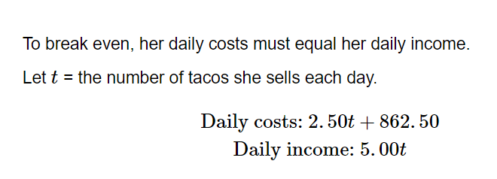
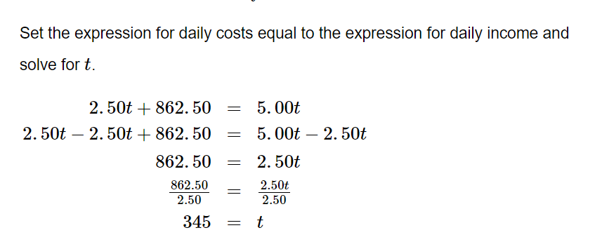

Answer
Notes:
Now that we have gone through the steps, it's time to practice. Let's solve some real-world problems and create two linear equations. Then, we can identify the variables and find the slope and y-intercept. Finally, we can graph the two equations on the same coordinate plane.

Slide 14
GeoGebra Practice
Exercises on System of Two Linear Equations in Two Variables: https://www.geogebra.org/m/dkvfzcff
Linear Equations in Two Variables: https://www.geogebra.org/m/RR7r8M5X
Linear Equation in Two Variables: https://www.geogebra.org/m/FW5H6vEv

Slide 15
Summary
Linear equations have two variables: x and y
Use the given information to find the slope and y-intercept
Identify variables in real-world problems to create two linear equations
Graph the two equations on the same coordinate plane
Practice with GeoGebra Exercises

