Slide 1
Angles of Similar Triangles
Math 8B Unit 3 Lesson 8
Notes:
In this presentation, we will learn about similar figures and how to describe them as having congruent corresponding angles.

Slide 2
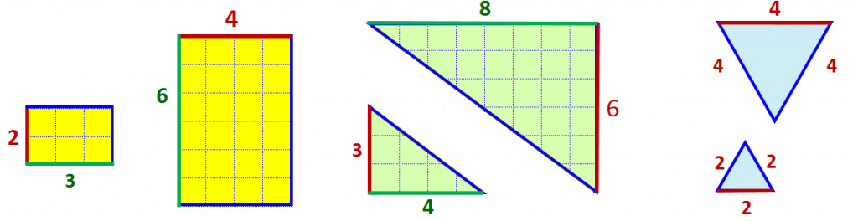

What are Similar Figures?
Similar figures have the same shape but not necessarily the same size.
The corresponding angles of similar figures are congruent.
Corresponding angles are angles in the same position in different figures.
Notes:
Two figures are similar if they have the same shape but not necessarily the same size. Corresponding angles are angles in the same position in different figures.

Slide 3
How to Identify Congruent Corresponding Angles?
Draw the corresponding angles in both figures.
Identify the angles.
If the angles are the same, then they are congruent.
Notes:
To identify congruent corresponding angles, draw the corresponding angles in both figures and measure them using a protractor. If the angles are the same, then they are congruent.

Slide 4
What is an Informal Argument?
An informal argument is a reason or explanation that is not strictly logical or mathematical.
Informal arguments use visual aids and observations to explain mathematical concepts.
Informal arguments help us to understand mathematical concepts in a more intuitive way.
Informal arguments are not formal proofs, but they help us to develop and understand mathematical concepts.
Notes:
An informal argument is an explanation or reason that uses visual aids and observations to explain mathematical concepts.

Slide 5
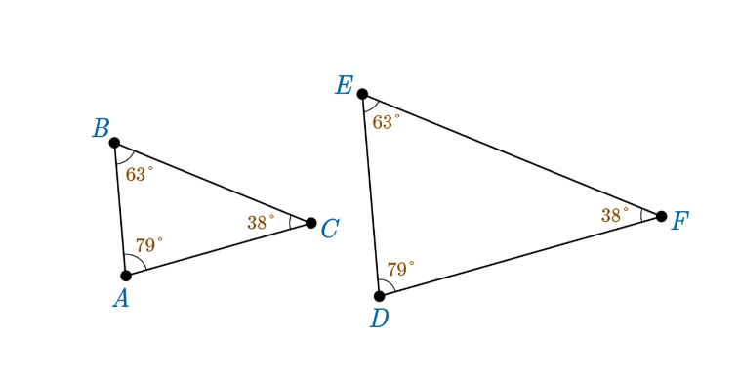
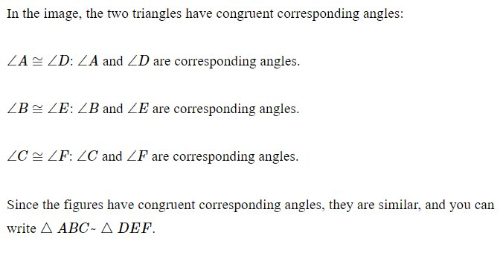
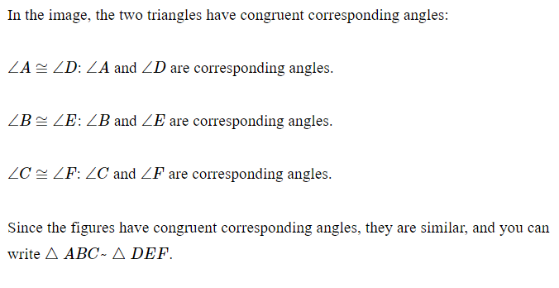
Example
Notes:
In this example, Figure A and Figure B are similar figures. Angle 1 in Figure A corresponds to Angle 1 in Figure B, Angle 2 in Figure A corresponds to Angle 2 in Figure B, and Angle 3 in Figure A corresponds to Angle 3 in Figure B. Therefore, the corresponding angles are congruent.

Slide 6
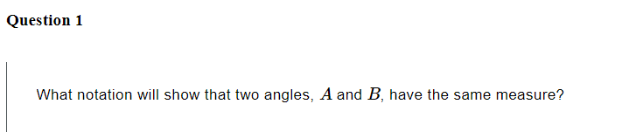
Practice

Slide 7

Answer

Slide 8
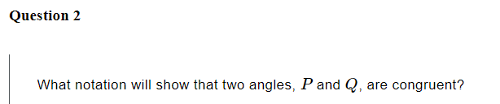
Practice

Slide 9

Answer

Slide 10
Summary
Similar figures have the same shape but not necessarily the same size.
The corresponding angles of similar figures are congruent.
Corresponding angles are angles in the same position in different figures.
To identify congruent corresponding angles, draw the corresponding angles in both figures and measure them using a protractor.
Notes:
In summary, we learned that similar figures have the same shape but not necessarily the same size. The corresponding angles of similar figures are congruent and corresponding angles are angles in the same position in different figures. To identify congruent corresponding angles, draw the corresponding angles in both figures and measure them using a protractor.

Slide 11
Similarity of Triangles
Similarity of triangles is an important concept in geometry.
Two triangles are similar if they have the same shape but not necessarily the same size.
In similar triangles, the corresponding angles are congruent.
We use informal arguments to show facts about the angle-angle criterion for similarity of triangles.
Notes:
In this presentation, we will learn about informal arguments to show facts about the angle-angle criterion for similarity of triangles.

Slide 12
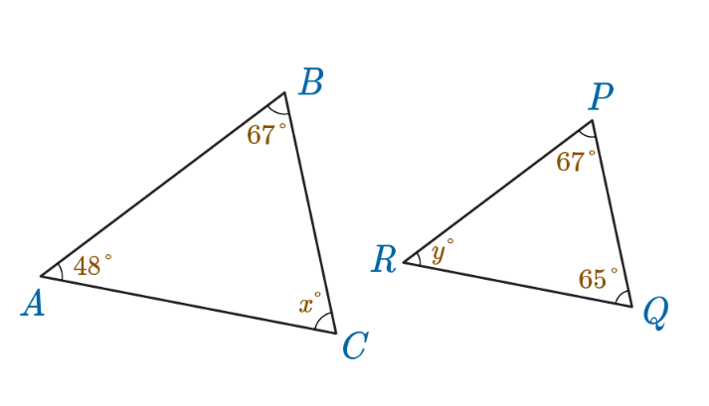

Practice

Slide 13
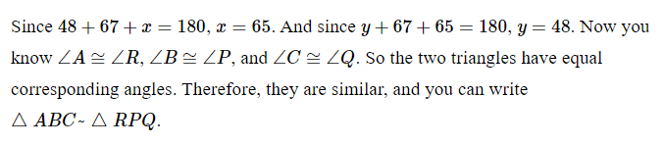
Answer

Slide 14
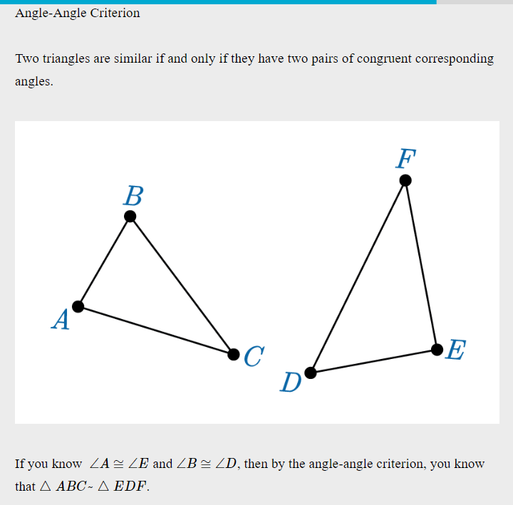
Angle-Angle Criterion for Similarity
The angle-angle criterion for similarity states that if two angles of one triangle are congruent to two angles of another triangle, then the triangles are similar.
This criterion is also known as AA criterion for similarity of triangles.
This criterion is useful for proving two triangles are similar.
We can use informal arguments to show facts about the angle-angle criterion for similarity of triangles.
Notes:
The angle-angle criterion for similarity states that if two angles of one triangle are congruent to two angles of another triangle, then the triangles are similar. We can use informal arguments to show facts about this criterion.

Slide 15
How to Use Informal Arguments for AA Criterion?
To use informal arguments to show AA criterion, we need to compare the angles between two triangles.
1
Find two angles in one triangle that are congruent to two angles in another triangle.
2
If these two angles are congruent, then we can use informal arguments to show that the two triangles are similar.
3
Notes:
To use informal arguments to show AA criterion, we need to compare the angles between two triangles. Find two angles in one triangle that are congruent to two angles in another triangle. If these two angles are congruent, then we can use informal arguments to show that the two triangles are similar.

Slide 16
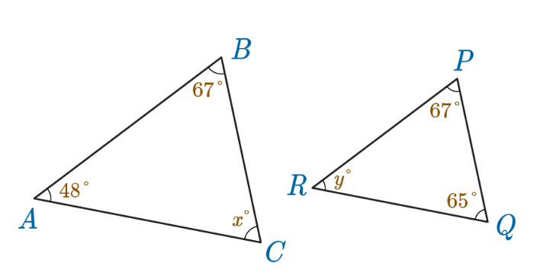
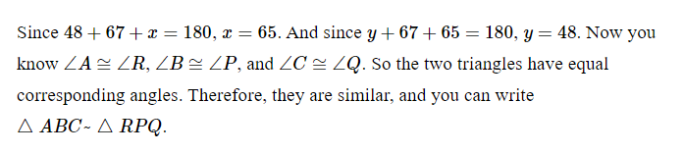
Example
Let's take an example to understand informal arguments for AA criterion.
In triangle ABC, angle A is congruent to angle R in triangle RPQ.
Angle B is congruent to angle P in triangle RPQ
Therefore, triangle ABC is similar to triangle RPQ by AA criterion for similarity.
Notes:
Let's take an example to understand informal arguments for AA criterion. In triangle ABC, angle A is congruent to angle D in triangle DEF. Angle B is congruent to angle E in triangle DEF. Therefore, triangle ABC is similar to triangle DEF by AA criterion for similarity.

Slide 17
Practice
Let's practice using informal arguments to show AA criterion for similarity.
Consider two triangles PQR and LMN.
Angle P is congruent to angle L.
Angle Q is congruent to angle M.
Can we use informal arguments to show that triangles PQR and LMN are similar?
Notes:
Let's practice using informal arguments to show AA criterion for similarity. Consider two triangles PQR and LMN. Angle P is congruent to angle L. Angle Q is congruent to angle M. Can we use informal arguments to show that triangles PQR and LMN are similar?

Slide 18
Answer
Yes, we can use informal arguments to show that triangles PQR and LMN are similar.
Since angle P is congruent to angle L and angle Q is congruent to angle M, we can use AA criterion to show that the triangles are similar.
Therefore, triangles PQR and LMN are similar.
Notes:
Since angle P is congruent to angle L and angle Q is congruent to angle M, we can use AA criterion to show that the triangles are similar. Therefore, triangles PQR and LMN are similar.

Slide 19
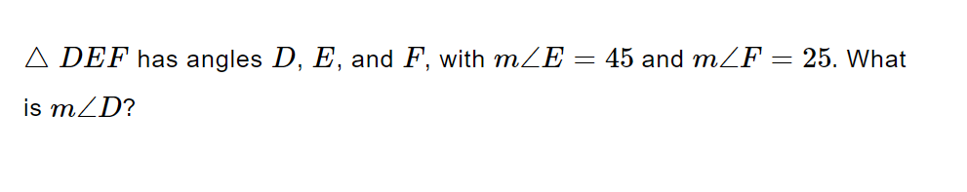
Practice

Slide 20
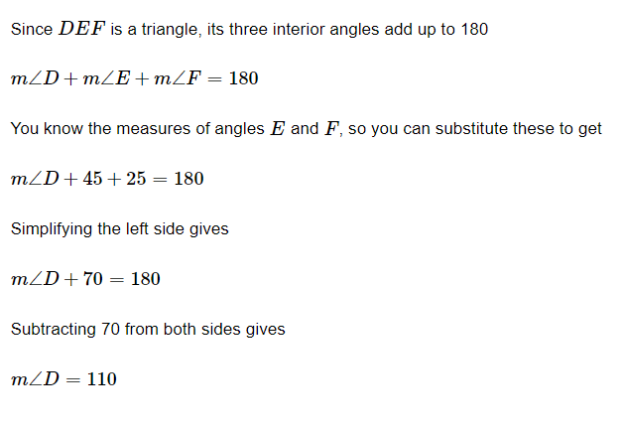
Answer

Slide 21
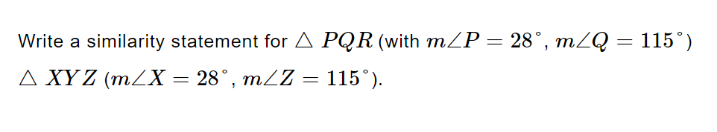
Practice

Slide 22
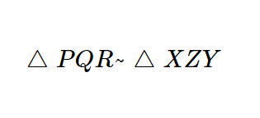
Answer

Slide 23
Summary
In this presentation, we learned about similarity of triangles and AA criterion for similarity.
We learned that informal arguments use visual aids and observations to explain mathematical concepts.
We learned how to use informal arguments to show AA criterion for similarity.
We also practiced using informal arguments to show AA criterion for similarity.

