Slide 1
Solving with Elimination
Math 8B Unit 6 Lesson 5
Notes:
Hello everyone! Today we will be learning how to solve systems of two linear equations in two variables using elimination with multiplication. This method is very useful in solving real-world problems and it's a great addition to your math skills. So, let's get started!

Slide 2

What is a System of Linear Equations in Two Variables?
A system of linear equations in two variables is a set of two equations with two variables.
The equations are linear, which means that the highest power of the variables is one.
The variables are usually x and y, but they can be any letters or symbols.
Notes:
Before we dive into solving systems of linear equations in two variables using elimination with multiplication, let's understand what a system of linear equations in two variables is. A system of linear equations in two variables is a set of two equations with two variables. The equations are linear, which means that the highest power of the variables is one. The variables are usually x and y, but they can be any letters or symbols.

Slide 3
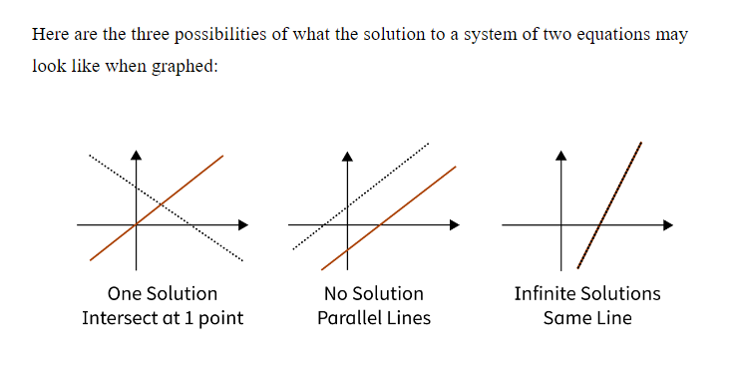

Slide 4

What is Elimination with Multiplication?
Elimination with multiplication is a method of solving systems of linear equations in two variables.
The goal is to eliminate one of the variables by multiplying one or both equations by a constant.
The constant is chosen in such a way that when the two equations are added, one of the variables is eliminated.
Notes:
Now that we know what a system of linear equations in two variables is, let's learn about elimination with multiplication. Elimination with multiplication is a method of solving systems of linear equations in two variables. The goal is to eliminate one of the variables by multiplying one or both equations by a constant. The constant is chosen in such a way that when the two equations are added, one of the variables is eliminated.

Slide 5
Step-by-Step Process of Elimination with Multiplication
Step 1: Rearrange the equations so that the variables line up vertically.
1
Step 2: Decide which variable to eliminate and multiply one or both equations by a constant.
2
Step 3: Add the two equations to eliminate the chosen variable.
3
Step 4: Solve for the remaining variable.
4
Step 5: Substitute the value of the remaining variable into one of the original equations and solve for the other variable.
5
Step 6: Check your answer by substituting the values of both variables into both original equations.
6
Notes:
Now that we understand the concept of elimination with multiplication, let's go through the step-by-step process of solving systems of linear equations in two variables using this method. Step 1: Rearrange the equations so that the variables line up vertically. Step 2: Decide which variable to eliminate and multiply one or both equations by a constant. Step 3: Add the two equations to eliminate the chosen variable. Step 4: Solve for the remaining variable. Step 5: Substitute the value of the remaining variable into one of the original equations and solve for the other variable. Step 6: Check your answer by substituting the values of both variables into both original equations.

Slide 6

Example Problem
Solve the system of linear equations in two variables using elimination with multiplication:
2x + 3y = 11
4x - y = 19
Notes:
Let's try applying elimination with multiplication to solve an example problem. Solve the system of linear equations in two variables using elimination with multiplication: 2x + 3y = 11 and 4x - y = 19.

Slide 7
Solution to Example Problem
Step 1: Rearrange the equations so that the variables line up vertically.
2x + 3y = 11
4x - y = 19
Step 2: Decide which variable to eliminate and multiply one or both equations by a constant.
Multiply the first equation by 2 to get 4x + 6y = 22.
Step 3: Add the two equations to eliminate the chosen variable.
4x + 6y = 22
4x - y = 19
7y = 3
y = 3/7
Step 4: Solve for the remaining variable.
Substitute y = 3/7 into either equation to get x = 25/7.
Step 5: Substitute the values of both variables into both original equations to check the answer.
Notes:
Here's the solution to the example problem we just solved. Step 1: Rearrange the equations so that the variables line up vertically. 2x + 3y = 11 and 4x - y = 19. Step 2: Decide which variable to eliminate and multiply one or both equations by a constant. Multiply the first equation by 2 to get 4x + 6y = 22. Step 3: Add the two equations to eliminate the chosen variable. 4x + 6y = 22 and 4x - y = 19. 7y = 3 and y = 3/7. Step 4: Solve for the remaining variable. Substitute y = 3/7 into either equation to get x = 25/7. Step 5: Substitute the values of both variables into both original equations to check the answer.

Slide 8
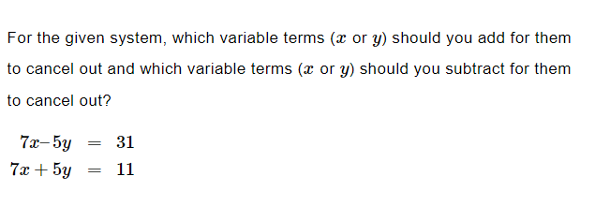
Practice

Slide 9

Answer

Slide 10
Systems of Equations with No Solutions or Infinite Solutions
Sometimes System of Equations have no solutions. Sometimes they have infinite amounts of solutions.

Slide 11
Example Problem
Solve the system of linear equations:
8x + 4y = 32
-8x – 4y = 32
Notes:
Let's try applying elimination with multiplication to solve an example problem.

Slide 12
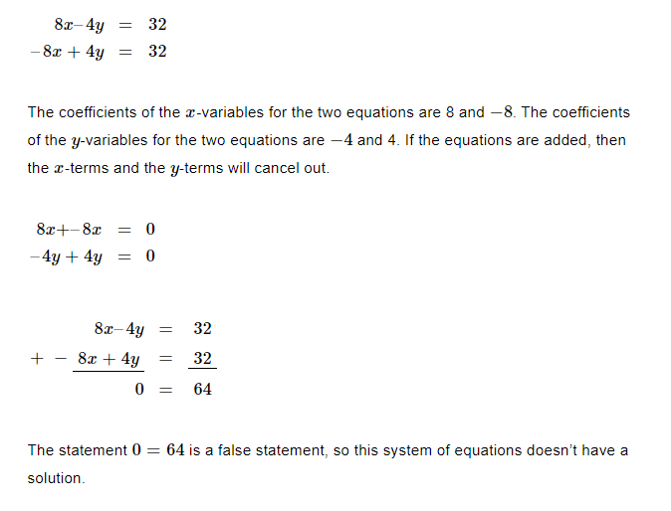
Solution to Example Problem

Slide 13

Summary
Define system of linear equations in two variables.
Use step-by-step process of elimination with multiplication.
System of equations with no solutions.
System of equations with infinite solutions.
Notes:
This presentation covered the basics of solving a system of linear equations in two variables using elimination with multiplication. We learned what a system of linear equations is, how to use the elimination with multiplication method, and the step-by-step process for solving these systems. Understanding these concepts can help in solving real-life problems involving linear equations.

