Slide 1
Equations of Linear Functions
Math 8B Unit 8 Lesson 7
Notes:
Welcome to our lesson about Linear Functions. Today, we'll be learning about linear equations and graphs. You might be wondering what exactly a linear function is. We'll get to that very soon!

Slide 2

What is a linear function?
A linear function is a function where the rate of change is constant.
The equation for a linear function is y = mx + b.
In the equation, m is the slope of the line and b is the y-intercept.
The slope of the line is the change in y divided by the change in x.
The y-intercept is the point at which the line crosses the y-axis.
Notes:
Now let's dive into linear functions. One way to think about it is as a straight line on a graph that has a constant rate of change. The equation for a linear function is y = mx + b, where m is the slope of the line and b is the y-intercept. The slope of the line is the change in y divided by the change in x. The y-intercept is the point at which the line crosses the y-axis. Let's take a look at some examples.

Slide 3
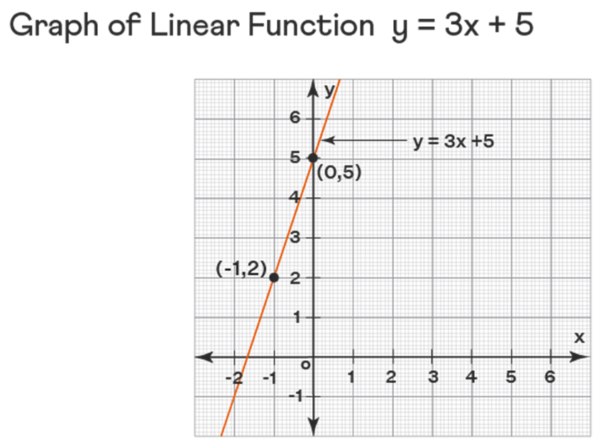
Graphing a linear function
To graph a linear function, we need to plot the y-intercept first.
From there, we use the slope to find another point on the line.
We can then draw a straight line through these two points.
The resulting graph will be a straight line.
The slope of the line can tell us a lot about the function.
Notes:
Now that we know what a linear function is, let's talk about how to graph one. First, we plot the y-intercept on the graph. From there, we use the slope to find another point on the line. We can then draw a straight line through these two points, and the resulting graph will be a straight line. The slope of the line can tell us a lot about the function, such as if it's increasing or decreasing.

Slide 4

Real-life examples
There are many real-life examples of linear functions.
For example, the cost of a taxi ride might be modeled by a linear function.
The distance a car can travel on a tank of gas might also be a linear function.
Linear functions are very useful in many areas of life!
Can you think of any other examples of linear functions?
Notes:
Linear functions are everywhere in the world around us! For example, the cost of a taxi ride might be modeled by a linear function, with the fixed starting cost being the y-intercept. The distance a car can travel on a tank of gas might also be a linear function, with the slope being the miles per gallon. Linear functions are very useful in many areas of life, and it's important to be able to recognize them.

Slide 5
Summary
A linear function is a function where the rate of change is constant.
1
The equation for a linear function is y = mx + b, where m is the slope and b is the y-intercept.
2
To graph a linear function, we plot the y-intercept and use the slope to find another point.
3
The resulting graph is a straight line.
4
Linear functions are everywhere in the world around us and are very useful!
5
Notes:
In conclusion, today we learned about linear functions and how to identify and graph them. We've learned that a linear function is a function where the rate of change is constant and that the equation for a linear function is y = mx + b. To graph a linear function, we plot the y-intercept and use the slope to find another point, resulting in a straight line. Linear functions are everywhere in the world around us and are very useful!

Slide 6
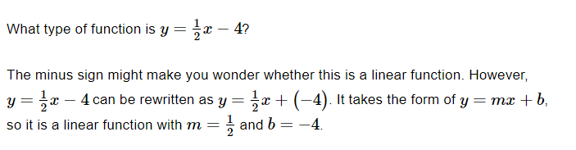
Example 1

Slide 7
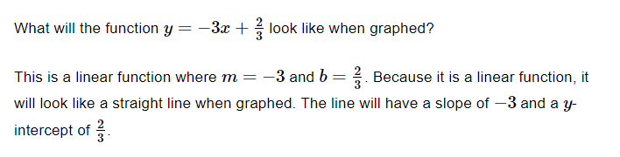
Example 2

Slide 8
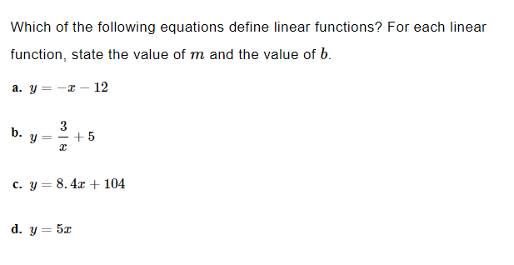
Practice

Slide 9
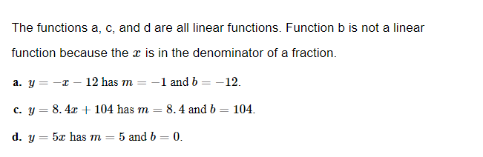
Answer

Slide 10
Writing the Equation of a Linear Function from a Table
To write the equation of a linear function from a table, we need to find the slope and y-intercept.
The slope is given by the change in y divided by the change in x (rise over run).
The y-intercept is the value of y when x is zero.
Once we have the slope and y-intercept, we can write the equation as y = mx + b.
Notes:
In this slide, we will explain to the students how to write the equation of a linear function from a table of x and y values. We will show them how to calculate the slope and y-intercept from the data, and how to use them to write the equation.

Slide 11
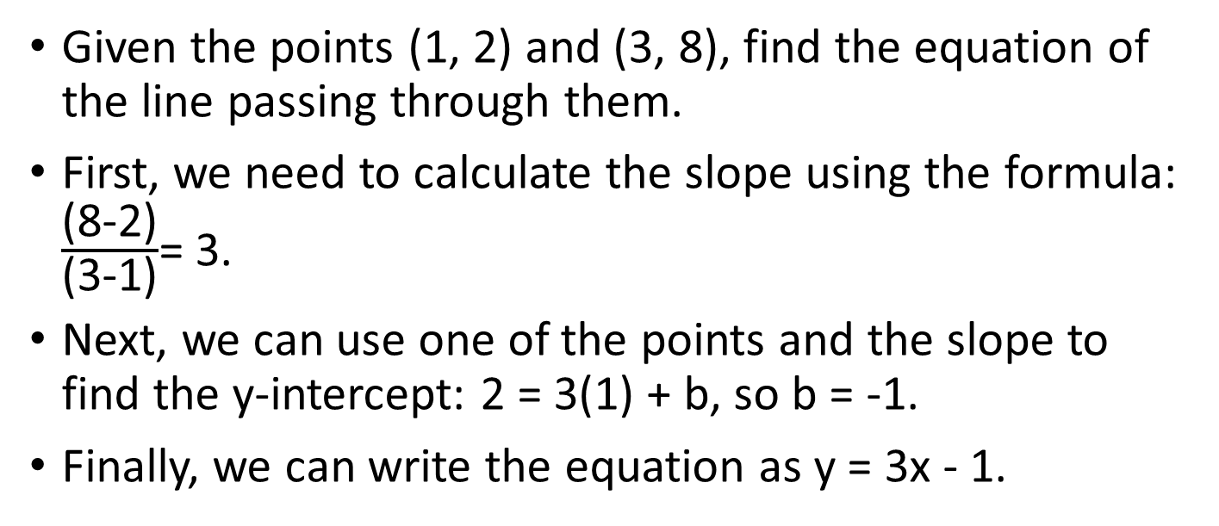
Example 1
Given the points (1, 2) and (3, 8), find the equation of the line passing through them.
First, we need to calculate the slope using the formula: $\frac{\text{(8-2)}}{\text{(3-1)}}$= 3.
Next, we can use one of the points and the slope to find the y-intercept: 2 = 3(1) + b, so b = -1.
Finally, we can write the equation as y = 3x - 1.
Notes:
In this slide, we will provide an example to the students to practice writing the equation of a linear function from two given points. We will show them the steps involved in finding the slope and y-intercept and how to use them to write the equation.

Slide 12
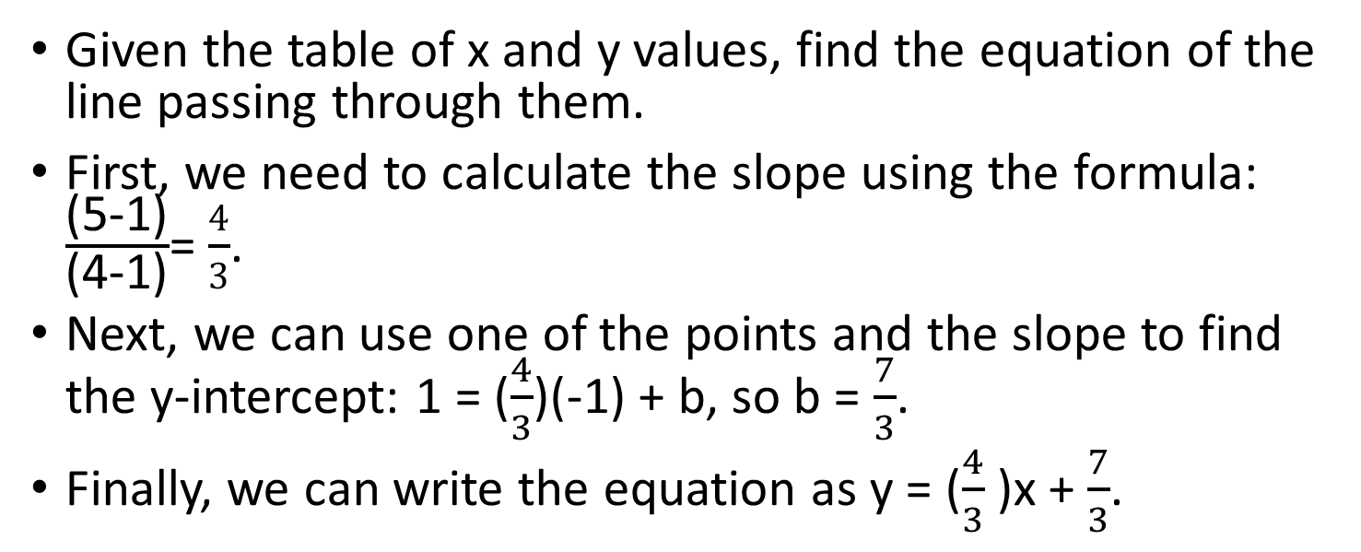
Example 2
Given the table of x and y values, find the equation of the line passing through them.
First, we need to calculate the slope using the formula: $\frac{\text{(5-1)}}{\text{(4-1)}}$= $\frac{4}{3}$.
Next, we can use one of the points and the slope to find the y-intercept: 1 = ($\frac{4}{3}$)(-1) + b, so b = $\frac{7}{3}$.
Finally, we can write the equation as y = ($\frac{4}{3}$)x + $\frac{7}{3}$.
Notes:
In this slide, we will provide another example to the students to practice writing the equation of a linear function from a given table of x and y values. We will show them the steps involved in finding the slope and y-intercept and how to use them to write the equation.

Slide 13
Practice
Now it's your turn to practice writing the equation of a linear function!
Use the given data to find the slope and y-intercept, and then write the equation.
Data set 1: (2, 5) and (6, 11)
Data set 2: (3, 4) and (7, 9)
Notes:
In this slide, we will provide two practice problems for the students to solve. We will give them the data sets and ask them to find the slope and y-intercept, and then write the equation of the line passing through the points.

Slide 14
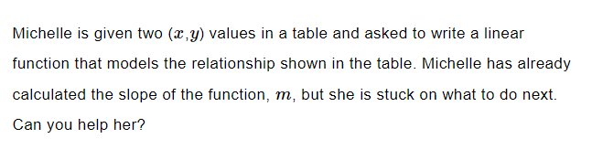
Practice

Slide 15
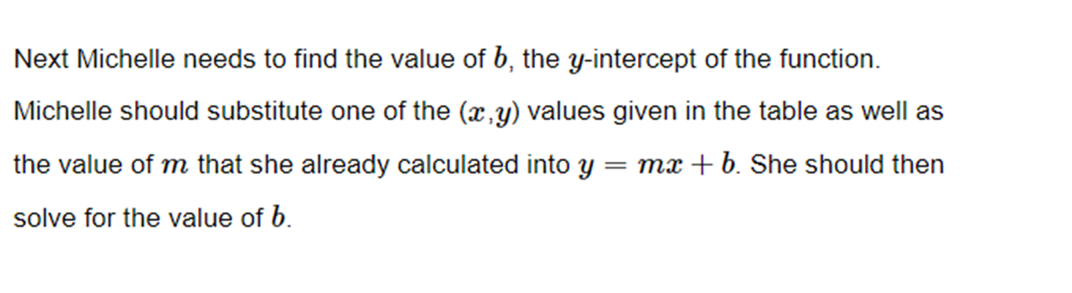
Answer

Slide 16
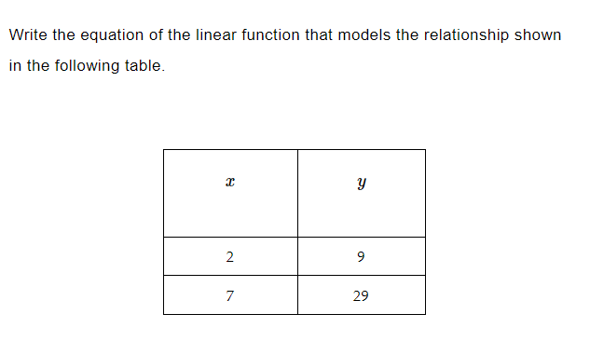
Practice
Practice

Slide 17

Answer

Slide 18
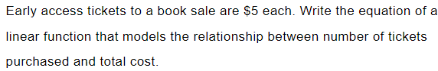
Practice

Slide 19

Answer
Answer

Slide 20
Review: Describing the relationship between two quantities
A linear function has a constant rate of change between two variables
This means that as one variable changes by a certain amount, the other variable changes by a consistent amount
The equation for a linear function is y = mx + b, where m is the slope and b is the y-intercept
Notes:
In this slide, we'll introduce students to linear functions and describe how they model the relationship between two quantities.

Slide 21
Review: Writing the equation of a linear function from two points
To write the equation of a linear function from two points, we need to find the slope of the line between them
The slope is the change in y divided by the change in x
Once we have the slope, we can use one of the points and the slope to find the y-intercept
Finally, we can write the equation in slope-intercept form: y = mx + b
Notes:
In this slide, we'll show students how to write the equation of a linear function given two points on the line.

Slide 22
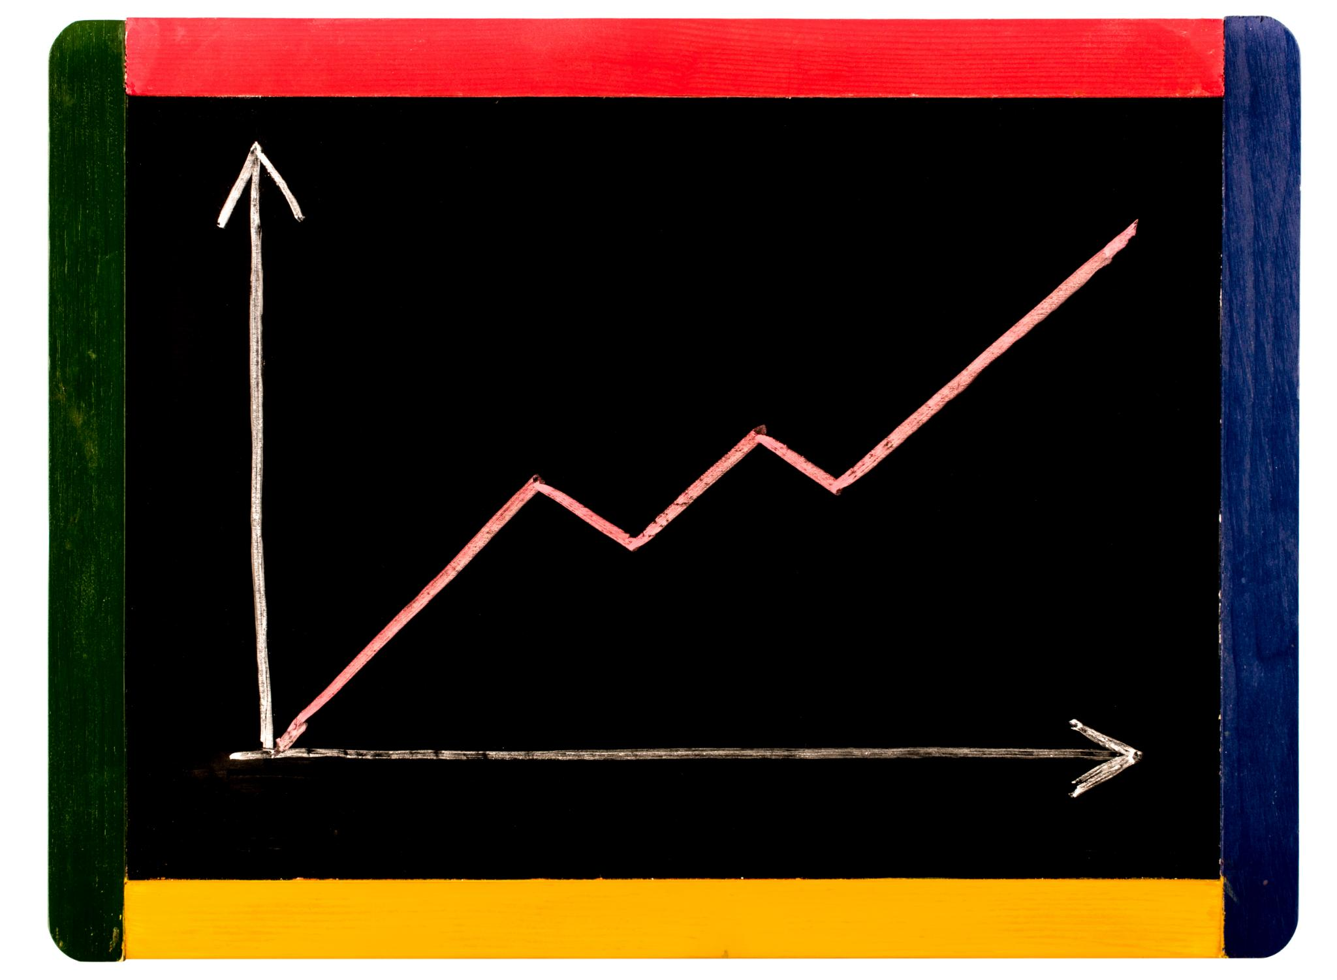
Review: Writing the equation of a linear function from a graph
To write the equation of a linear function from a graph, we need to find the slope of the line
We can find the slope by picking two points on the line and using the slope formula
Once we have the slope, we can use the y-intercept from the graph to write the equation in slope-intercept form: y = mx + b
Notes:
In this slide, we'll show students how to write the equation of a linear function given a graph of the line.

Slide 23
Summary
In this presentation, we learned what a linear function is, how to graph it, and how to write its equation from a table of data.
We also worked through some examples and practice problems to reinforce our understanding of the concept.
Remember, a linear function is a powerful tool for modeling the relationship between two variables in real-life situations.
Notes:
In this slide, we will summarize the key points covered in the presentation and remind the students of the importance of linear functions in real-life situations.

