Slide 1
Slope and y-intercepts
Math 8B Unit 8 Lesson 4
Notes:
Welcome to this presentation on linear functions. In this presentation, you will learn how to determine the initial value and rate of change for a linear function given a description of the relationship between the two quantities. Linear functions are used extensively in mathematics as well as science and engineering, so understanding how to work with them is an important skill to have.

Slide 2
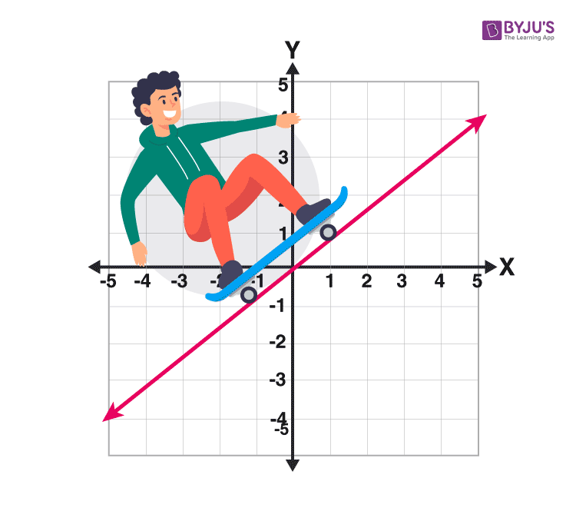
What are Linear Functions?
A linear function is a type of function that can be graphed as a straight line.
It has a constant rate of change and a fixed initial value.
Linear functions can be expressed in the form y = mx + b, where m is the slope or rate of change, and b is the initial value or y-intercept.
Notes:
To understand how to determine the initial value and rate of change for a linear function, it is important to first understand what a linear function is. A linear function is a type of function that can be graphed as a straight line. It has a constant rate of change and a fixed initial value. Linear functions can be expressed in the form y = mx + b, where m is the slope or rate of change, and b is the initial value or y-intercept.

Slide 3
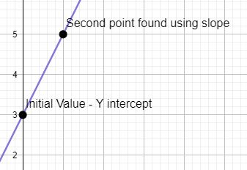
Initial Value
The initial value is the value b in the linear function; also known as the y-intercept or where the graph intersects the y-axis.
To determine the initial value, you can look at the graph or use the formula y = mx + b.
If you know two points on the graph, you can use the point-slope formula to find the equation of the line and then identify the initial value.
Notes:
Now that you understand what a linear function is, let's learn how to determine the initial value. The initial value of a linear function is the y-intercept or where the graph intersects the y-axis. To determine the initial value, you can look at the graph or use the formula y = mx + b. If you know two points on the graph, you can use the point-slope formula to find the equation of the line and then identify the initial value.

Slide 4

Rate of Change
The value m in the linear function y = mx + b; Also called the slope of a linear function
To determine the rate of change, you can use the formula (y2 - y1) / (x2 - x1) where (x1, y1) and (x2, y2) are two points on the line.
You can also use the slope-intercept form of the equation, y = mx + b, to identify the rate of change.
Notes:
In addition to the initial value, it is also important to know how to determine the rate of change of a linear function. The rate of change of a linear function is the slope or steepness of the line. To determine the rate of change, you can use the formula (y2 - y1) / (x2 - x1) where (x1, y1) and (x2, y2) are two points on the line. You can also use the slope-intercept form of the equation, y = mx + b, to identify the rate of change.

Slide 5
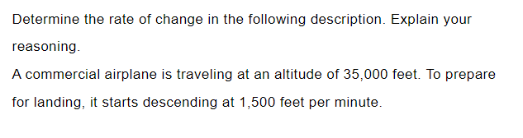
Practice
Y = mx + b

Slide 6
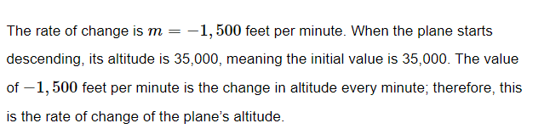
Answer

Slide 7
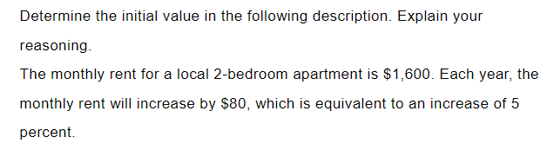
Practice
Y = mx + b

Slide 8
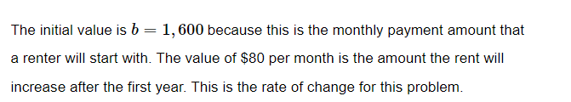
Answer

Slide 9
Given Two Values
Identify the two values
Use the formula: m= $\frac{y2−y1}{x2−x1}$
Use the formula: m= (𝑦2−𝑦1)/(𝑥2−𝑥1)
The result is the rate of change
Notes:
Given two values, you can identify the rate of change by using the formula (y2 - y1) / (x2 - x1).

Slide 10

Finding Initial Value
Identify one of the points (x, y)
Substitute the values into y = mx + b
Solve for b (the initial value)
Notes:
To find the initial value, substitute one of the points (x, y) into y = mx + b and solve for b (the initial value).

Slide 11
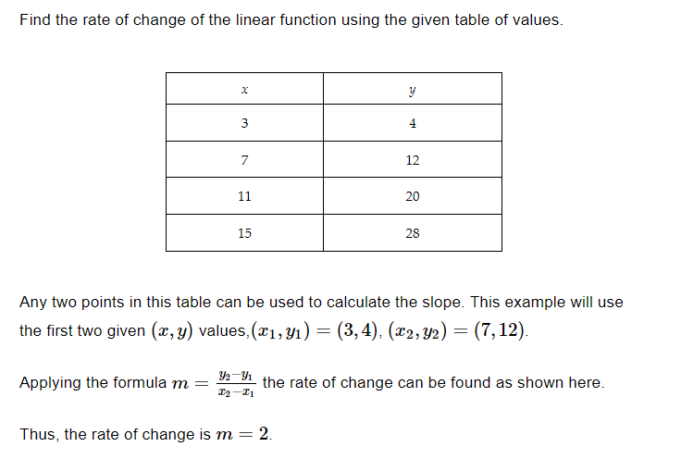
Example

Slide 12
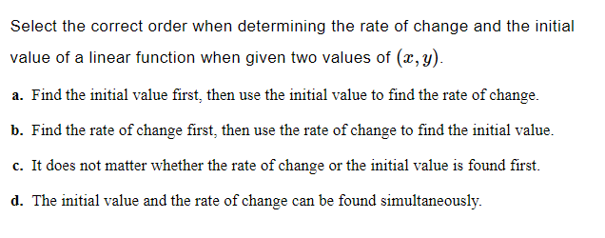
Practice

Slide 13

Answer

Slide 14
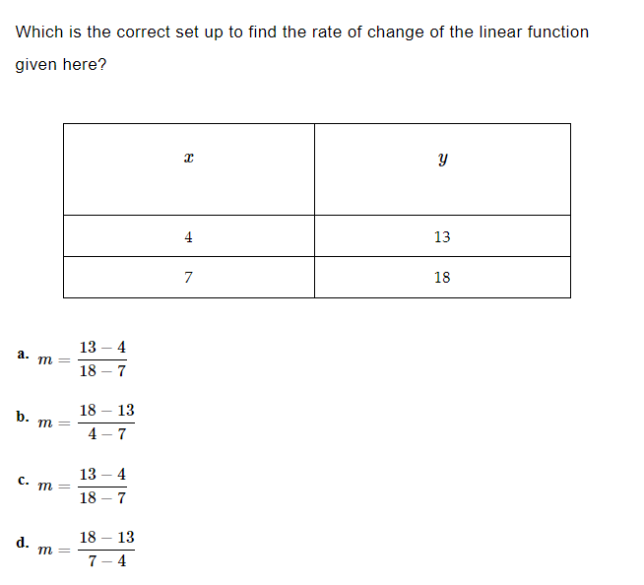
Practice

Slide 15

Answer

Slide 16
Geogebra
Rate of Change demo: https://www.geogebra.org/m/WPwpXMwp
Determine the rate of change: https://www.geogebra.org/m/rkysy8YN
Understanding rate of change: https://www.geogebra.org/m/tyzrhyhR
Calculate rate of change: https://www.geogebra.org/m/AhVFBpEY

Slide 17
Summary
Linear functions are functions that can be graphed as a straight line
Linear functions have a constant rate of change and a fixed initial value
The initial value of a linear function is the y-intercept
The rate of change of a linear function is the slope of the line
Practice problems help to understand the concepts of linear functions
Geogebra helps to visually understand the concepts of linear functions

