Slide 1
Proportional Relationships
Math 8B Unit 5 Lesson 2
Notes:
In math, a ratio is a comparison of two or more quantities. A ratio can be used to describe the relationship between two numbers, such as the ratio of boys to girls in a classroom or the ratio of apples to oranges in a basket.

Slide 2
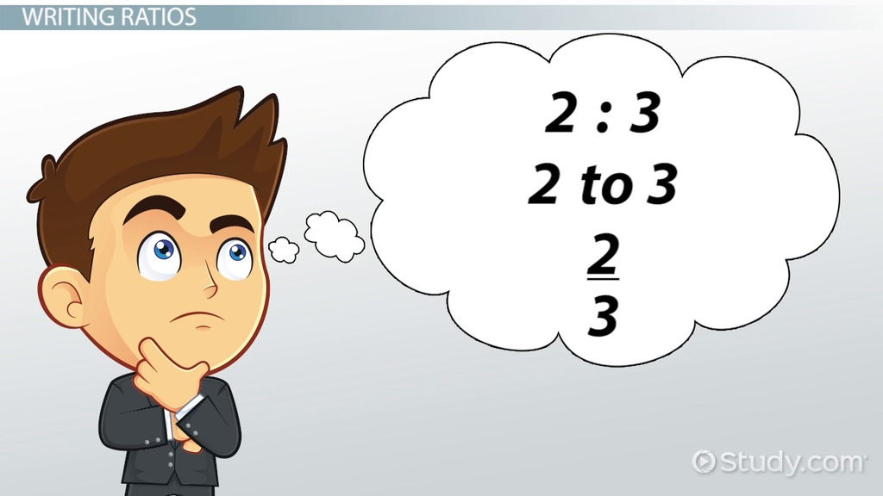
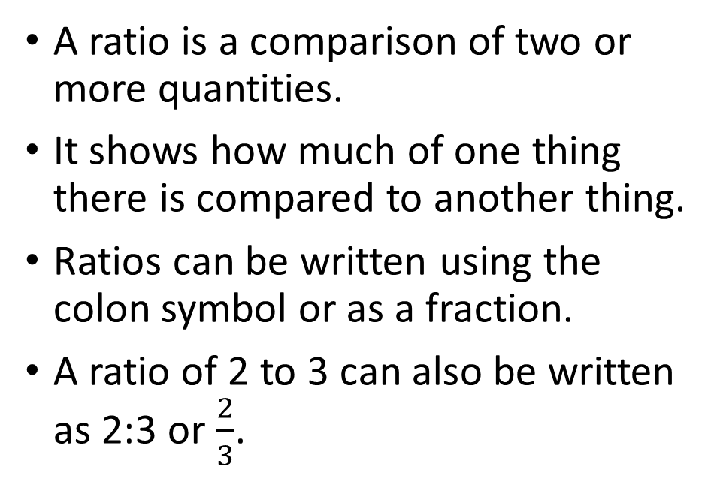
What is a Ratio?
A ratio is a comparison of two or more quantities.
It shows how much of one thing there is compared to another thing.
Ratios can be written using the colon symbol or as a fraction.
A ratio of 2 to 3 can also be written as 2:3 or $\frac{2}{3}$.
Notes:
In mathematics, a ratio is used to compare two or more quantities. This can be very useful when analyzing data or solving problems. A ratio can be written using the colon symbol (:) or as a fraction. It is important to remember that ratios compare two or more quantities, so both sides of the ratio must be measured in the same units.

Slide 3
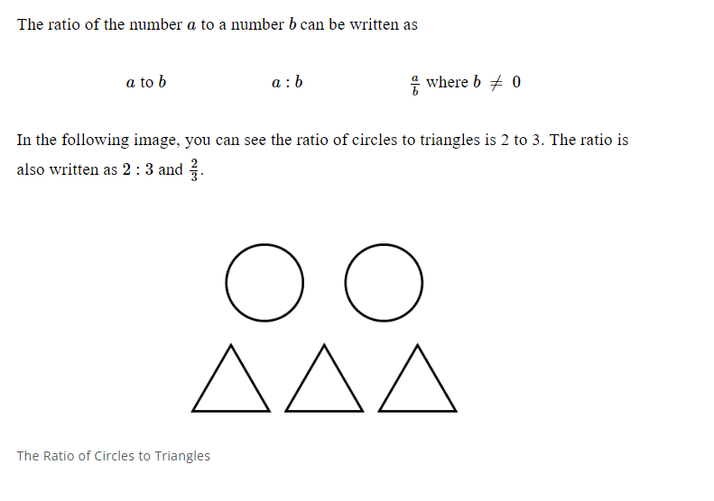
Writing a Ratio
A ratio can be written using a colon.
The order of the ratio matters.
Ratios should be simplified to their lowest terms.
Notes:
When writing a ratio, we use a colon to separate the two numbers. For example, if there are 20 boys and 15 girls in a classroom, we can write the ratio of boys to girls as 20:15 or 20/15. It is important to write the numbers in the correct order, as the ratio of girls to boys would be 15:20. Ratios should always be simplified to their lowest terms.

Slide 4
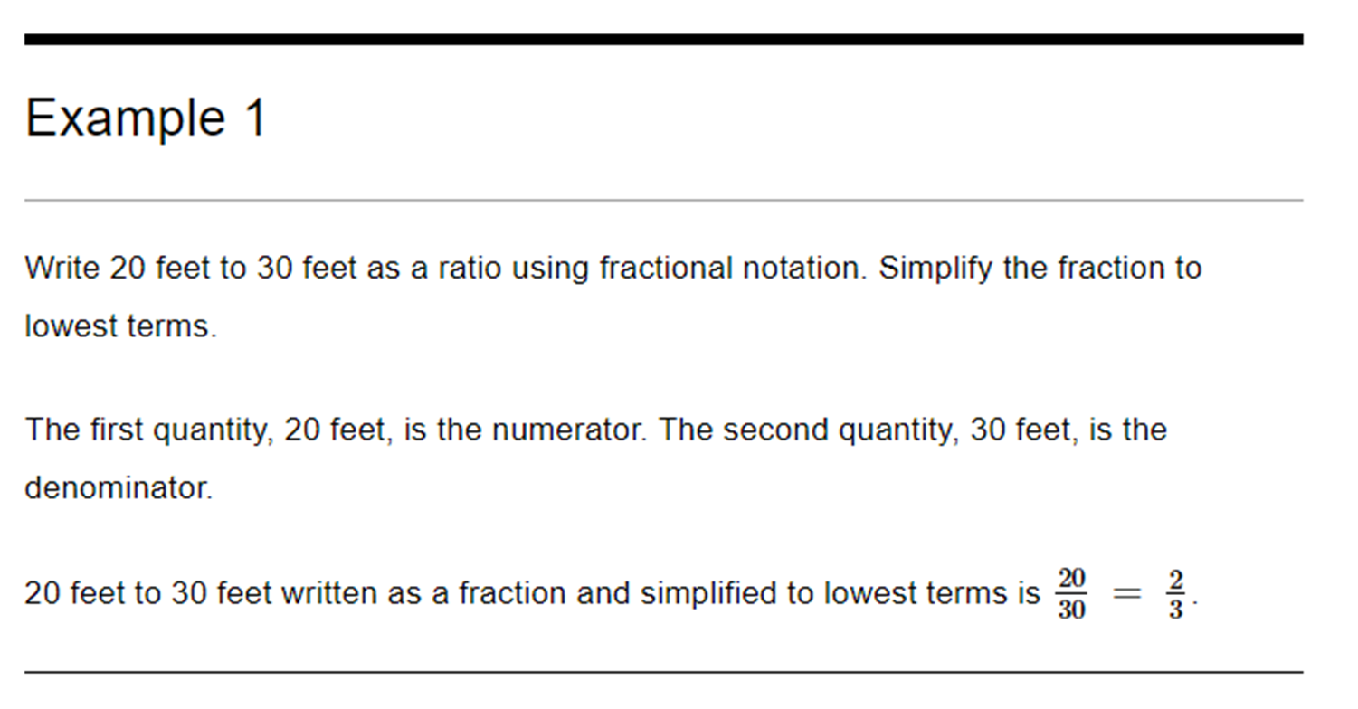
Writing Ratios in Fractional Notation
A ratio can be written as a fraction.
The ratio 2:3 can be written as 2/3
To write a ratio in fractional notation, put the first term in the numerator and the second term in the denominator.
The ratio 4:7 can be written as 4/7
Notes:
For middle school students, it is important to understand ratios in fractional notation as it is an important part of representing the relationship between two quantities in mathematics. This notation helps in simplifying the ratio and making it easier to work with. Encourage students to practice writing ratios in fractional notation so they can master this concept.

Slide 5
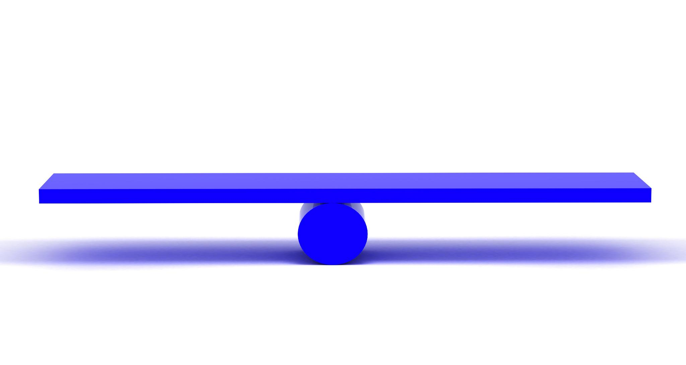
Equivalent Ratios
Equivalent ratios have the same value.
Equivalent ratios can be found by multiplying or dividing both sides by the same number.
Equivalent ratios can be used to compare different quantities.
Notes:
Equivalent ratios have the same value, but may be written differently. For example, the ratios 2:3 and 4:6 are equivalent, as they both represent the same relationship between two quantities. To find an equivalent ratio, we can multiply or divide both sides by the same number. Equivalent ratios can be useful when comparing different quantities.

Slide 6

Ratio Word Problems
Ratio word problems often involve finding a missing value.
Ratio word problems can be solved using cross-multiplication.
It is important to label units when solving ratio word problems.
Notes:
Ratio word problems involve using ratios to solve real-world problems. These problems often involve finding a missing value in a ratio. To solve a ratio word problem, we can use cross-multiplication, where we multiply both sides of the equation by the denominator of the missing value. It is important to label units when solving ratio word problems, such as miles per gallon or dollars per hour.

Slide 7
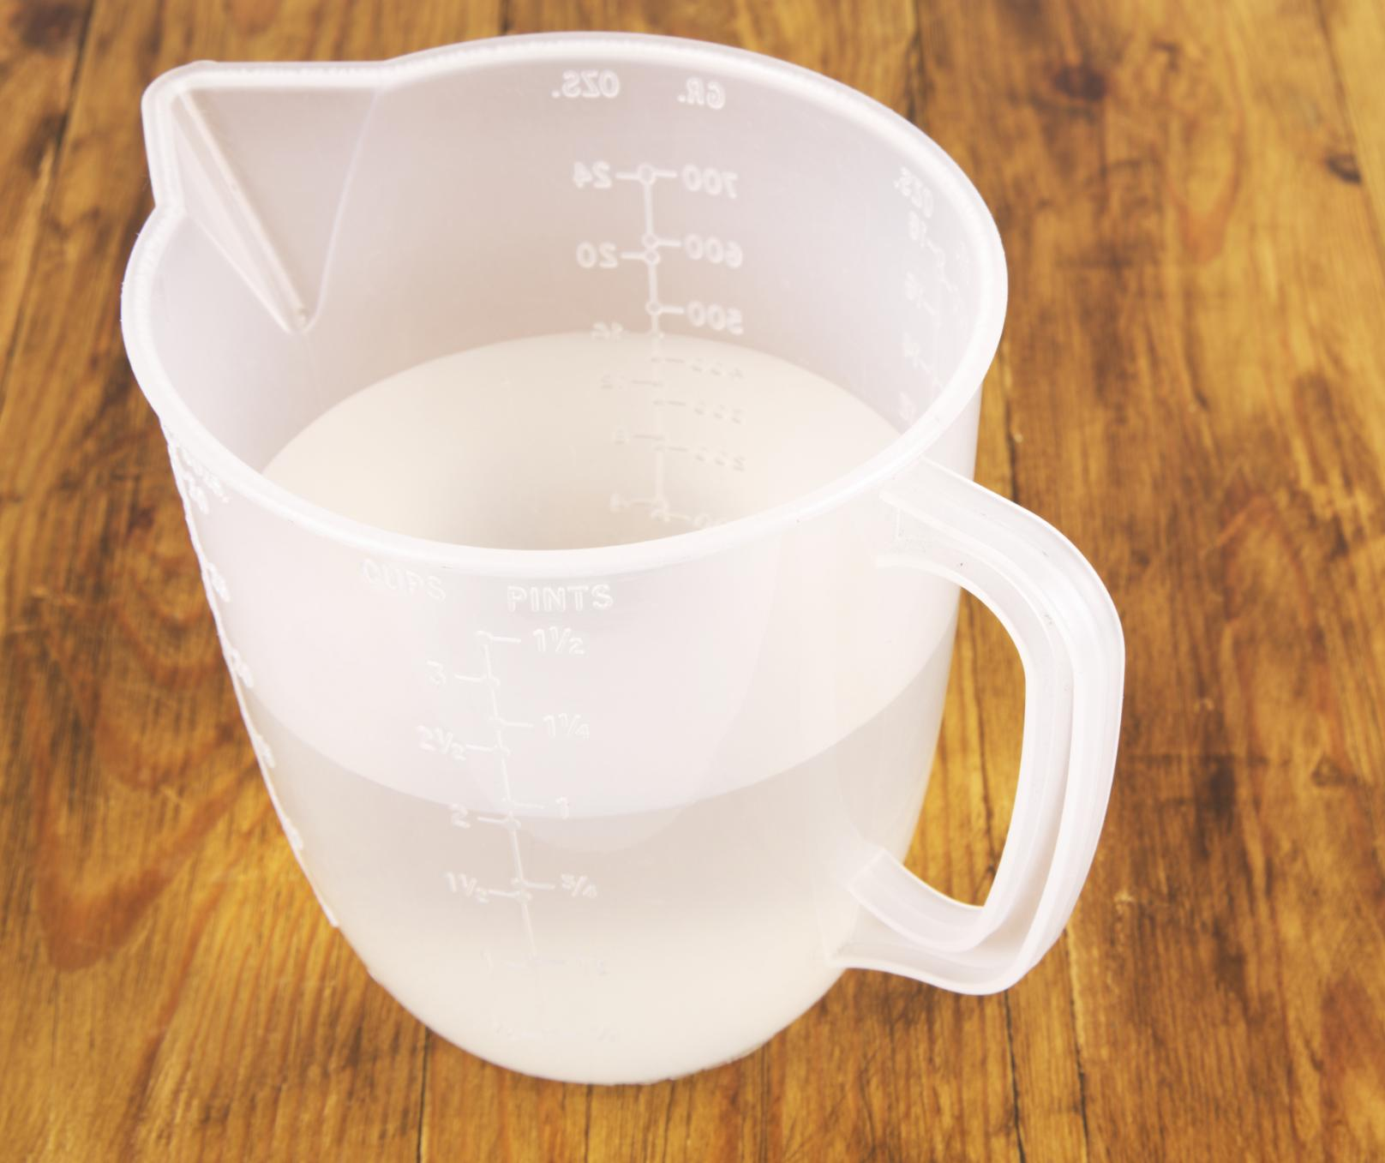
Real World Examples of Ratios
Recipes often use ratios, such as 2 cups of flour to 1 cup of sugar.
The aspect ratio of a TV or computer screen is a ratio of width to height.
Fuel economy in vehicles is measured by the ratio of miles per gallon (mpg).
Notes:
Ratios are used in many everyday situations, especially when comparing two or more quantities. Understanding how to use ratios can help with tasks such as cooking, home improvement, and budgeting.

Slide 8

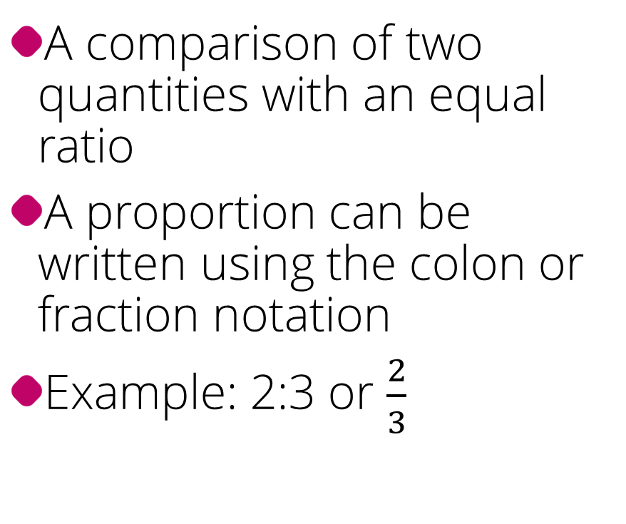
What is a Proportion?
A comparison of two quantities with an equal ratio
A proportion can be written using the colon or fraction notation
Example: 2:3 or $\frac{2}{3}$
Notes:
In mathematics, a proportion is a statement that two ratios are equal. It is often used to compare and solve problems involving ratios.

Slide 9
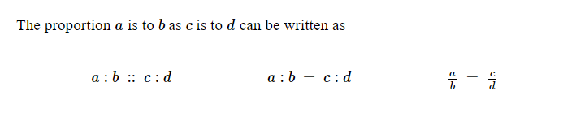
How to Write a Proportion?
Identify the two ratios that are being compared
Write the ratios using the colon or fraction notation
Place an equal sign between the two ratios
Notes:
To write a proportion, you need to compare two ratios that have the same meaning. This can be done by using the colon or fraction notation and placing an equal sign between the two ratios.

Slide 10
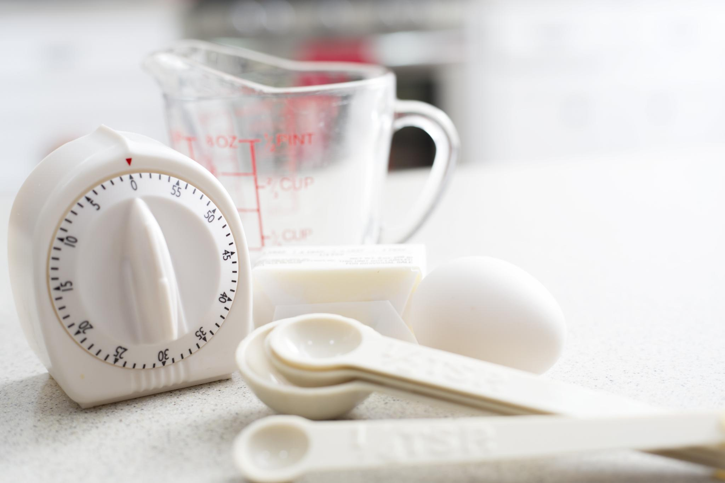
Real World Examples of Proportions
Recipes often use proportions, such as 2 cups of flour to 1 cup of sugar.
The aspect ratio of a TV or computer screen is a proportion of width to height.
Fuel economy in vehicles is measured by the proportion of miles per gallon (mpg).
Notes:
This slide provides real-world examples of proportions that are used in various fields. It is important to understand how proportions work as they are integral to many mathematical concepts.

Slide 11
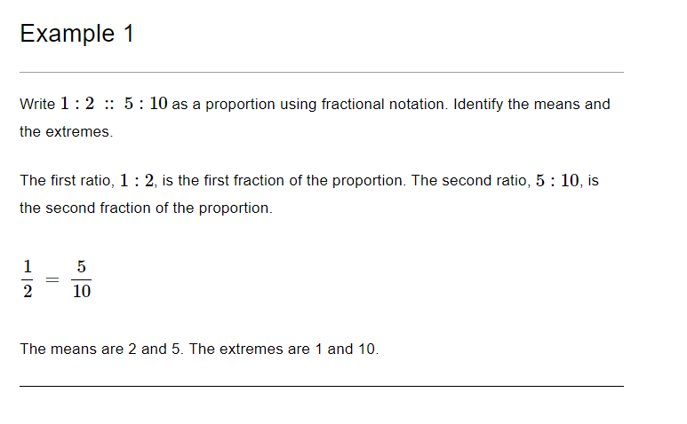
Practice

Slide 12
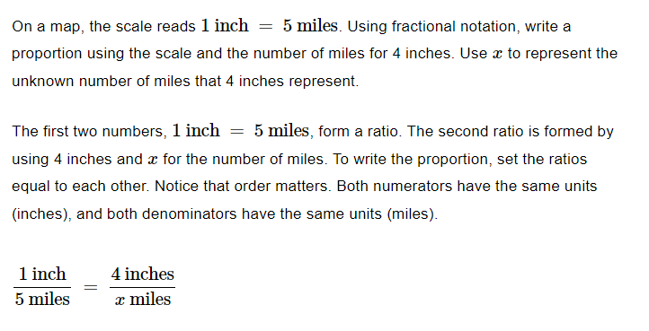
Practice

Slide 13
Determining if two ratios are proportional
Step 1: Write the two ratios in the form of fractions
1
Step 2: Simplify the fractions to their lowest terms
2
Step 3: Compare the simplified fractions to see if they are equal
3
Notes:
To determine if two ratios are proportional, first write the ratios in fractional form. Then, simplify the fractions to their lowest terms. Finally, compare the simplified fractions to see if they are equal. If they are equal, the ratios are proportional.

Slide 14
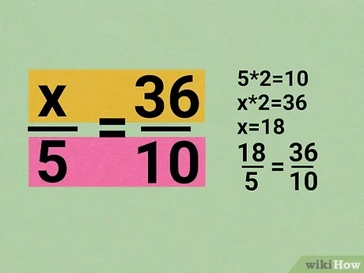
How to Solve a Proportion?
Cross-multiply the ratios
Simplify the resulting equation by combining like terms
Solve for the unknown variable
Notes:
To solve a proportion, cross-multiply the two ratios and simplify the resulting equation. Then solve for the unknown variable. Remember to check your solution by plugging it back into the original proportion.

Slide 15

Cross-Multiplication
Cross-multiplication is a method used to solve proportions.
Cross-multiplication is a shortcut method for solving proportion problems.
It involves multiplying the numerator of one ratio with the denominator of the other ratio, and then setting the two products equal.
The result is a simple equation that can be solved for the missing value.
Notes:
When solving proportion problems, cross-multiplication can save time and provide a quick solution. However, it's important to understand how cross-multiplication works conceptually, rather than relying on it as a memorized formula.

Slide 16
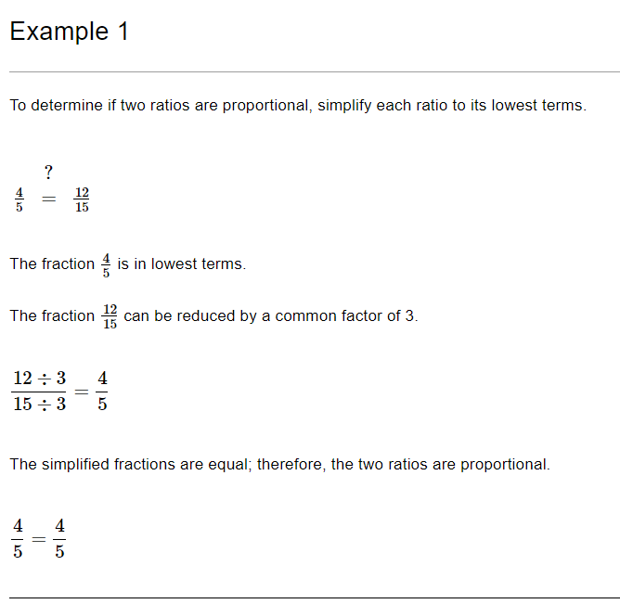
Practice

Slide 17
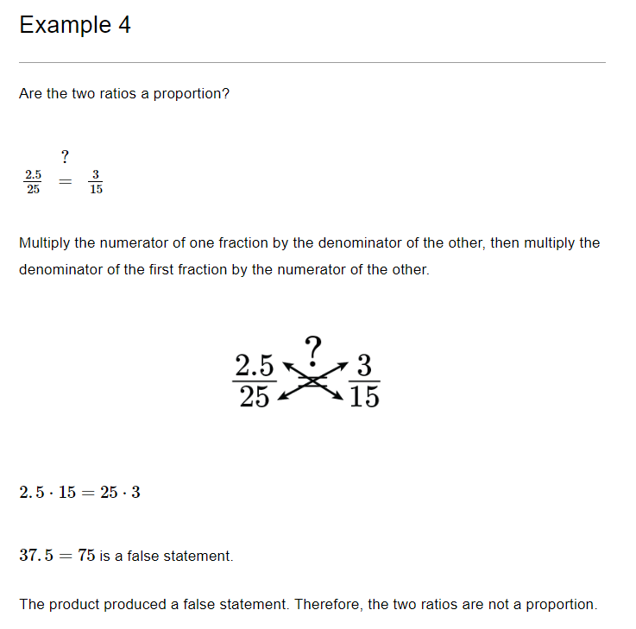
Practice

Slide 18

Summary
How to Make a Ratio
Equivalent Ratios
Determining if two ratios are proportional

