Slide 1

Graphing Proportional Relationships
Math 8B Unit 5 Lesson 4
Notes:
Hello everyone, today we are going to learn how to derive the equation y = mx for a line through the origin. It's a simple equation that describes a straight line. Before we begin, let's first understand what is a straight line.

Slide 2
Key Words
Linear equation – an equation where all the variables are to the first power; its graph forms a straight line.
Proportional Relationship – a relationship in which two or more quantities have a constant ratio.
Slope – the ratio of the change in y to the change in x

Slide 3
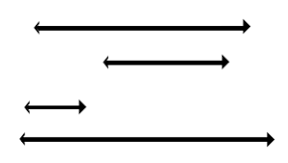
What is a Straight Line?
Straight lines have no curves
Straight lines do not change direction
Notes:
A straight line is the shortest distance between two points. It has no curves and does not change direction. We can also say that it has a constant angle with respect to the x-axis.

Slide 4

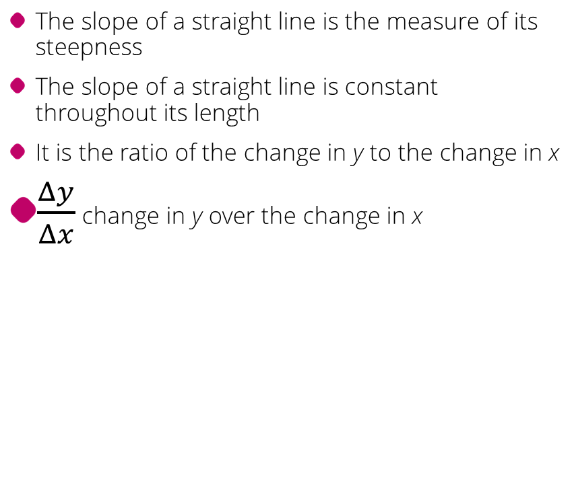
Slope of a Straight Line
The slope of a straight line is the measure of its steepness
The slope of a straight line is constant throughout its length
It is the ratio of the change in y to the change in x
$\frac{Δy}{Δx}$ change in y over the change in x
Notes:
The steepness of a straight line is measured by its slope. The slope is constant throughout the length of the line. It is defined as the ratio of the change in y to the change in x. It is denoted by the letter m.

Slide 5

Equation of a Straight Line
The equation of a straight line is y = mx
m is the slope of the line
Notes:
The equation of a straight line is given by y = mx, where m is the slope of the line. If we know the slope of a line, we can easily write its equation. Let's see how to do that.

Slide 6
Deriving the Equation y = mx
Choose any two points on the line
Find the slope of the line
Write the equation y = mx
Notes:
To derive the equation y = mx, we need to choose any two points on the line. Let's call these points (x1, y1) and (x2, y2). The slope of the line passing through these two points is given by (y2 - y1) / (x2 - x1). Let's call this slope m. Therefore, the equation of the line is y - y1 = m(x - x1). We can simplify this equation to y = mx - mx1 + y1. Since the line passes through the origin, we have y1 = 0 and x1 = 0. Hence, y = mx is the equation of the line.

Slide 7

Practice Exercise
Choose any two points on a line passing through the origin
Find the slope of the line
Write the equation y = mx
Notes:
Now that we have learned how to derive the equation y = mx for a line through the origin, let's do a practice exercise. Choose any two points on a line passing through the origin, find the slope of the line, and write its equation in the form y = mx.

Slide 8
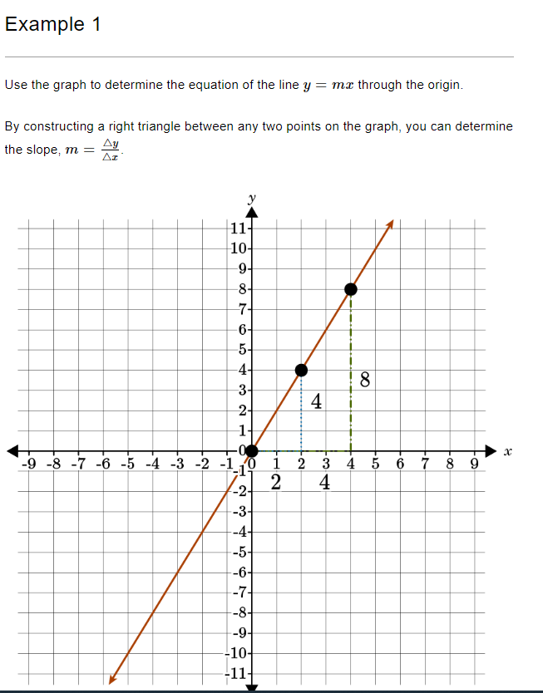

Slide 9
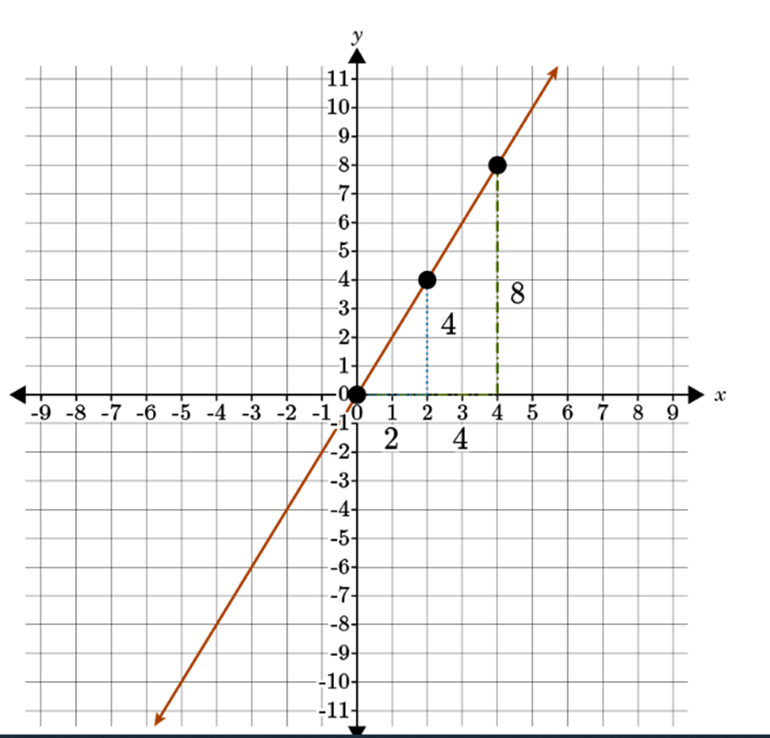
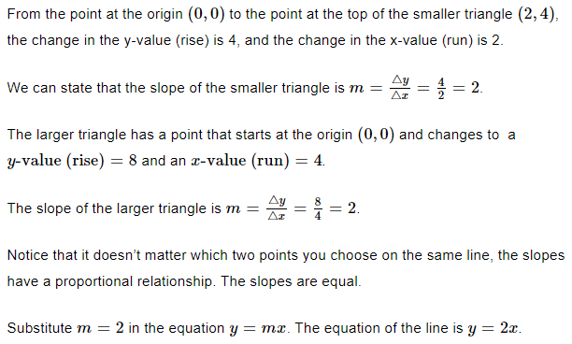

Slide 10
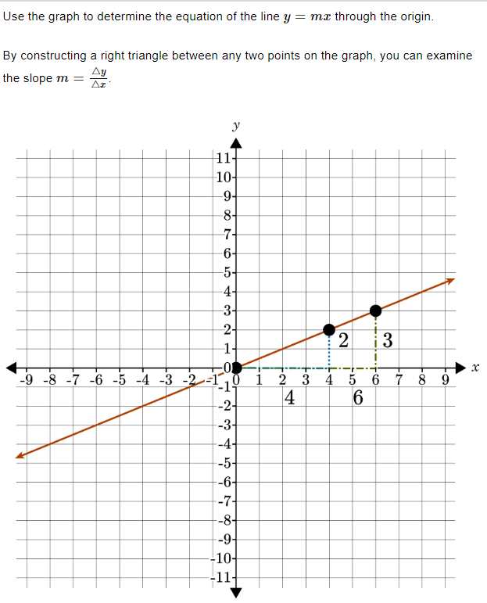

Slide 11
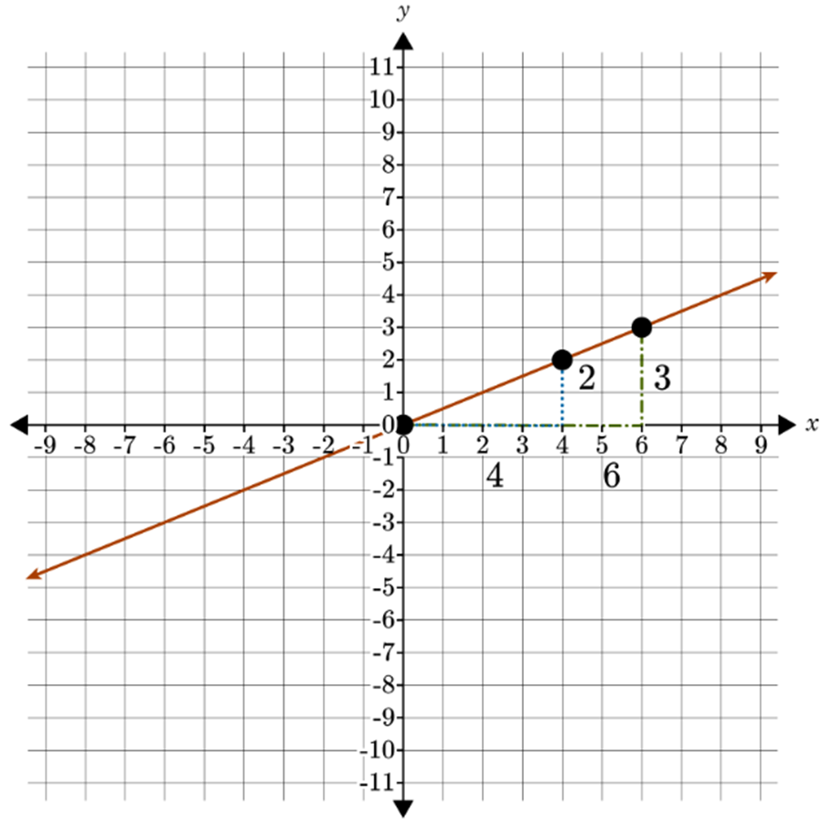
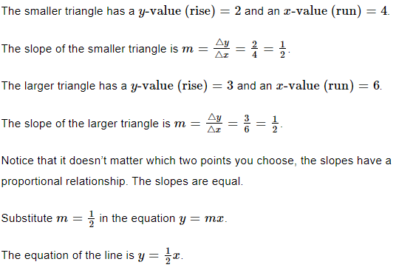

Slide 12

Distance-Time Graph
Distance-time graphs are used to show the distance covered in a journey over a period of time
They are commonly used in physics
The slope of the line in a distance-time graph represents speed
The area under the line in a distance-time graph represents the total distance covered during the journey
Notes:
This graph is commonly used in physics and engineering. One practical example of using a distance-time graph is tracking the motion of a moving object. By plotting the distance vs time graph, the speed can be calculated by finding the slope of the graph, and the distance covered can be calculated by finding the area under the graph.

Slide 13

Velocity-Time Graph
Velocity-time graphs are used to show the velocity of an object over a period of time
They are commonly used in physics and engineering
The slope of the line in a velocity-time graph represents the acceleration of the object
The area under the line in a velocity-time graph represents the distance traveled by the object during the journey
Notes:
This graph is commonly used in physics and engineering. One practical example of using a velocity-time graph is tracking the motion of a moving car. By plotting the velocity vs time graph, the acceleration of the car can be calculated by finding the slope of the graph, and the distance traveled can be calculated by finding the area under the graph.

Slide 14
What are Proportional Relationships?
Proportional relationships are relationships between two variables that are always in a constant ratio
For example, the ratio of width to length in a rectangle is always constant

Slide 15

Graphing Proportional Relationships
Proportional relationships are relationships between two variables that are always in a constant ratio
To graph proportional relationships, plot the pairs of values on the coordinate plane and connect the points with a straight line

Slide 16
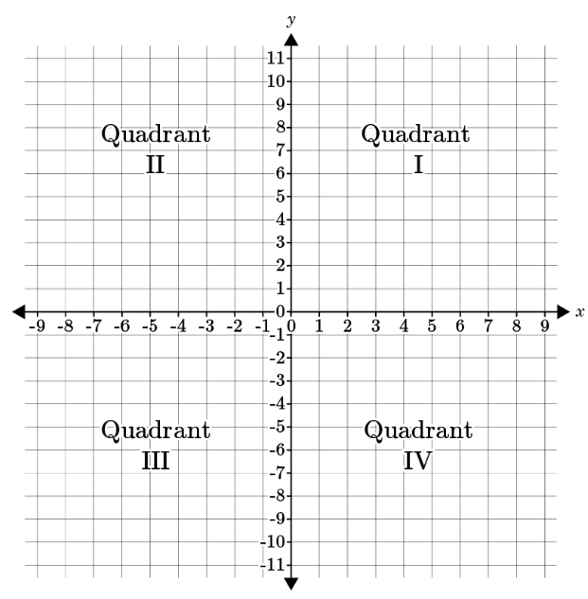
The Coordinate Plane
The coordinate plane is a 2-dimensional system used to locate points
It is formed by two number lines, the x-axis and y-axis, that intersect at the origin
Points on the coordinate plane are represented by their x-coordinate and y-coordinate
The x-coordinate represents the horizontal position and the y-coordinate represents the vertical position
The origin (0,0) is the point where both the x-axis and y-axis intersect
Notes:
In this slide, we will teach middle school students about the coordinate plane. We will cover how to read and plot points on a coordinate plane, how to find coordinates of a point, and how to locate points with given coordinates. We will use examples, images, and exercises to explain the concepts clearly.

Slide 17
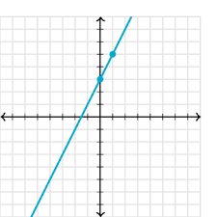
Graphing Using Slope
Graphing using slope involves finding the rise and run between two points on a line and using that ratio to determine the slope of the line.
The slope is the steepness of the line and can be positive, negative, zero or undefined.
To graph a line with a given slope, use the slope to find a second point on the line and then connect the two points to draw the line.
Notes:
When graphing a line, it's important to choose two points that are on the line, so that the line you draw actually represents the line you're trying to graph. If you're given the slope of the line and one point that's on the line, you can find another point by using the slope formula. Once you have two points, you can draw a line through them to represent the graph of the line. Always label the axes and include units of measure when relevant.

Slide 18
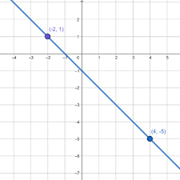
Graphing by Plotting Points
Plotting points on a coordinate plane helps in graphing
We need two numbers to name a point on a coordinate plane: an x-coordinate and a y-coordinate
The x-coordinate is the first number and the y-coordinate is the second number
The point (0, 0) is called the origin
We can use the slope to find more points to graph a line
We can connect the points and get a graph
Notes:
This slide aims to teach middle school students how to graph by plotting points on a coordinate plane. It explains the role of coordinates and the importance of identifying the origin. It also teaches how the slope can be used to find more points and graph a line on the coordinate plane. Students can practice plotting points and graphing lines using this slide.

Slide 19
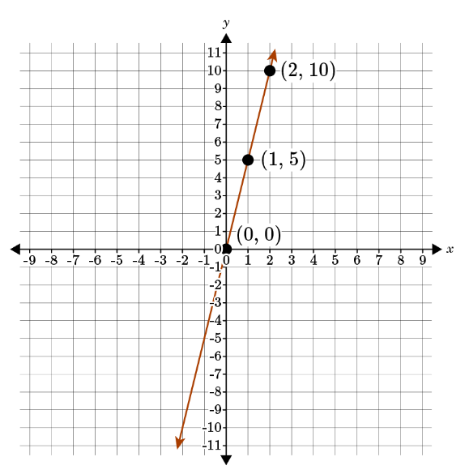
Practice: Graph the equation by plotting points y = 5x

Slide 20
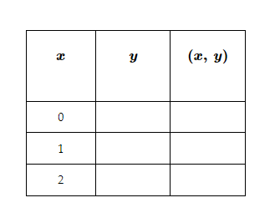
Practice: Graph the equation by plotting points y = 5x
Complete the table

Slide 21
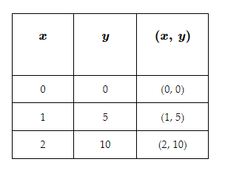
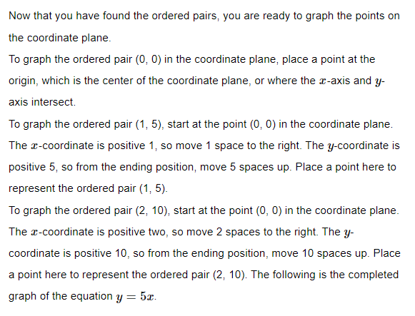
Practice: Graph the equation by plotting points y = 5x

Slide 22
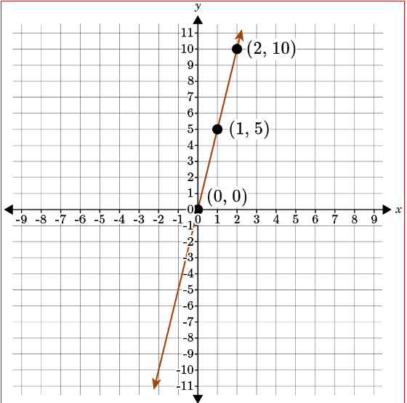
Practice: Graph the equation by plotting points y = 5x

Slide 23
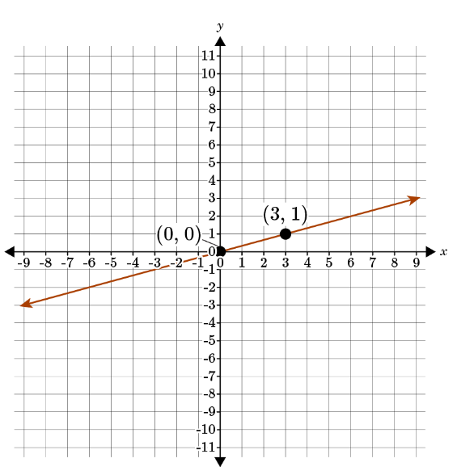
Practice: Use the slope to graph the equation y = $\frac{1}{3}$ x

Slide 24
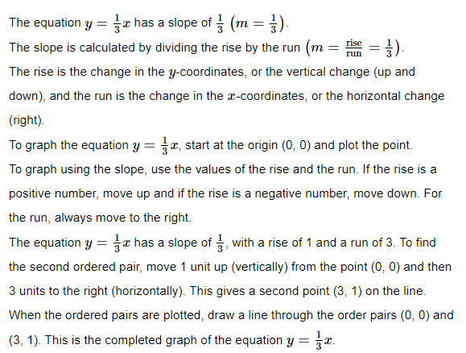
Practice: Use the slope to graph the equation y = $\frac{1}{3}$ x

Slide 25
GeoGebra practice
Constructing the slope triangle: https://www.geogebra.org/m/BndFHyNy#material/pmRXErdg
Practice Finding Slope Between Two Points: https://www.geogebra.org/m/bMbH2JtD
Graph using the Slope and Y-intercept: https://www.geogebra.org/m/c6ckgw7e

Slide 26
Summary
Deriving the equation y = mx
Graphing proportional relationships
The coordinate plane
Slope of a straight line
Equation of a straight line
Distance-Time & Velocity-Time Graphs

