Slide 1
Slope in Real-World Problems
Math 8B Unit 8 Lesson 5
Notes:
Welcome to this presentation on Understanding the Rate of Change in Linear Functions. In this presentation, we will learn how to interpret the rate of change of a linear function in terms of the situation it models and its table of values.

Slide 2
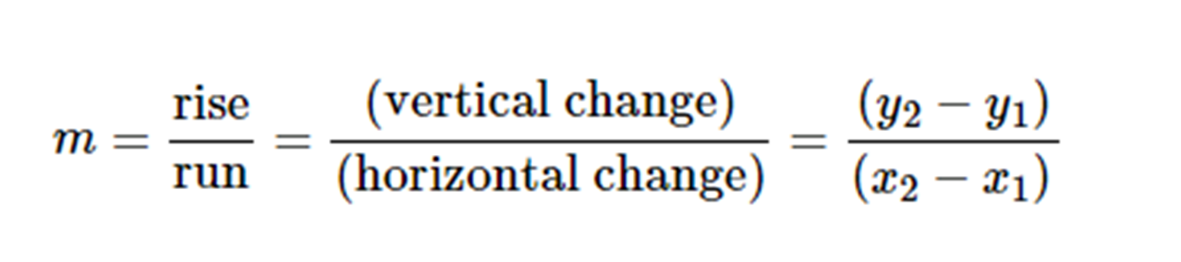

What is Rate of Change?
Rate of Change is the constant represented by the ratio of two values: another name for the constant of proportionality.
The amount of change in the output (y) variable for every one unit of change in the input (x) variable in a linear function.
It is also known as the slope of the linear function
The rate of change indicates how fast or slow the output variable is changing with respect to the input variable.
Notes:
The rate of change in a linear function is the slope of the line. It tells us how much the output variable changes for every one unit of change in the input variable. For example, if a linear function has a rate of change of positive 3, it means that for every one unit increase in x, the y-value increases by 3. Similarly, a negative rate of change means that the output variable is decreasing as the input variable increases.

Slide 3
Applications of Rate of Change
Rate of Change is used to describe the relationship between two variables in a linear function.
It can be used to predict the value of one variable based on the value of the other variable.
Analyze table of values to find the rate of change
Notes:
Rate of change is used in many real-world situations. For example, if we know the rate of change of the price of a product over time, we can predict its future price. Similarly, if we know the rate of change of the distance traveled by a vehicle with respect to time, we can predict how far it will go at a given time. In order to analyze the rate of change, we can use a table of values to find the change in y divided by the change in x.

Slide 4
Interpretation of Rate of Change
Positive rate of change means increase
Negative rate of change means decrease
Zero rate of change means no change
Increased rate of change means faster increase or decrease
Notes:
Interpreting the rate of change is important to understand the relationship between the input and output variables. If the rate of change is positive, it means that the output variable is increasing with an increase in input variable. If the rate of change is negative, it means that the output variable is decreasing with an increase in input variable. If the rate of change is zero, it means that there is no change in the output variable with respect to the input variable. An increased rate of change means that the output variable is changing faster with respect to the input variable.

Slide 5
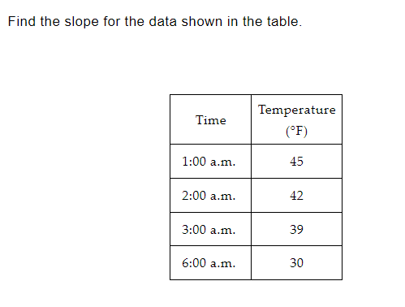
Practice

Slide 6
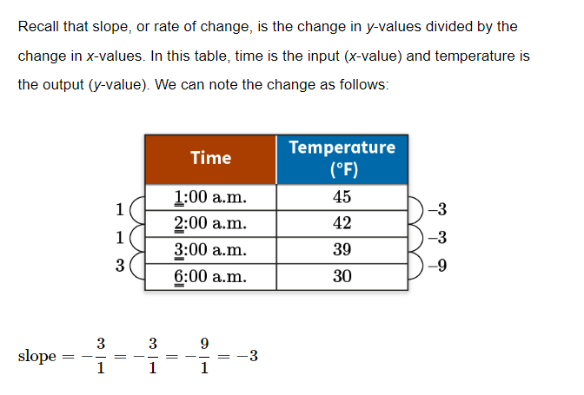
Answer

Slide 7
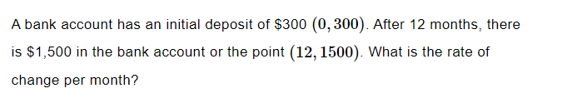
Practice

Slide 8
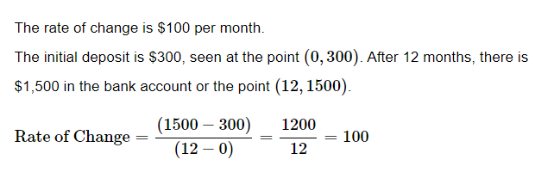
Answer

Slide 9
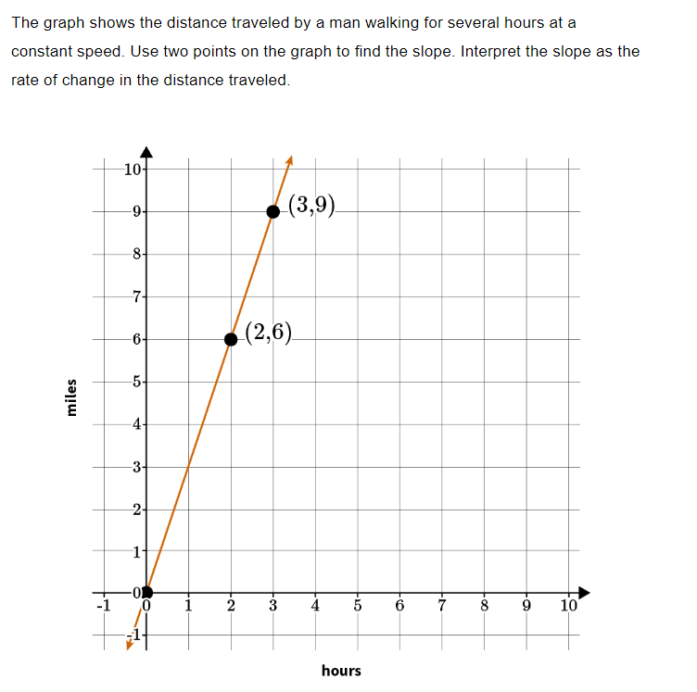
Example

Slide 10
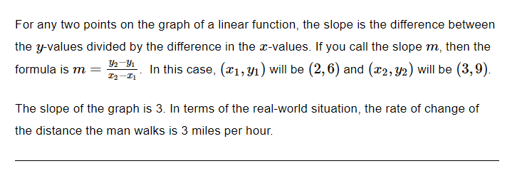
Example

Slide 11
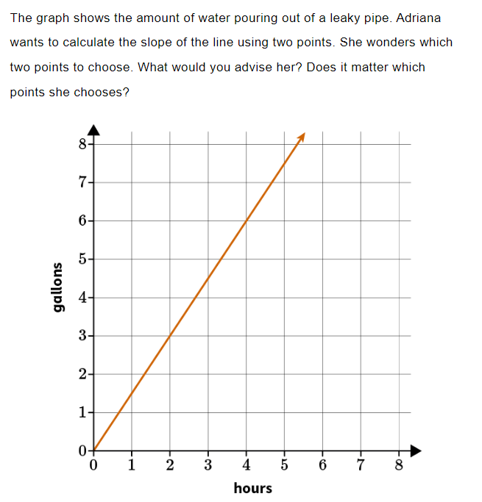
Practice

Slide 12
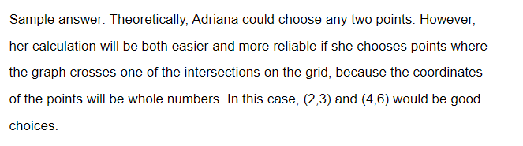
Answer

Slide 13
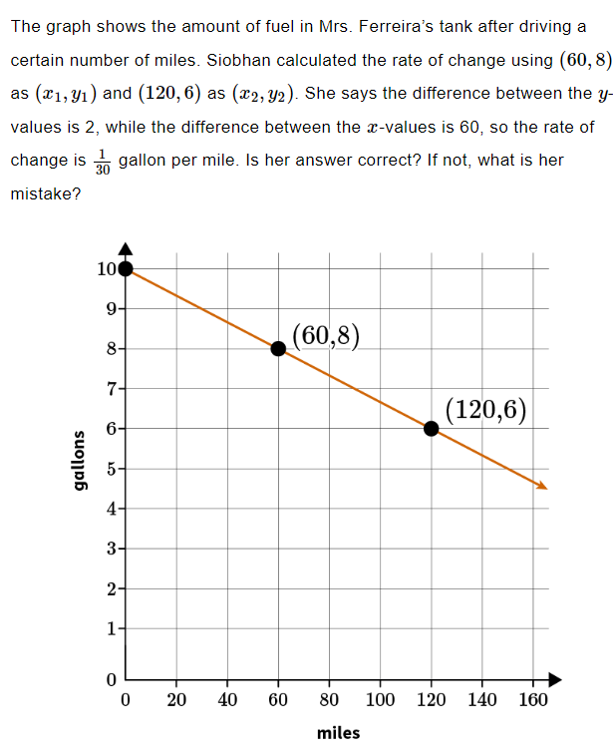
Practice

Slide 14
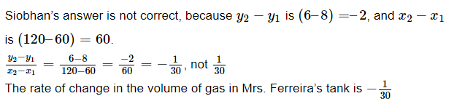
Answer

Slide 15

Summary
Rate of Change is used in linear functions to describe the relationship between two variables.
It is calculated by finding the change in output variable (y) divided by the change in input variable (x).
Interpretation of rate of change is important to understand the relationship between input and output variables.
It can be used to predict future values of one variable based on the rate of change.
Notes:
In conclusion, rate of change is a very important concept in linear functions. We can use it to describe the relationship between two variables, predict future values, and analyze many real-life situations. By understanding how to interpret the rate of change, we can better understand the relationship between input and output variables. Thank you for watching.

