Slide 1
Volume of Composite 3D Figures
Math 7B Unit 7; Lesson 7
Notes:
Welcome, students! Today, we'll learn how to find the volume of composite three-dimensional objects.

Slide 2
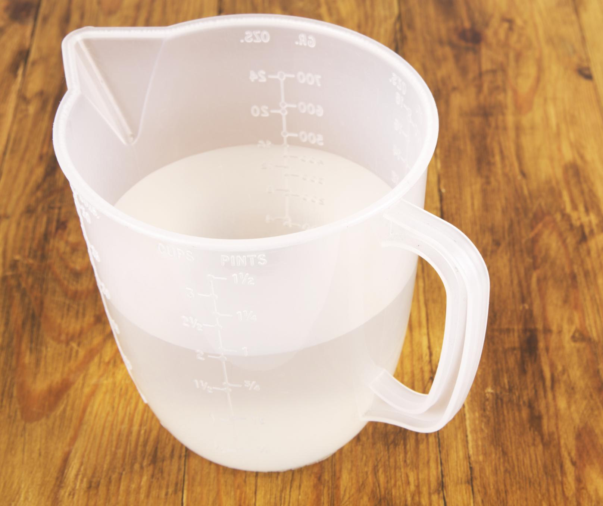
What is Volume?
Volume is the amount of space an object occupies.
Volume is measured in cubic units.
Volume is calculated by multiplying length, width, and height.
Notes:
Before we learn about composite objects, let's review the basics of volume.

Slide 3
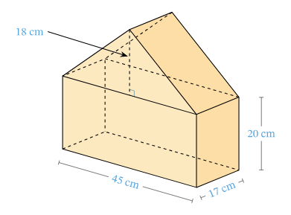
What are Composite Objects?
Composite objects are made up of two or more three-dimensional objects.
Composite objects can have irregular shapes.
Composite objects can be made of different materials.
Notes:
Now that we know what volume is, let's talk about composite objects and what makes them unique.

Slide 4
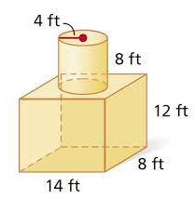
Breaking it Down
To find the volume of a composite object, break it down into simpler shapes.
Find the volume of each shape using the volume formula.
Add the volumes of the simpler shapes together to find the total volume.
Notes:
Breaking down a composite object into simpler shapes makes it easier to find the volume.

Slide 5
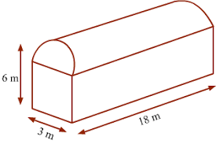
Example: Rectangular Prism & Cylinder
A composite object can be made up of a rectangular prism and a cylinder.
Find the volume of the rectangular prism and cylinder separately.
Add the volumes of the rectangular prism and cylinder to find the total volume of the composite object.
Notes:
Let's work through an example to see how we can apply what we've learned.

Slide 6
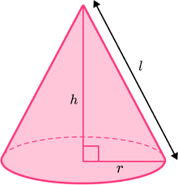
Example: Triangular Prism & Cone
Another composite object can be made up of a triangular prism and a cone.
Find the volume of the triangular prism and cone separately.
Add the volumes of the triangular prism and cone to find the total volume of the composite object.
Notes:
Here's another example to help reinforce what we've learned.

Slide 7

Applications in Real Life
Architects use volume calculations to design buildings.
Engineers use volume calculations to design machines and structures.
Notes:
Knowing how to find the volume of composite objects can come in handy in many careers.

Slide 8

Challenges
Composite objects can be tricky to work with.
Remember to break down the object into simpler shapes.
Practice makes perfect!
Notes:
Working with composite objects can be challenging, but with practice, anyone can master it.

Slide 9
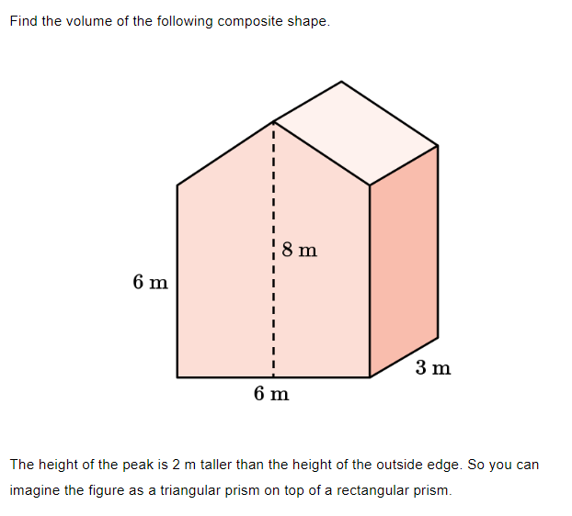
Practice

Slide 10
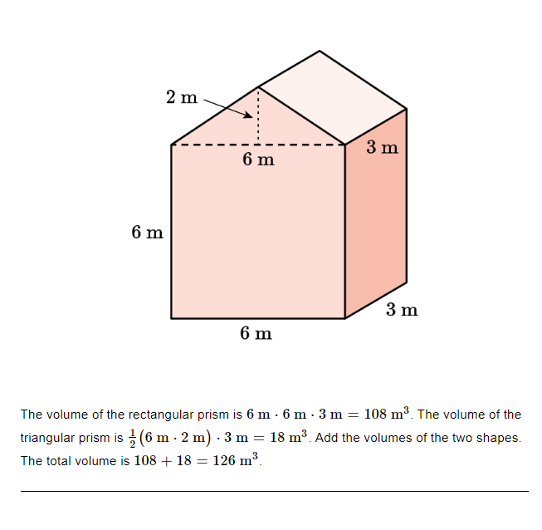
Practice

Slide 11

Review
Volume is the amount of space an object occupies.
Composite objects are made up of two or more three-dimensional objects.
To find the volume of a composite object, break it down into simpler shapes and add the volumes together.
Notes:
Let's review what we've learned today.

Slide 12

Thank You!
Notes:
Thank you for joining me today to learn about finding the volume of composite three-dimensional objects.

