Slide 1
Solving Surface Area Problems of Complex 3D Objects
Math 7B Unit 6; Lesson 8
Notes:
Hey everyone! Today, we will be learning how to calculate the surface area of complex 3D objects, which are composed of both cubes and right prisms. We will go over the steps and formulas needed to solve these problems.

Slide 2
Keywords
composite three-dimensional figure – a three-dimensional figure made up of two or more three-dimensional figures
cube – a right prism with bases and lateral faces that are congruent squares
right prism – a three-dimensional figure with two faces, called bases, that are congruent, parallel polygons aligned one directly opposite the other, and lateral faces that are congruent rectangles
right rectangular prism – a right prism with bases that are rectangles
right triangular prism – a right prism with bases that are triangles surface area – the measure of the total area of the surface of a three-dimensional shape
surface area – the measure of the total area of the surface of a three-dimensional shape

Slide 3
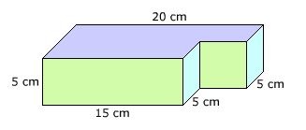
Identifying the Shapes
Identify the cubes and right prisms in the 3D object
Count the number of each shape
Notes:
The first step to solving surface area problems of complex 3D objects is to identify the cubes and right prisms in the object. After identifying them, we need to count the number of each shape.

Slide 4
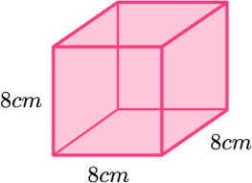
Calculating the Surface Area of Cubes
Find the area of one face of the cube
Multiply by 6 for the total surface area
Notes:
For each cube in the object, we need to find the area of one face by squaring the length of one side. Then, we multiply that area by 6 to get the total surface area of the cube.

Slide 5
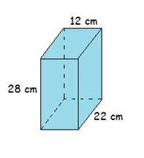
Calculating the Surface Area of Right Prisms
Find the area of the two bases of the right prism
Find the perimeter of one base and multiply by the height
Add the areas from step 1 and 2 for the total surface area
Notes:
For each right prism in the object, we need to find the area of the two bases by multiplying the base length and width. Then, we find the perimeter of one base and multiply that by the height of the prism. Next, we add the areas from step 1 and 2 to get the total surface area of the right prism.

Slide 6
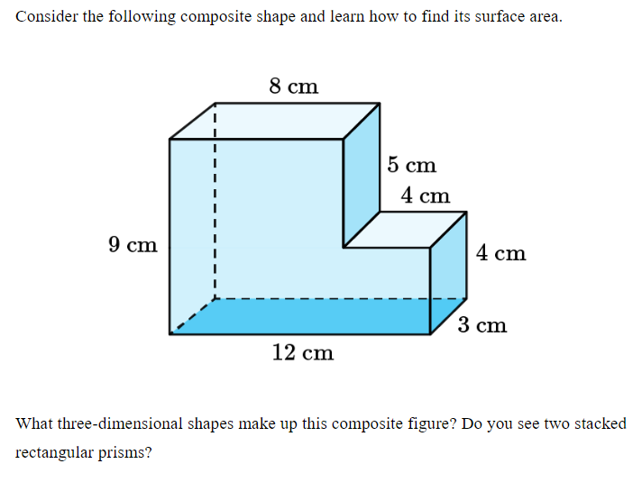
Practice Problem

Slide 7
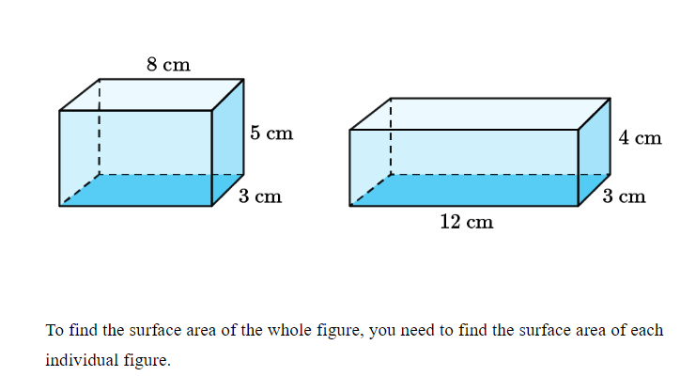

Slide 8
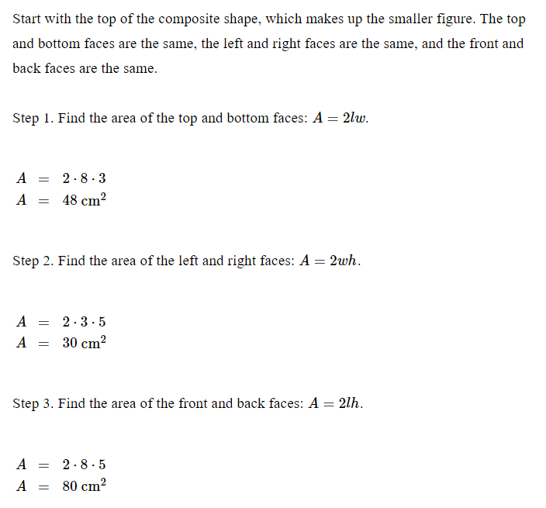

Slide 9
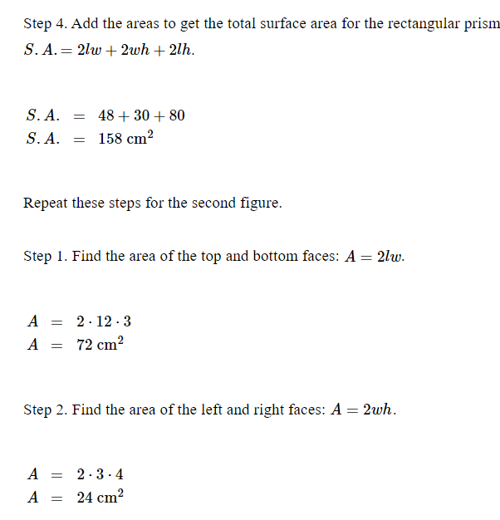

Slide 10
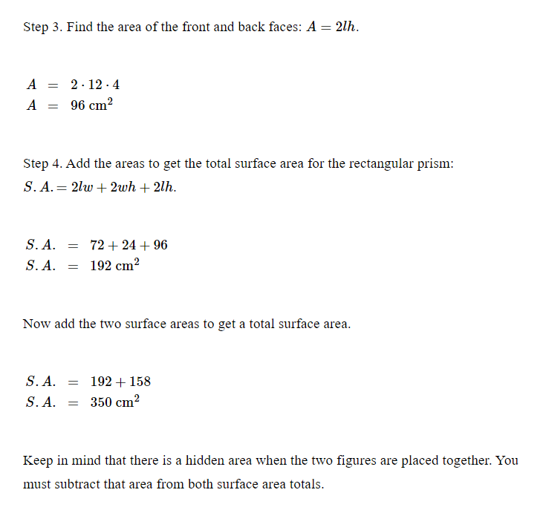

Slide 11
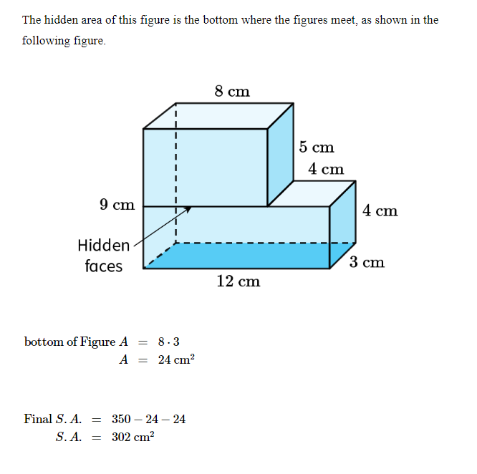

Slide 12
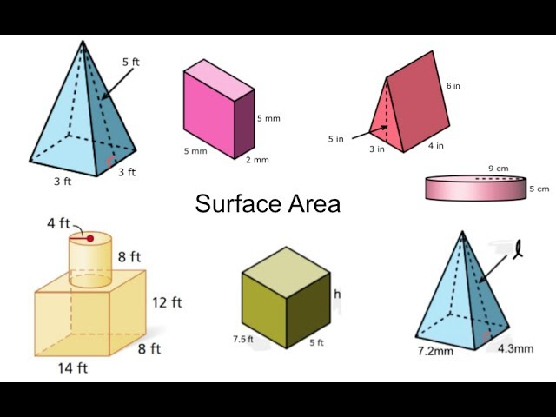
Adding the Surface Areas
Surface Area of 3D Solids
Notes:
Finally, we add the surface areas of each cube and right prism in the object to get the total surface area of the complex 3D object.

Slide 13
Keywords
base – the two opposite, identical, parallel faces of a prism
composite figure – a figure that can be divided into two or more basic shapes
prism – a geometric solid with two identical base and rectangular lateral faces
surface area – the measure of the total area of the surface of a three-dimensional shape

Slide 14

Real World Examples Using Surface Area of Composite Figures
A cereal box is a composite figure with multiple rectangular faces, and the surface area is needed to calculate the amount of material required to create the box.
A pyramid-shaped roof on a house is a composite figure with a square base and four triangular faces. The surface area is needed to determine the amount of shingles required to cover the roof.
Calculating the surface area of composite figures is important in construction and manufacturing industries to make efficient use of materials and reduce costs.
Notes:
In the real world, we come across many composite figures like a cereal box, pyramid-shaped roof on a house, etc. To calculate the amount of material required to create such figures, we need to know their surface area. For example, in the case of a cereal box, the surface area is needed to determine the amount of cardboard required to create the box. Similarly, in the case of a pyramid-shaped roof on a house, the surface area is needed to calculate the amount of shingles required to cover the roof. Calculating the surface area of composite figures is an important skill in the construction and manufacturing industries as it helps to make efficient use of materials and reduce costs.

Slide 15

Solving Surface Area Problems of Complex 3D Objects
Learn how to solve surface area problems of complex 3D objects
Identify different types of three-dimensional figures
Understand the concept of surface area
Notes:
In this presentation, we will learn how to find the surface area of complex composite figures. We will first start with understanding the concept of surface area and then move to identifying different types of three-dimensional figures. Finally, we will learn how to calculate the surface area of these figures.

Slide 16
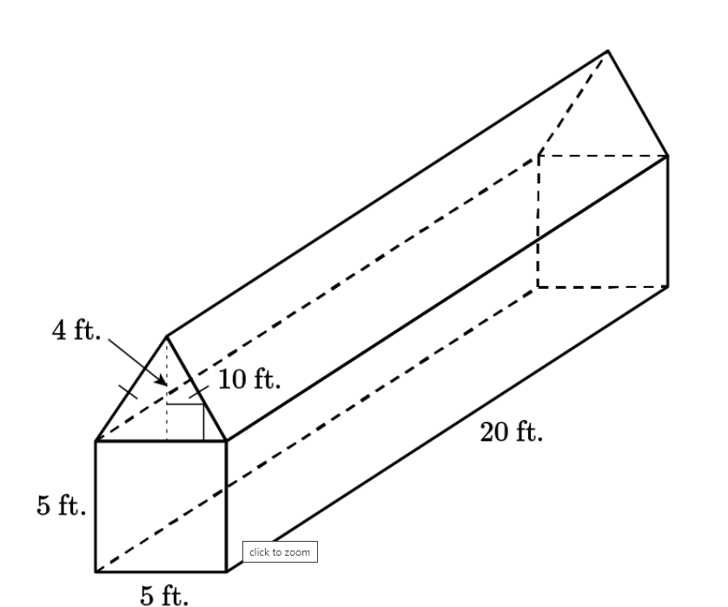
Calculating the Surface Area with a Triangular Prisms
Find the area of the two rectangular faces using formula: A=2lw
Find the area of two identical triangular faces: A=(2) (½) bh
Add the areas to get the total area of the faces of the triangular prism that are on the surface of the composite figure
Add the two areas to get the total surface area of the composite figure.
Notes:
For each right prism in the object, we need to find the area of the two bases by multiplying the base length and width. Then, we find the perimeter of one base and multiply that by the height of the prism. Next, we add the areas from step 1 and 2 to get the total surface area of the right prism.

Slide 17

Practice Problems
Use the formulas we learned to solve practice problems
Identify the cubes and right prisms in the complex 3D objects
Notes:
To reinforce our learning, we will now solve some practice problems using the formulas we learned. We will also identify the cubes and right prisms in some complex 3D objects.

Slide 18
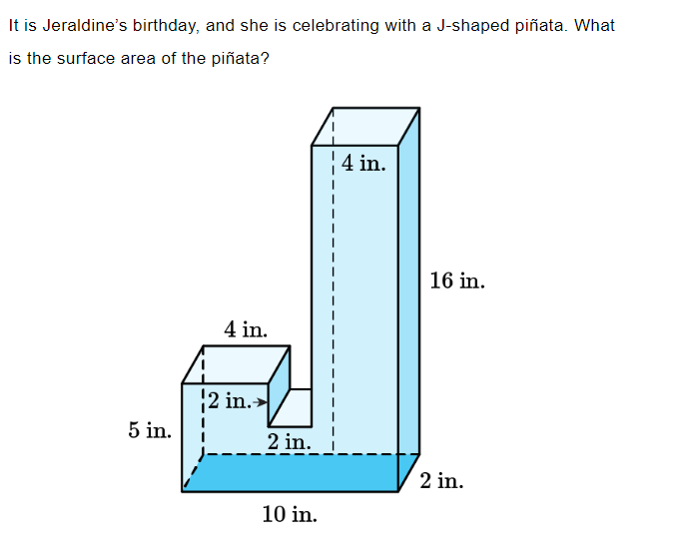
Practice Problem

Slide 19
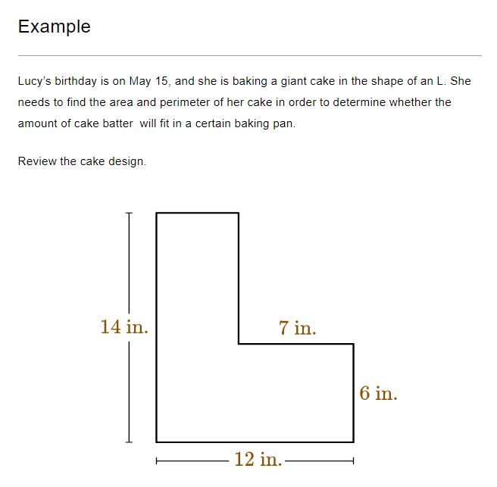
Practice

Slide 20
