Slide 1
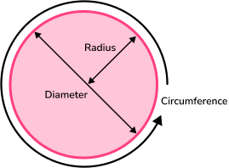
Math 7B, Unit 5 Lesson 6
Discovering the Relationship between Circumference and Area of a Circle
Notes:
Welcome to this presentation on discovering the relationship between circumference and area of a circle! In this presentation, we will explore the basic concepts and formulas relating to circles, and how we can use these to understand the relationship between the circumference and area of a circle. By the end of this presentation, you will be able to use these concepts to solve problems involving circles in real-world situations.

Slide 2
Key Words
area (A) – the amount of space, in square units, that the circle takes up within a two-dimensional plane
circumference (C) – the distance around a circle
diameter (d) – a straight line from one outside side of a circle to the other, passing through the center
pi (ππ) – a numerical value with an endless, nonrepeating decimal, 3.14159...; the ratio of a circle’s circumference to its diameter
radius (r) – a straight line from the center of the circle to the outside side of the circle

Slide 3

What is a Circle?
A circle is a two-dimensional shape that is perfectly round.
It has no angles or corners, and all points on its boundary are equidistant from its center.
Notes:
Before we can begin to understand the relationship between circumference and area, we need to understand what a circle is. A circle is a two-dimensional shape that is perfectly round. It has no angles or corners, and all points on its boundary are equidistant from its center. We can represent a circle using a variety of formulas and measurements, including its diameter, radius, circumference, and area.

Slide 4



Real-World Examples
Circles can be found all around us in everyday life.
Examples of circles in real-world situations include wheels, clocks, and pizza.
Notes:
Circles can be found all around us in everyday life. Examples of circles in real-world situations include wheels, clocks, and pizza. Understanding the relationship between the circumference and area of a circle can help us in practical situations, such as calculating the distance traveled by a bicycle wheel or determining the amount of pizza needed to feed a group of people.

Slide 5
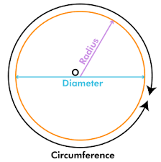
Circumference: What is it and how do we calculate it?
The circumference of a circle is the distance around its boundary.
It is equal to the diameter of the circle multiplied by pi (π).
Notes:
The circumference of a circle is the distance around its boundary. It is equal to the diameter of the circle multiplied by pi (π). We can use this formula to calculate the circumference of any circle, as long as we know its diameter or radius. Circumference is an important measurement to know when dealing with circles, as it can help us solve problems involving the perimeter or length of curved objects.

Slide 6
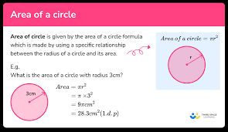
Area: What is it and how do we calculate it?
The area of a circle is the amount of space it takes up inside its boundary.
It is equal to the radius of the circle squared (multiplied by π).
Notes:
The area of a circle is the amount of space it takes up inside its boundary. It is equal to the radius of the circle squared (multiplied by π). We can use this formula to calculate the area of any circle, as long as we know its radius or diameter. Area is an important measurement to know when dealing with circles, as it can help us solve problems involving the surface area or volume of curved objects.

Slide 7
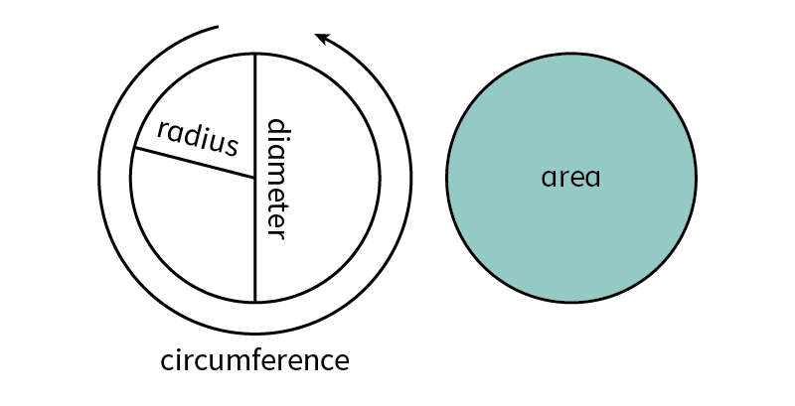
Circumference and Area of a Circle
To calculate the circumference of a circle, we use the formula 2πr, where r is the radius of the circle. C = 2πr OR C=πd
To calculate the area of a circle, we use the formula πr², where r is the radius of the circle. A = πr²
To complete a table for circumference and area of a circle, we need to know the radius of the circle.
The relationship between circumference and area is defined as: C² = 4πA
Notes:
In order to complete a table for circumference and area of a circle, we need to know the radius of the circle. Once we know the radius, we can use the formulas 2πr and πr² to calculate the circumference and area, respectively. By filling out the table with the calculated values for different radii, we can see the relationship between the circumference and area of a circle.

Slide 8
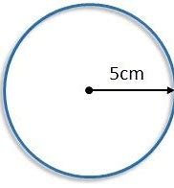
Practice
Verify that the equation C² = 4πA is true for a circle that has a radius of 5cm.

Slide 9
Practice
What is the area of a circle that has a circumference of 10π?

Slide 10
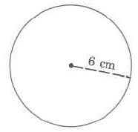
Table for Circumference and Area of a Circle
When given the radius, you can complete a chart to show circumference and area.
Fill in the table using the formulas for circumference and radius.
Formulas
Radius | Circumference | Area
6 in.
C=2πr
A=πr2
Notes:
Let's complete a table for the circumference and area of a circle with a radius of 3 units. Using the formula 2πr, we can calculate that the circumference of the circle is 6π units. Using the formula πr², we can calculate that the area of the circle is 9π square units. By filling out the table with the calculated values for different radii, we can see the relationship between the circumference and area of a circle.

Slide 11
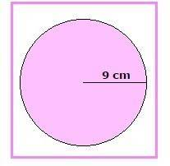
Table for Circumference and Area of a Circle
When given the radius, you can complete a chart to show circumference and area.
Fill in the table using the formulas for circumference and radius.
Formulas
Radius | Circumference | Area
9 in.
C=2πr
A=πr2
Notes:
Let's complete a table for the circumference and area of a circle with a radius of 3 units. Using the formula 2πr, we can calculate that the circumference of the circle is 6π units. Using the formula πr², we can calculate that the area of the circle is 9π square units. By filling out the table with the calculated values for different radii, we can see the relationship between the circumference and area of a circle.

