Slide 1

Circumference of a Circle: A Strategic Guide
Math 7B, Unit 5, Lesson 5
Notes:
Welcome to our strategic guide on using the formula for the circumference of a circle. In this presentation, you'll learn how to apply this formula to your advantage.

Slide 2
Key Terms:
circumference (C) – the distance around a circle
diameter (d) – a straight line from one outside side of a circle to the other, passing through the center
pi (π) – a numerical value with an endless, nonrepeating decimal, 3.14159...; the ratio of a circle’s circumference to its diameter
radius (r) – a straight line from the center of the circle to the outside side of the circle

Slide 3
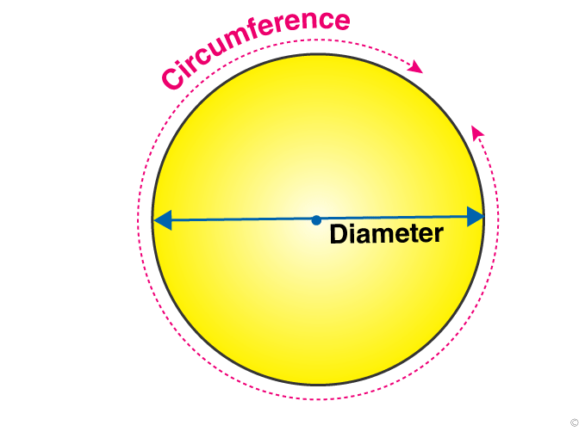
What is Circumference?
Circumference is the distance around the edge of a circle.
It's like measuring the perimeter of a shape, but for circles.
Circumference is an important measurement in geometry and can help us solve many problems.
Notes:
Before we dive into the formula, let's define what circumference is and how it can be measured. It's important to understand this concept in order to use it effectively.

Slide 4

Real-World Applications of Circumference
Using circumference to find the distance around a circular track
Using circumference to find the amount of fencing needed to enclose a circular garden
Notes:
Circumference can be used in many real-world applications such as finding the distance around a race track or the amount of fencing needed to surround a circular garden. It is important to remember to label the units correctly when using the formula for circumference.

Slide 5
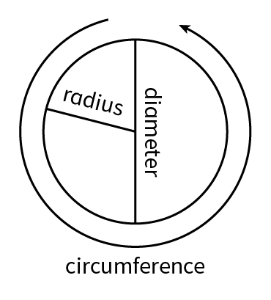
The Formula for Circumference
The formula for circumference is C = 2πr, where C is the circumference, π is pi (approx. 3.14), and r is the radius of the circle.
The radius is half the diameter, which is the distance across the circle through its center.
Knowing the formula and the value of pi, we can calculate the circumference of any circle.
Notes:
Now that we know what circumference is, let's learn the formula for calculating it. Don't worry, it's not as complicated as it looks!

Slide 6
Key Terms:
Constant of proportionality– the number representing the relationship of two numbers written as a proportion or a ratio, typically represented by the variable k, remains the same; other names are the unit rate or rate of change
Proportional relationships-a relationship in which two or more quantities have a constant ratio

Slide 7

Proportional Relationship between Diameter and Circumference
Circumference and diameter are proportional in a circle
As the diameter of a circle increases, so does the circumference
The ratio of circumference to diameter is always equal to pi (π)
Notes:
In circles, the circumference is proportional to the diameter. That means that if you double the diameter, you will also double the circumference. The ratio of circumference to diameter is always equal to pi (π). This means that, no matter the size of the circle, if you divide the circumference by the diameter, the result will always be pi. This relationship is very useful in many areas of mathematics and science.

Slide 8
Practice
How would you find the circumference of a circle if the diameter is 9?
9

Slide 9
Practice
How would you find the circumference of a circle if the radius is 5?
5

Slide 10

Unit Rate and Proportionality
The constant of proportionality is another name for the unit rate
In circles, the constant of proportionality is pi (π)
The formula for the circumference of a circle is an example of using the unit rate
Notes:
The constant of proportionality is another name for the unit rate. In circles, the constant of proportionality is pi (π). This means that, for any circle, if you divide the circumference by the diameter, you will always get pi as the result. The formula for the circumference of a circle, C = 2πr, uses this relationship between the circumference and the diameter to find the circumference of a circle when you know the diameter or radius. This formula is a great example of using the unit rate to find a solution to a problem.

Slide 11
Key Terms:
circumference (C) – the distance around a circle
constant of proportionality – the number representing the relationship of two numbers written as a proportion or a ratio, typically represented by the variable k, remains the same; other names are the unit rate or rate of change
diameter (d) – a straight line from one side of a circle to the other, passing through the center
pi (ππ) – a numerical value with an endless, nonrepeating decimal, 3.14159...; the ratio of a circle’s circumference to its diameter
proportional relationship – a relationship in which two or more quantities have a constant ratio
radius (r) – a straight line from the center of the circle to the side of the circle

Slide 12
Practice
The diameter of a circle is 15 feet. Using π (3.14), find the circumference of the circle.
15 feet

Slide 13
Practice
The radius of a circle is 4 feet. Using π (3.14), find the circumference of the circle.
4 feet

Slide 14
Practice
If the circumference around a circle is 1,200 inches, how can you find the diameter?
Practice

Slide 15
Practice
Find the area of the circle.
3 feet

Slide 16
Review
Circumference is the distance around the edge of a circle.
The formula for circumference is C = 2πr, where C is the circumference, π is pi, and r is the radius of the circle.
Circumference can be used to solve many geometry and real-life problems.
Notes:
Congratulations! You now have a better understanding of circumference and how to use the formula to solve problems. Keep practicing and applying this concept to your math studies and everyday life.

