Slide 1
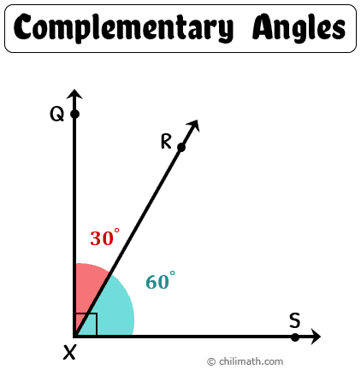
Math 7 B
Unit 3: Angle Pairs
Lesson 5: Solve Equations with Complementary Angles

Slide 2




Key Words
adjacent angles –
complementary angles –
equation –
expression –
two angles that are side by side and share a common ray and vertex
two angles whose measures have a sum of 90 degrees
a mathematical expression with an equal sign, containing numbers, variables, and/or operations
a math sentence using numbers, operations, and variable(s), but does not include an equal sign

Slide 3
Key Words
right angle –
simplify –
variable –
an angle that measures 90 degrees
the process of writing an expression in the shortest way possible that is equivalent to the original expression
a letter used to represent a number that is unknown

Slide 4
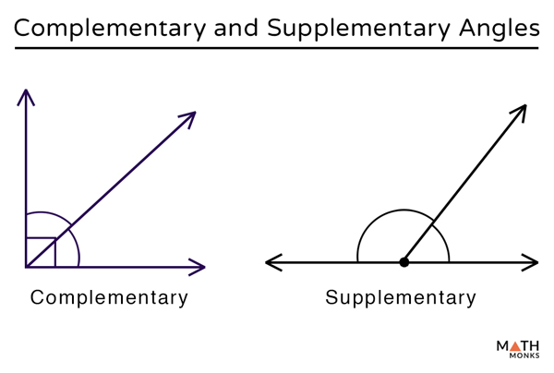
What are Complementary Angles?
Complementary angles are pairs of angles that add up to 90°.
Complementary angles can be adjacent or nonadjacent angles.
  If the two angles are adjacent, then they will form a right angle, or an angle measure of 90°.
  If the angles are nonadjacent, the angles will not share a common side, but their measures will still total 90°.
Complementary angles are always acute angles

Slide 5
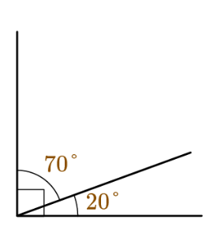
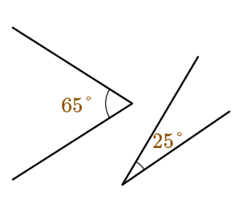
Examples of Complementary Angles
The angle measures of 70° and 20° are adjacent angles because they share a common side and vertex. These two adjacent angles are also complementary: 70°+20°=90°
The angles measuring 65° and 25° are nonadjacent because they do not share a common side or vertex. However, the two angles are also complementary: 65°+25°=90°

Slide 6
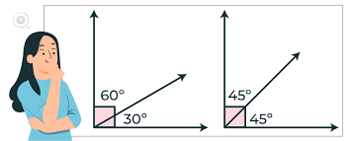
Writing and Solving Equations for Complementary Angles
Because complementary angles always equal 90°, we can write an equation to solve for an unknown angle measure. Use the operation of addition with the two angles, and set them equal to 90°
We can use algebra to solve for unknown angles.
  For example, if we know one angle is 30 degrees, we can use the equation x + y = 90 to solve for the other angle.
  x + y = 90 can be rearranged to solve for x or y.
Expressions can also be used in place of a single variable for unknown angles.
Notes:
Now that we know what complementary angles are, let's learn how to write equations for them. To write an equation for unknown complementary angles, we need to use variables. Let's use 'x' to represent one angle, and 'y' to represent the other angle. Since the angles are complementary, we know that they add up to 90 degrees. This means we can set up an equation: x + y = 90.

Slide 7
Writing Equations of Complementary Angles - Example
Write an equation of two complementary nonadjacent angles whose measures are expressed as (3x)° and (x+5)°.
First, complementary angles always equal 90°. Therefore, the equation will equal 90°.
The two angles are given as expressions. Addition is the operation that takes place between the two complementary angles. Include the entire expression in the place of each angle measure: (3x) and (x+5).
(3x)° + (x+5)° = 90° → Set the expression to equal 90°.
3x° + x° + 5° = 90° → Simplify.
4x° + 5° = 90°

Slide 8
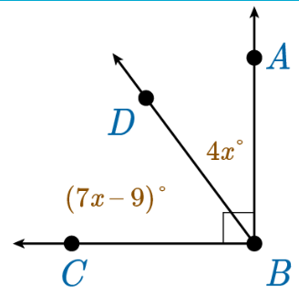
Solving Equations of Complementary Angles - Example
Set up an equation and solve for x. Then use it to solve for both angle measures.
First, set up an equation using the expressions given and then solve for the variable: m∠CBD+m∠DBA = m∠CBA → (7x−9)°+(4x)°=90°
  (7x−9)°+(4x)°= 90°
  11x° - 9 = 90°
  11x° = 99°
  x = 9
Now, solve for the missing angle measure using the variable answer.
  ∠CBD → 7x-9; 7(9) – 9; 63-9; 54
  ∠DBA→ 4x; 4(9); 36
Check the work by adding the two angle measures and verifying they equal 90°
  54° + 36° = 90°

Slide 9
Real World Example
Complementary angles can be used to determine the angle at which a ladder should be placed against a wall to ensure the ladder is at a safe angle.
Imagine a ladder is leaning against a wall. If the ladder is too steep, it can be unsafe for the person climbing it. If it's not steep enough, it can be difficult to climb and may also be unstable.
To find the optimal angle for the ladder, we can use the equation x + y = 90, where x is the angle between the ladder and the ground, and y is the angle between the ladder and the wall.
By using complementary angles, we can determine the angle at which the ladder should be placed to ensure it is at a safe and stable angle.
Notes:
This real-world example can be used to demonstrate the practicality and usefulness of complementary angles in everyday life. It also highlights the importance of understanding angle measurements in various fields.

Slide 10
Wrap Up
Great job! Now you know how to write and solve an equation for unknown complementary angles.
Remember to use x + y = 90 as your equation.
Practice, practice, practice!
Notes:
Congratulations on learning how to write an equation for unknown complementary angles! Remember to use x + y = 90 as your equation. Practice as much as you can to become an expert. Keep up the great work!

