Slide 1
Math 7 B
Unit 3: Angle Pairs
Lesson 10: Find Missing Angles

Slide 2
Key Words
adjacent – the relationship of two angles that share a vertex and a side
complementary angles – two angles whose measures have a sum of 90 degrees
supplementary angles – two angles whose measures have a sum of 180 degrees
vertical angles – the angles across from each other when two lines intersect

Slide 3
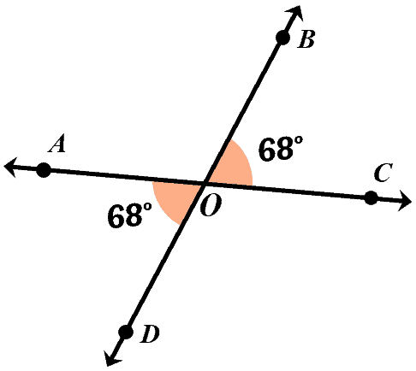
Vertical Angles
Vertical angles are two angles across from each other in a figure that share a vertex.
Vertical angles have equal measures.
The measure of one angle can be used to find the measure of the other.
Notes:
Vertical angles are opposite angles formed when two lines intersect. They are always congruent, which means they have the same measure. If we know the measurement of one vertical angle, we can use that to find the measurement of the other. For example, if we have an angle with a measure of 40 degrees, we know that the vertical angle across from it also measures 40 degrees. We can use this information to write an equation to find a missing angle. Let's look at an example.

Slide 4
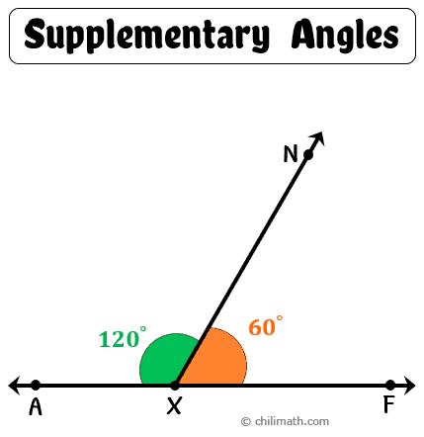
Supplementary Angles
Supplementary angles are a pair of angles which add up to 180 degrees.
The measure of one angle can be used to find the measure of the other.
To find the measure of a missing angle, set it equal to 180 minus the known angle and solve for the variable.
Notes:
Supplementary angles are two angles that add up to 180 degrees. If we know the measure of one supplementary angle, we can use that to find the measure of the other. For example, if we have an angle that measures 80 degrees, we know that the supplementary angle measures 100 degrees. We can use this information to write an equation to find a missing angle.

Slide 5
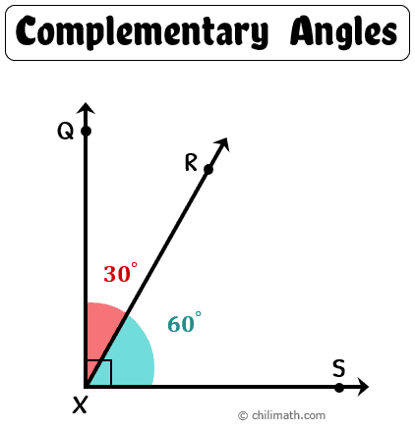
Complementary Angles
Complementary angles add up to 90 degrees.
The measure of one angle can be used to find the measure of the other.
To find the measure of a missing angle, set it equal to 90 minus the known angle and solve for the variable.
Notes:
Complementary angles are two angles that add up to 90 degrees. If we know the measure of one complementary angle, we can use that to find the measure of the other. For example, if we have an angle that measures 30 degrees, we know that the complementary angle measures 60 degrees. We can use this information to write an equation to find a missing angle.

Slide 6
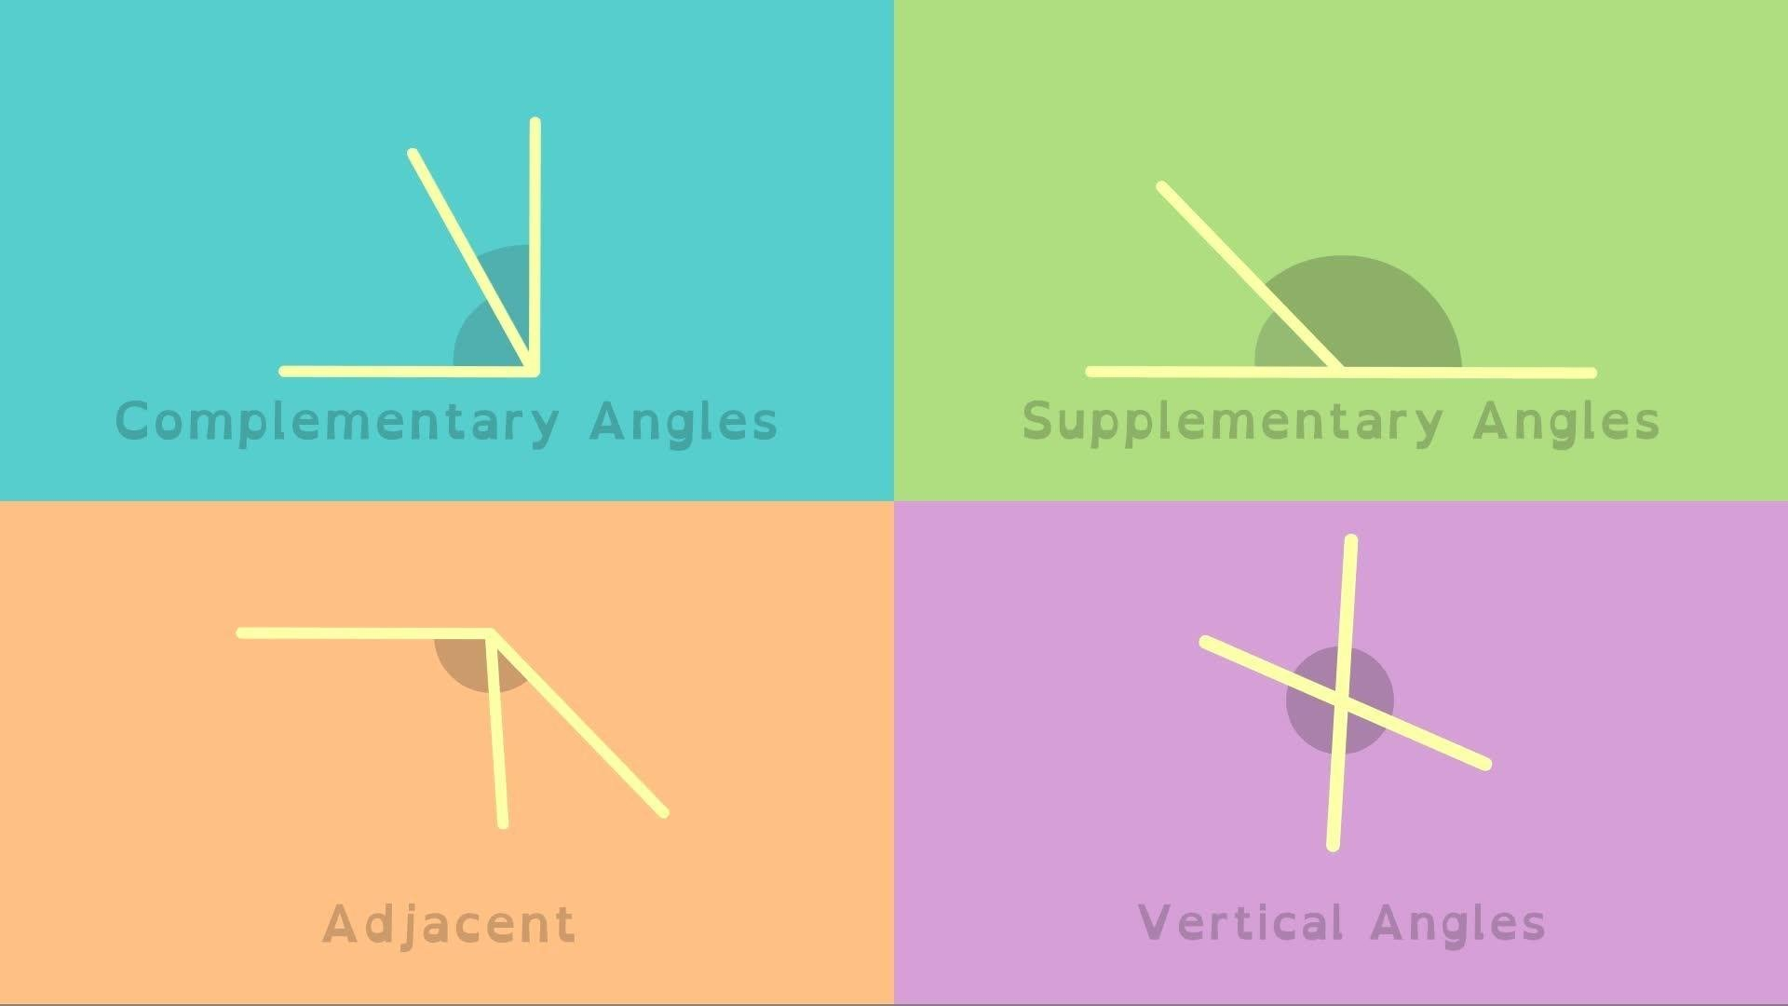
Angles

Slide 7
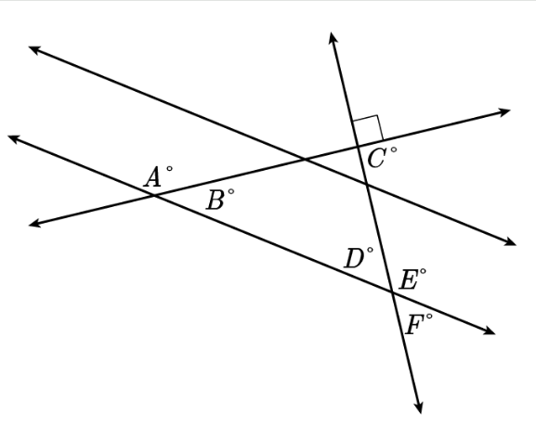
Using Angle Relationships to Solve for Missing Angles
You are given the measure of ∠D is 85°, but the measures of ∠E and ∠F are missing. What can you do to solve for these missing angles?
First, identify the angle relationships.
  Recognize that ∠D and ∠F are vertical angles, so their measures will be equal to each other.
  Because ∠D and ∠E are supplementary, their angles will have a sum of 180 degrees.
  With these two facts, you know that m∠F=85° and you can solve for m∠E: 85° + m∠E = 180°
  Now you know that m∠D=85°, m∠E=95°, and m∠F=85°.

Slide 8
Using Angle Relationships to Solve for Missing Angles, cont’d
You now need to solve for the measures of ∠A and ∠B.
You are given that m∠A=(6x+14)° and m∠B=(2x+14)°.
Looking at the image, ∠A and ∠B are supplementary, so their measures added together will equal 180. Use this information to set up an equation:
  (6x+14)° + (2x+14)° = 180°
  8x° + 28° = 180° → Subtract 28 from both sides.
  8x° = 152° → Divide both sides by 8.
  x = 19
You are not finished yet. This is only the value of x, not the whole measure of the angles. Take the value for x and substitute it into each angle’s measure equation.
  m∠A is (6(19)+14)° = 128°
  m∠B is (2(19) +14)° = 52°

Slide 9
Using Angle Relationships to Solve for Missing Angles, cont’d
You now need to solve for the measures of ∠A and ∠B.
You are given that m∠A=(6x+14)° and m∠B=(2x+14)°.
Looking at the image, ∠A and ∠B are supplementary, so their measures added together will equal 180. Use this information to set up an equation:
  (6x+14)° + (2x+14)° = 180°
  8x° + 28° = 180° → Subtract 28 from both sides.
  8x° = 152° → Divide both sides by 8.
  x = 19
You are not finished yet. This is only the value of x, not the whole measure of the angles. Take the value for x and substitute it into each angle’s measure equation.
  m∠A is (6(19)+14)° = 128°
  m∠B is (2(19) +14)° = 52°

Slide 10
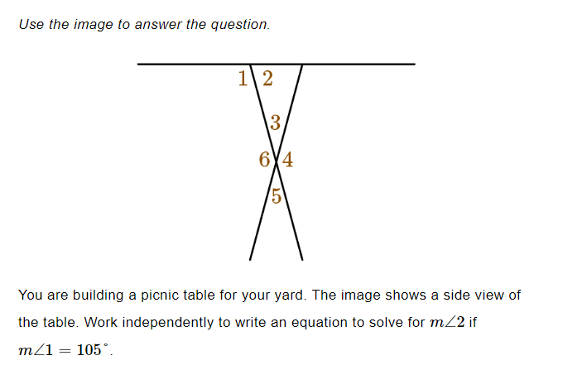
Practice

Slide 11
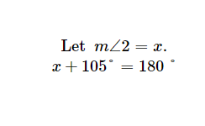
Solution

Slide 12
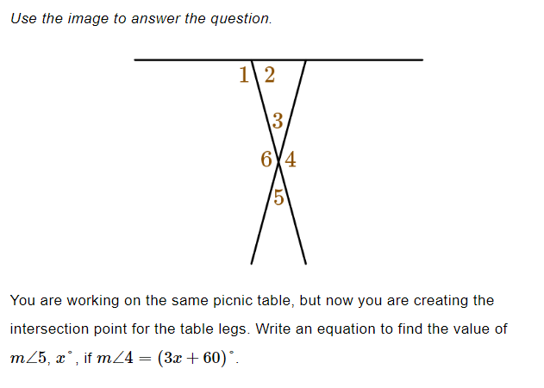
Practice

Slide 13

Solution

Slide 14
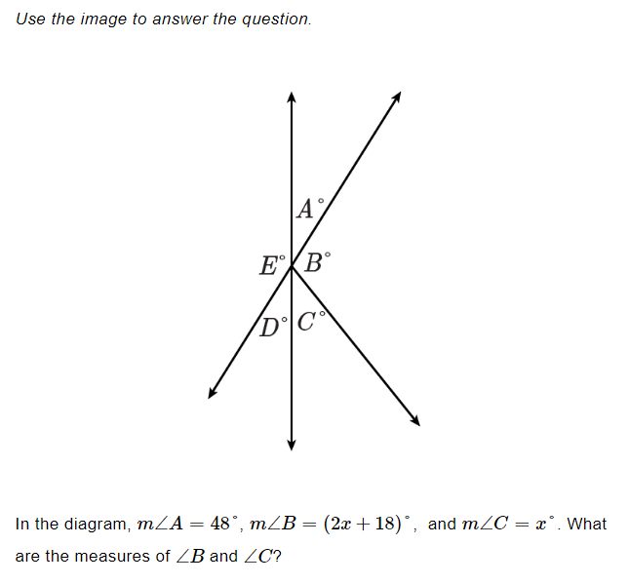
Practice

Slide 15

Solution

Slide 16
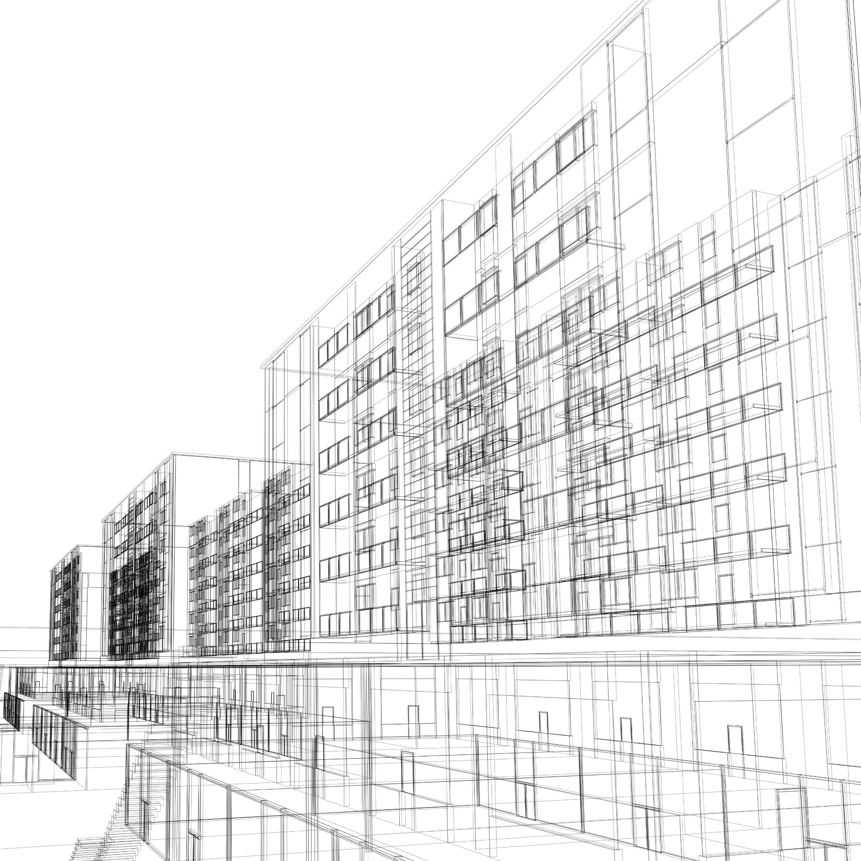
Real World Application: Architectural Design
Architects use angles to create structures that are safe and functional.
Angles help determine how load is distributed on a structure.
Angles can be used to calculate how much material is needed for a project.
Notes:
Architects use angles to create structures that are safe and functional. By using the principles of angle relationships, they can determine how load is distributed on a structure, and calculate how much material is needed for a project. For example, if they are designing a bridge, they need to make sure that the angles and supports of the bridge can handle the weight of the vehicles that will be using it. By using angle relationships, they can determine the ideal design for the bridge and ensure that it is safe for use.

Slide 17
Conclusion
Understanding angle relationships can help in solving mathematical and real-life problems. You may have used a single type of angle relationship in a math problem. In real life, however, figures are usually much more complex and have many types of angles.
Supplementary angles are two angles whose measures have a sum of 180 degrees.
Complementary angles have a sum of 90 degrees.
Vertical angles are equal angles that share a vertex and are located directly across from each other.
Finally, adjacent angles share a vertex and one side.
Notes:
This presentation covered the main concepts of angle pairs, including complementary, supplementary, and vertical angles. We also discussed real-world applications of angles in architectural design. Remember that adjacent angles share a vertex and a side, vertical angles are equal, and supplementary angles add up to 180 degrees. Complementary angles add up to 90 degrees. These concepts can be used to solve for missing angle measurements and have important practical applications.

