Slide 1

Welcome to Graphing Inequalities on Number Lines!
Notes:
In today's presentation, we will be learning about graphing inequalities on number lines. This skill is important in solving real-world problems and can help us make sense of information we see around us.

Slide 2
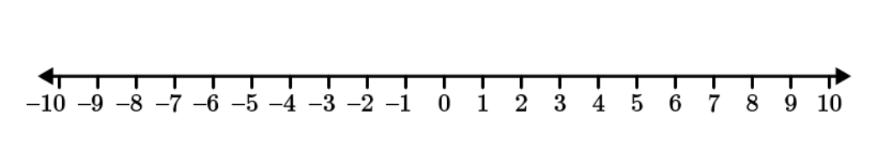
Key Terms
inequality – a statement that one expression is less than, greater than, less than or equal to, or greater than or equal to another expression t
Example: 4x + 2 ≥ 25
number line – a straight line with numbers added at equal intervals along its length
Example:

Slide 3

What are Inequalities?
Inequalities are mathematical expressions that use the symbols <, >, ≤, or ≥ to compare two quantities.
Symbols:
< stands for 'less than'
> stands for 'greater than'
≤ stands for 'less than or equal to'
≥ stands for 'greater than or equal to
Notes:
An inequality is a way of comparing two values. It's like an equation but instead of equal sign, we use symbols like <, >, ≤, and ≥. We can use inequalities to compare temperature, weight, height, and other values.

Slide 4
What is a Number Line?
A number line is a straight line with numbers placed at equal intervals along its length.
The numbers on the line can be positive, negative, or zero.
The number line helps us to visualize the order of numbers and their relationships with one another.
Notes:
A number line is a visual representation of numbers in which each point on the line corresponds to a number. It can be used to show the order of numbers, as well as their relationships with one another. Number lines are often used in elementary and middle school math classes, and can be a helpful tool for understanding basic math concepts.

Slide 5
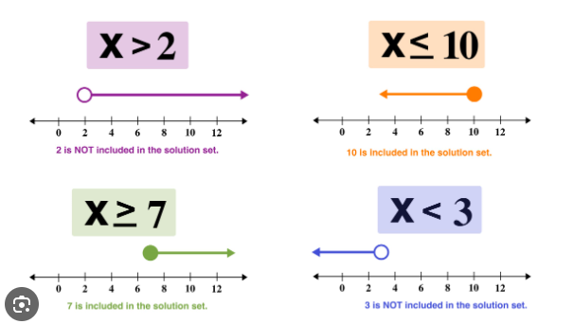
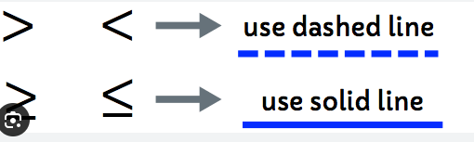
Representing Inequalities on Number Lines
Notes:
We can use number lines to graph inequalities. The open and close circles on the number line tell us whether the solution includes the endpoint or not. If the endpoint is included, we use a closed circle. If it's not included, we use an open circle. The type of line we use on the number line depends on the type of inequality we are graphing. We use dotted lines for inequalities that include 'less than' or 'greater than', and we use solid lines for inequalities that include 'less than or equal to' or 'greater than or equal to'.

Slide 6
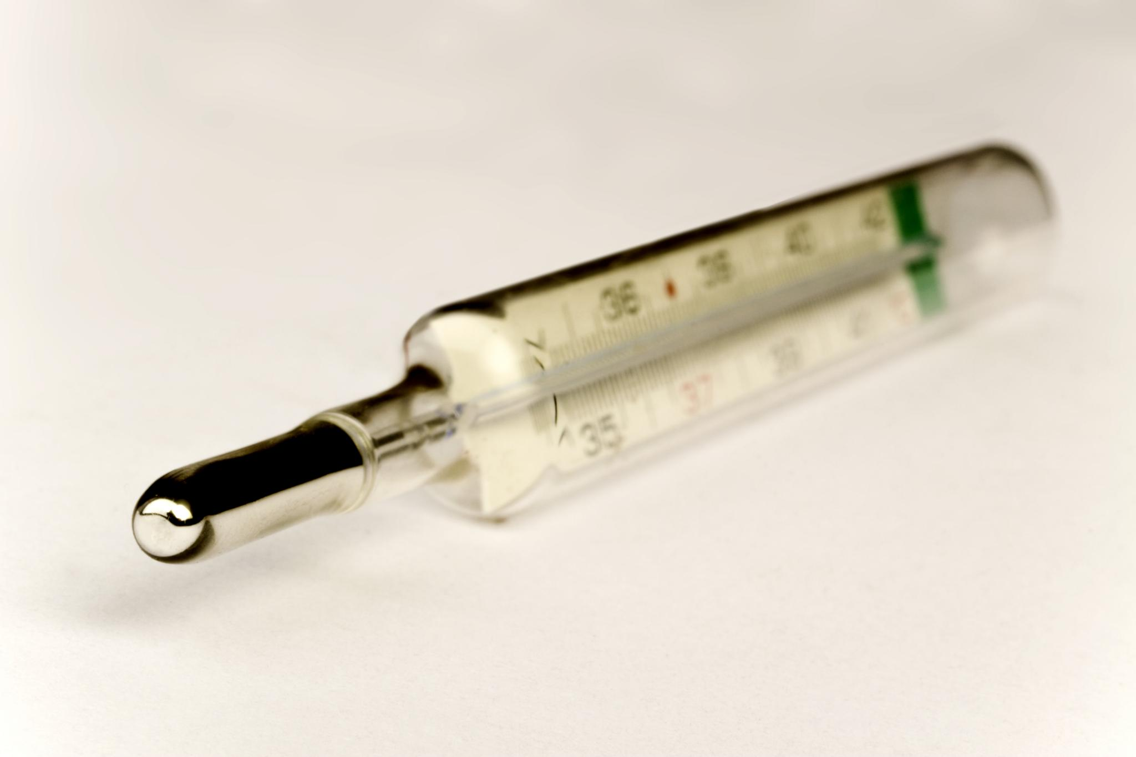
Real-World Examples of Graphing Inequalities on Number Lines
Determining acceptable temperature ranges for storing perishable food items
Determining age limits for certain activities such as driving and voting
Analyzing income levels for eligibility for government benefits
Determining appropriate dosage levels for medication based on a patient's weight
Notes:
Graphing inequalities on number lines can be useful in various real-world scenarios. For example, when storing perishable food items, it is important to ensure that the temperature remains within an acceptable range. Graphing the inequality representing the acceptable temperature range can help in visualizing the range and ensuring it stays within safe limits. Similarly, when determining age limits for certain activities, such as driving or consuming alcohol, graphing the inequality on a number line can help in visualizing the age range. Graphing inequalities can also be useful in determining income eligibility for government benefits or analyzing appropriate medication dosage levels based on a patient's weight.

Slide 7
Examples
Let's graph the inequality x > 3 on a number line.
First, we draw a number line and put an open circle at 3.
Then, we draw a dotted line to the right to indicate that all the numbers greater than 3 are included in the solution set.
Notes:
Let's practice graphing some inequalities on a number line. Remember to use an open or closed circle and a dotted or solid line depending on the type of inequality. For example, if we were to graph x > 3, we first put an open circle at 3 and draw a dotted line to the right to represent all the numbers greater than 3. If we were to graph y ≤ 5, we would put a closed circle at 5 and draw a solid line to the left to represent all the numbers less than or equal to 5.

Slide 8
Examples
Let's graph the inequality y ≤ 5 on a number line.
First, we draw a number line and put a closed circle at 5.
Then we draw a solid line to the left to indicate that all the numbers less than or equal to 5 are included in the solution set.
Notes:
Let's practice graphing some inequalities on a number line. Remember to use an open or closed circle and a dotted or solid line depending on the type of inequality. For example, if we were to graph x > 3, we first put an open circle at 3 and draw a dotted line to the right to represent all the numbers greater than 3. If we were to graph y ≤ 5, we would put a closed circle at 5 and draw a solid line to the left to represent all the numbers less than or equal to 5.

Slide 9
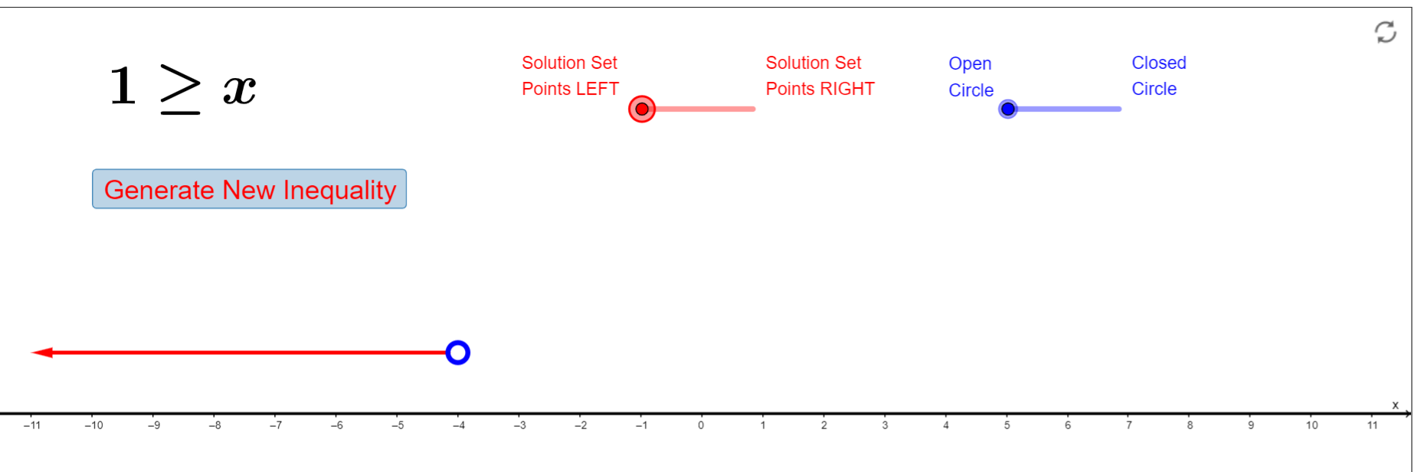
GeoGebra Examples
You can use this GeoGebra link to graph simple inequalities on a number line: https://www.geogebra.org/m/t48PNuJa
Graphing Inequalities on the Number Line: https://www.geogebra.org/m/bYGED3dY
  You can click on the "Generate New Inequality" button to generate a new inequality to graph.

Slide 10
Practice Problem
Aron is saving up to buy a new bicycle. He’s hoping to save at least $500 in the next four weeks so that he might be able to buy the new bicycle by the end of the summer. At the beginning of the first week, his grandmother gives him $20 as a birthday present. He will also earn money each week working at his dad’s store. How much money will he need to earn each week working at his dad’s store to meet his savings goal?

Slide 11
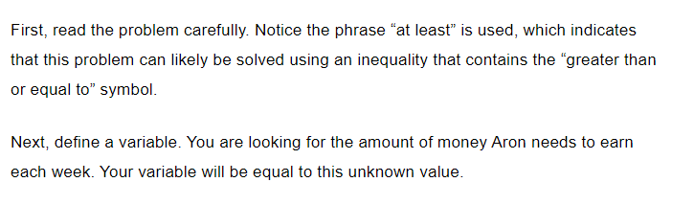
Solution

Slide 12
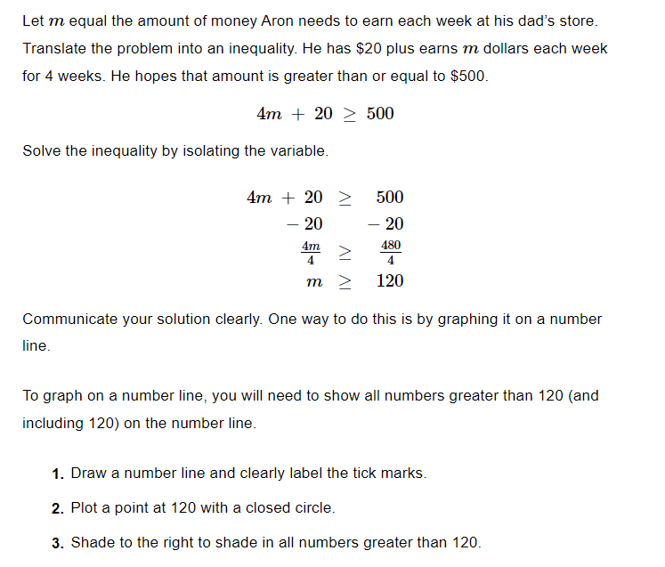

Slide 13
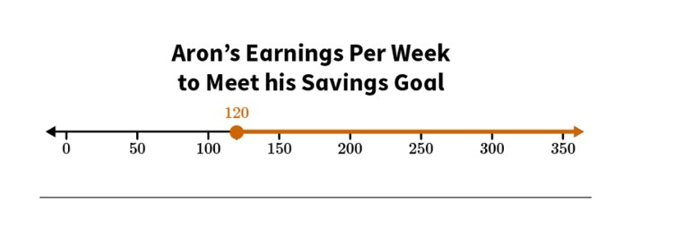
Solution

Slide 14

Conclusion
Graphing inequalities on number lines is a valuable skill for solving real-world problems.
Remember to use an open or closed circle and a dotted or solid line depending on the type of inequality you are graphing.
Practice graphing inequalities to improve your skills!
Notes:
In conclusion, graphing inequalities on number lines is a skill that can help us solve real-world problems and make sense of information we see around us. Remember to use an open or closed circle and a dotted or solid line depending on the type of inequality you are graphing. Practice graphing inequalities to improve your skills!

