Slide 1
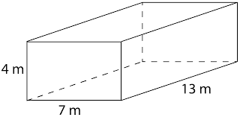
Applications of Surface Area of Rectangular Prisms
Math 7B Unit 6; Lesson 5
Notes:
Welcome to our presentation on mastering the surface area of rectangular prisms! Today, we will explain what surface area means, teach you how to calculate the surface area of rectangular prisms and give you some real-world examples to help you understand how to use this knowledge in practice.

Slide 2
Keywords
cube – a three-dimensional figure with 6 square faces, 12 edges, and 8 vertices
rectangular prism – a three-dimensional figure with two rectangular bases
surface area – the measure of the total area of the surface of a three-dimensional shape
triangular prism – a three-dimensional shape with two triangular bases

Slide 3
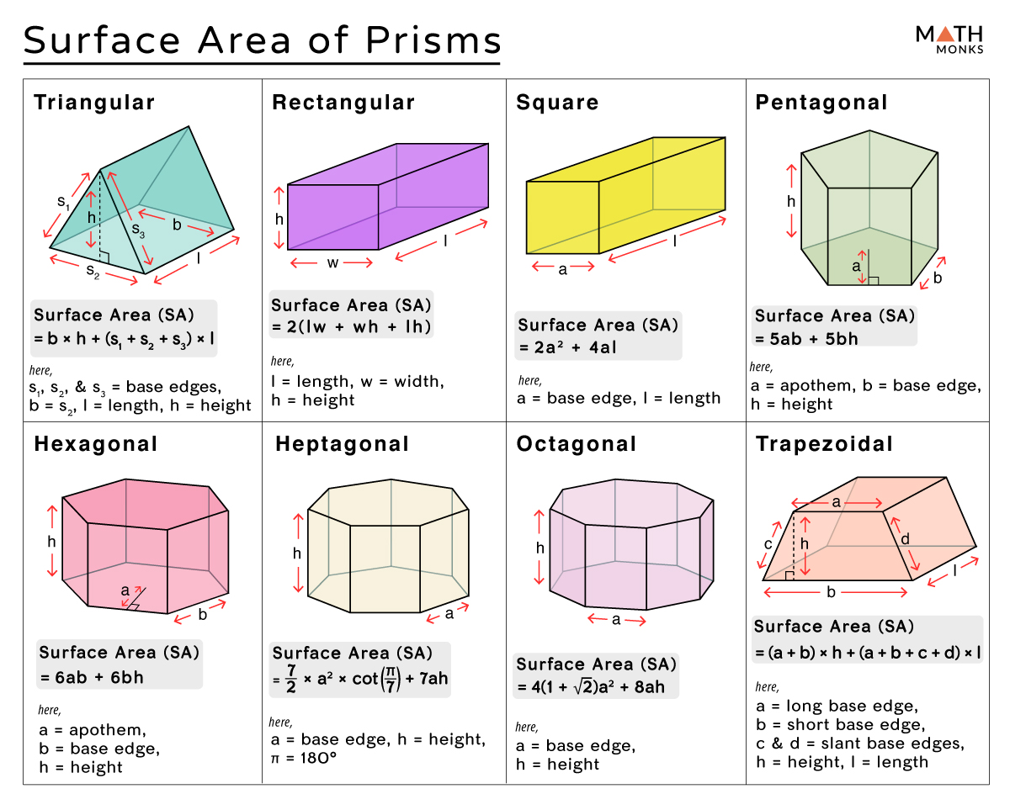
Calculating Surface Area of Rectangular Prisms
Surface area is the sum of all the areas of the rectangular faces of a three-dimensional object
To calculate the surface area of a rectangular prism, find the area of each face and add them together
The formula for finding the surface area of a rectangular prism is: SA = 2lw + 2lh + 2wh
Notes:
Now, let's learn how to calculate the surface area of a rectangular prism. First, you need to find the area of each face. Then, you add all of the areas together to find the total surface area. The formula to find the surface area of a rectangular prism is SA = 2lw + 2lh + 2wh. Let's practice applying this formula to some examples.

Slide 4
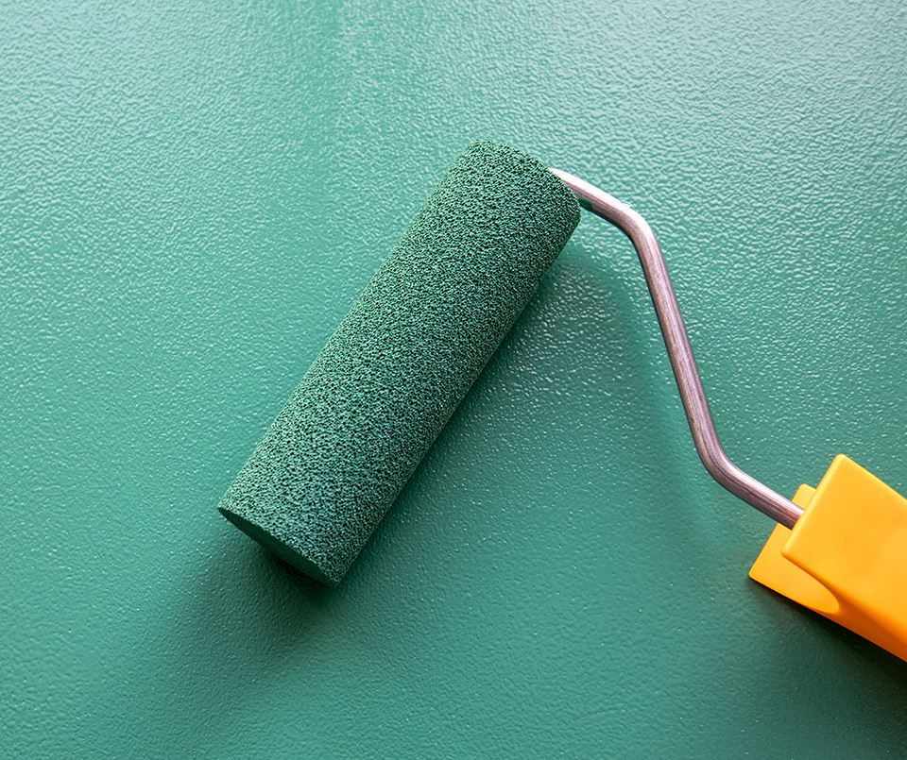
Real-World Examples of Surface Area of Rectangular Prisms
Calculating the surface area of a room is important to determine the amount of paint or wallpaper needed to cover the walls
Surface area can be used to calculate the amount of wrapping paper needed to wrap a box
Calculating the surface area of a shipping container helps determine the shipping cost
Notes:
Now that we've learned how to calculate the surface area of a rectangular prism, let's look at some real-world examples. Calculating the surface area can be useful in many situations, such as determining the amount of paint or wallpaper needed to cover the walls of a room or calculating the amount of wrapping paper needed to wrap a present in a box. In addition, companies use surface area to calculate shipping costs for their products. Knowing how to calculate surface area is a useful skill in many areas of life.

Slide 5
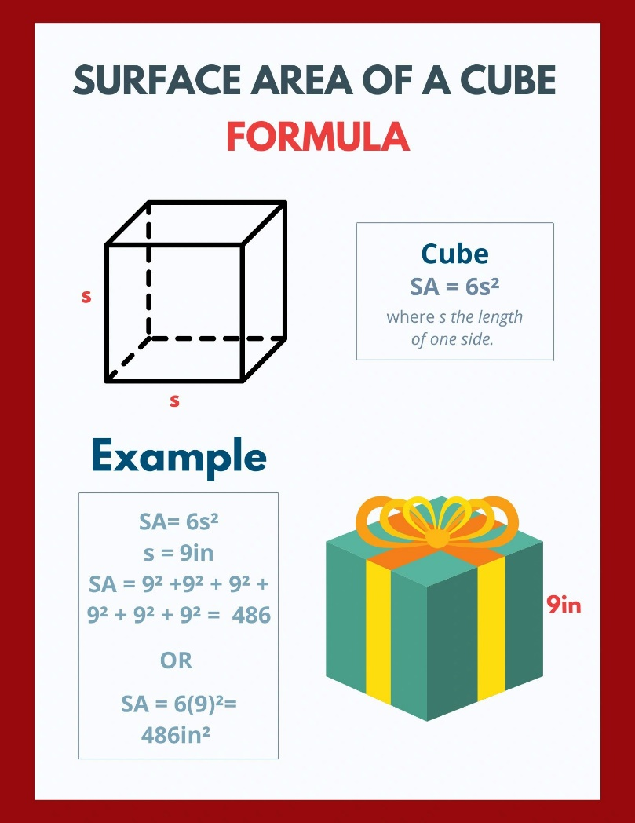
Mastering Surface Area of Cubes
A cube is a special kind of rectangular prism where all six faces are congruent squares
The formula to find the surface area of a cube is SA = 6s², where s is the length of one side
Surface area of a cube can be used to calculate the amount of wrapping paper needed to wrap a cube-shaped gift
Notes:
Cubes are a special kind of rectangular prism where all six faces are congruent squares. To find the surface area of a cube, we use the formula SA = 6s², where s is the length of one side. Calculating the surface area of a cube can be useful for determining the amount of wrapping paper needed to wrap a cube-shaped gift, for example. Now that you know how to calculate the surface area of a rectangular prism and a cube, you are ready to tackle real-world problems involving surface area!

Slide 6
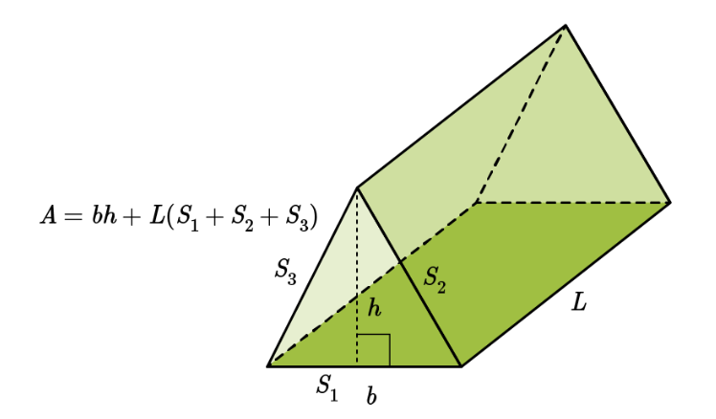
What is a Triangular Prism?
A three-dimensional shape with two triangular bases
It has 3 rectangular faces and 2 triangular faces
It has 9 edges and 6 vertices
Notes:
Introduce the concept of a triangular prism and provide some basic information about its characteristics.

Slide 7
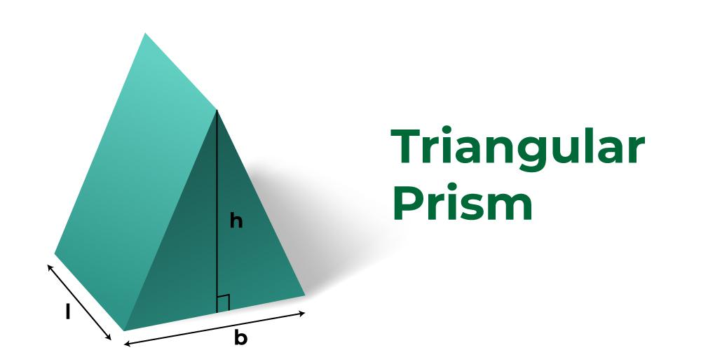
Calculating the Surface Area of a Triangular Prism
Surface area is the sum of the areas of all faces of a three-dimensional shape
To calculate the surface area of a triangular prism, find the area of each face and add them together
The formula for finding the surface area of a triangular prism is: SA = (l x w) + (l x s) + (w x s) + (b x h) + (b x h)
Notes:
Explain how to calculate the surface area of a triangular prism using the formula and provide an example.

Slide 8
Example Problem: Finding the Surface Area of a Triangular Prism
Calculate
Given the dimensions of a triangular prism, calculate its surface area using the formula
Show
Show step-by-step how to apply the formula to the given dimensions
Include
Include units in the final answer
Notes:
Provide a detailed example problem to demonstrate the process of finding the surface area of a triangular prism.

Slide 9
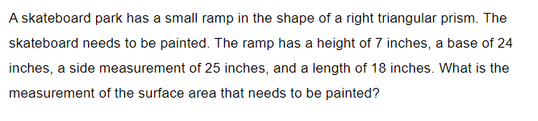
Practice

Slide 10
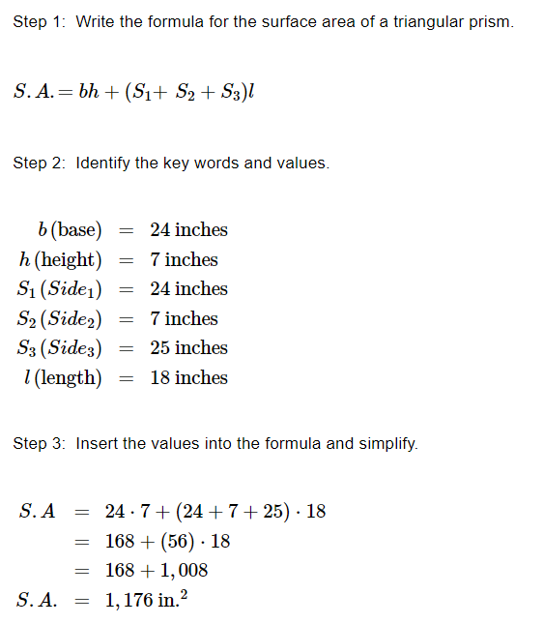

Slide 11

Real-World Applications of Triangular Prism Surface Area
Calculating the surface area of a tent to determine the amount of fabric needed for construction
Determining the amount of paint or wallpaper needed to cover the walls of a triangular prism-shaped room
Calculating the surface area of a shipping container to determine shipping costs
Notes:
Describe some practical uses for knowing how to calculate the surface area of a triangular prism.

Slide 12
Review: Calculating Surface Area of Triangular Prisms
A triangular prism has two triangular bases and three rectangular faces
To find the surface area, calculate the area of each face and add them together
Use the formula SA = (l x w) + (l x s) + (w x s) + (b x h) + (b x h)
Notes:
Summarize the key information covered in the presentation and provide a review of how to calculate the surface area of a triangular prism.

