Slide 1
Math 7 B
Unit 3: Angle Pairs
Lesson 7: Solve Equations with Supplementary Angles

Slide 2
Key Words
equation – a mathematical statement showing that two quantities or expressions are equal
supplementary angles – two angles whose measures add up to 180 degrees

Slide 3

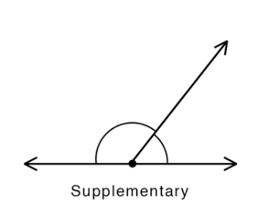
Identifying Supplementary Angles
Supplementary angles are two angles that add up to 180 degrees
If two angles are known to be supplementary angles and you know the measure of one, you can determine the measure of the other angle by subtracting the known angle from 180 degrees
Notes:
The first step to working with supplementary angles is identifying them. When two angles add up to 180 degrees, they are considered supplementary. We can use this knowledge to find the missing angle when only one angle is known. Now let's see how to draw them.

Slide 4
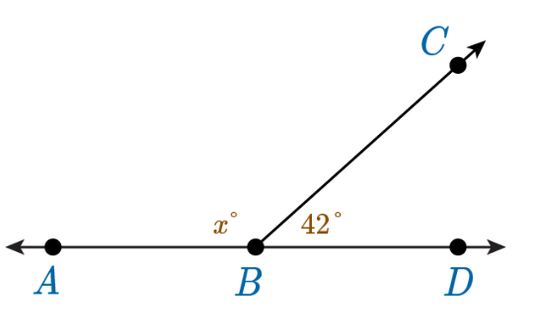
Supplementary Angles
In this case, the line AD is a horizontal line, so the two angles are supplementary, meaning that they will add up to 180°.
To solve for the missing angle measurement x, write an equation: x°+42°=180°.
Solving this equation will reveal the value of x, which is the value of that angle.

Slide 5
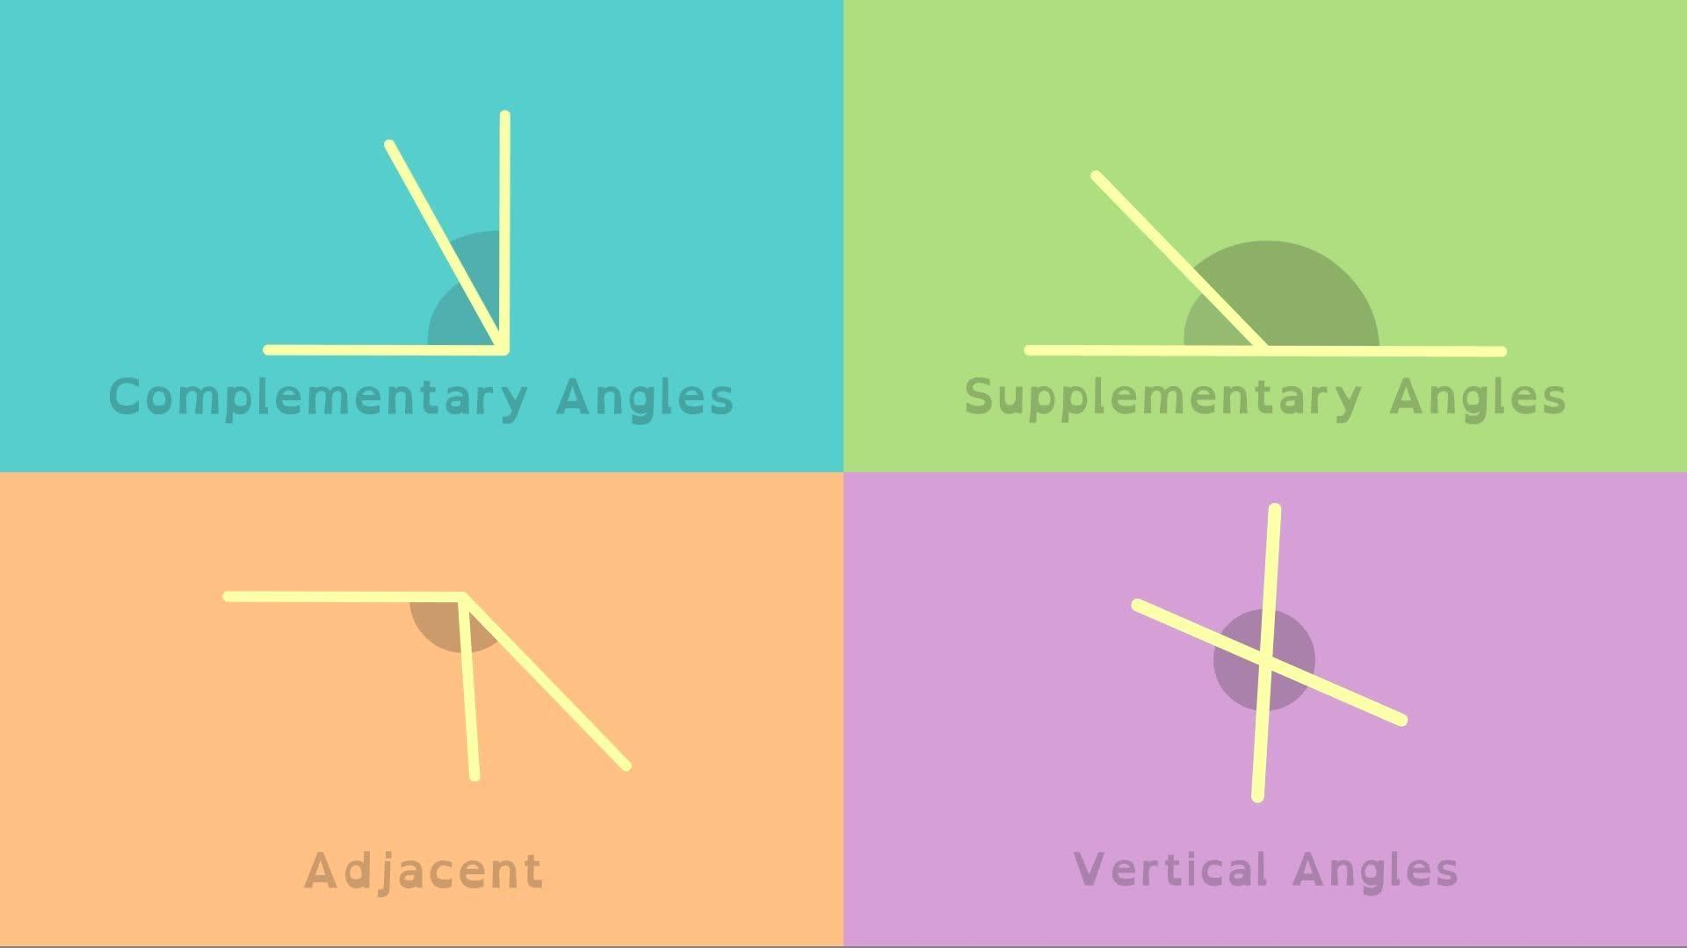
Solving Problems with Supplementary Angles
Using the fact that supplementary angles add up to 180 degrees, we can solve problems involving unknown angles
When working with supplementary angles, we can set up an equation to solve for the missing angle
Notes:
Now that we know how to identify and draw supplementary angles, it's time to learn how to solve problems involving them. We can use the fact that supplementary angles add up to 180 degrees to set up an equation to solve for the missing angle. With this technique, we can easily solve problems involving supplementary angles.

Slide 6
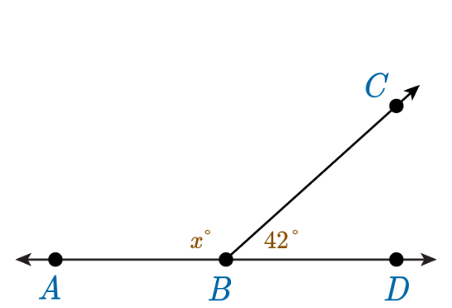
Example Problem
In the image, ∠ABC and ∠CBD are supplementary. That means that their measures will add up to 180°. Using this fact, you can determine the value of the missing angle by setting up and solving an equation:
x + 42° = 180° → Set up the equation to equal 180°
x + 42° - 42° = 180° - 42° → Subtract 42° from each side
x = 138°
The value of the unknown angle is 138°.
Notes:
Let's put our knowledge of supplementary angles to use with this example problem. We know that the two angles are supplementary, so they add up to 180 degrees. We also know that one angle measures 40 degrees. To find the measure of the other angle, we can subtract the known angle from 180 degrees. The other angle measures 140 degrees.

Slide 7
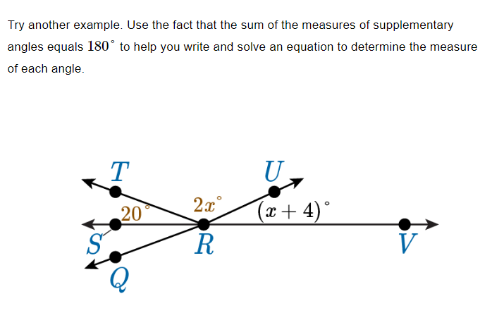
Practice Problem
Notes:
Let's put our knowledge of supplementary angles to use with this example problem. We know that the two angles are supplementary, so they add up to 180 degrees. We also know that one angle measures 40 degrees. To find the measure of the other angle, we can subtract the known angle from 180 degrees. The other angle measures 140 degrees.

Slide 8
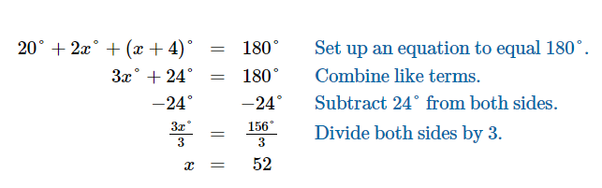
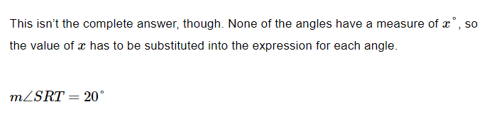
Solution

Slide 9

Real-World Application of Supplementary Angles
In construction, supplementary angles are used to make sure that the angles of the building are correct
Supplementary angles are also used in navigation to help determine directions
Supplementary angles are used in design and layout of various objects, such as furniture and buildings
Notes:
Supplementary angles have many real-world applications in fields such as construction, navigation, and design. In construction, supplementary angles are used to make sure that the angles of the building are correct. This is important to ensure that the building is structurally sound and able to withstand the forces it will experience. In navigation, supplementary angles are used to help determine directions. By measuring the angle between the sun and the horizon at a given time of day, navigation can be done without the need for modern technology. Supplementary angles are also used in design and layout of various objects, such as furniture and buildings. By ensuring that angles are supplementary, designers can create objects that are functional and visually appealing.

Slide 10

Conclusion
Supplementary angles are two angles whose measures add up to 180 degrees
To solve for the missing angle measurement, we can set up an equation to solve for the missing angle
In construction, supplementary angles are used to make sure that the angles of the building are correct
Notes:
In conclusion, understanding the concept of supplementary angles is crucial in various fields such as construction and navigation. By solving equations to determine missing angle measurements, we can ensure the accuracy of designs and layouts. Thank you for your attention.

