Slide 1
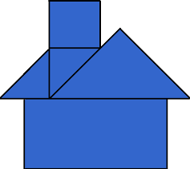
Area of Composite Two-Dimensional Shapes
Math 7B
Unit 5 Lesson 3
Notes:
Hello everyone, in this presentation, we will be learning how to solve problems involving the area of composite two-dimensional shapes made of polygons. We will start with the definition of composite shapes and give examples of composite shapes.

Slide 2
Key Words
area – the measurement of two-dimensional space taken up by an object or figure
composite shape – a shape made up of smaller shapes
polygon – a closed figure with three or more straight sides
rectangle – a quadrilateral with four right angles
square – a quadrilateral with four right angles and four equal sides
triangle – a three-sided polygon

Slide 3
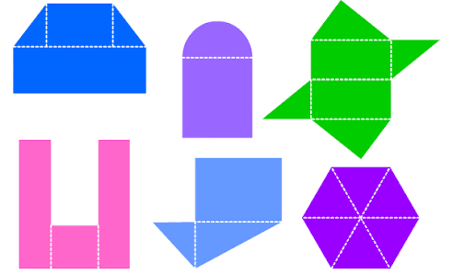
What is a composite shape?
A composite shape is a shape made up of two or more two-dimensional shapes.
Composite shapes can be made up of polygons or other shapes like circles.
Notes:
A composite shape is a shape made up of two or more two-dimensional shapes. In other words, it is a shape made up of other shapes. This is also known as a compound shape. Composite shapes can be made up of polygons or other shapes like circles. Let us look at examples of composite shapes.

Slide 4

Real-World Examples
Calculating the area of a garden bed that consists of a rectangle and an adjacent semicircle
Determining the area of a soccer field that has a semicircular section at each end
Computing the area of a playground that is made up of a rectangle with a triangular section on one end
Notes:
Real-world examples of composite shapes can be found in a variety of situations including landscaping, sports fields, and playgrounds.

Slide 5
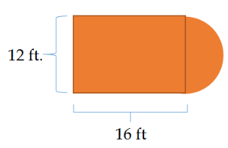
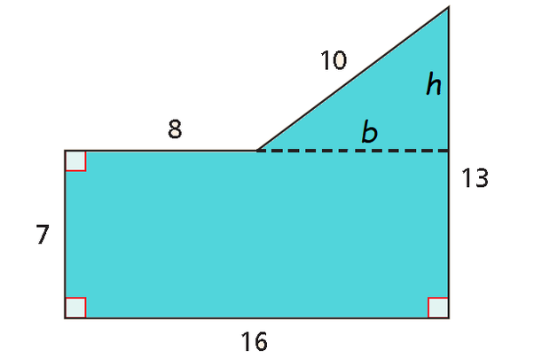
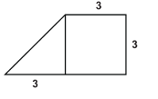
Examples of Composite Shapes
A rectangle with a semicircle on top
A triangle with a rectangle on the bottom
A square with a triangle on the side
Notes:
Here are some examples of composite shapes. We have a rectangle with a semicircle on top, a triangle with a rectangle on the bottom, and a circle with a rectangle on the side. Notice that each of these shapes is made up of two or more other shapes. Now, let us learn how to find the area of these composite shapes.

Slide 6
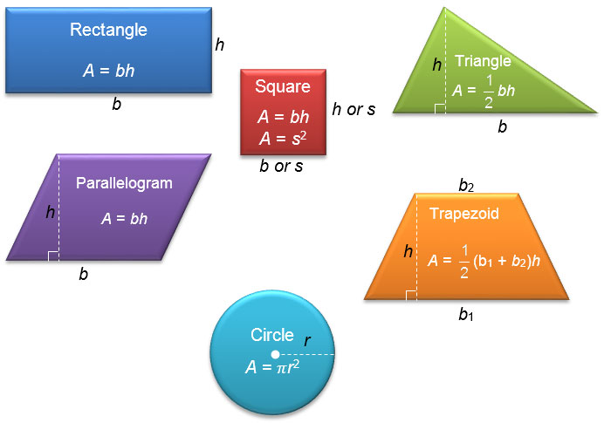
Finding the area of composite shapes
Break down the composite shape into smaller shapes
Find the area of each smaller shape
Add the areas of all the smaller shapes together
Notes:
To find the area of a composite shape, we need to break it down into smaller shapes, find the area of each smaller shape, and then add the areas of all the smaller shapes together. Let us go through an example to better understand this process.

Slide 7
Example: Finding the area of a composite shape
A composite shape made up of a rectangle and a semicircle
Divide the shape into a rectangle and a semicircle
Find the area of the rectangle and the semicircle
Add the areas of the rectangle and semicircle together to get the total area
Notes:
Here is an example of how to find the area of a composite shape. We have a composite shape made up of a rectangle and a semicircle. We can divide the shape into a rectangle and a semicircle. Then, we can find the area of the rectangle and the semicircle. Finally, we can add the areas of the rectangle and semicircle together to get the total area. Let us try a practice problem.

Slide 8
Practice Problem
Find the area of the composite shape below
Divide the shape into smaller shapes
Find the area of each smaller shape
Add the areas of all the smaller shapes together
Notes:
Here is a practice problem for you to solve. Find the area of the composite shape below by dividing it into smaller shapes, finding the area of each smaller shape, and then adding the areas of all the smaller shapes together. Good luck!

Slide 9
Practice Problem
Find the area of the composite shape below
Divide the shape into smaller shapes
Find the area of each smaller shape
Add the areas of all the smaller shapes together
Notes:
Here is a practice problem for you to solve. Find the area of the composite shape below by dividing it into smaller shapes, finding the area of each smaller shape, and then adding the areas of all the smaller shapes together. Good luck!

Slide 10
Recap: Finding the area of composite shapes
Break down the composite shape into smaller shapes
Find the area of each smaller shape
Add the areas of all the smaller shapes together
Notes:
To find the area of a composite shape, we need to break it down into smaller shapes, find the area of each smaller shape, and then add the areas of all the smaller shapes together. Let us go through an example to better understand this process.

