Slide 1
Experimental Probability
Math 7B Unit 8 Lesson 3
Notes:
Probability refers to the likelihood of an event occurring, while relative frequency is the number of times an event occurs in relation to the total number of trials. We can use probability to predict relative frequency.

Slide 2
Keywords
empirical probability – a numerical measure that describes how frequently an event occurred in an actual
frequency – the number of times an event occurred in a random experiment
relative frequency – the ratio of the number of times the event occurred to the total number of trials conducted
theoretical probability – a numerical measure for the likelihood of an event to happen

Slide 3

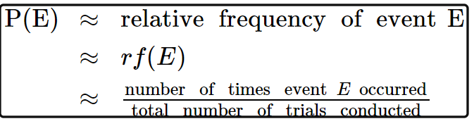
Example: Tossing a Coin
When we toss a coin, there are two possible outcomes – heads or tails.
The probability of getting heads is 1/2 or 0.5, and the probability of getting tails is also 1/2 or 0.5.
If we toss the coin 100 times, we can expect to get around 50 heads and 50 tails.
This means that the relative frequency of getting heads is approximately 0.5, and the relative frequency of getting tails is also approximately 0.5.
Notes:
Let's apply the concept of probability to predict the relative frequency of getting heads and tails when we toss a coin.

Slide 4
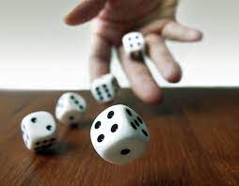
Example: Rolling a Die
A die has six possible outcomes – 1, 2, 3, 4, 5, or 6.
The probability of getting any one of these outcomes is 1/6 or approximately 0.17.
If we roll the die 120 times, we can expect to get around 20 of each outcome (1, 2, 3, 4, 5, or 6).
This means that the relative frequency of getting any one of these outcomes is approximately 0.17.
Notes:
Let's apply the concept of probability to predict the relative frequency of getting any one of the six outcomes when we roll a die.

Slide 5
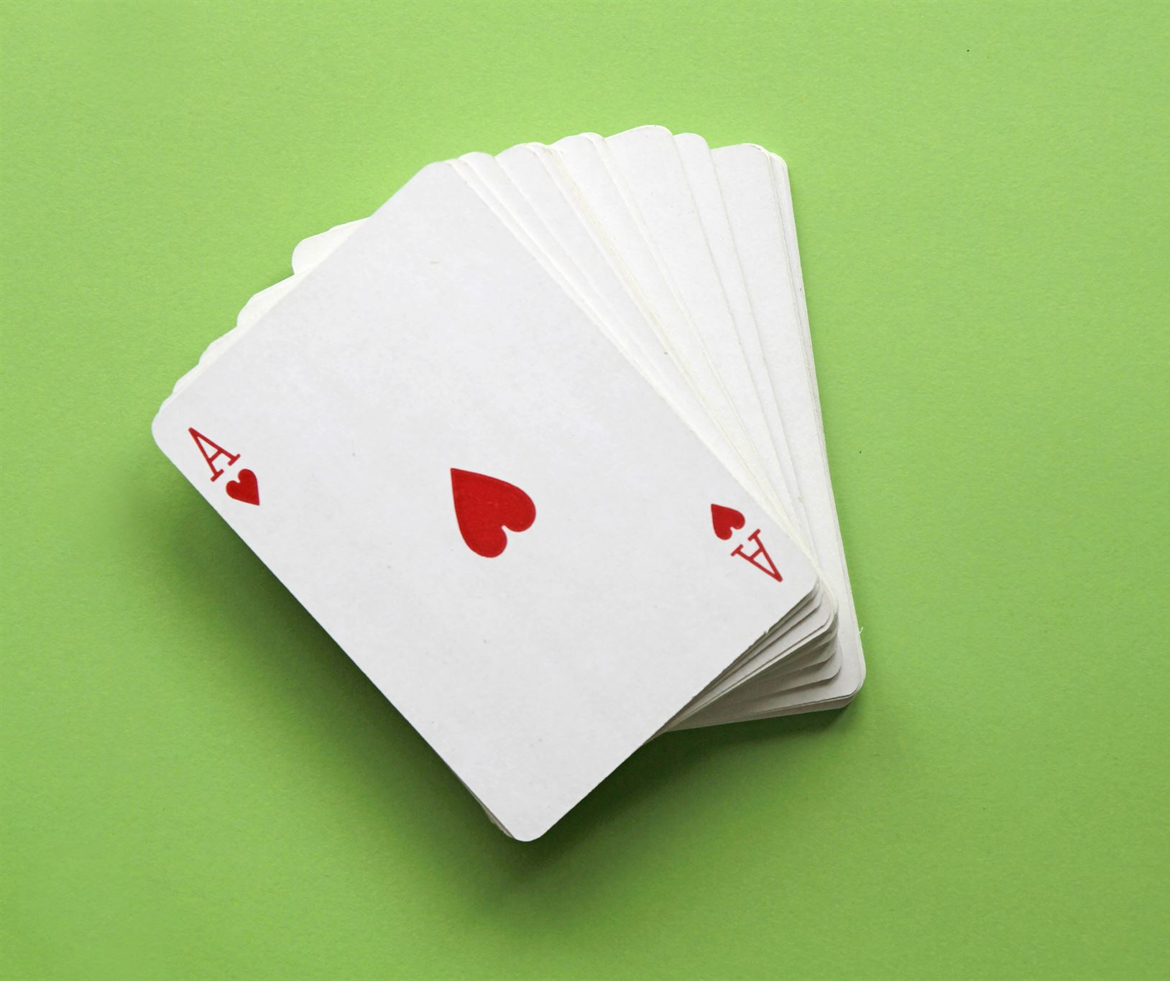
Example: Drawing a Card
A standard deck of cards has 52 cards, divided into 4 suits – hearts, diamonds, clubs, and spades.
There are 13 cards in each suit – ace, 2, 3, 4, 5, 6, 7, 8, 9, 10, jack, queen, and king.
If we draw a card from a shuffled deck, the probability of getting any one of these cards is 1/52 or approximately 0.02.
If we draw 500 cards from a shuffled deck, we can expect to get around 10 of each card (ace, 2, 3, 4, 5, 6, 7, 8, 9, 10, jack, queen, and king).
This means that the relative frequency of getting any one of these cards is approximately 0.02.
Notes:
Let's apply the concept of probability to predict the relative frequency of getting any one of the 52 cards when we draw a card from a shuffled deck.

Slide 6
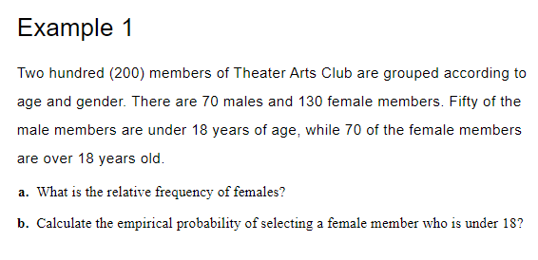
Practice

Slide 7
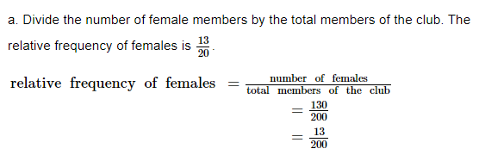
Solve

Slide 8
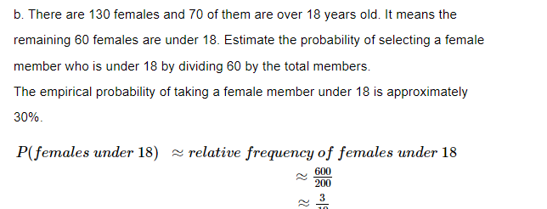
Solve

Slide 9
Keywords
Counter example – an example that disproves a statement or claim
Experimental probability – a numerical measure that describes how frequently an event occurred in an actual experiment
frequency – the number of times an event occurred in a random experiment
Law of large numbers – the experimental probability of an event gets closer to its theoretical probability as the number of trials increases
relative frequency – the ratio of the number of times the event occurred to the total number of trials conducted
theoretical probability – a numerical measure for the likelihood of an event to happen

Slide 10
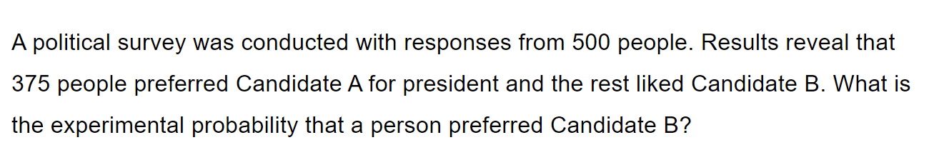
Practice
Notes:
16% answer

Slide 11
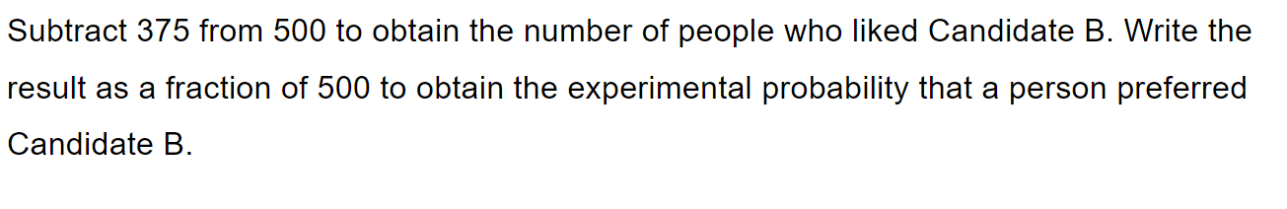
Practice
Notes:
16% answer

Slide 12



Solve
Notes:
16% answer

Slide 13
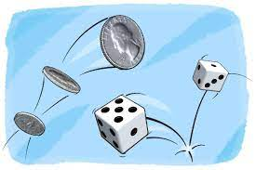
Conclusion
Probability can be used to predict approximate relative frequency.
Relative frequency is the number of times an event occurs in relation to the total number of trials.
By understanding probability and relative frequency, we can make predictions and draw conclusions about chance events.
Notes:
We have learned that probability can be used to predict the approximate relative frequency of events. This is a useful skill that can be applied to a wide range of scenarios.

