Slide 1
Assessing Visual Overlap of Two Numerical Data Distributions
Math 7B Unit 9 Lesson 6
Notes:
Welcome to the presentation on Assessing Visual Overlap of Two Numerical Data Distributions with Similar Variabilities. In this presentation, you will learn how to informally assess the degree of visual overlap of two numerical data distributions with similar variabilities. Let's get started!

Slide 2
Key Words
distribution – the shape and spread of data values on a visual display
dot plot – a visual display of data using dots
mean – the sum of the data divided by the number of data values
measure of center – a measure that describes the typical value of a data set
median – the middle value of a data set when data values are ordered from least to greatest
mode – the most frequent value in a data set
outlier – a data point that is significantly different than all of the other data points
range – the difference between the largest and smallest data values
Notes:
Speaker notes: In statistics, mean is a measure of center of a data set. It is also known as the average value. Mean is calculated by adding all the numbers in the data set and then dividing the sum by the number of values in the set. For example, if we have a data set of test scores [55, 60, 70, 80, 90], the mean can be calculated as (55+60+70+80+90)/5= 71. This means that the average test score in this data set is 71.

Slide 3
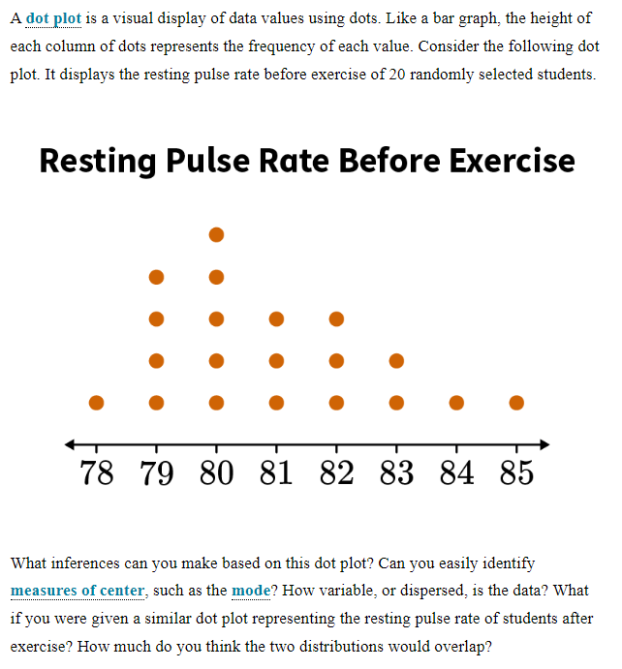
Dot Plot Review
A dot plot is a useful tool for displaying numerical data
It uses dots to represent data points
It is especially useful for small data sets

Slide 4
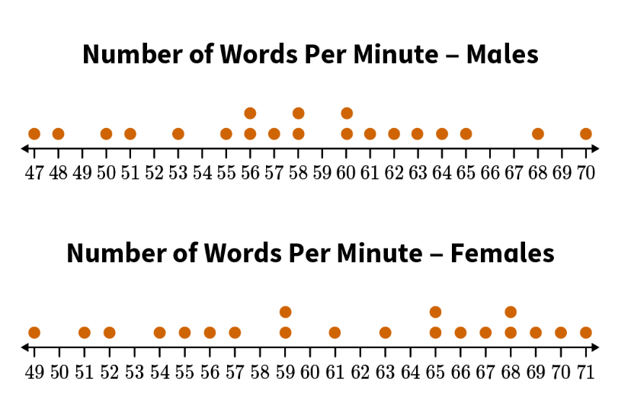
Overview of Visual Overlap and Variability
Visual overlap occurs when two data sets share similar values or ranges
Example:
Variability refers to the spread of the data points in a data set
Assessing visual overlap is important for comparing data sets and identifying trends
Notes:
Before we dive into the specifics of assessing visual overlap, let's first define the terms 'visual overlap' and 'variability'. Visual overlap occurs when two data sets share similar values or ranges. Variability, on the other hand, refers to the spread of the data points in a data set. Assessing visual overlap is important for comparing data sets and identifying trends.

Slide 5
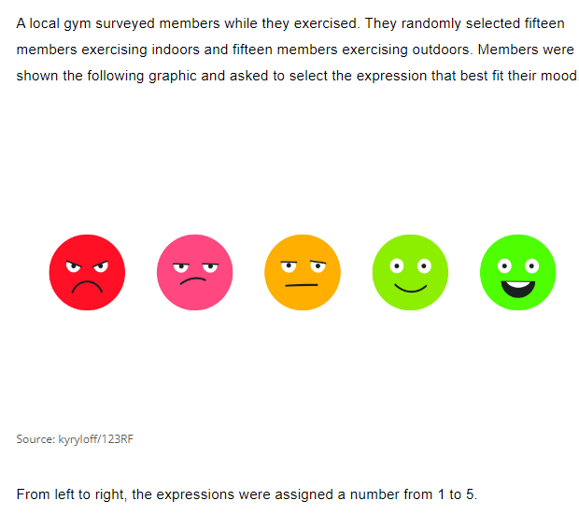
Practice

Slide 6
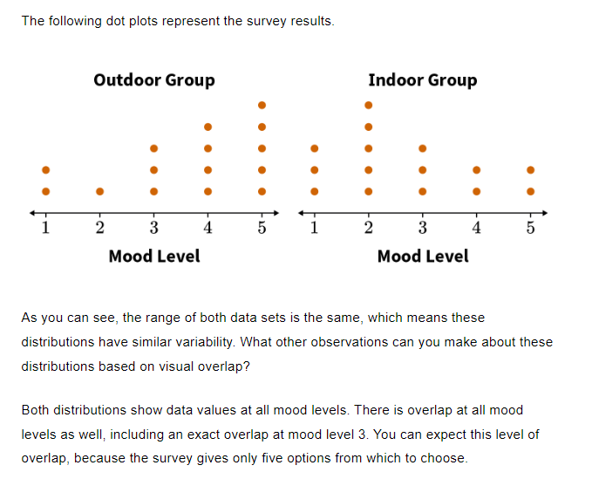

Slide 7
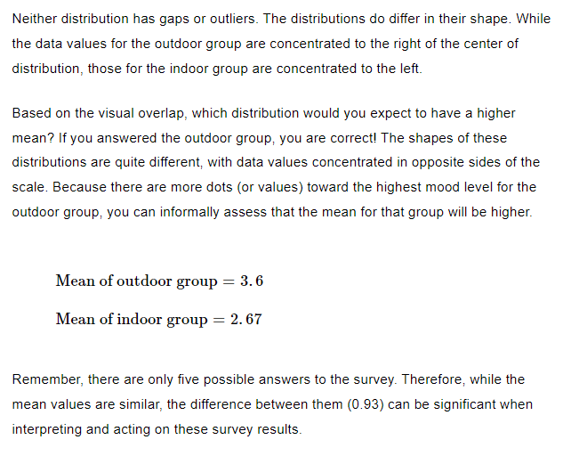

Slide 8
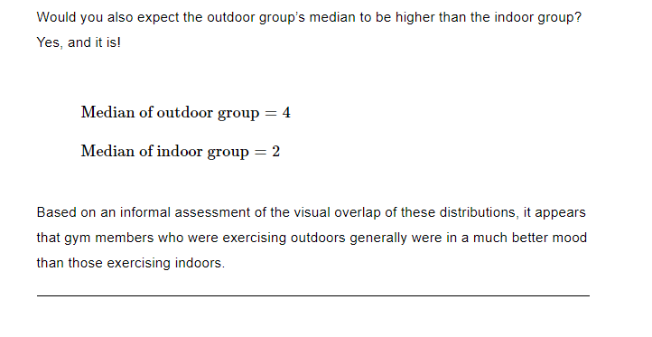

Slide 9
Key Words
asymmetric distribution – a distribution in which the shape of the graph on one side of the center is different from the other side
measure of center – a measure that describes the typical value of a data set
measure of variability – a measure that indicates how dispersed or varied data values are in a data set
symmetric distribution – a distribution in which the shape of the graph on one side of the center is the same as the other side
Notes:
Speaker notes: In statistics, mean is a measure of center of a data set. It is also known as the average value. Mean is calculated by adding all the numbers in the data set and then dividing the sum by the number of values in the set. For example, if we have a data set of test scores [55, 60, 70, 80, 90], the mean can be calculated as (55+60+70+80+90)/5= 71. This means that the average test score in this data set is 71.

Slide 10
Measures of Center and Variability
Two numerical data distributions can be compared through their measures of center and variability.
A measure of center gives the typical value of the data set, and it provides the center of the distribution.
A measure of variability, on the other hand, indicates how varied or spread out the distribution of data values is.
Notes:
Mean is a commonly used measure of central tendency and is useful in comparing data sets.

Slide 11
Comparing Two Numerical Distributions
The mean, median, and mode are the most common measures of center. If these measures of center are equal, then the distribution of data is symmetric. In a symmetric distribution, the shape of the graph on one side of the center is the same as the other side.
If these measures of center have different values, then the distribution of data is asymmetric. In an asymmetric distribution, the shape of the graph on one side of the center is different from the other side.

Slide 12
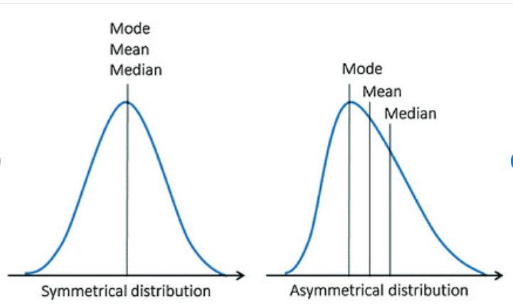
Measures of variability play an important role in describing the dispersion of data in the given distribution.
High variability, or dispersion, indicates that values tend to fall further away from the center of the data set and are less consistent
A high range indicates values are spread out
Low variability, or dispersion, indicates values are clustered around the center of the data set and are more consistent.
A low range indicates values are close together.

Slide 13
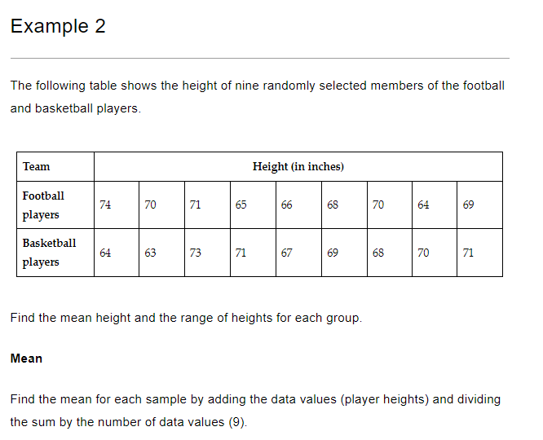
Practice

Slide 16
Summary
Assessing visual overlap of two numerical data distributions
Measures of center
Visual overlap and variability
Measuring the difference between centers

