Slide 1
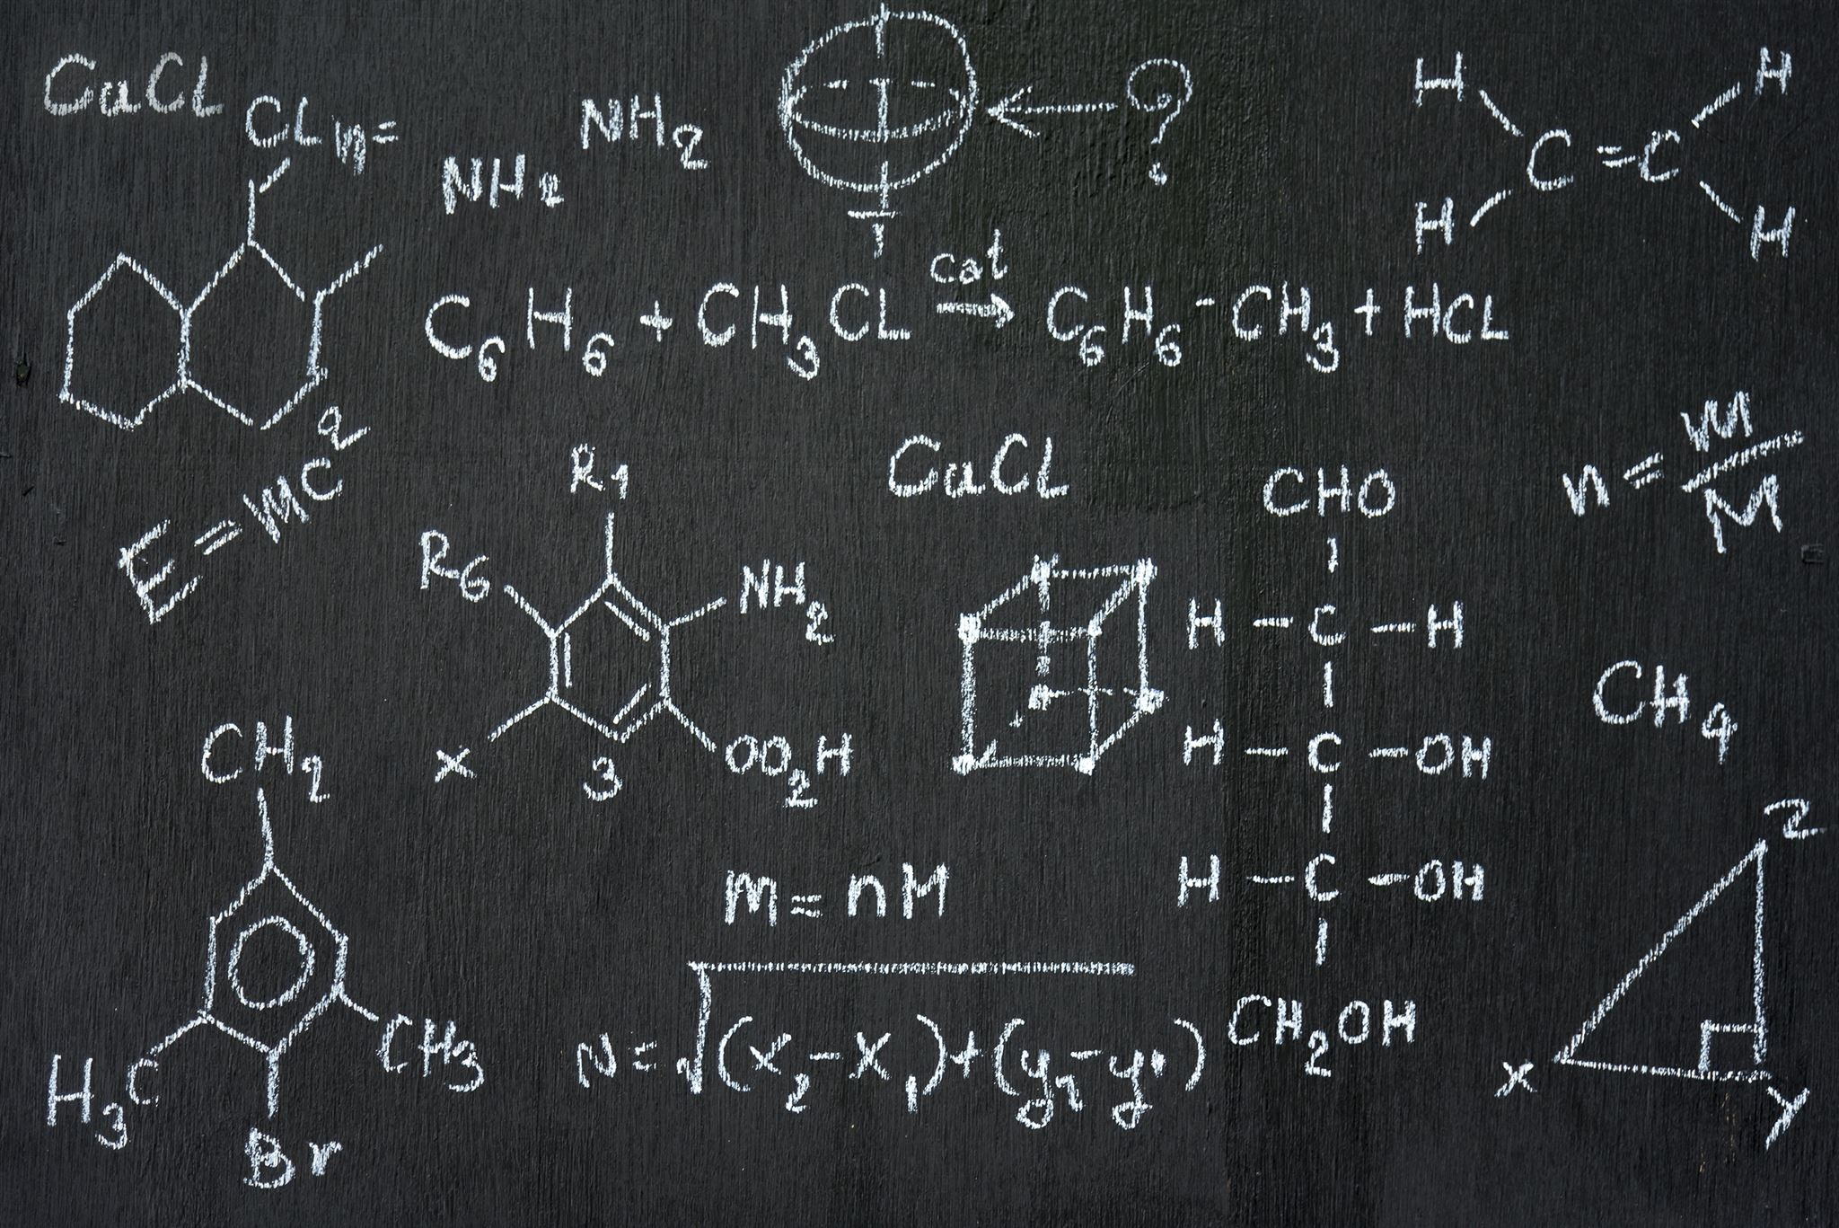
Welcome to the Mean
Math 7B Unit 9 Lesson 4
Notes:
In this presentation, we will learn about how to find the mean of quantitative data sets. The mean is a measure of central tendency. It tells us where the center of the data is. Let's begin!

Slide 2
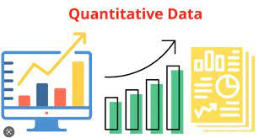
Key Words
mean – the sum of the data divided by the number of data values
outlier – a data point that is significantly different than all of the other data points
quantitative data – data that can be measured or counted

Slide 3

What is the Mean?
The mean is the sum of all the values in a data set divided by the number of values in the data set
The mean is also referred to as the average
In order to find the mean, you need to know all the values in the data set
The mean is a measure of central tendency that can help us compare different data sets
Notes:
The mean is a way of finding the center of the data. It can be used to compare different data sets and to see how much variation there is in the data. To find the mean, we add up all the values in the data set and then divide by the number of values.

Slide 4
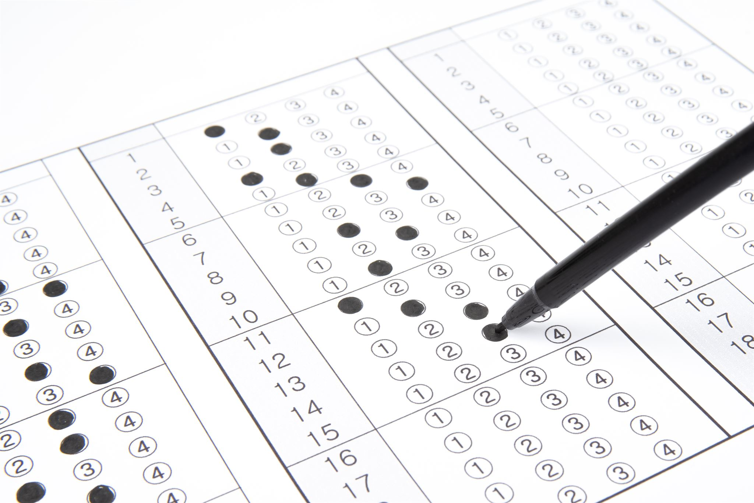
Finding the Mean: Example 1
Let's say we have a data set of test scores: 85, 90, 92, 88, 95
To find the mean, we add up all the scores: 85 + 90 + 92 + 88 + 95 = 450
There are 5 scores in the data set, so we divide by 5: 450 / 5 = 90
The mean test score is 90
Notes:
Let's look at an example of how to find the mean. Suppose we have a data set of test scores: 85, 90, 92, 88, 95. To find the mean, we add up all the scores and then divide by the number of scores. In this case, the mean test score is 90.

Slide 5
Finding the Mean: Example 2
Now let's say we have a data set of heights in inches: 62, 65, 69, 70, 72, 76
To find the mean, we add up all the heights: 62 + 65 + 69 + 70 + 72 + 76 = 414
There are 6 heights in the data set, so we divide by 6: 414 / 6 = 69
The mean height is 69 inches
Notes:
Let's look at another example of how to find the mean. Suppose we have a data set of heights in inches: 62, 65, 69, 70, 72, 76. To find the mean, we add up all the heights and then divide by the number of heights. In this case, the mean height is 69 inches.

Slide 6
What is an Outlier?
An outlier is a data point that is significantly different from other data points in a data set.
Outliers can be caused by measurement errors, natural variation, or other factors.
It's important to identify outliers because they can have a big impact on the mean and other measures of central tendency.
Notes:
An outlier is a data point that is significantly different from other data points in a data set. Outliers can be caused by measurement errors, natural variation, or other factors. It's important to identify outliers because they can have a big impact on the mean and other measures of central tendency. For example, if there is an outlier in a data set, the mean may not be a good representation of the 'typical' value in the data set. When we calculate the mean, the outlier is given the same weight as all the other data points, which can skew the result. To identify outliers, we can use a number of methods, including the interquartile range (IQR) and the Z-score. We'll talk more about these methods in the next few slides.

Slide 7
Practice!
Now that we know how to find the mean, let's practice!
Here are two data sets. Find the mean for each one:
Data set 1: 4, 8, 12, 16, 20
Data set 2: 3, 7, 9, 11, 15, 20
Notes:
It's time to practice finding the mean! Here are two data sets. Can you find the mean for each one? Data set 1: 4, 8, 12, 16, 20. Data set 2: 3, 7, 9, 11, 15, 20. Good luck!

Slide 8
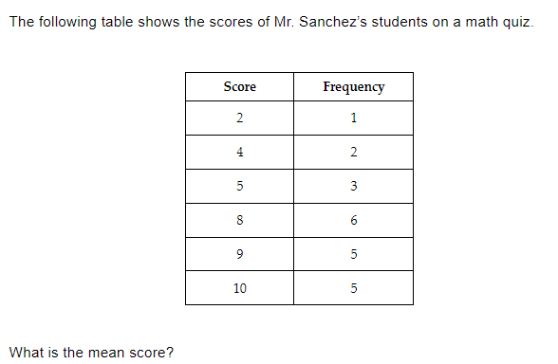
Practice

Slide 9
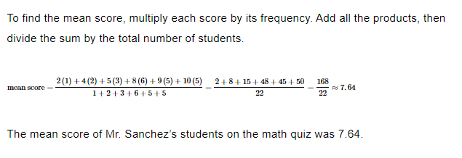

Slide 10
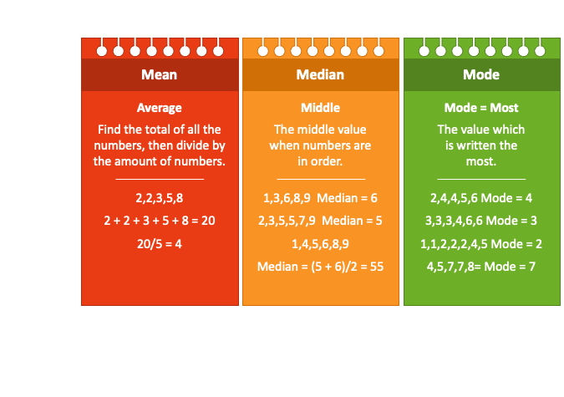
Key Words
mean – the sum of the data divided by the number of data values
outlier – a data point that is significantly different than all of the other data points
measure of center – a measure that describes the typical value of a data set
median – the middle value of a data set when data values are ordered from least to greatest
mode – the most frequent value in a data set

Slide 11
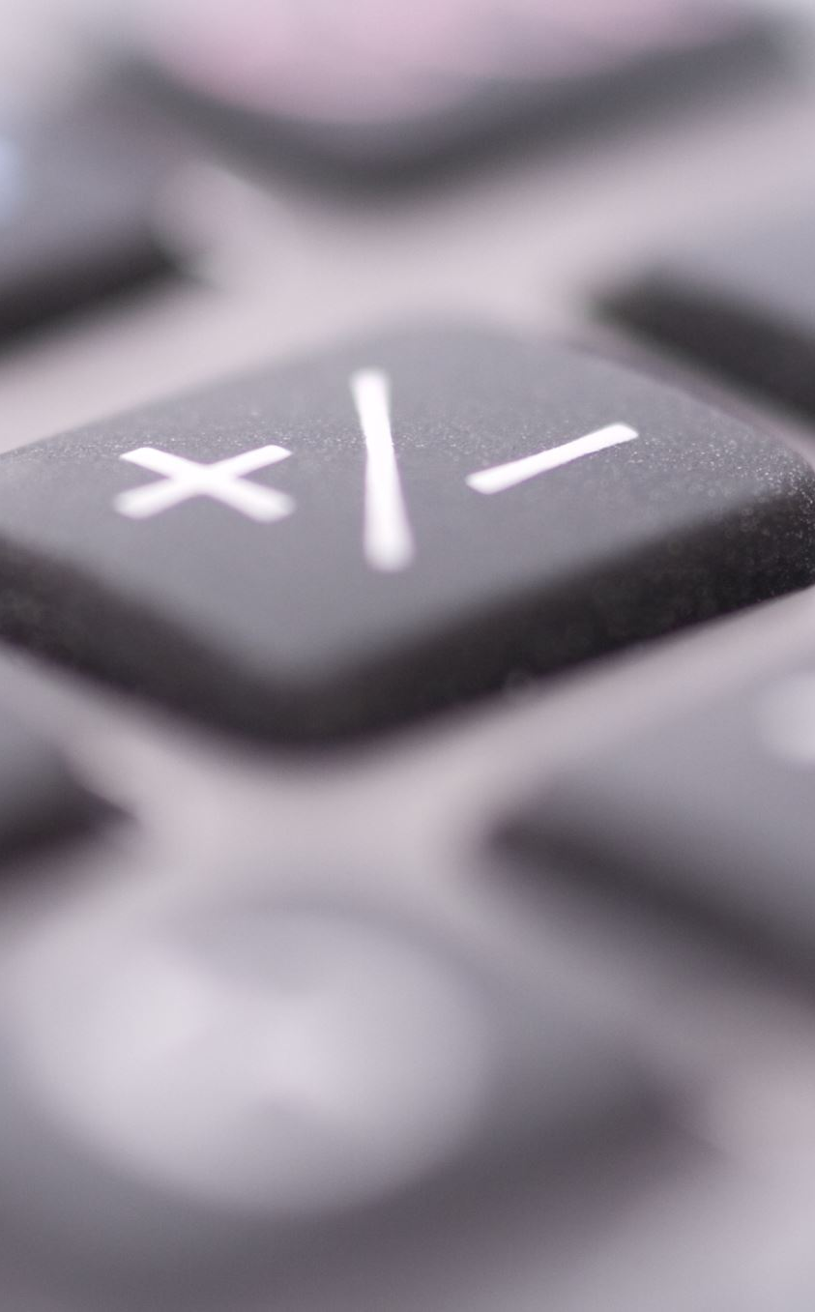
Introduction to Median
Median is the central value of a dataset
It divides the dataset into two halves with an equal number of values
Median is used as a measure of central tendency
Notes:
In statistics, median is a value that separates a dataset into two equal halves. It is a better measure of central tendency than mean when dealing with skewed datasets or datasets with outliers.

Slide 12
How to Find the Median
Arrange the dataset in ascending or descending order
If the dataset has an odd number of values, the median is the middle value
If the dataset has an even number of values, the median is the average of the two middle values
Notes:
To find the median, we need to order the dataset first. Then, we can determine the middle value(s) depending on whether the dataset has an odd or even number of values.

Slide 13
Example with a Quantitative Dataset
Let's say we have a dataset of exam scores: 80, 85, 90, 95, 100
We arrange the dataset in ascending order: 80, 85, 90, 95, 100
The median is the middle value, which is 90
Notes:
In this example, the dataset has an odd number of values, so the median is the middle value (90)

Slide 14

Example with a Dataset Represented in a Display
Let's say we have a dataset of ages represented in a dot plot
We count the number of dots: 2, 3, 4, 1, 2, 3, 2
We arrange the counts in ascending order: 1, 2, 2, 2, 3, 3, 4
The median is the middle value, which is 2
Notes:
In this example, we need to count the number of dots for each age and arrange them in ascending order. The median is the middle value, which is 2 (represented by the vertical line in the dot plot).

Slide 15
Practice Questions
Find the median of the following dataset: 7, 9, 3, 1, 5
Find the median of the following dataset: 10, 20, 30, 40, 50, 60
Find the median of the following dataset represented in a histogram
Which dataset has a higher median? Dataset A: 2, 4, 6, 8, 10 or Dataset B: 1, 3, 5, 7, 9
Practice Space:
Notes:
These practice questions will help you reinforce your understanding of finding the median for different datasets.

Slide 16
Summary
Median is the central value of a dataset
It divides the dataset into two halves with an equal number of values
To find the median, we need to arrange the dataset in ascending or descending order and determine the middle value(s)
Median is a better measure of central tendency than mean for skewed datasets or datasets with outliers
Notes:
Understanding how to find the median is important in statistics, as it helps us to identify the central tendency of a dataset. We can use the median as a measure of central tendency instead of the mean in certain situations.

