Slide 1
Welcome to the World of Range
Math 7B Unit 9 Lesson 5
Notes:
Good day! Today, we will learn how to determine the range of a quantitative data set. The range is the difference between the largest and the smallest numbers in a data set. In this presentation, we will take a closer look at how to calculate the range of data sets presented in line graphs and bar charts.

Slide 2
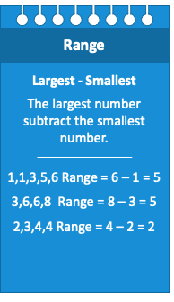
Key Words
measure of variability – a measure that indicates how dispersed or varied data values are in a data set
quantitative data set – a data set with numerical data values
range – the difference between the largest and smallest data values

Slide 3
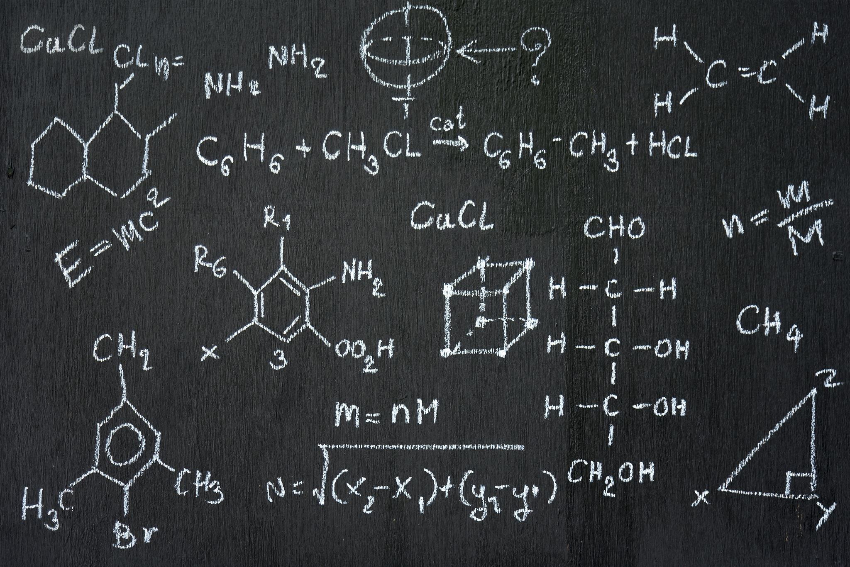
Understanding Range in Math
Range measures the spread of data in a set.
It tells us how far apart the highest and lowest values are in a set.
The formula for range is simple: Range = highest value - lowest value
Range can be used to compare data sets.
Notes:
In mathematics, range refers to the difference between the highest and lowest values in a given data set. It is a simple yet important measure of variability. Range can be used to compare different data sets and to understand how spread out the data points are in each set. Let's practice calculating range with some examples in the next slides.

Slide 4
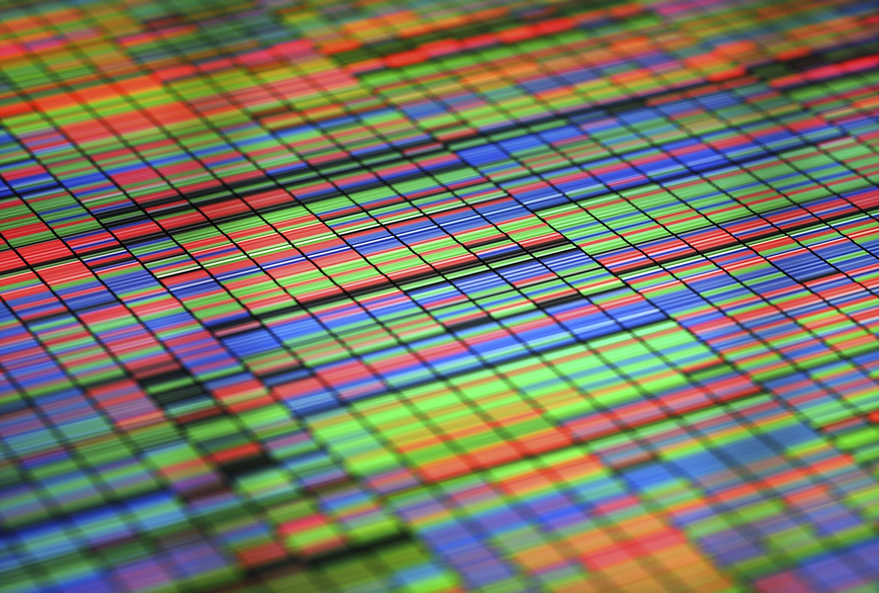
Variability in Math
Variability measures the extent of how spread out the data points are in a given data set.
Variability can be measured using range, interquartile range and standard deviation.
Range is the difference between the largest and smallest data points in a data set.
Interquartile range is the difference between the 75th percentile and the 25th percentile of the data set.
Standard deviation measures how far the data set is from the mean of the data set.
Measures of variability are useful for comparing data sets.
Notes:
In math, variability is a measure of how spread out the data points are in a given data set. There are different ways to measure variability, including range, interquartile range and standard deviation. Range is the difference between the largest and smallest data points in a data set. Interquartile range is the difference between the 75th percentile and the 25th percentile of the data set. Standard deviation measures how far the data set is from the mean of the data set. Measures of variability are useful for comparing data sets.

Slide 5
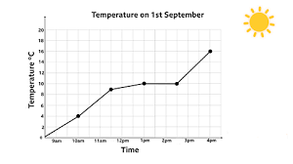
Line Graphs and Range
Line graphs are used to show a trend or a change over time
To calculate the range, find the highest and lowest points on the line graph
The difference between the highest and lowest points is the range
Notes:
Line graphs are often used to represent data that changes over time. To find the range of a data set presented in a line graph, find the highest and lowest points on the graph. The range is the difference between these two points.

Slide 6
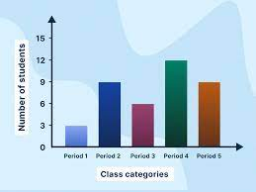
Bar Charts and Range
Bar charts are used to compare different categories of data
To calculate the range, find the tallest and shortest bars on the chart
The difference between the tallest and shortest bars is the range
Notes:
Bar charts are used to compare different categories of data. To find the range of a data set presented in a bar chart, find the tallest and shortest bars on the chart. The range is the difference between these two bars.

Slide 7
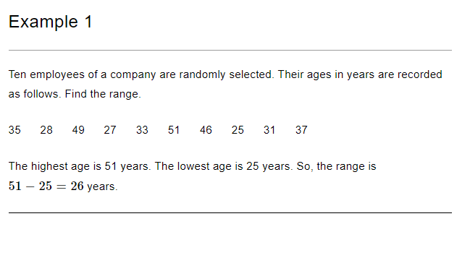
Practice

Slide 8
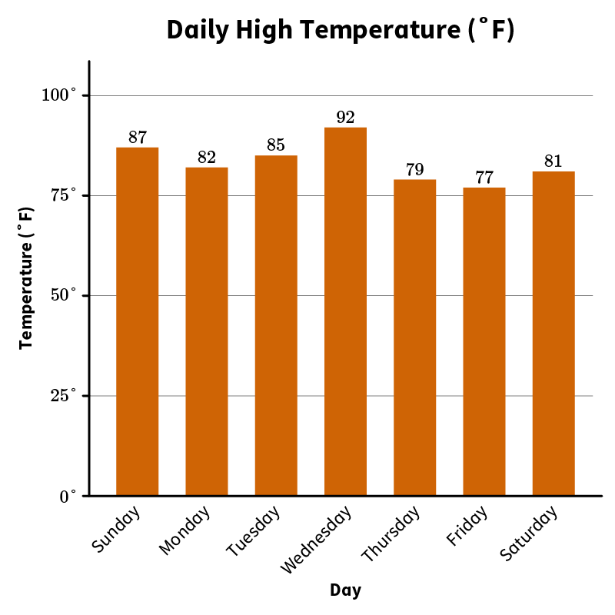
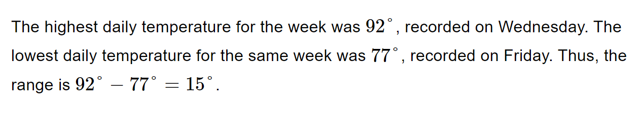
Practice- Find the Range

Slide 9
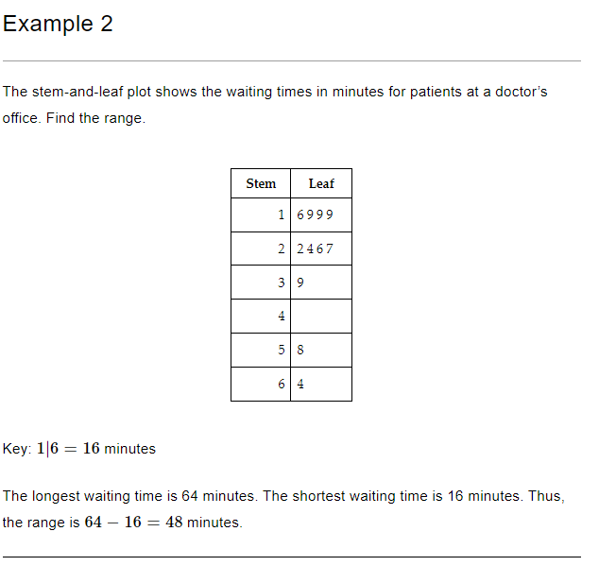
Practice

Slide 10
Key Words
parameter – a number that describes a characteristic of a whole population
statistic – a number that describes a characteristic of a sample

Slide 11
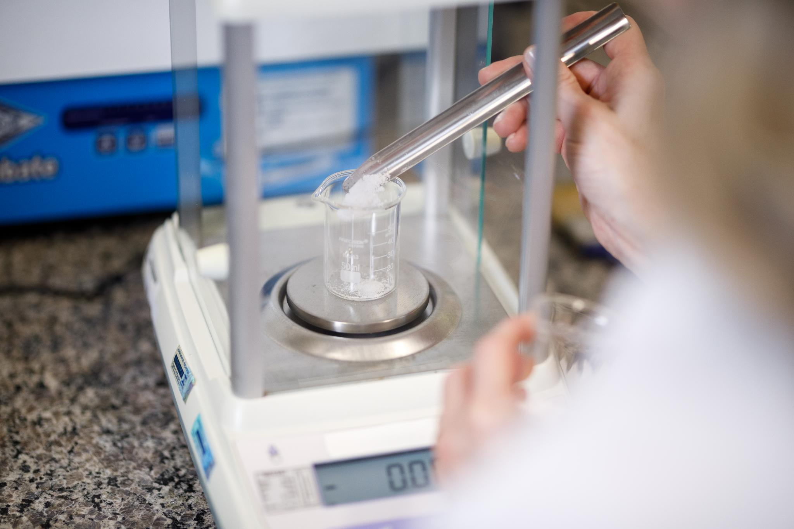
Generating Multiple Samples
Generating multiple samples of the same size is critical to gauge the variation in estimates or predictions.
Randomly selecting samples is essential to ensure the sample is representative.
When generating multiple samples, it is important to track the results carefully.
Notes:
In order to make accurate predictions or estimates, it is important to understand the variation in data. Generating multiple samples of the same size is one way to do this. When generating samples, it is important to randomly select them to ensure that they are representative of the population. Additionally, it is important to keep track of the results carefully to ensure accuracy.

Slide 12
Random Sampling
Random sampling involves selecting samples from a population randomly.
This method ensures that every member of the population has an equal chance of being selected.
Random sampling produces an unbiased representation of the population.
Notes:
Random sampling is the process of selecting samples from a population randomly. This ensures that every member of the population has an equal chance of being selected. Random sampling produces an unbiased representation of the population and is an essential tool when generating multiple samples to measure data variation.

Slide 13
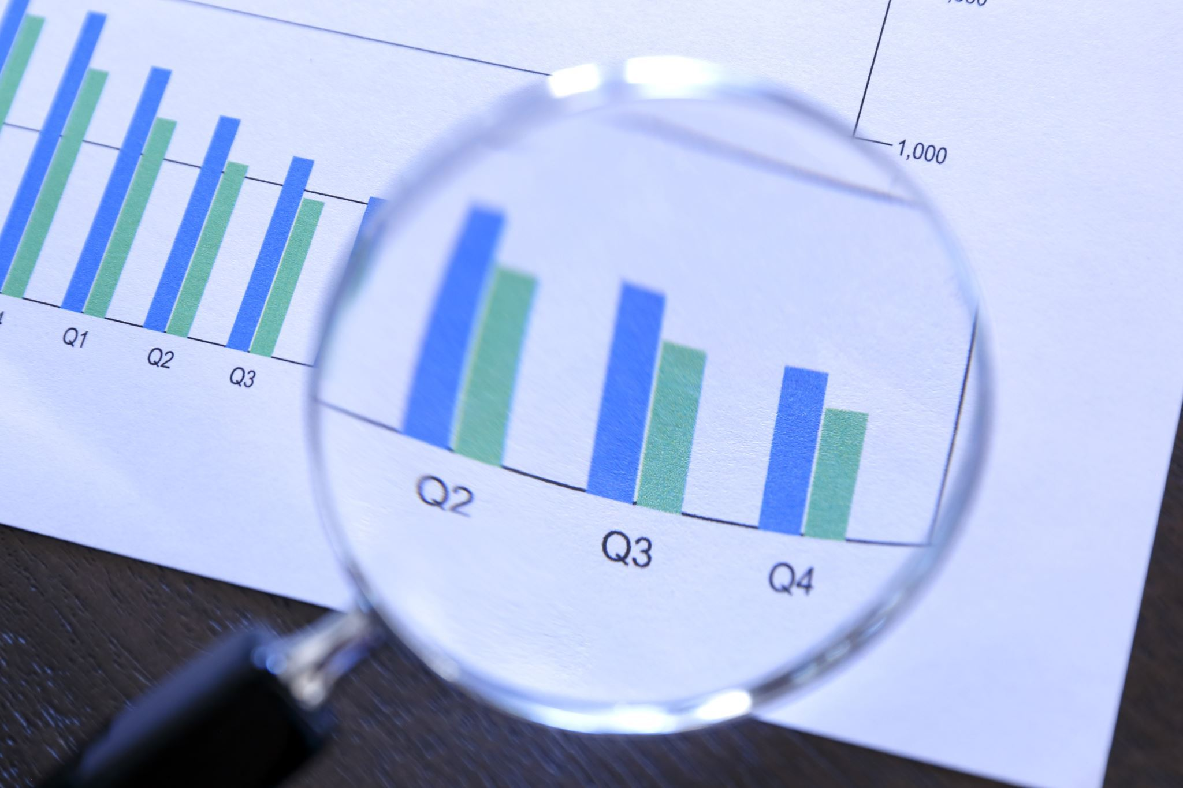
Tracking Results
When generating multiple samples, it is important to track the results carefully.
Keeping track of the results allows analysis of the variation between samples.
Tracking the results also helps identify any anomalies or errors in the process.
Notes:
When generating multiple samples, it is important to track the results carefully. This allows for analysis of the variation between samples and helps identify any anomalies or errors in the process. Keeping track of the results is an important step in accurately gauging the variation in estimates or predictions.

Slide 14
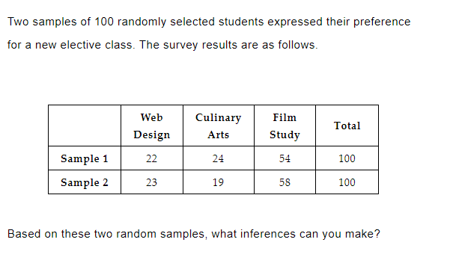
Practice

Slide 15
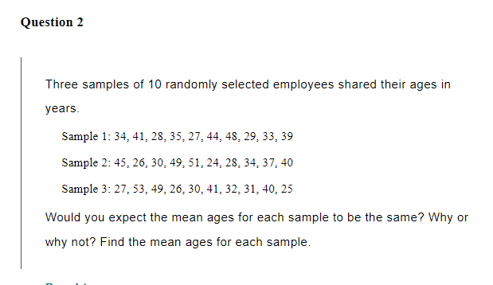
Practice

Slide 16
Measures of Variability in Math
Measures of variability help us understand how spread out a set of data is.
Range, interquartile range, and standard deviation are three common measures of variability.
Range is the difference between the highest and lowest values in a data set.
Interquartile range is the difference between the 75th percentile and the 25th percentile of a data set.
Standard deviation measures how far the data is from the mean of a data set.
Notes:
In order to make informed comparative inferences about two populations, we need to understand measures of variability in math. These measures of variability help us understand how spread out a set of data is. There are three common measures of variability - range, interquartile range, and standard deviation. Range is the difference between the highest and lowest values in a data set. Interquartile range is the difference between the 75th percentile and the 25th percentile of a data set. Standard deviation measures how far the data is from the mean of a data set.

Slide 17
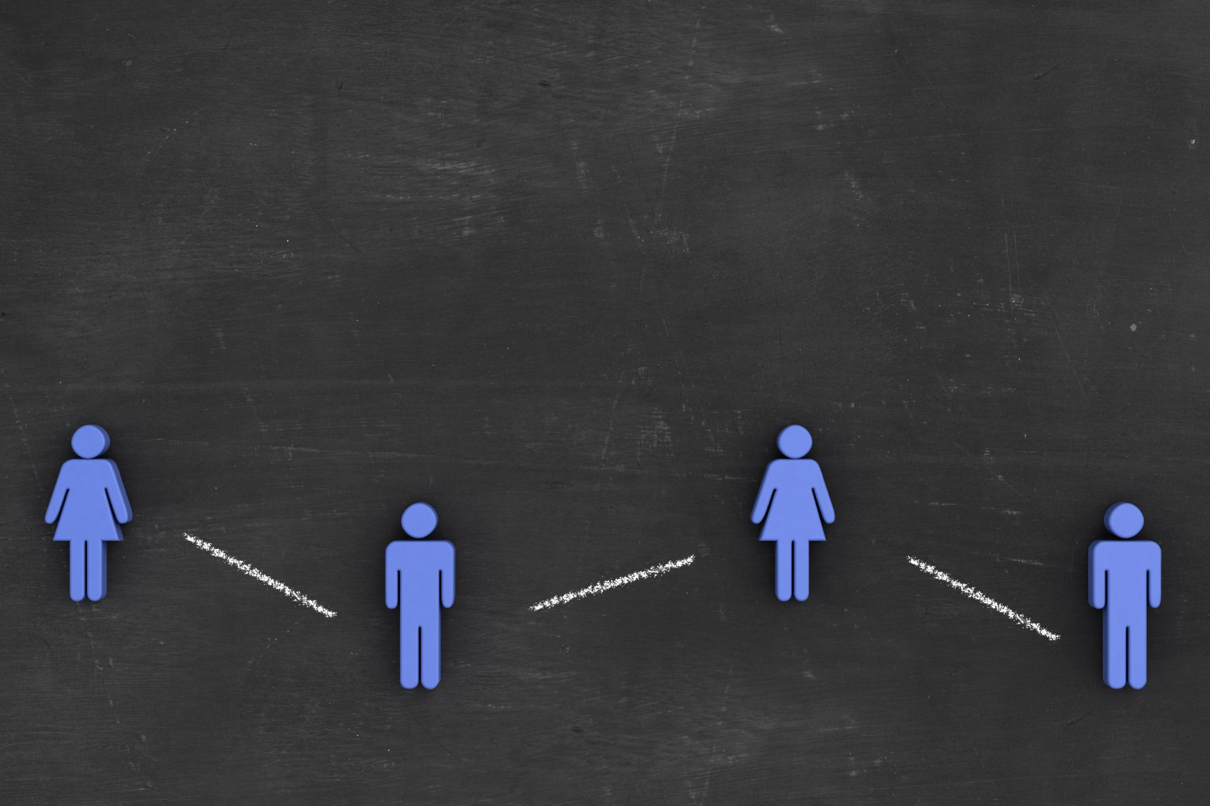
Comparing Two Populations
Comparing two populations can help us understand how they differ in a certain characteristic.
We can use random samples to draw comparative inferences.
Random samples should be representative of the population.
We can use measures of variability to compare the spread of data in the two populations.
If the spread of data in two populations is similar, we can make informal comparative inferences about the two populations.
Notes:
Comparing two populations can help us understand how they differ in a certain characteristic. We can use random samples to draw comparative inferences. The random samples should be representative of the population. We can use measures of variability to compare the spread of data in the two populations. If the spread of data in two populations is similar, we can make informal comparative inferences about the two populations.

Slide 18
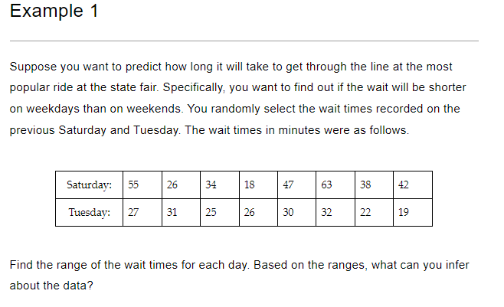
Practice

Slide 19

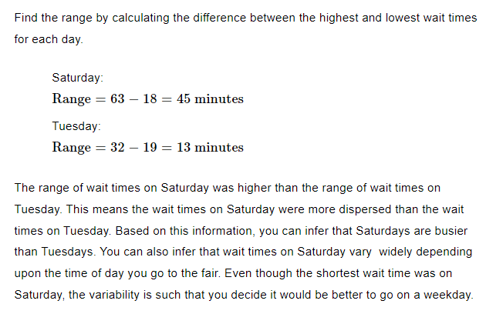

Slide 20
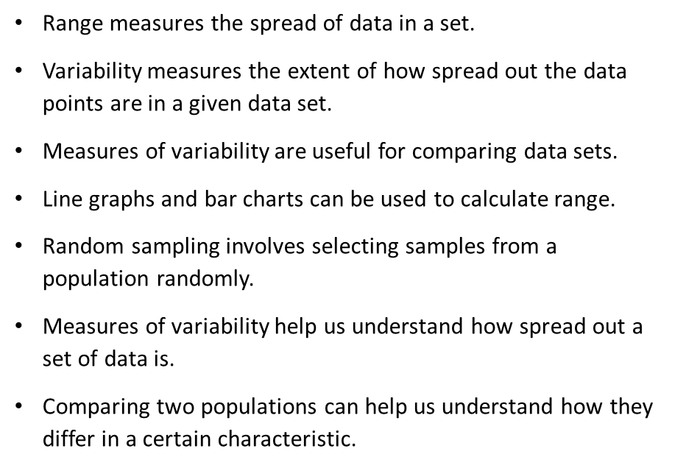
Key Points

