Slide 1
Understanding Probability of a Compound Event
Math 7B Unit 8 Lesson 6
Notes:
In this presentation, we will be learning about the probability of a compound event and how to describe it as a ratio of the outcomes in the compound event to the total outcomes in the sample space. This is an essential concept in mathematics and will help us in many real-life situations.

Slide 2
Key words
compound event – an event consisting of two or more simple events
dependent event – an event that can occur only if another event occurs first
event – a subset of a sample space, a collection of outcomes
independent event – the occurrence of one event does not affect the occurrence of another event
mutually exclusive events – two or more events that cannot occur at the same time
mutually inclusive events – two or more events that can occur at the same time
probability – a numerical measure of the likelihood of an event to happen
sample space – the set of all possible outcomes of a chance process
simple event – an event that has a single outcome

Slide 3

What is a Compound Event?
A compound event is one that is made up of two or more simple events.
A simple event is one that has a single outcome.
Notes:
Before we can understand the probability of a compound event, we need to know what a compound event is. A compound event is one that is made up of two or more simple events. A simple event is one that has a single outcome.

Slide 4

Dependent Events
In probability, dependent events are events in which the occurrence of one event affects the likelihood of the other event.
Dependent events are the opposite of independent events.
An example of a dependent event is drawing a card from a deck and not putting it back. The probability of drawing a certain card changes depending on the previously drawn card.
Notes:
A dependent event is one in which the outcome of one event affects the probability of the other event. For example, drawing a card from a deck and not replacing it changes the probability of drawing a certain card. This is in contrast to independent events, where the outcome of one event does not affect the probability of the other event. It is important to understand dependent events in probability because they can have a significant impact on the overall probability of a compound event.

Slide 5
Independent Events
The occurrence of one event does not affect the occurrence of another event.
Notes:
A dependent event is one in which the outcome of one event affects the probability of the other event. For example, drawing a card from a deck and not replacing it changes the probability of drawing a certain card. This is in contrast to independent events, where the outcome of one event does not affect the probability of the other event. It is important to understand dependent events in probability because they can have a significant impact on the overall probability of a compound event.

Slide 6
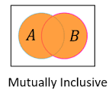
Mutually Inclusive Events
Mutually inclusive events are events where they occur together.
The probability of mutually inclusive events is greater than the probability of either event alone.
An example of mutually inclusive events is rolling an even number and rolling a number less than 5 with a single die.
Notes:
In probability, mutually inclusive events refer to the events that can occur together. They are the opposite of mutually exclusive events in which the occurrence of one event excludes the occurrence of another event. The probability of mutually inclusive events is greater than the probability of either event alone because there are more ways that the events can occur. For example, when rolling a single die, the events of rolling an even number and rolling a number less than 5 are mutually inclusive because they can occur together. There are three ways to roll an even number and a number less than 5: rolling a 2 or a 4. Thus the probability of mutually inclusive events is 3 out of 6 or 1/2.

Slide 7
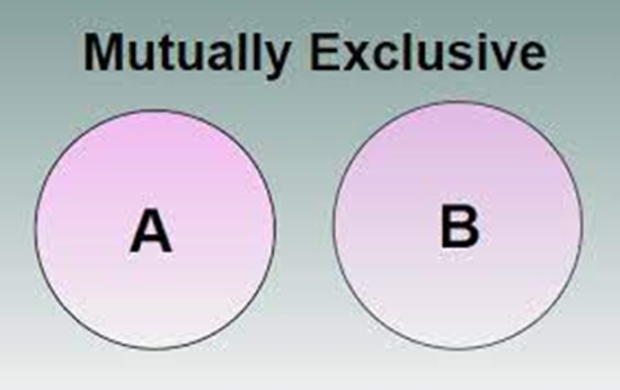
Mutually Exclusive Events
Mutually exclusive events are events that cannot occur at the same time.
The probability of mutually exclusive events is the sum of their individual probabilities.
An example of mutually exclusive events is rolling a number greater than 4 and rolling a number less than or equal to 2 with a single die.
Notes:
Explain to students that mutually exclusive events cannot happen simultaneously. They can also think of it as only one event happening at a time. For example, if we roll a die, we can either get an even number or an odd number, but not both at the same time. To calculate the probability of mutually exclusive events, we add the probabilities of each event happening separately.

Slide 8

What is Probability?
Probability is the likelihood of an event occurring.
Probability is expressed as a number between 0 and 1.
0 means the event is impossible and 1 means the event is certain.
Notes:
Now that we know what a compound event is, let's talk about probability. Probability is the likelihood of an event occurring. It is expressed as a number between 0 and 1, with 0 meaning the event is impossible and 1 meaning the event is certain.

Slide 9

How Do We Calculate Probability of a Compound Event?
To calculate the probability of a compound event, we need to find the number of outcomes in the compound event and the total number of outcomes in the sample space.
We then express this as a ratio - the number of outcomes in the compound event divided by the total number of outcomes in the sample space.
Notes:
Now, let's learn how to calculate the probability of a compound event. To do this, we need to find the number of outcomes in the compound event and the total number of outcomes in the sample space. We then express this as a ratio - the number of outcomes in the compound event divided by the total number of outcomes in the sample space.

Slide 10
Example Problem
Let's say we are rolling two dice.
What is the probability of rolling a sum of 7?
The sample space consists of 36 possible outcomes.
There are 6 possible ways to roll a sum of 7.
Therefore, the probability of rolling a sum of 7 is 6/36 or 1/6.
Notes:
Let's work through an example problem. Say we are rolling two dice. What is the probability of rolling a sum of 7? The sample space consists of 36 possible outcomes. There are 6 possible ways to roll a sum of 7. Therefore, the probability of rolling a sum of 7 is 6/36 or 1/6.

Slide 11
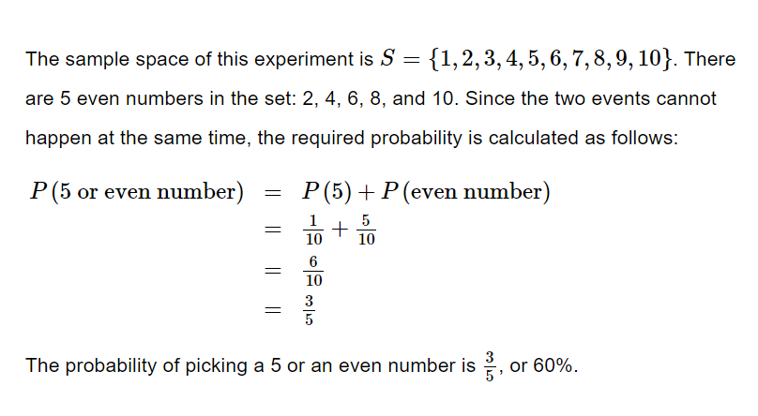
Solve.

Slide 12
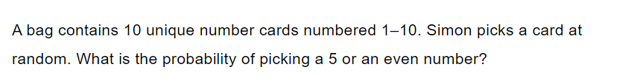
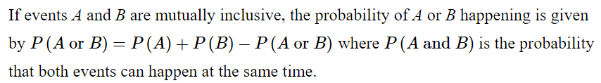
Practice

Slide 13
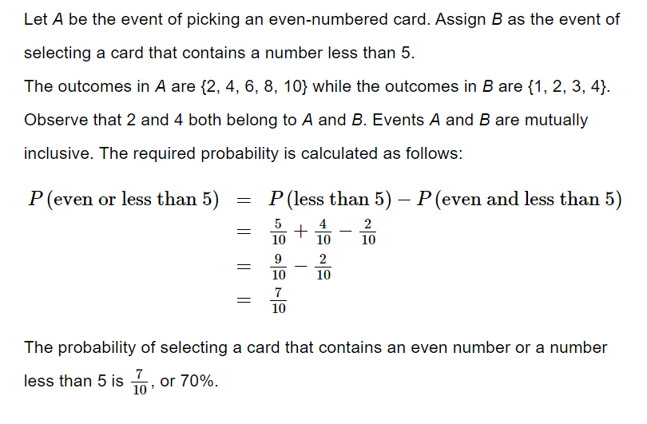
Solve

Slide 14
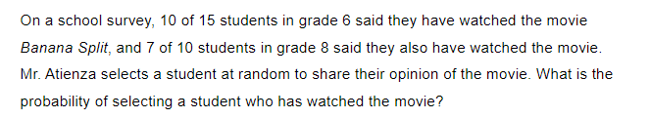
Practice

Slide 15
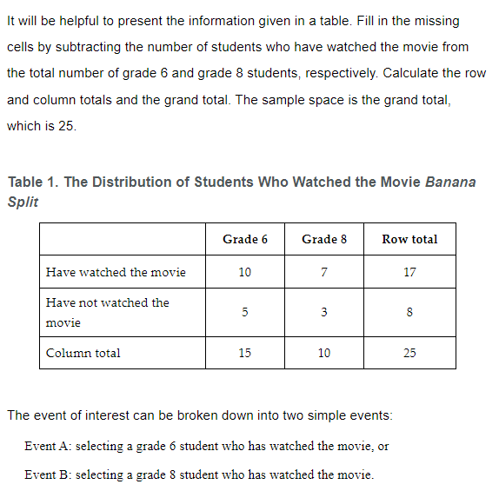
Practice

Slide 16
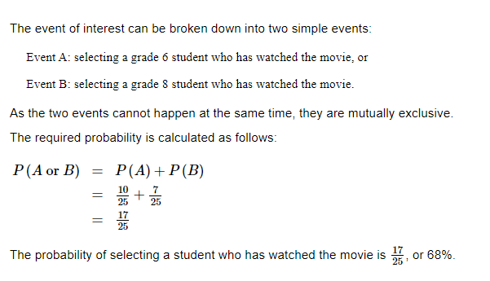
Solve

