Slide 1
Probability Approximation: Understanding Chance Events
Math 7B Unit 8 Lesson 5
Notes:
Probability is the measure of the likelihood of an event occurring. It is calculated as the total number of favorable outcomes divided by the total number of possible outcomes. In this presentation, we will discuss how to approximate probability using long-run relative frequency.

Slide 2
Key Words
chance event – a set that contains some outcomes from a chance process
experimental probability – a numerical measure that describes how frequently an event occurred in an actual experiment
frequency – the number of times an event occurred in repeated trials of a chance process
Law of Large Numbers – the relative frequency of an event approaches the probability of that event in repeated independent trials of a chance process
long-run relative frequency – the ratio of the number of times the event occurred in the very long sequence of observations to the total number of trials conducted
Probability model – the presentation of outcomes of a chance process along with their probabilities
relative frequency – the ratio of the number of outcomes in a specified event to the total number of outcomes
sample space – the set of all possible outcomes of a random experiment
simulation – an artificial recreation of a random experiment, usually with the use of a computer
trial – a particular performance of a random experiment

Slide 3
The Law of Large Numbers
The law of large numbers states that as the number of trials of a random event increases, the average outcome of those trials gets closer to the expected outcome.
For example, if we flip a coin 10 times, we might not get exactly 50% heads and 50% tails. But if we flip a coin 1000 times, we will likely get very close to 50% heads and 50% tails.
The law of large numbers applies to probability, where the expected outcome is the probability of an event occurring.
Practical applications of the law of large numbers include insurance, gambling, and quality control in manufacturing.
Notes:
The law of large numbers is a mathematical concept that allows us to estimate the likelihood of an event occurring based on the frequency of its occurrence over a large number of trials. It is an important concept in probability, statistics, and many areas of science and engineering. By understanding the law of large numbers, we can improve our ability to make predictions, solve problems, and make decisions based on data.

Slide 4

What is Probability?
Probability is the measure of the likelihood of an event occurring.
It can be expressed as a fraction, decimal or percentage.
Notes:
Probability is a measure of the likelihood of an event occurring. A probability is a number between 0 and 1 (inclusive) that represents the chance or likelihood of an event happening. It can be expressed as a fraction, decimal or percentage. For example, the probability of flipping a coin and getting heads is 0.5 or 50%.

Slide 5

What is Long-Run Relative Frequency?
Long-run relative frequency is the proportion of times an event occurs in the long run.
To approximate probability using long-run relative frequency, we need to do many trials of the chance event.
As we do more trials, the long-run relative frequency should approach the probability of the event.
Notes:
Long-run relative frequency is the proportion of times an event occurs in the long run. The more trials we do, the closer the long-run relative frequency will be to the true probability of the event. For example, if we flip a coin 100 times and it lands heads up 60 times, the long-run relative frequency is 0.6 or 60%. As we continue to flip the coin, the long-run relative frequency should approach 0.5 or 50%, which is the true probability of getting heads when flipping a fair coin.

Slide 6

Practice
Flip a coin 20 times and record the number of heads and tails.
Calculate the long-run relative frequency of getting heads.
Repeat the experiment with more trials and see if the long-run relative frequency gets closer to 0.5.
Notes:
To practice approximating probability using long-run relative frequency, you can flip a coin 20 times and record the number of heads and tails. Calculate the long-run relative frequency of getting heads and see if it is close to 0.5, which is the true probability of getting heads when flipping a fair coin. Repeat the experiment with more trials and see if the long-run relative frequency gets closer to 0.5.

Slide 7
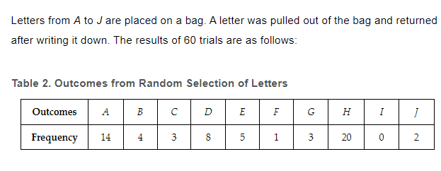
Practice

Slide 8
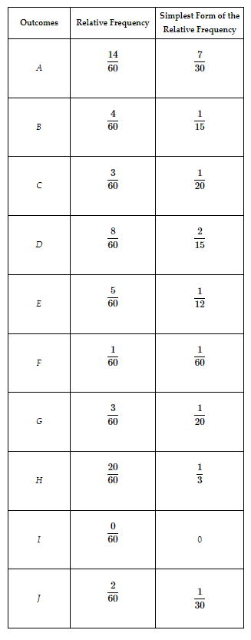
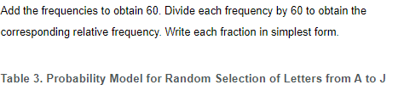

Slide 9
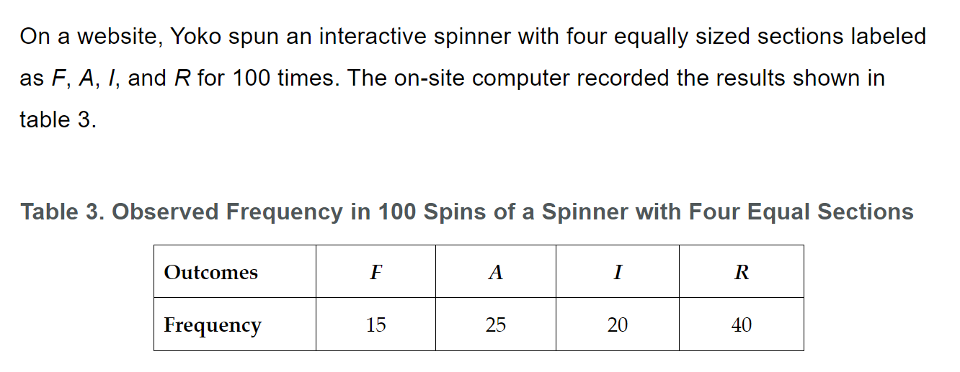
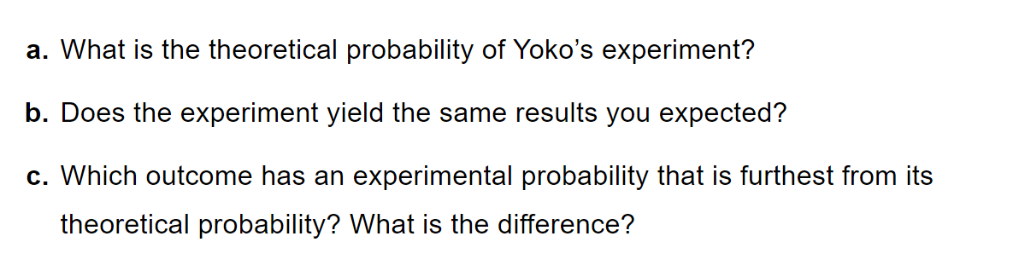
Practice

Slide 10
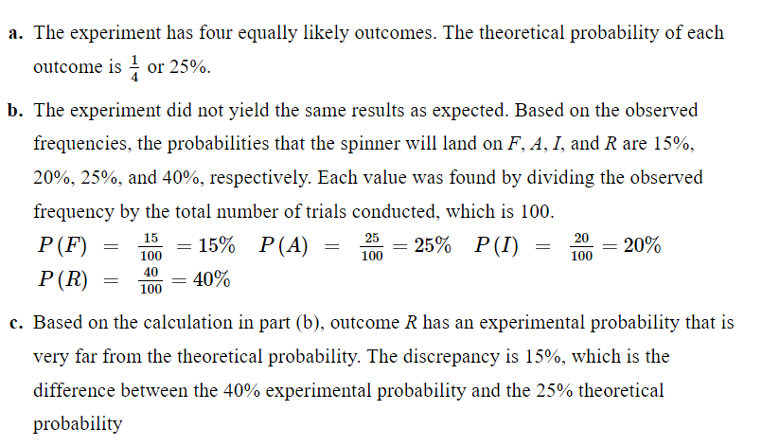
Practice

Slide 11
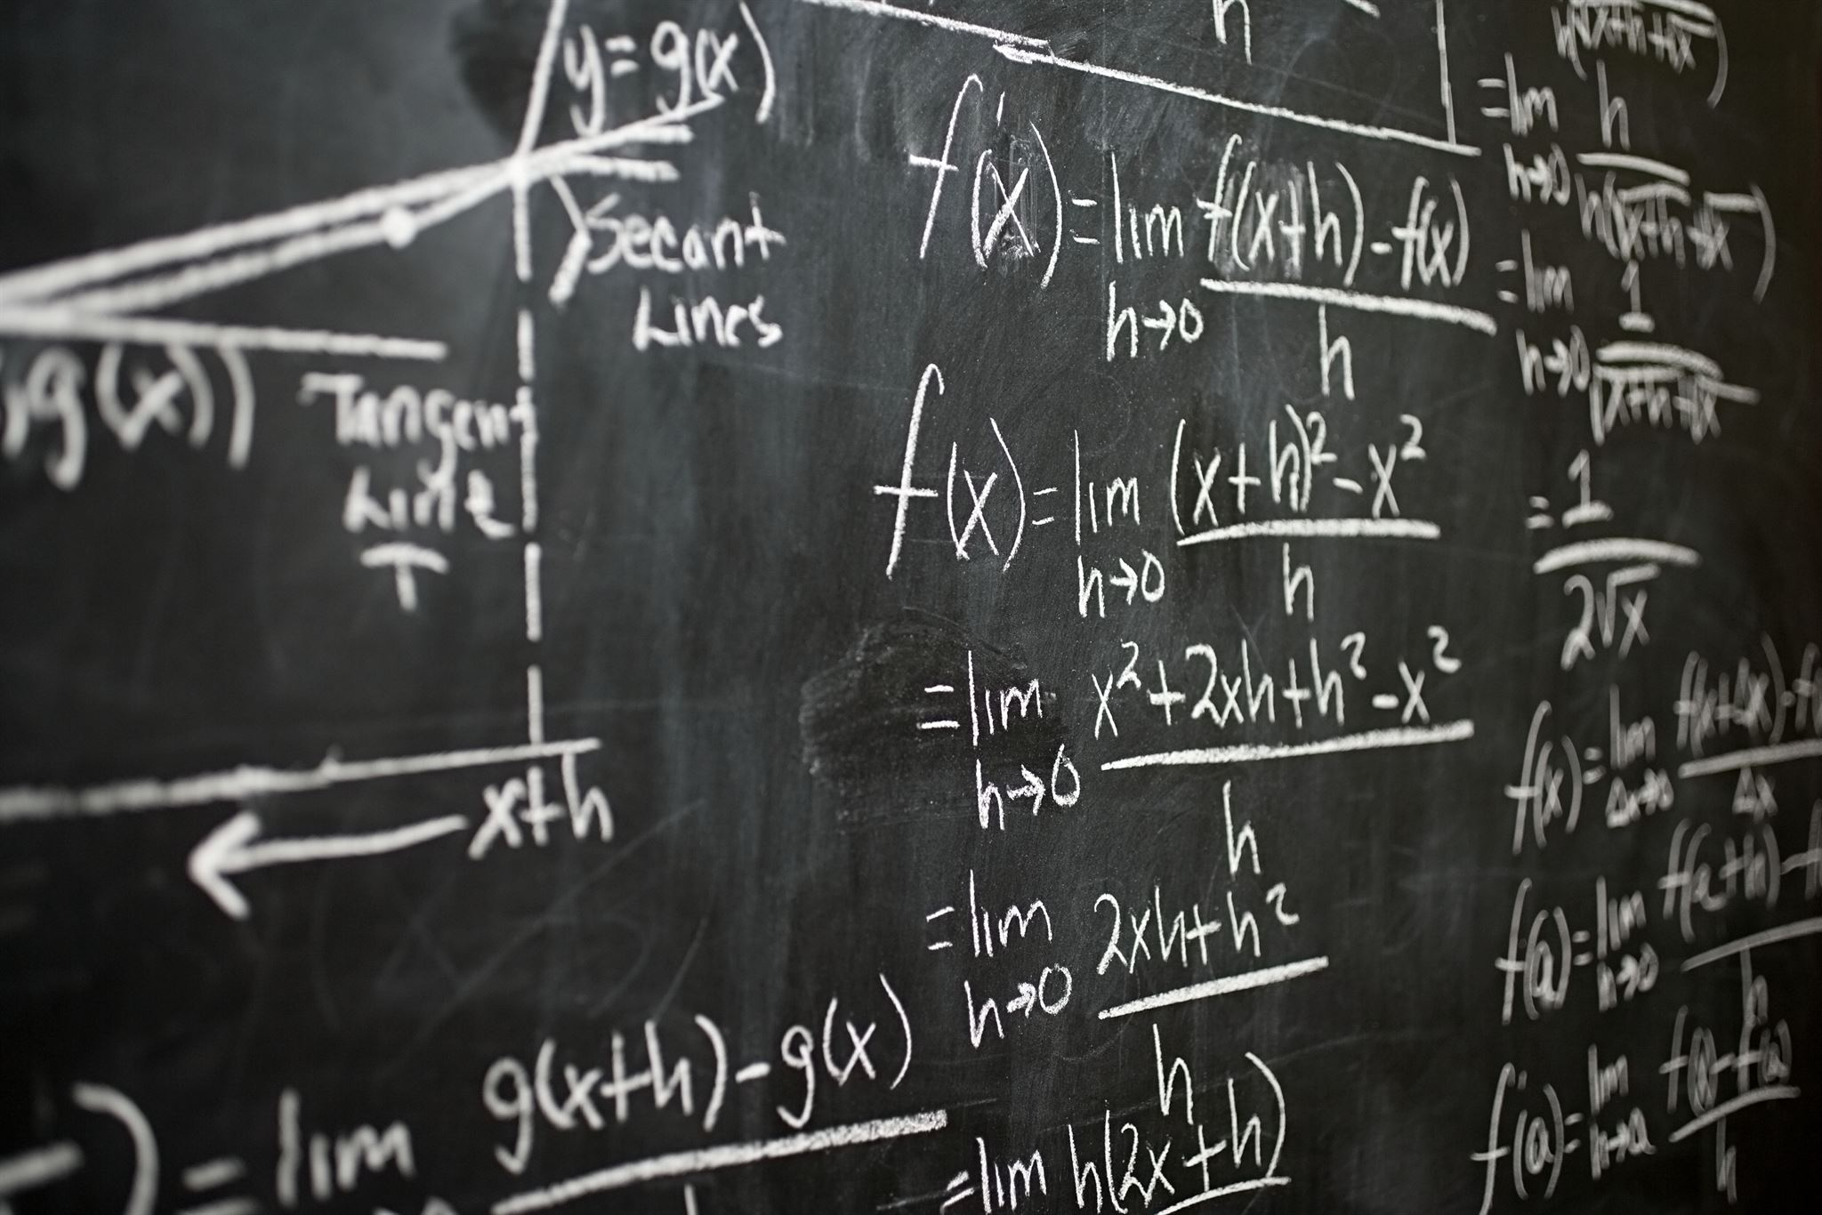
Summary
Probability is the measure of the likelihood of an event occurring.
Long-run relative frequency is the proportion of times an event occurs in the long run.
To approximate probability using long-run relative frequency, we need to do many trials of the chance event.
The more trials we do, the closer the long-run relative frequency will be to the true probability of the event.
Notes:
Probability is the measure of the likelihood of an event occurring. Long-run relative frequency is the proportion of times an event occurs in the long run. To approximate probability using long-run relative frequency, we need to do many trials of the chance event. The more trials we do, the closer the long-run relative frequency will be to the true probability of the event.

