Slide 1
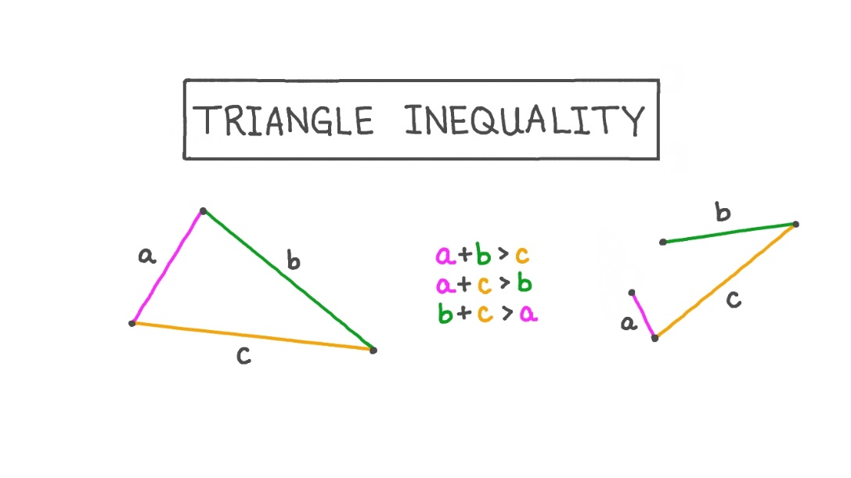
The Triangle Inequality Theorem
Unit 4 Lesson 3
Notes:
Welcome to our lesson on the Triangle Inequality Theorem. By the end of this presentation, you will be able to determine the conditions relating to whether three segments can form a triangle, using the Triangle Inequality Theorem. Let's get started!

Slide 2

Key Words
Triangle: a three-sided polygon
Theorem: a statement or rule proven true

Slide 3
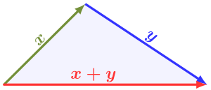
What is the Triangle Inequality Theorem?
The Triangle Inequality Theorem states that the sum of the lengths of any two sides of a triangle must be greater than the length of the remaining side.
This theorem helps us determine whether three segments can form a triangle or not.
Notes:
The Triangle Inequality Theorem is a fundamental concept in geometry that helps us decide whether three segments can form a triangle. The theorem states that the sum of the lengths of any two sides of a triangle must be greater than the length of the third side. To illustrate this concept, imagine we have three sticks of different lengths: 5 cm, 8 cm, and 11 cm. Can these sticks form a triangle? Let's use the Triangle Inequality Theorem to find out.

Slide 4

Real World Examples of the Triangle Inequality Theorem
It helps engineers design stronger bridges and buildings.
It helps pilots fly planes safely by ensuring that the right amount of fuel is used.
In sports like basketball, it helps players determine the shortest distance between two points on the court.
Notes:
The Triangle Inequality Theorem is not just a math concept. Its applications are vast and varied. From sports to engineering to aviation, this theorem helps us make better decisions, increase efficiency, and improve safety.

Slide 5
Applying the Triangle Inequality Theorem
To apply the Triangle Inequality Theorem, take any two lengths and add them together.
Compare the sum to the remaining length.
If the sum is greater than the remaining length, then the three segments can form a triangle.
Notes:
To apply the Triangle Inequality Theorem, let's consider two examples. In Example 1, we have three segments with lengths 3 cm, 4 cm, and 6 cm. We take the first two lengths, 3 cm and 4 cm, and add them together to get 7 cm. We then compare this sum to the remaining length, 6 cm. Since 7 cm is greater than 6 cm, these three segments can form a triangle. In Example 2, we have three segments with lengths 2 cm, 7 cm, and 10 cm. Again, we take the first two lengths, 2 cm and 7 cm, and add them together to get 9 cm. We then compare this sum to the remaining length, 10 cm. Since 9 cm is less than 10 cm, these three segments cannot form a triangle.

Slide 6

Example 1
Let's try an example using lengths of 4 cm, 7 cm, and 12 cm.
Can these three segments form a triangle? How do you know your answer is correct?
Notes:
Now, let's try another example using the Triangle Inequality Theorem. We have three segments of lengths 4 cm, 7 cm, and 12 cm. Can we form a triangle using these segments? We take the first two segments, 4 cm and 7 cm, and add them together: 4 + 7 = 11. We then compare this sum to the remaining length of 12 cm. Is 11 greater than 12? No, it is not! Therefore, these three segments cannot form a triangle.

Slide 7
Example 2
Let's try another example using lengths of 4 cm, 2 cm, and 15 cm.
Can these three segments form a triangle? How do you know your answer is correct?
Notes:
Now, let's try another example using the Triangle Inequality Theorem. We have three segments of lengths 4 cm, 7 cm, and 12 cm. Can we form a triangle using these segments? We take the first two segments, 4 cm and 7 cm, and add them together: 4 + 7 = 11. We then compare this sum to the remaining length of 12 cm. Is 11 greater than 12? No, it is not! Therefore, these three segments cannot form a triangle.

Slide 8
Recap
The Triangle Inequality Theorem helps us determine whether three segments can form a triangle.
To apply the theorem, we take any two lengths, add them together, and compare the sum to the remaining length.
If the sum is greater than the remaining length, then the three segments can form a triangle.
Notes:
Congratulations, you now know how to use the Triangle Inequality Theorem to determine whether three segments can form a triangle or not. Remember, to apply the theorem, we take any two lengths, add them together, and compare the sum to the remaining length. If the sum is greater than the remaining length, then the three segments can form a triangle. Keep practicing, and good luck!

