Slide 1
How to Compute Actual Lengths from Scale Drawings
Notes:
In this presentation, we will learn how to calculate actual lengths from scale drawings. A scale drawing is a drawing that represents a real object but is smaller or larger than the actual object.

Slide 2
Key Words
Area – the size of the surface of the two-dimensional plane of a regular quadrilateral
ratio – a comparison between the relative amounts of two quantities
scale drawing – a two-dimensional model of a figure that is not the same size as the original and has been increased or decreased by a scale factor
scale factor – the ratio between the size of an actual object and a representation of that object

Slide 3
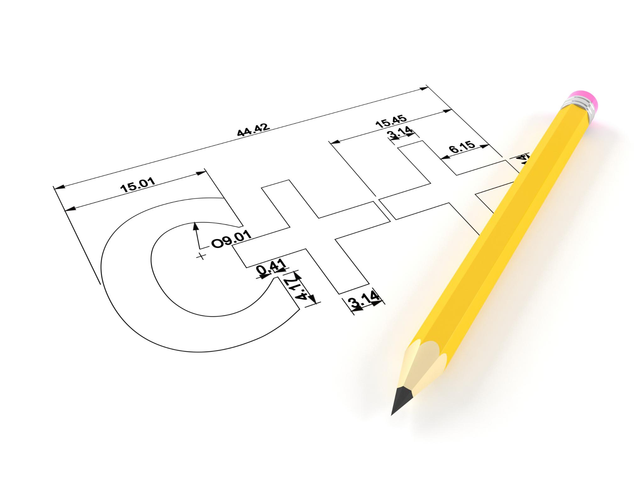
What is a Scale Drawing?
A scale drawing is a proportional two-dimensional drawing of an object.
It's used to show the size of an object that is too large or too small to be drawn at actual size.
The scale of a drawing tells you how much the drawing has been scaled down from the actual size.
Notes:
A scale drawing is a representation of an object that is proportional to the actual size of the object. The scale of a drawing is the ratio of the length in the drawing to the length in the actual object. For example, a scale of 1:10 means that the drawing is one-tenth the size of the actual object.

Slide 4
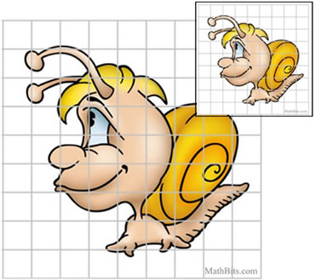
How to Compute Actual Lengths from Scale Drawings
To find the actual length of an object from a scale drawing, multiply the length of the object in the drawing by the scale factor.
The scale factor is the ratio of the length in the drawing to the actual length of the object.
For example, if the scale is 1:10 and the length of the object in the drawing is 3 cm, the actual length of the object is 30 cm (3 x 10).
Notes:
To find the actual length of an object from a scale drawing, you need to know the scale factor. Multiply the length of the object in the drawing by the scale factor to find the actual length of the object. For example, if the scale factor is 1:10 and the length of the object in the drawing is 3 cm, the actual length of the object is 30 cm (3 x 10).

Slide 5
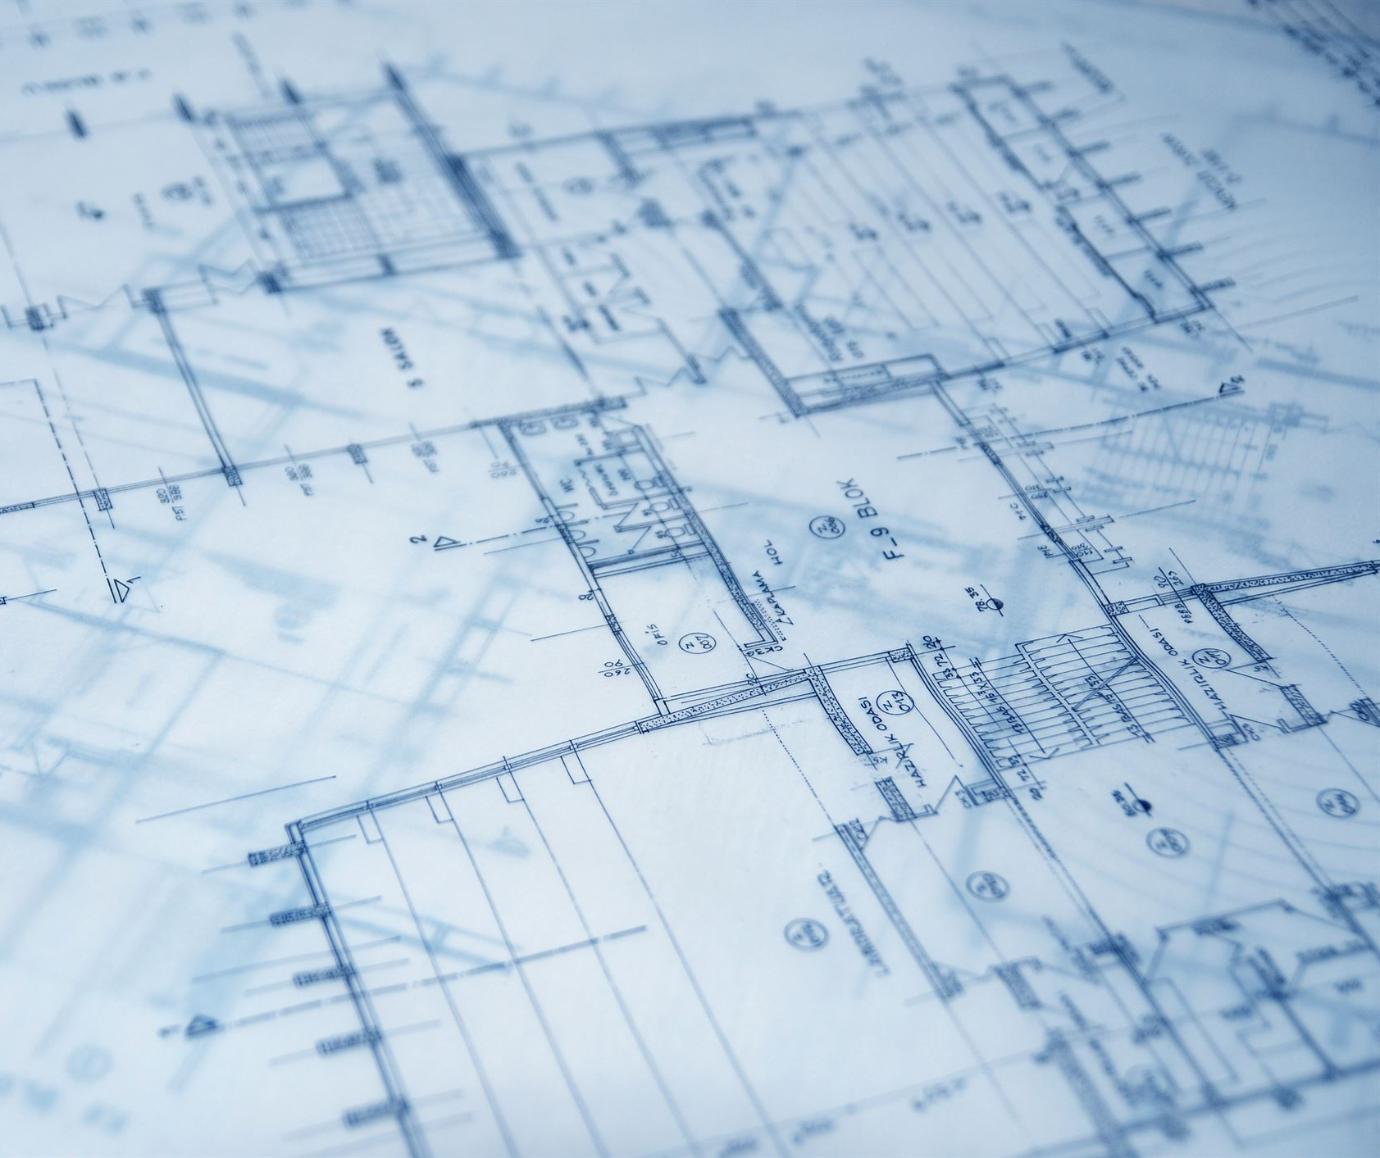
Real World Examples
Many industries use scale drawings, including architecture, engineering, and cartography.
Blueprints for buildings are scale drawings.
Maps are also scale drawings that show the size and location of features on the Earth's surface.
Notes:
Scale drawings are used in many industries, including architecture, engineering, and cartography. Blueprints for buildings are scale drawings that show the layout and dimensions of the building. Maps are also scale drawings that show the location and size of features on the Earth's surface.

Slide 6

Practice
To become proficient in computing actual lengths from scale drawings, lots of practice is required.
Be sure to check your work and ask for help if you're stuck.
Notes:
To get better at computing actual lengths from scale drawings, you need lots of practice. There are many online resources where you can find practice problems and solutions. Be sure to check your work and ask for help if you're stuck.

Slide 7
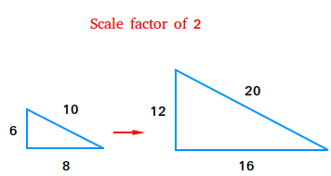
Finding the Scale Factor
To find the actual area of an object from a scale drawing, we first need to find the scale factor.
The scale factor is the ratio of the length in the drawing to the actual length of the object.
For example, if the scale is 1:2 and the length of the object in the drawing is 8 cm, the actual length of the object is 16 cm (8 x 2).
Notes:
Now that we understand what a scale drawing is, let's learn about finding the scale factor. The scale factor is the ratio of the length in the drawing to the actual length of the object. We will use this scale factor to find the actual area of an object from a scale drawing.

Slide 8
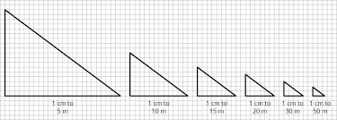
Computing Actual Areas
To compute the actual area from a scale drawing, we need to square the scale factor.
For example, if the scale factor is 1:10, we would square 10 to get 100.
Then, we would multiply the area of the object in the drawing by the squared scale factor.
The result is the actual area of the object.
Notes:
Now that we have found the scale factor, let's learn how to compute the actual area from a scale drawing. We need to square the scale factor and multiply the area of the object in the drawing by the squared scale factor. This will give us the actual area of the object from the scale drawing.

Slide 9
Practice
Ozzy drew a picture of his new house. The actual length of the driveway is 20 feet. If it is represented with a length of 4 feet on the picture, what was the scale factor used? How do you know you are correct?
4 feet

Slide 10

Practice
Ashley created a replica of the Empire State Building after visiting New York City. The actual height of the Empire State building is 1,250. The replica is 12.5 feet in height. What was the scale factor used by Ashley to create her replica?

Slide 11
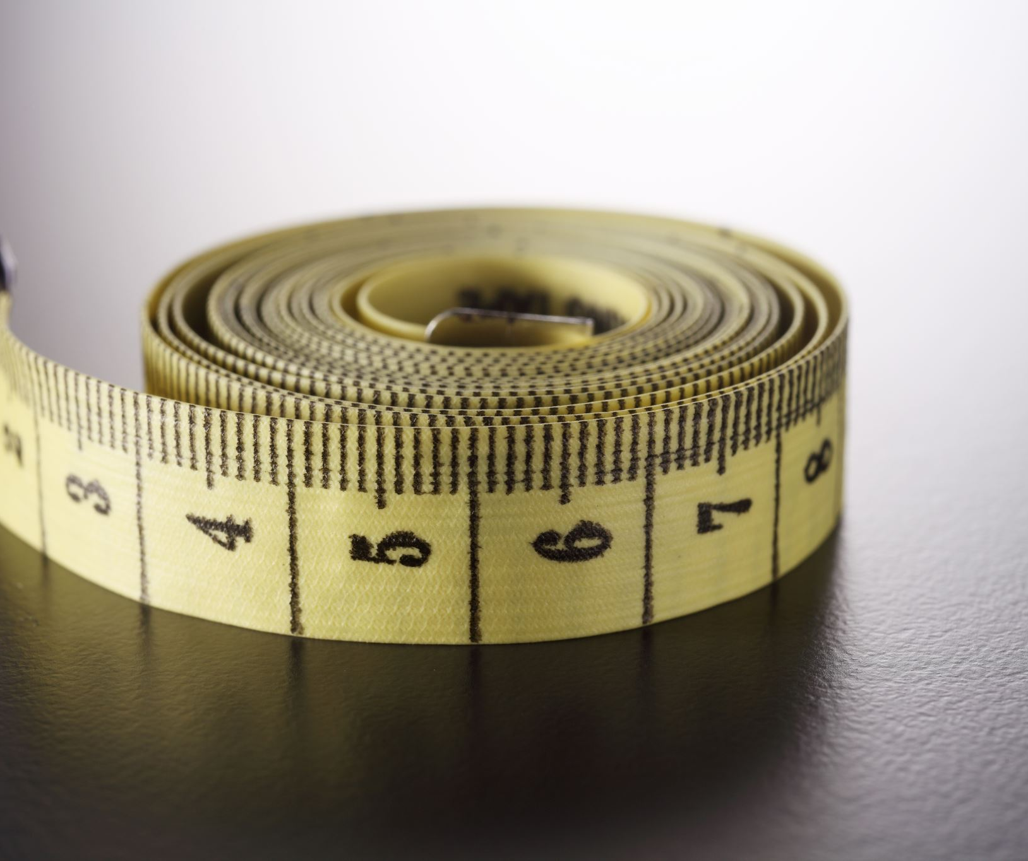
Conclusion
Computing actual lengths from scale drawings is an important skill for many industries.
With practice, you can become proficient at this skill.
Remember to always check your work and ask for help if you need it.
Notes:
Computing actual lengths from scale drawings is a skill that is used in many industries, including architecture and engineering. With practice, you can become proficient at this skill. Always check your work and ask for help if you need it.

