Slide 1
Math 7B
Unit 3: Angle Pairs
Lesson 3: Solve Equations with Adjacent Angles

Slide 2
Key Words
Addition Angle Postulate – a statement that when two angles are placed side by side, the measure of the resulting angle is the sum of the measures of the two angles
adjacent angles – two angles that are side by side and share a common ray and vertex
equation – a mathematical expression with an equal sign, containing numbers, variables, and/or operations
expression – a math sentence using numbers, operations, and variable(s), but does not include an equal sign
right angle – an angle that measures 90 degrees
variable – a letter used to represent a number that is unknown

Slide 3
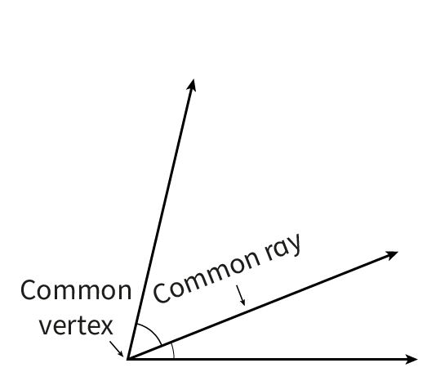
What are Adjacent Angles?
Adjacent angles are two angles that share a common vertex and a common ray.
The Addition Angle Postulate states that the measure of a resulting angle formed from two adjacent angles is the sum of the measures of the smaller angles.
Notes:
Adjacent angles are angles that share a common vertex and a common side. The non-shared sides of adjacent angles form a straight line. In the image provided, angles A and B are adjacent angles. Angle AOB measures 140 degrees and angle BOC measures 40 degrees. By using the measures of adjacent angles, we can solve for the unknown angle.

Slide 4
Writing an Equation for an Unknown Angle
We can solve for the measure of an unknown adjacent angle by writing an equation.
Add the measures of the two adjacent angles and set them equal to the total angle measure given, using a variable in the place of the unknown angle measure.
Solve for the unknown angle by isolating the variable.
This same procedure applies even if the unknown angle measure is given in the form of an expression instead of a variable.
Notes:
To write a multi-step equation for an unknown angle, we add the measures of the adjacent angles together to find the sum. We then set the sum equal to 180 degrees, since the three angles in a triangle add up to 180 degrees. Finally, we solve for the unknown angle by isolating the variable. In the image provided, angles A and B are adjacent angles that add up to 140 degrees. We can then write the equation 140 + x = 180, where x is the measure of the unknown angle. By solving for x, we find that the unknown angle measures 40 degrees.

Slide 5
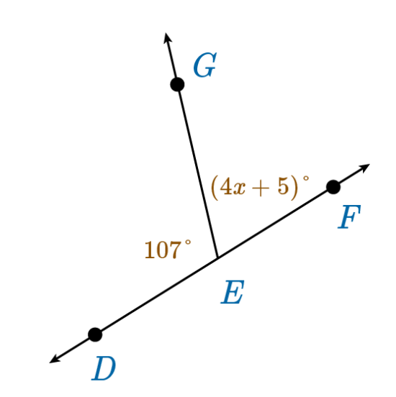
Example
Start by setting the sum of the measures of the two angles equal to the measure of the larger angle. The larger angle measure is 180°, because the two angles together make a straight line.
  m∠DEG + m∠GEF = 180°
Replace the angle measures with the expression or information given.
  107° + (4x+5)° = 180°
Solve for x.
107°+ (4x+5)° = 180°
(4x)° + 5° = 73°
(4x)° + 5° = 73°
(4x)° = 68°
x = 17
Notes:
Let's work through an example problem. In the image provided, angle AOB measures 110 degrees and angle BOC measures 70 degrees. We can use the measures of adjacent angles to solve for the unknown angle. The adjacent angles AOB and BOC add up to 180 degrees, so we can write the equation 110 + 70 + x = 180, where x is the measure of the unknown angle. By solving for x, we find that the unknown angle measures 0 degrees. However, this is not possible since an angle cannot have a measure of 0 degrees. Therefore, our answer is not valid and we should check our work.

Slide 6
Solving Equations of Adjacent Angles with Expressions
An expression is like an equation but does not have an equal sign.
Expressions are used to indicate a value using numbers, variables, and operations. Expressions cannot be solved as is. However, expressions are used to create an equation if given an equivalence value.
Instead of using a single variable, the angle measures are represented by expressions.
Set up an equation using expressions, solve for the variable, and then solve for the missing angle measure using the variable.
Notes:
To write a multi-step equation for an unknown angle, we add the measures of the adjacent angles together to find the sum. We then set the sum equal to 180 degrees, since the three angles in a triangle add up to 180 degrees. Finally, we solve for the unknown angle by isolating the variable. In the image provided, angles A and B are adjacent angles that add up to 140 degrees. We can then write the equation 140 + x = 180, where x is the measure of the unknown angle. By solving for x, we find that the unknown angle measures 40 degrees.

Slide 7
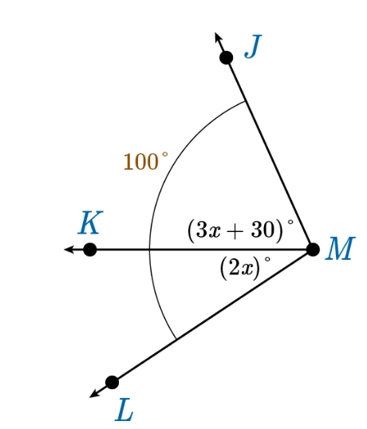
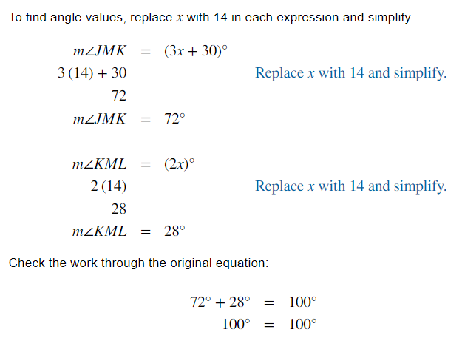
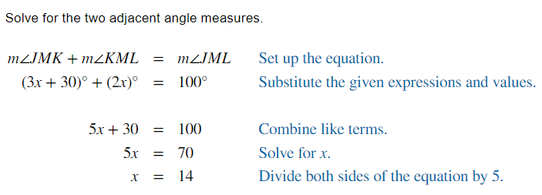
Example Problem
Notes:
Let's work through an example problem. In the image provided, angle AOB measures 110 degrees and angle BOC measures 70 degrees. We can use the measures of adjacent angles to solve for the unknown angle. The adjacent angles AOB and BOC add up to 180 degrees, so we can write the equation 110 + 70 + x = 180, where x is the measure of the unknown angle. By solving for x, we find that the unknown angle measures 0 degrees. However, this is not possible since an angle cannot have a measure of 0 degrees. Therefore, our answer is not valid and we should check our work.

Slide 8
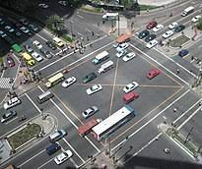
Real-World Example
Imagine you are standing on a street corner and the two roads form an angle. One road is going north and the other is going east. The angle between the two roads is 90 degrees. If you know the measure of one of the angles formed by the roads and a third road, you can use the concept of adjacent angles to find the measure of the other angle. For example, if the third road forms a 40-degree angle with the road going north, then the angle it forms with the road going east is 50 degrees, because 90 - 40 = 50.

Slide 9

In Conclusion
Adjacent angles are angles that share a common vertex and a common side.
To write a multi-step equation for an unknown angle, add the measures of the adjacent angles, set the sum equal to 180 degrees, and solve for the unknown angle.
If both angles are represented by an expression, first solve for the variable and the solve for the missing angle measure using the variable.
Always check your work to make sure that your answer is valid.
Notes:
In conclusion, adjacent angles are angles that share a common vertex and a common side. To write a multi-step equation for an unknown angle, we add the measures of the adjacent angles, set the sum equal to 180 degrees, and solve for the unknown angle. It is important to always check your work to make sure that your answer is valid.

