Slide 1
Discovering the Area of Non-right Triangles
Math 6B Unit 6; Lesson 3
Notes:
In this presentation, we will learn how to calculate the area of non-right triangles using two methods: composing the shape into rectangles and decomposing it into triangles and other shapes. By the end of it, you will be able to solve complex geometry problems with ease.

Slide 2
Keywords
area of a right triangle – the base times the height divided by 2
composition – the creation of a shape around a central shape
decomposition – the breakdown of a shape into smaller shapes
vertex – the point where two sides of a polygon meet forming an angle

Slide 3
Composing Non-right Triangles into Rectangles
Divide the non-right triangle into two right triangles by drawing its altitude.
1
Calculate the area of each right triangle using the formula 1/2 * Base * Height.
2
Add the areas of the two right triangles to find the total area of the non-right triangle.
3
Notes:
One way to find the area of a non-right triangle is by dividing it into two right triangles and then adding their areas. This method requires you to first find the altitude of the triangle. We can then use this altitude to form two right triangles, each of which has one leg that is a side of the original non-right triangle and whose other leg is the altitude.

Slide 4
Decomposing Non-right Triangles into Triangles and Other Shapes
Divide the non-right triangle into smaller triangles and rectangles.
Find the area of each shape using its respective formula.
Add the areas of all the shapes to get the total area of the non-right triangle.
Notes:
Another way to find the area of a non-right triangle is by dividing it into smaller triangles and rectangles. We can do this by drawing lines from one vertex of the triangle to the other two vertices, creating several smaller triangles and rectangles. We can then find the area of each shape separately using its respective formula and add them up to get the total area of the non-right triangle.

Slide 5
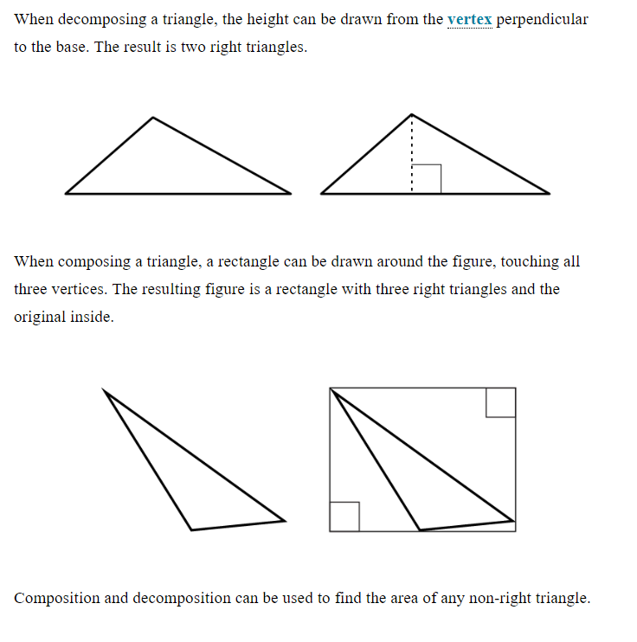

Slide 6
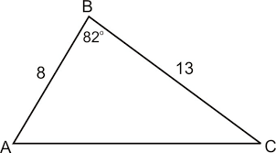
GeoGebra Practice
Area of Non-Right Angled Triangle: https://www.geogebra.org/m/wwyhv9e5

Slide 7
Tips and Tricks
Always draw a picture of the problem and label the given information.
Be careful when calculating the altitude of a triangle.
Check your work by using both methods and see if you get the same answer.
Notes:
To make sure you are successful in finding the area of non-right triangles, here are some tips and tricks to keep in mind. Always take your time, double-check your work, and ask for help if you need it. With practice, you'll become a geometry pro in no time!

Slide 8
Practice Problems
Solve
Solve for the area of a non-right triangle with base 8cm and height 7cm.
Solve
Solve for the area of a non-right triangle with sides of length 12cm, 5cm, and 13cm.
Solve
Solve for the area of a non-right triangle with base 10cm and height 6cm.
Notes:
Now that we have learned both methods of finding the area of non-right triangles, let's put our knowledge to the test with some practice problems. Remember to read each problem carefully and choose the method that works best for you.

Slide 9
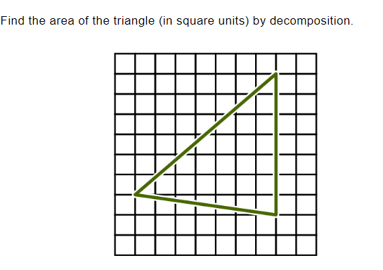
Practice

Slide 10
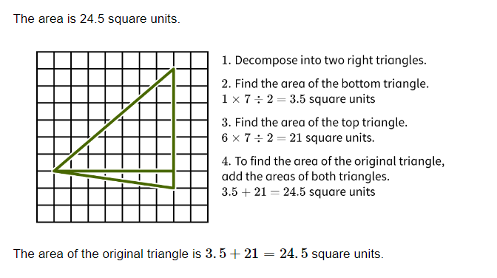
Answer

Slide 11
Conclusion
We have learned two methods of finding the area of non-right triangles.
Composing the shape into rectangles and decomposing it into triangles and other shapes.
Both methods require you to first find the altitude of the triangle.
Remember to practice and check your work!
Notes:
In conclusion, we have learned two methods of finding the area of non-right triangles. Both methods require you to first find the altitude of the triangle, but one involves composing the shape into rectangles and the other involves decomposing it into triangles and other shapes. With practice and patience, you can master both methods and become a geometry expert!

