Slide 1
Understanding Surface Area of Triangular Prisms
Math 6B Unit 7 Lesson 9
Notes:
In this presentation, we will be learning about the surface area of triangular prisms. Triangular prisms are three-dimensional objects that have five faces – two congruent triangles and three rectangles. We will explore how to calculate their surface area.

Slide 2
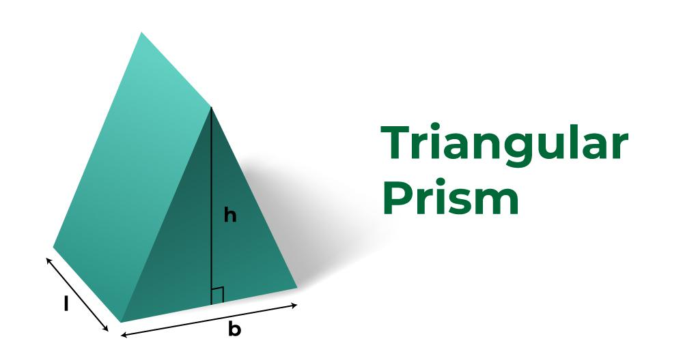
Identifying the Parts of a Triangular Prism
Triangular prisms have 5 faces
2 triangles and 3 rectangles
Base: one of the triangles
Height: perpendicular distance between the bases
Slant Height: the distance between the apex and midpoint of a side of the base
Notes:
To calculate the surface area of a triangular prism, we first need to identify its parts. The triangular prism has five faces – two congruent triangles and three rectangles. The base is one of the triangles, and the height is the perpendicular distance between the bases. The slant height is the distance between the apex and the midpoint of a side of the base.

Slide 3
Calculating the Lateral Area of a Triangular Prism
Lateral area: sum of the area of three rectangles
Formula for the area of a rectangle: A = lw
Formula for the lateral area: L = ph
p: perimeter of the base
h: height of the prism
Notes:
To calculate the lateral area of a triangular prism, we need to add the area of three rectangles. The formula for the area of a rectangle is A = lw. The formula for the lateral area of a triangular prism is L = ph, where p is the perimeter of the base and h is the height.

Slide 4
Calculating the Total Surface Area of a Triangular Prism
Total surface area: sum of the lateral area and area of two triangles
Formula for the area of a triangle: A = 1/2bh
b: base of the triangle
h: height of the triangle
Notes:
To calculate the total surface area of a triangular prism, we need to add the lateral area and the area of two triangles. The formula for the area of a triangle is A = 1/2bh, where b is the base of the triangle and h is the height.

Slide 5
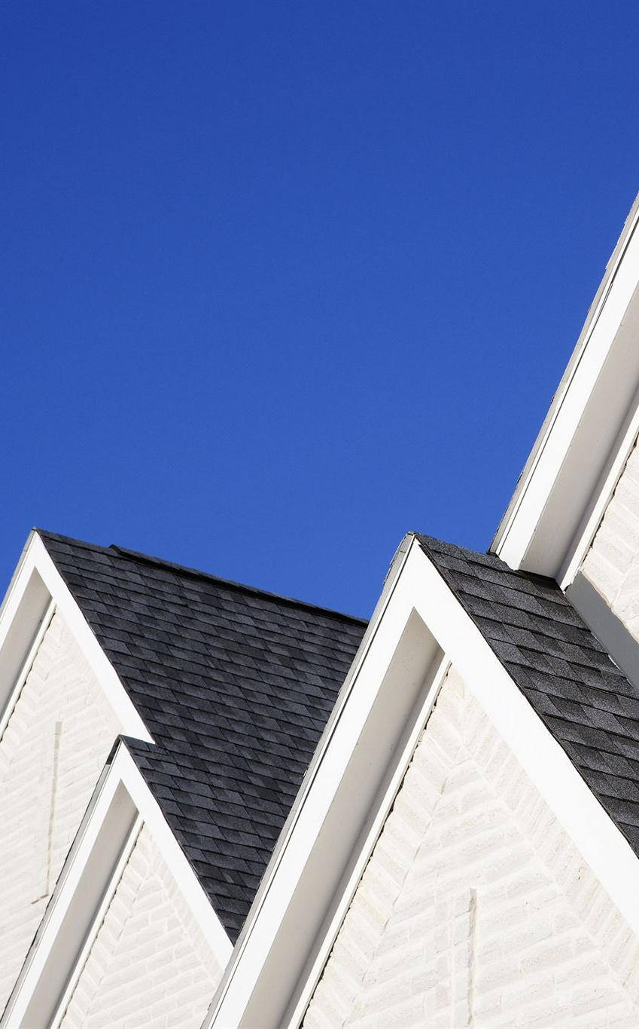
Real-Life Applications of Triangular Prisms
Examples: roofs of houses, shipping containers
Triangular prisms are used in architecture, engineering, and design
Knowing how to calculate their surface area is important in these fields
Notes:
Triangular prisms are used in real-life applications such as roofs of houses and shipping containers. Understanding how to calculate their surface area is important in fields such as architecture, engineering, and design.

Slide 6
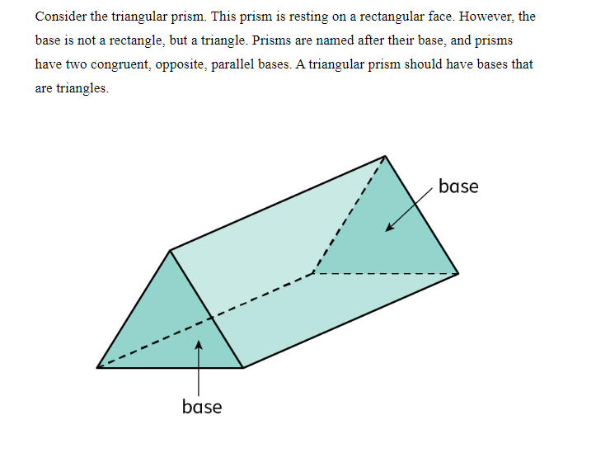
Prism to Net

Slide 7
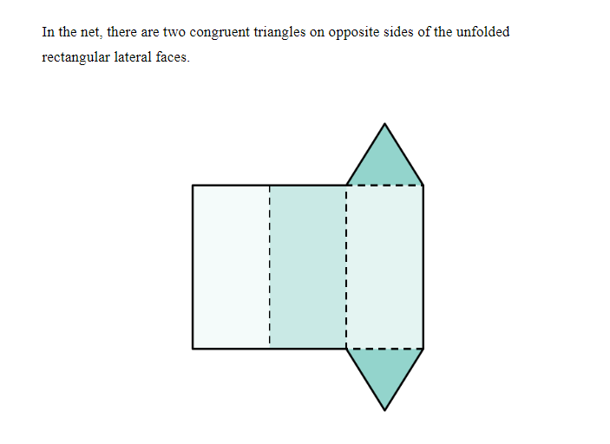
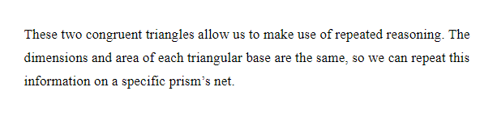
Prism to Net

Slide 8
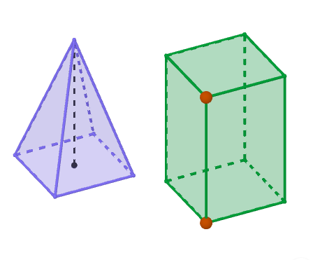
GeoGebra Practice
Connecting Volumes of Pyramids and Prisms Using Visual Models
https://www.geogebra.org/m/jz5exwtn

Slide 9
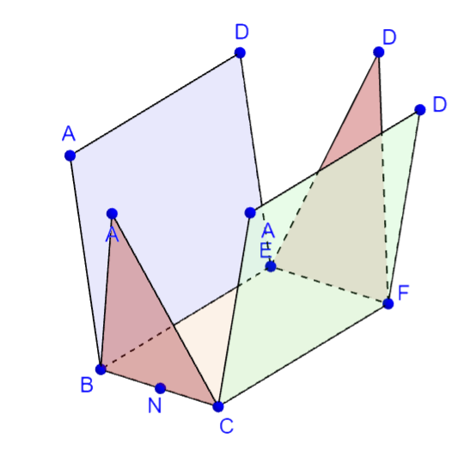
GeoGebra Practice
Net and Surface Area of Triangular Prism
https://www.geogebra.org/m/aJv7KdWB#material/Z39w5RnP

Slide 10
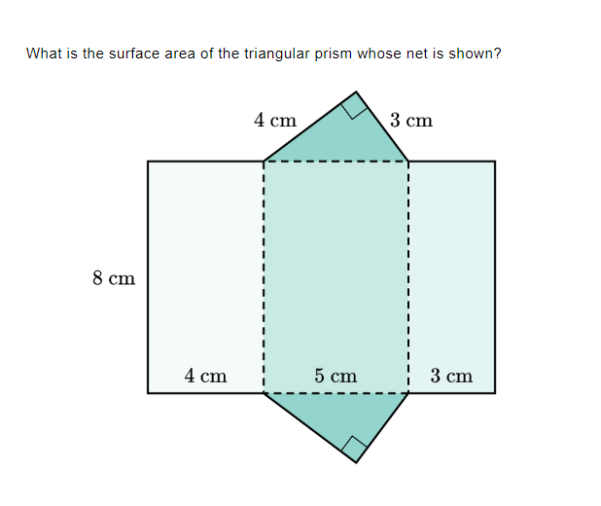
Practice

Slide 11

Answer

Slide 12
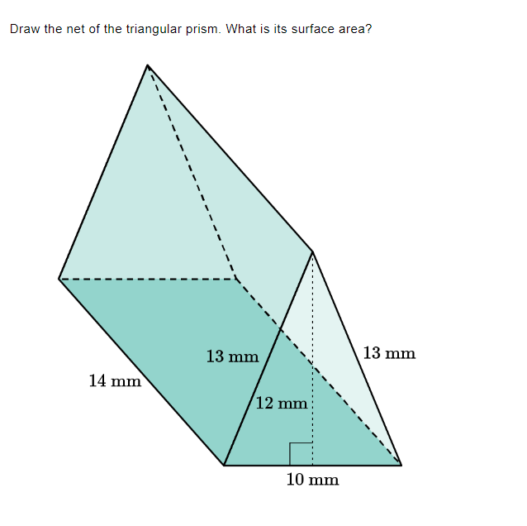
Practice

Slide 13
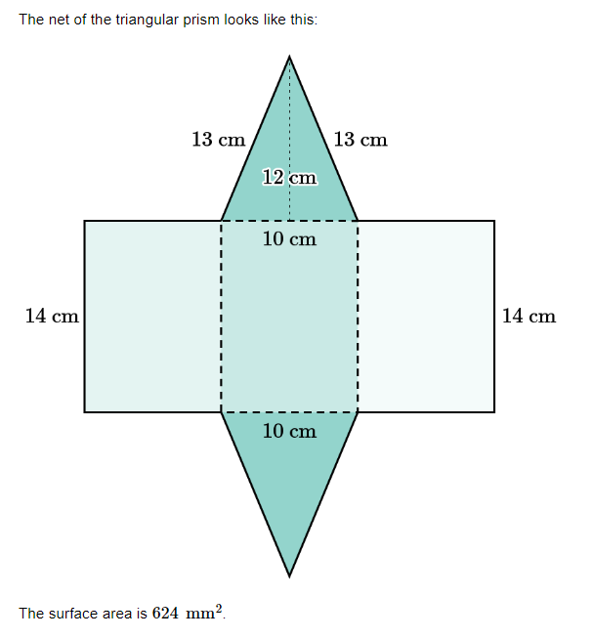
Answer

Slide 14
Summary of Understanding Surface Area of Triangular Prisms
A triangular prism has 5 faces, 2 triangles, and 3 rectangles.
The base of a triangular prism is one of the triangles, and the height is the perpendicular distance between the bases.
The slant height is the distance between the apex and midpoint of a side of the base.
The lateral area of a triangular prism is the sum of the area of three rectangles.
The total surface area of a triangular prism is the sum of the lateral area and the area of two triangles.
Real-life applications of triangular prisms include roofs of houses and shipping containers.
Knowing how to calculate the surface area of a triangular prism is important in architecture, engineering, and design.

