Slide 1
Welcome to Finding the Area of Polygons
Math 6B Unit 6 Lesson 5
Notes:
In this presentation, we will learn how to find the area of polygons using different methods. Area is the measure of the amount of space enclosed by a two-dimensional shape. It is important to understand how to find area because it helps us determine the amount of material required to cover a surface.

Slide 2
Composing Polygons into Rectangles
A rectangle is a four-sided polygon with all angles measuring 90 degrees.
A rectangle can be used to compose other polygons.
To find the area of a polygon, we can break it into smaller rectangles and add their areas together.
Notes:
One way to find the area of polygons is to compose them into rectangles. To do this, we draw a rectangle that completely encloses the polygon and then divide the rectangle into smaller rectangles that can be added together to find the area of the original polygon. This method works for polygons with straight sides and right angles.

Slide 3
Decomposing Polygons into Triangles and other Shapes
A triangle is a three-sided polygon with the sum of its angles always equaling 180 degrees.
Polygons can be broken down into triangles and other shapes to find their area.
To find the area of a polygon, we break it into triangles and other shapes and then add their areas together.
Notes:
Another way to find the area of polygons is to decompose them into triangles and other shapes. We can do this by drawing lines inside the polygon that divide it into triangles and other shapes. We then find the area of each triangle and other shape and add them together to find the area of the original polygon.

Slide 4
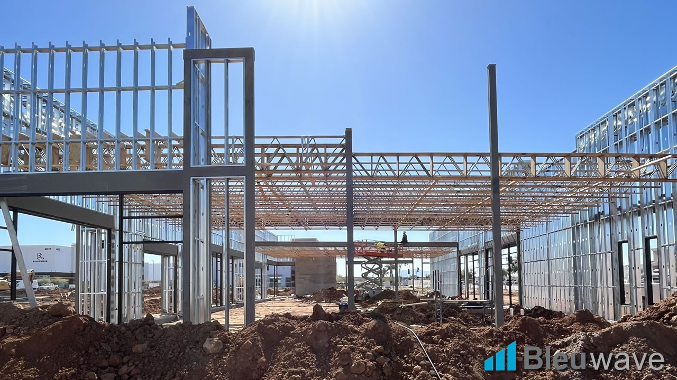
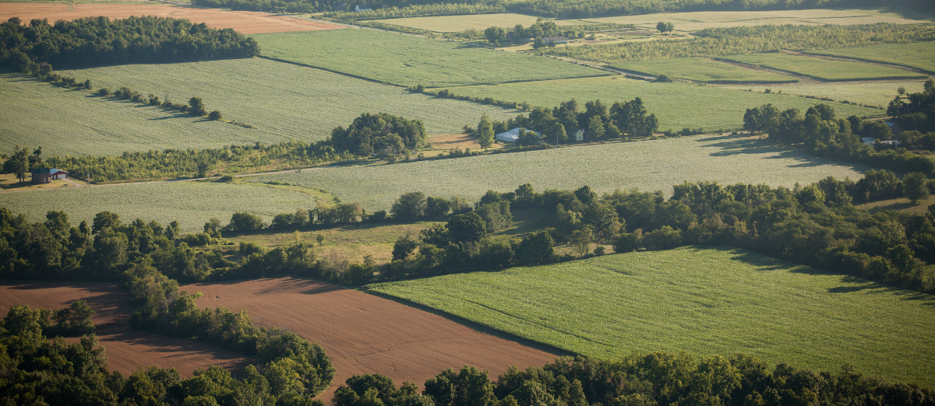
Real World Applications
Real World Examples
Finding the area of polygons is important in many real-world applications.
It is used in construction to determine how much material is needed to build something.
It is also used in agriculture to determine the area of land and measure the amount of fertilizer or pesticide needed.
Notes:
Finding the area of polygons is an important skill that we can use in many real-world applications. For example, in construction, we need to determine how much material is needed to cover a surface such as walls or floors. In agriculture, we need to determine the area of land and measure the amount of fertilizer or pesticide needed to treat the land.

Slide 5

Practice Finding the Area of Polygons
Practice makes perfect!
Let's try to find the area of different polygons using the methods we have learned.
Remember to use the formulas for the different shapes and add their areas together.
Notes:
It's time to put our knowledge to the test! We will practice finding the area of different polygons using the two methods we have learned. Remember to use the formulas for the different shapes and add their areas together. You can work on these problems alone or with a partner.

Slide 6
GeoGebra Practice
Area of regular polygons: https://www.geogebra.org/m/E7RtHHBS
Area Of Polygons Exploration: https://www.geogebra.org/m/QUwWt9nU
Finding area: https://www.geogebra.org/m/bxszfffj

Slide 7
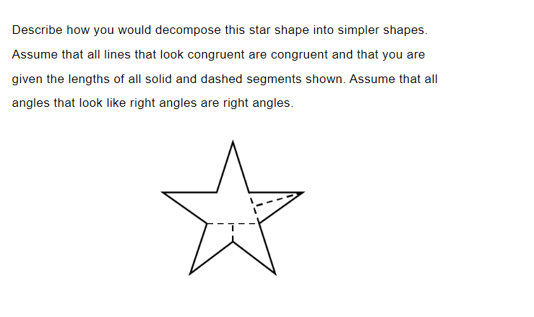
Practice

Slide 8
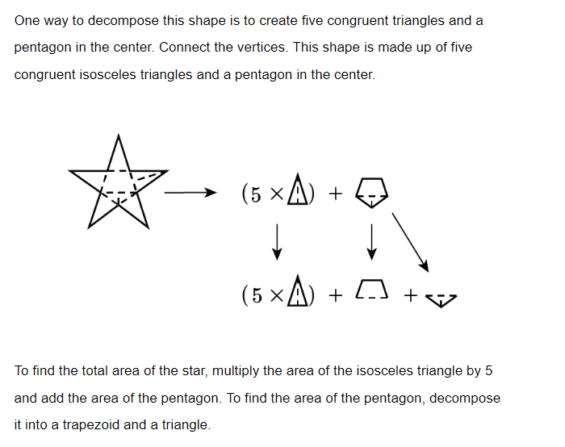
Answer

Slide 9
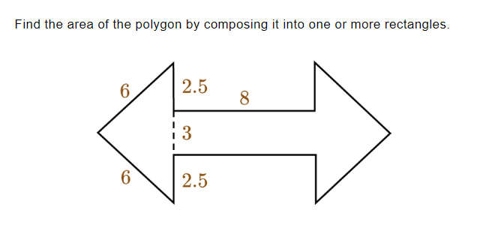
Practice

Slide 10
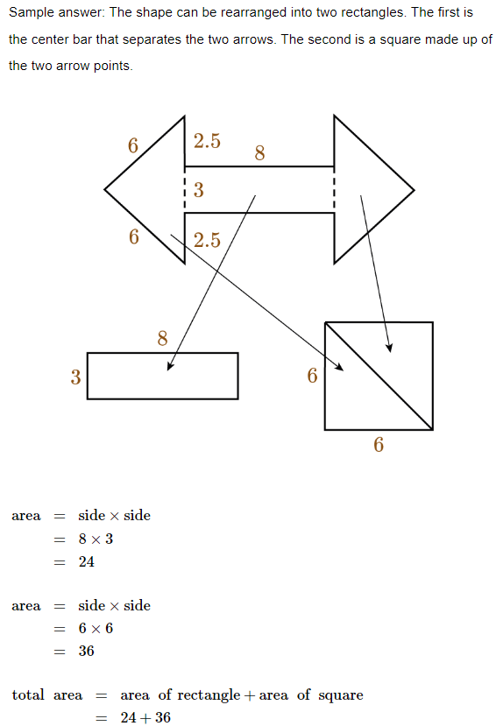
Answer

Slide 11

Conclusion
We have learned different methods for finding the area of polygons.
We can compose polygons into rectangles or decompose them into triangles and other shapes.
Finding the area of polygons is important in many real-world applications.
Notes:
In this presentation, we have learned different methods for finding the area of polygons. We can compose polygons into rectangles or decompose them into triangles and other shapes. It is important to understand how to find area because it helps us determine the amount of material required to cover a surface. We have also seen that finding the area of polygons is important in many real-world applications such as construction and agriculture.

