Slide 1
Use Coordinate Geometry to Solve Problems
Math 6B Unit 7 Lesson 3
Notes:
Welcome to this presentation on Using Coordinates to Find the Length of a Side Joining Points with the Same Second Coordinate for Polygons in the Coordinate Plane and How to Apply This Technique in the Context of Solving Mathematical Problems. In this presentation, we will be discussing how to use coordinates to find the length of a side joining points with the same second coordinate for polygons in the coordinate plane and how to apply this technique to solve mathematical problems.

Slide 2
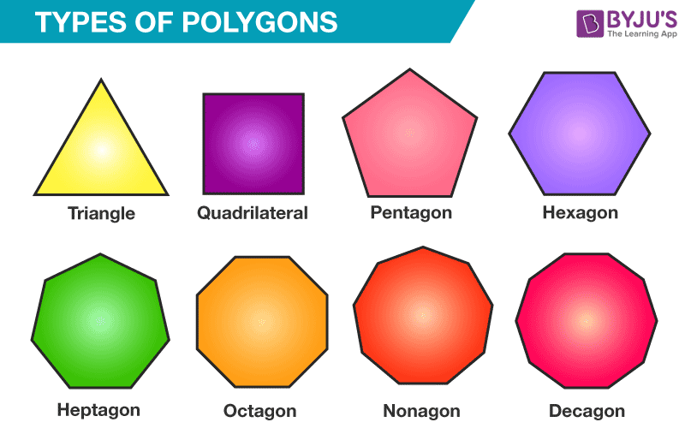
What is a Polygon?
A polygon is a closed figure made up of straight line segments
Polygons can be classified by the number of sides they have
Notes:
Before we dive into how to use coordinates to find the length of a side joining points with the same second coordinate for polygons in the coordinate plane, let's first define what a polygon is. A polygon is a closed figure made up of straight line segments. Polygons can be classified by the number of sides they have. Some examples of polygons include triangles, squares, pentagons, and hexagons.

Slide 3
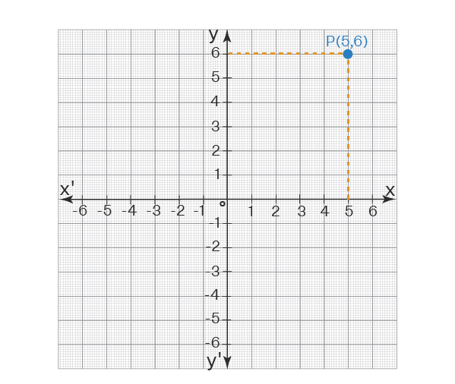
The Coordinate Plane
The coordinate plane is a two-dimensional plane formed by the intersection of a horizontal number line and a vertical number line
Points on the coordinate plane are identified by their coordinates
Notes:
Now that we have discussed what a polygon is, let's talk about the coordinate plane. The coordinate plane is a two-dimensional plane formed by the intersection of a horizontal number line and a vertical number line. Points on the coordinate plane are identified by their coordinates, which are written as (x, y). The x-coordinate represents the horizontal distance from the y-axis, and the y-coordinate represents the vertical distance from the x-axis.

Slide 4
The Coordinate Plane
Coordinates – a pair of numbers that indicates the position of a point in a coordinate plane, typically written as (x, y)
Ordered Pair – the point (x,y)
X-coordinate – the first number in an ordered pair;
Y-coordinate – the second number in an ordered pair.
Notes:
Now that we have discussed what a polygon is, let's talk about the coordinate plane. The coordinate plane is a two-dimensional plane formed by the intersection of a horizontal number line and a vertical number line. Points on the coordinate plane are identified by their coordinates, which are written as (x, y). The x-coordinate represents the horizontal distance from the y-axis, and the y-coordinate represents the vertical distance from the x-axis.

Slide 5

Finding the Length of a Side Joining Points with the Same Second Coordinate
To find the length of a side joining points with the same second coordinate, subtract the x-coordinates of the two points
The absolute value of the result is the length of the side
Notes:
Now that we understand what the coordinate plane is, let's talk about how to use it to find the length of a side joining points with the same second coordinate. To find the length of a side joining points with the same second coordinate, subtract the x-coordinates of the two points. The absolute value of the result is the length of the side. Let's look at an example. If we have two points, (2, 4) and (6, 4), the x-coordinates are 2 and 6. When we subtract 6 from 2, we get -4. The absolute value of -4 is 4, so the length of the side joining these two points is 4 units.

Slide 6
Using Coordinates to Find the Length of a Side Joining Points with the Same Second Coordinate
Using this technique can help us solve problems related to polygons in the coordinate plane
For example, we can use this technique to find the perimeter of a polygon
Notes:
Now that we know how to use coordinates to find the length of a side joining points with the same second coordinate, let's talk about how to apply this technique in the context of solving mathematical problems. Using this technique can help us solve problems related to polygons in the coordinate plane. For example, we can use this technique to find the perimeter of a polygon. To find the perimeter of a polygon, we simply add up the lengths of all the sides. We can use the technique we just learned to find the length of each side and then add them together to get the perimeter.

Slide 7
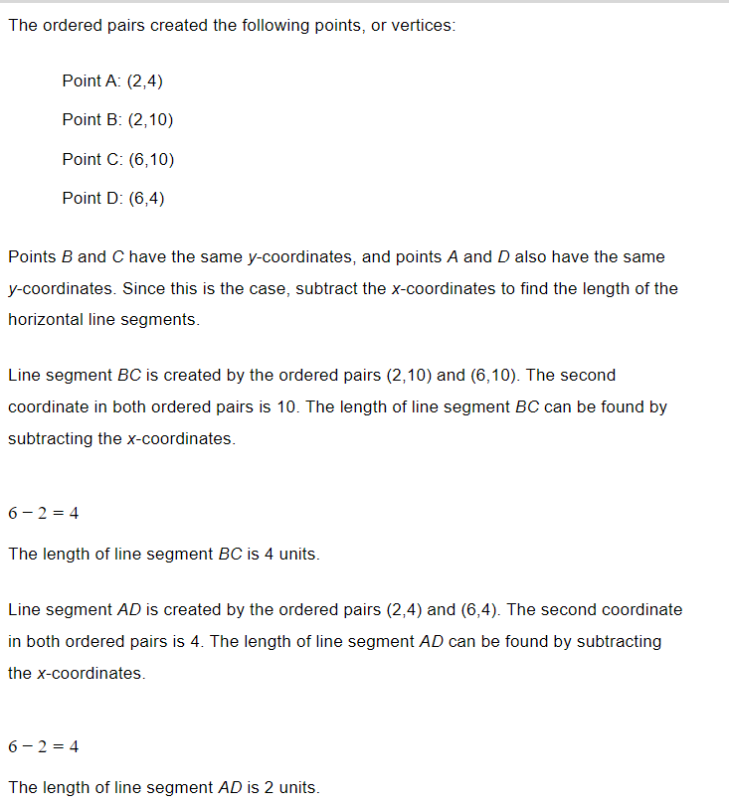
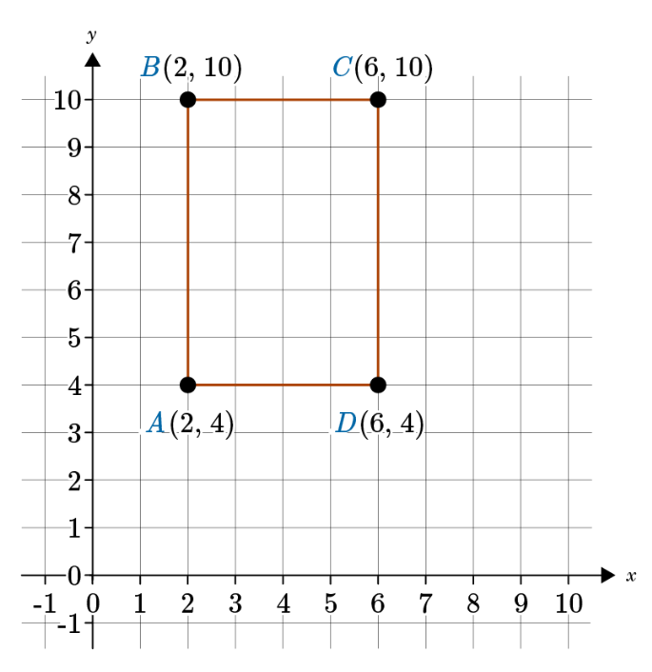
Example

Slide 8
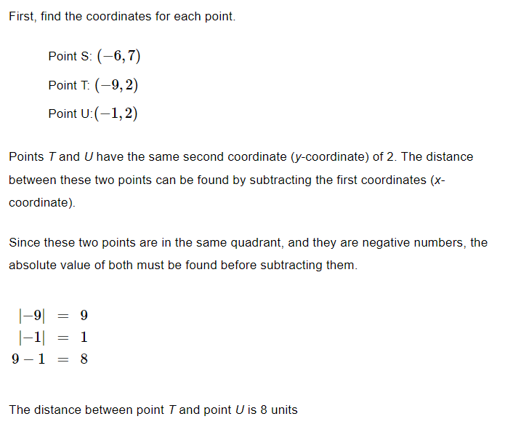
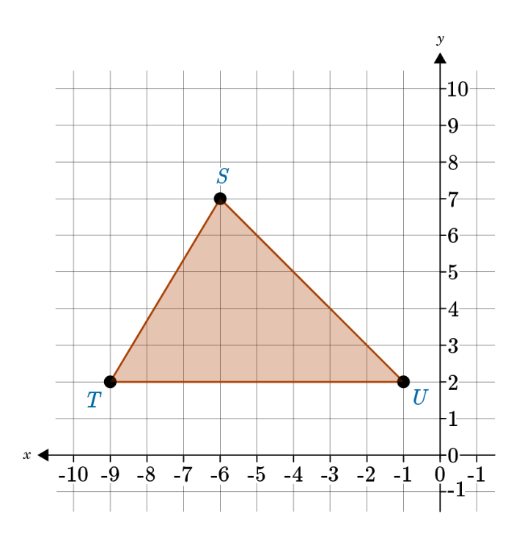
Example

Slide 9
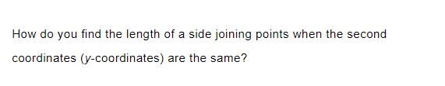
Practice

Slide 10

Answer

Slide 11

Practice

Slide 12

Answer
Answer

Slide 13
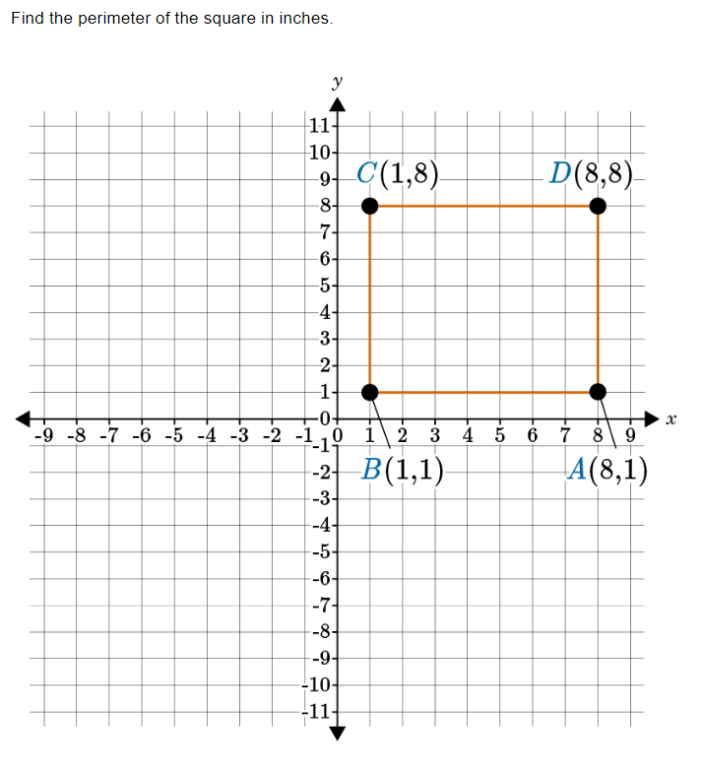
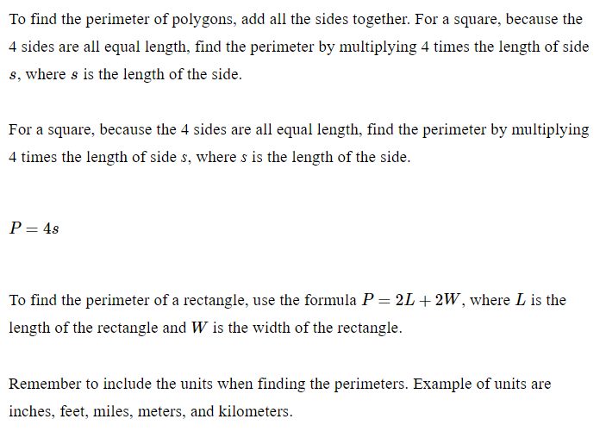
Perimeter of Polygons

Slide 14
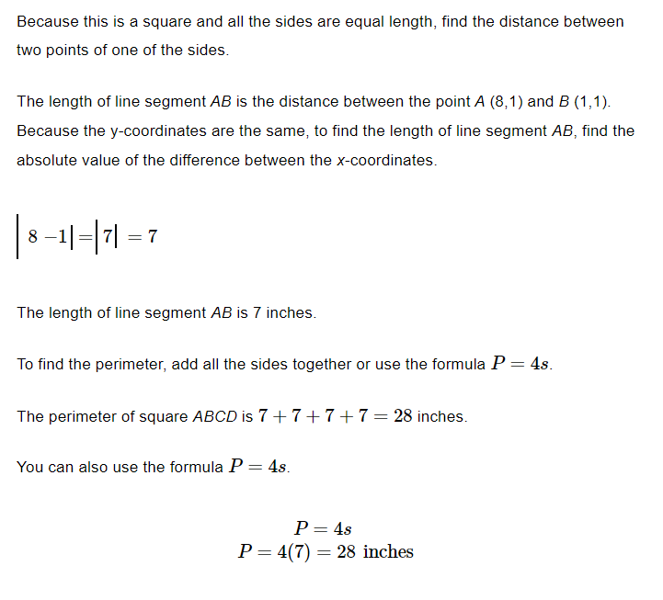
Perimeter of Polygons

Slide 15
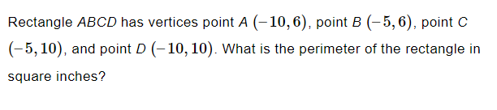
Practice

Slide 16
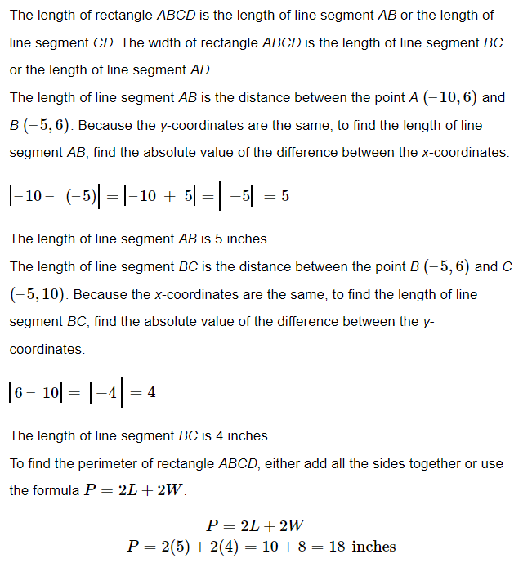
Solve

Slide 17
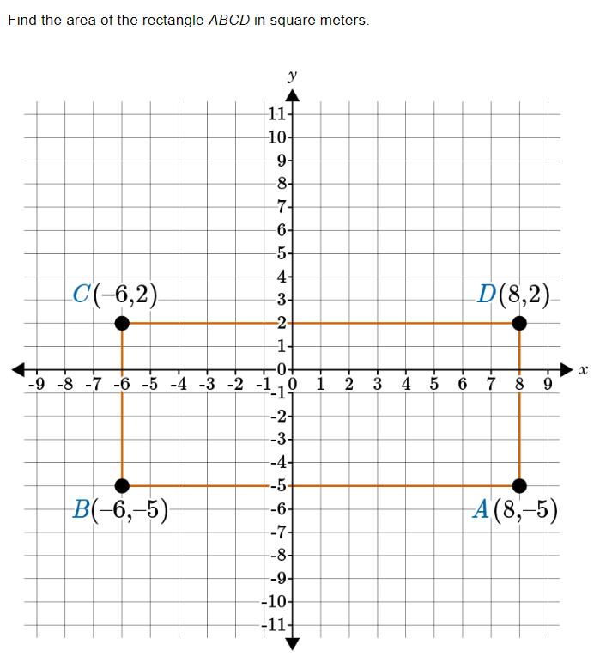
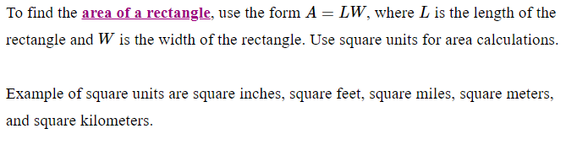
Area of Polygons

Slide 18
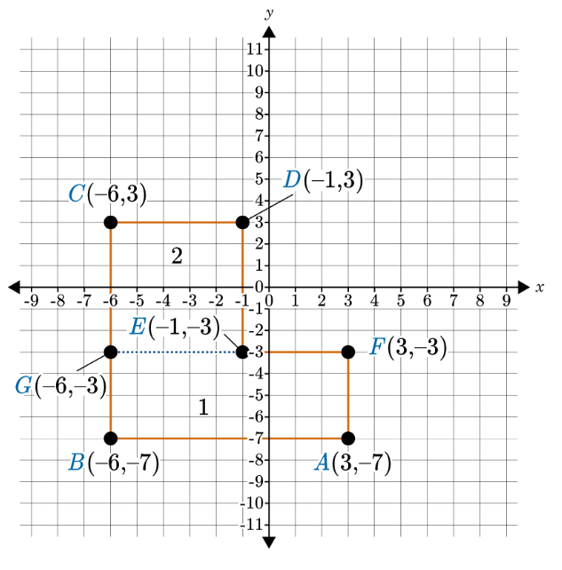
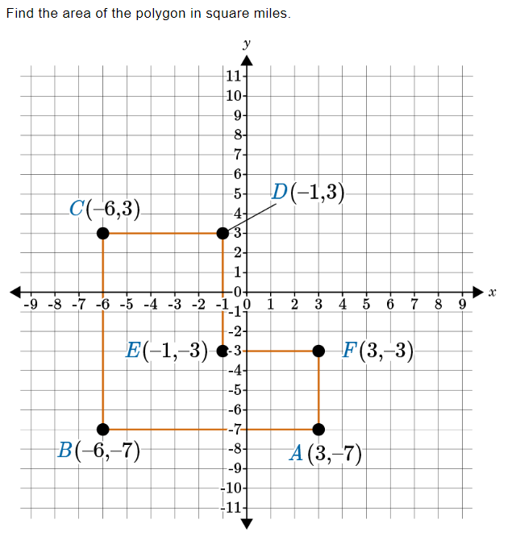
Practice

Slide 19
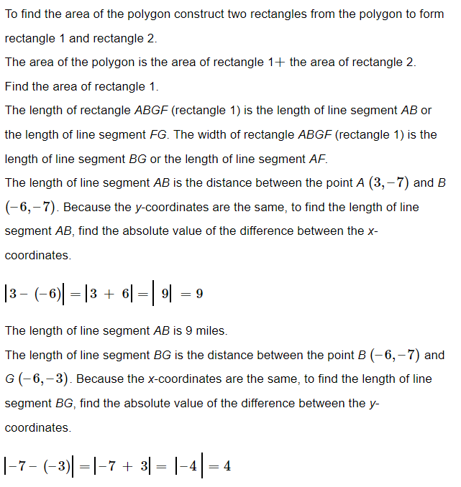
Practice

Slide 20
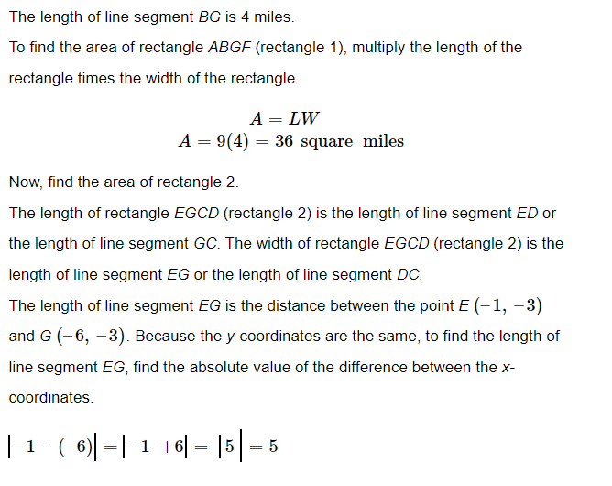
Practice

Slide 21
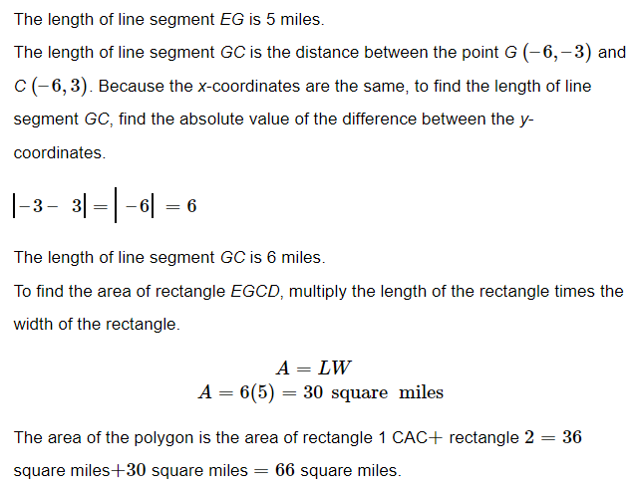
Practice

Slide 22
GeoGebra Practice
Finding Side Lengths: https://www.geogebra.org/m/ame9bds5
Area and Perimeter in a Coordinate Plane: https://www.geogebra.org/m/t5w3twnc

Slide 23
Summary of Key Points
Polygons are closed figures made up of straight line segments
Polygons can be classified by the number of sides they have
The coordinate plane is a two-dimensional plane formed by the intersection of a horizontal number line and a vertical number line
Points on the coordinate plane are identified by their coordinates
To find the length of a side joining points with the same second coordinate, subtract the x-coordinates of the two points
The absolute value of the result is the length of the side
Using this technique can help us solve problems related to polygons in the coordinate plane
For example, we can use this technique to find the perimeter of a polygon

