Slide 1
Finding the Surface Area of Rectangular Prisms
Math 6B Unit 7 Lesson 6
Notes:
Welcome to this presentation on how to find the surface area of rectangular prisms. In this presentation, you will learn how to use this concept to solve real-world problems.

Slide 2
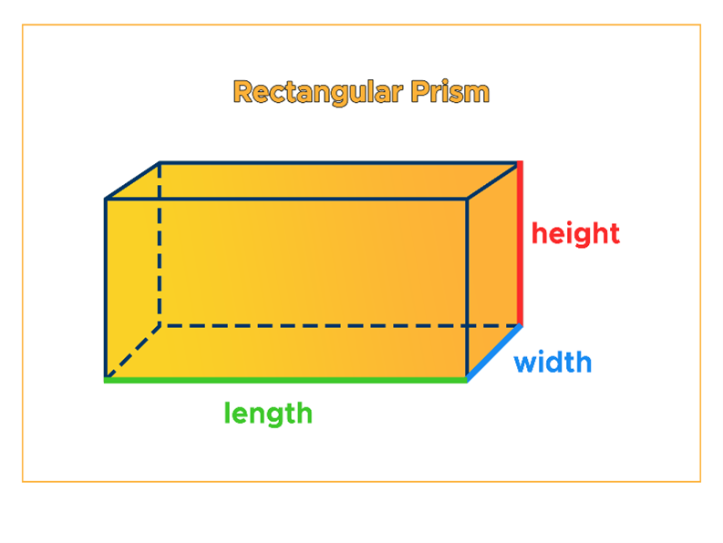
What is a Rectangular Prism?
A rectangular prism is a 3D object with 6 faces
Each face of a rectangular prism is a rectangle
Rectangular prisms are commonly found in everyday objects
Notes:
Before we dive into finding the surface area of a rectangular prism, let's first understand what it is. A rectangular prism is a 3D object with 6 faces, where each of those faces is a rectangle. You can find rectangular prisms in everyday objects like building blocks or a shoe box.

Slide 3
Calculating Surface Area
Surface area is the sum of the areas of all the faces of an object
Use the formula SA = 2lw + 2lh + 2wh to calculate surface area of a rectangular prism
Notes:
Now that you know what a rectangular prism is, let's learn how to calculate surface area. Surface area is the sum of the areas of all the faces of an object. To find the surface area of a rectangular prism, use the formula SA = 2lw + 2lh + 2wh.

Slide 4
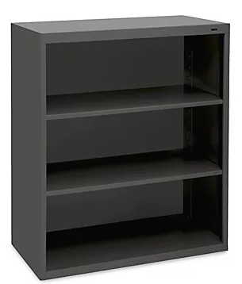
Example Problem 1
A bookshelf is 3 feet wide, 6 feet tall, and 1.5 feet deep
What is the surface area of the bookshelf?
Solution: SA = 2(3x6) + 2(6x1.5) + 2(3x1.5) = 57 sq. feet
Notes:
Let's put what we've learned into practice with an example problem. Suppose we have a bookshelf that is 3 feet wide, 6 feet tall, and 1.5 feet deep. What is the surface area of the bookshelf? Using the formula SA = 2lw + 2lh + 2wh, we get SA = 2(3x6) + 2(6x1.5) + 2(3x1.5) = 57 sq. feet.

Slide 5

Example Problem 2
A gift box is 8 inches long, 5 inches wide, and 3 inches tall
What is the surface area of the gift box?
Solution: SA = 2(8x5) + 2(5x3) + 2(8x3) = 142 sq. inches
Notes:
Let's try another example. Suppose we have a gift box that is 8 inches long, 5 inches wide, and 3 inches tall. What is the surface area of the gift box? Using the formula SA = 2lw + 2lh + 2wh, we get SA = 2(8x5) + 2(5x3) + 2(8x3) = 142 sq. inches.

Slide 6
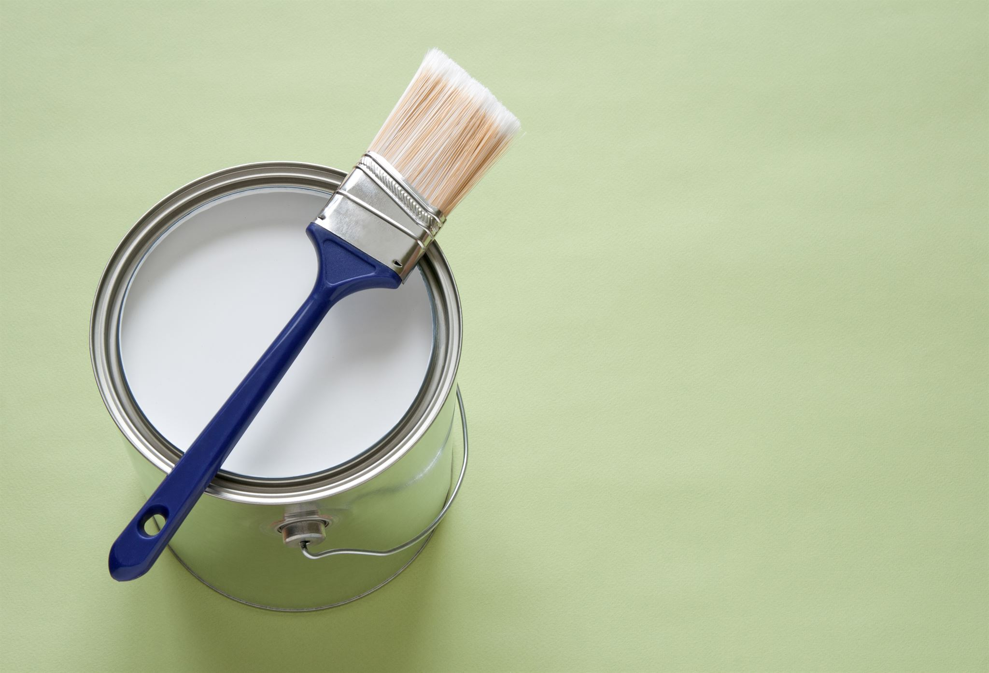
Real-World Applications
Surface area is used in many real-world situations
Examples include painting a room or wrapping a gift
Calculating surface area helps you save time and money by estimating how much material is needed
Notes:
Now that you understand surface area and how to calculate it, let's explore some real-world applications. Surface area is used in many situations, such as painting a room or wrapping a gift. Calculating surface area helps you save time and money by estimating how much material is needed.

Slide 7
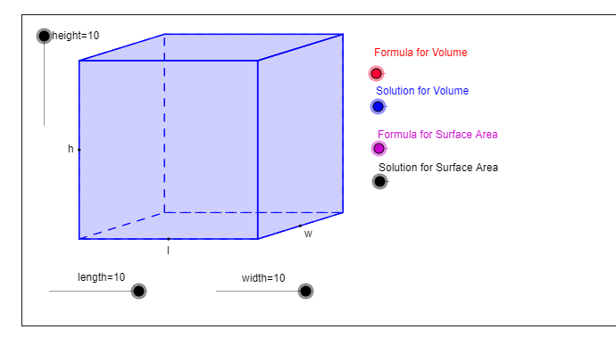
GeoGebra Practice
https://www.geogebra.org/m/ZA6rNhqs#material/YmKvYv3A

Slide 8
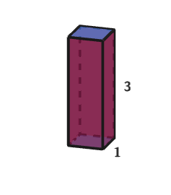
GeoGebra Practice
https://www.geogebra.org/m/wuhfdcpx

Slide 9
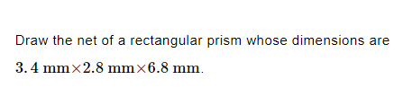
Practice

Slide 10
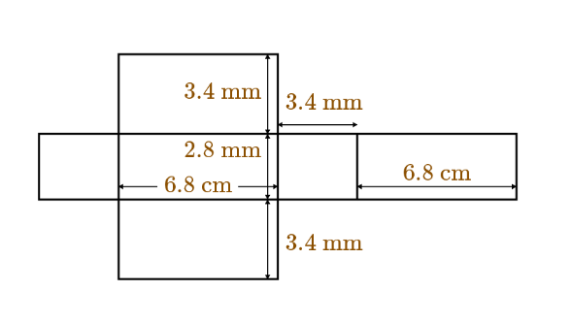
Answer

Slide 11
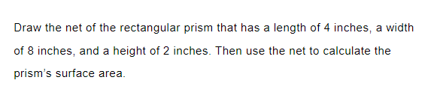
Practice

Slide 12

Answer

Slide 13
Summary of Key Points
A rectangular prism is a 3D object with 6 faces
Use the formula SA = 2lw + 2lh + 2wh to calculate the surface area of a rectangular prism
Surface area is the sum of the areas of all the faces of an object
Calculating surface area helps you save time and money by estimating how much material is needed
Notes:
This slide provides a summary of the key points covered in the presentation on finding the surface area of rectangular prisms. It is important to remember these key concepts when working with rectangular prisms in real-world applications.

