Slide 1
Welcome to the Area of Special Quadrilaterals!
Math 6B Unit 6 Lesson 4
Notes:
Hello, and welcome to the world of special quadrilaterals! Today we will learn how to find the area of some special types of quadrilaterals. By the end of this presentation, you will be able to find the area of trapezoids, parallelograms, and rhombuses by composing them into rectangles or decomposing them into triangles and other shapes.

Slide 2
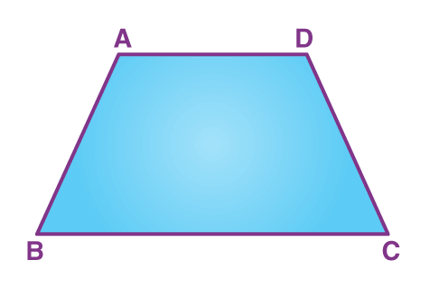
Trapezoids
A trapezoid is a quadrilateral with only one pair of parallel sides
The formula for finding the area of a trapezoid is (a+b)h/2, where a and b are the lengths of the two parallel sides, and h is the height of the trapezoid
Notes:
Let's start with trapezoids. A trapezoid is a quadrilateral with only one pair of parallel sides. To find the area of a trapezoid, we can compose it into a rectangle with the same height and the sum of the lengths of the two parallel sides as the base. Then, we can divide the rectangle into two triangles and find the area of the trapezoid by taking half of the rectangle's area. Alternatively, we can decompose the trapezoid into two smaller trapezoids and a rectangle, and use the formula (a+b)h/2 to find the area.

Slide 3
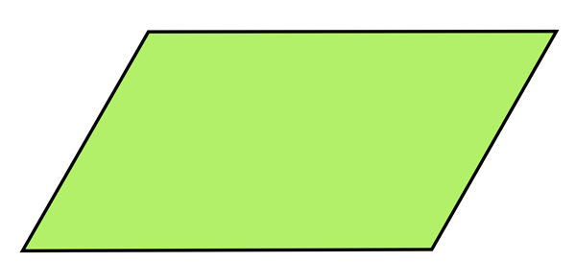
Parallelograms
A parallelogram is a quadrilateral with opposite sides parallel
The formula for finding the area of a parallelogram is bh, where b is the base of the parallelogram and h is its height
Notes:
Next, let's look at parallelograms. A parallelogram is a quadrilateral with opposite sides parallel. To find the area of a parallelogram, we can compose it into a rectangle with the same base and height, and then divide the rectangle into two congruent triangles. We can then use the formula bh to find the area of the parallelogram, which is the same as the area of the rectangle. Alternatively, we can decompose the parallelogram into two congruent triangles and rearrange them to form a rectangle, and then use the same formula to find the area.

Slide 4
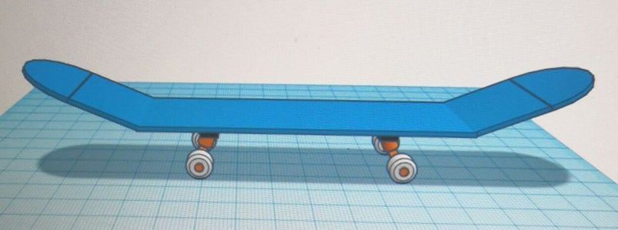

Real World Examples of Parallelograms
The roof of many houses is a parallelogram.
A skateboard is a parallelogram-shaped object.
The screen of most laptops is a parallelogram.
Notes:
Parallelograms are all around us. From the roofs of our houses to the screens of our laptops, it is one of the most common shapes in our environment. Skateboard decks are also a great example of a parallelogram-shaped object.

Slide 5

Rhombuses
A rhombus is a quadrilateral with all sides of equal length
The formula for finding the area of a rhombus is d1d2/2, where d1 and d2 are the lengths of the diagonals of the rhombus
Notes:
Finally, let's learn how to find the area of rhombuses. A rhombus is a quadrilateral with all sides of equal length. To find the area of a rhombus, we can decompose it into four congruent triangles, and then rearrange them to form a rectangle. The diagonals of the rhombus will be the base and height of the rectangle, so we can use the formula d1d2/2 to find the area of the rhombus, which is the same as the area of the rectangle.

Slide 6

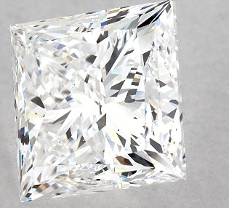
Real World Examples of Rhombuses
Some examples of rhombuses include diamonds, kites, and some signs and logos
Diamonds are a type of rhombus that is commonly used in jewelery and engagement rings
The kite shape is often seen in children's toys and decorations
The iconic Chevrolet logo is an example of a rhombus
Notes:
Rhombuses are commonly found in the real world in the form of diamonds, kites, and some signs and logos. Diamonds are a type of rhombus that is frequently used in jewelry and engagement rings. The kite shape is often seen in children's toys and decorations. The iconic Chevrolet logo is an example of a rhombus.

Slide 7
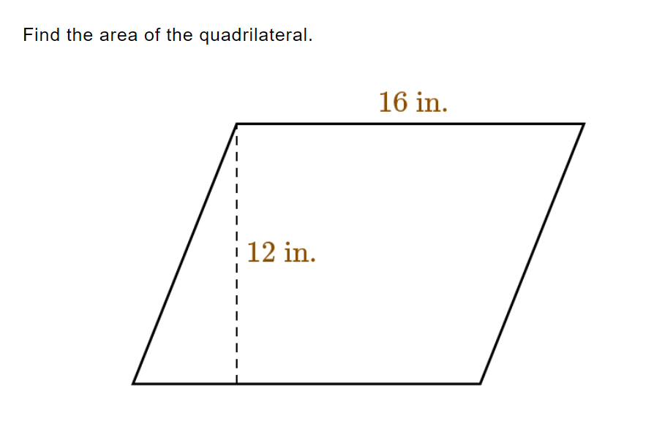
Practice
Work Space

Slide 8
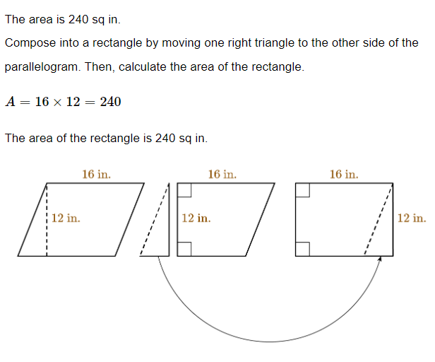

Answer

Slide 9
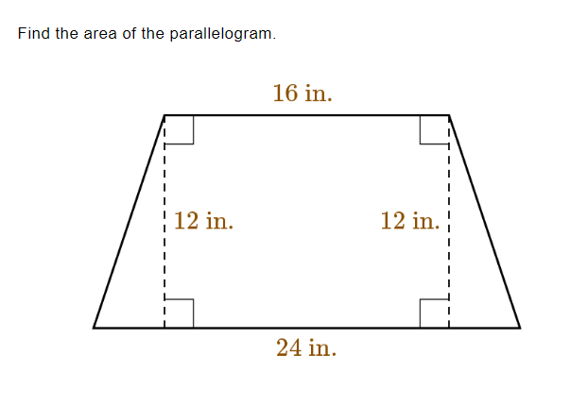
Practice
Work Space

Slide 10
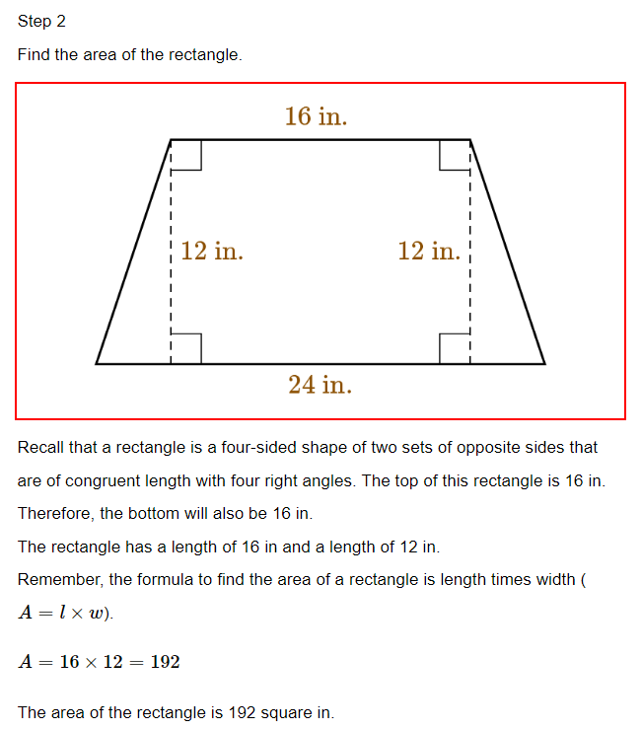
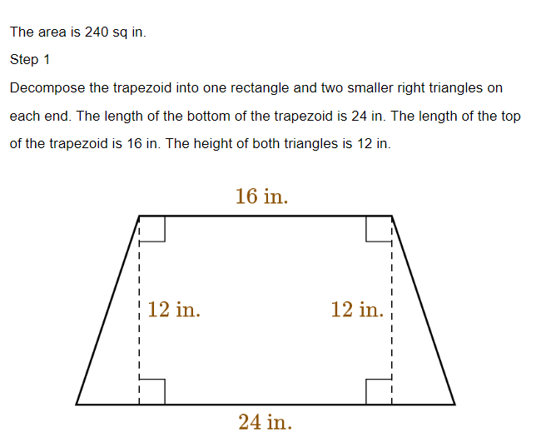
Answer

Slide 11
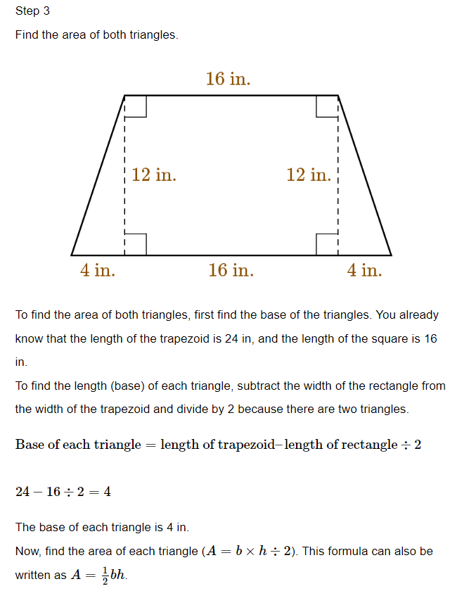
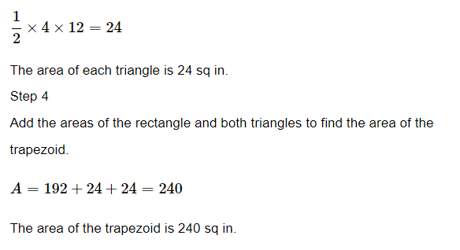
Answer

Slide 12
GeoGebra Practice
Trapezoid Investigation: https://www.geogebra.org/m/HyUu7pH5#material/tNaqNQdu
Parallelogram Investigation: https://www.geogebra.org/m/HyUu7pH5#material/msR2b8Fu
Rectangle Exploration: https://www.geogebra.org/m/HyUu7pH5#material/eG7XKgkz
Parallelogram area: https://www.geogebra.org/m/zjafd8zb

Slide 13

Key Points Summary
Introduction to special quadrilaterals
Trapezoids and their properties
Parallelograms and their properties
Real world examples of parallelograms
Rhombuses and their properties
Real world examples of rhombuses
GeoGebra explorations for trapezoids, parallelograms, and rectangles
Notes:
This presentation covered the properties and real world examples of key types of quadrilaterals. It also included GeoGebra explorations to further investigate trapezoids, parallelograms, and rectangles.

