Slide 1
Represent Numerical Data
Math 6B Unit 8 Lesson 2

Slide 2
Key Words
categorical dataset – a collection of related data in which each data point is part of a category other than numbers dataset – a collection of related data, or information
dot plot – a simple chart using circles to stand for data points
histogram – a method of displaying data visually using bars and ranges of data
numerical dataset – a collection of related data in which each data point is a number
observation – a data point or piece of data
statistics – a branch of math that deals with the collection and analysis of data

Slide 3
Reporting Observations in a Numerical Data Set
All data points are numbers. Ex. Number of baskets scored in a game.
Observations are individual data points.
The number of observations in a data set is also known as its size.
To report the size of a data set, count the number of observations.

Slide 4
Reporting Observations in a Categorical Data Set
All data points are not numbers but groups or categories. Ex. Types of trees at the park.
Observations are individual data points.
The number of observations in a data set is also known as its size.
To report the size of a data set, count the number of observations.

Slide 5
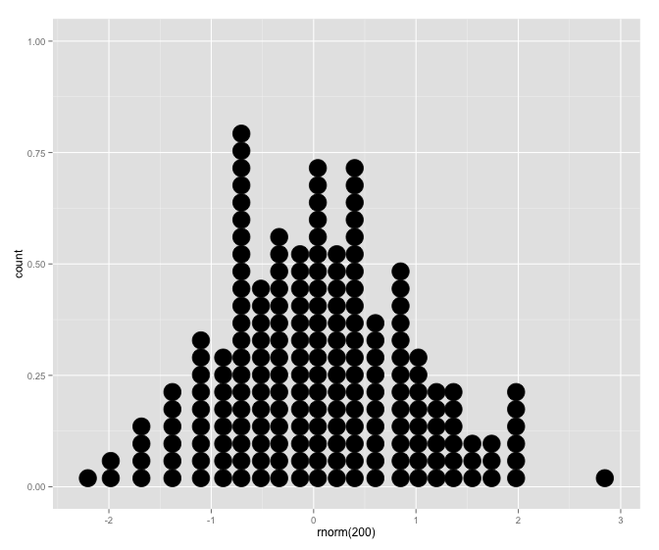
Creating a Dot Plot
A dot plot is a visual representation of numerical data.
Each observation in the data set is represented by a dot on a number line.
The number of dots above each value on the number line represents the frequency of that value in the data set.
Dot plots are especially useful for small data sets.

Slide 6
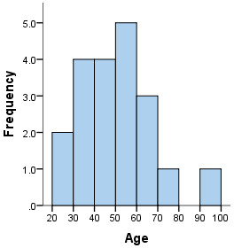
Creating a Histogram
A histogram is a visual representation of numerical data.
Data is grouped into intervals or bins on the horizontal axis.
The number of observations that fall into each bin is represented by the height of a bar above the bin on the vertical axis.
Histograms are especially useful for large data sets.

Slide 7
Choosing the Right Visual Representation
The choice between a dot plot and a histogram depends on the size of the data set.
Dot plots are best for small data sets.
Histograms are best for large data sets.
Both dot plots and histograms can effectively communicate numerical data.

Slide 8
Practice Exercise
Create a dot plot to visualize the following data set: 1, 3, 5, 5, 5, 8, 9, 10.
Notes:
Let's practice creating visual representations of data. Create a dot plot to visualize the following data set: 1, 3, 5, 5, 5, 8, 9, 10. Then, create a histogram to visualize the following data set: 2, 4, 5, 5, 6, 7, 8, 8, 8, 9, 9, 9, 10, 10, 10, 10. Remember to choose the right tool for each data set based on its size.

Slide 9
Practice Exercise
Create a histogram to visualize the following data set: 2, 4, 5, 5, 6, 7, 8, 8, 8, 9, 9, 9, 10, 10, 10, 10.

Slide 10
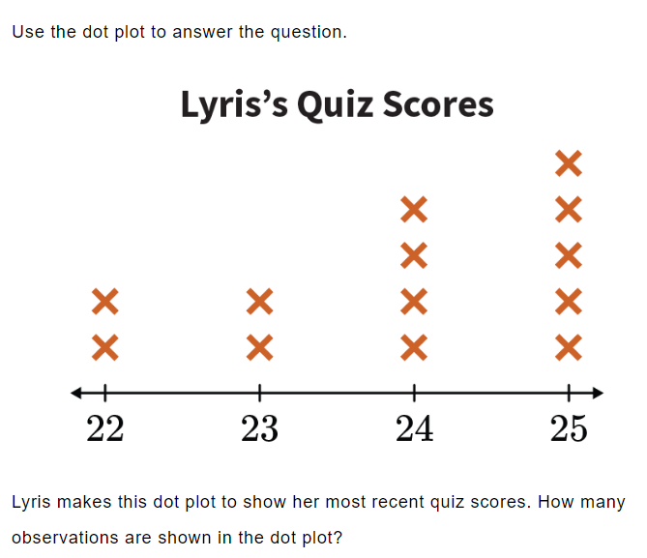
Practice

Slide 11

Answer

Slide 12
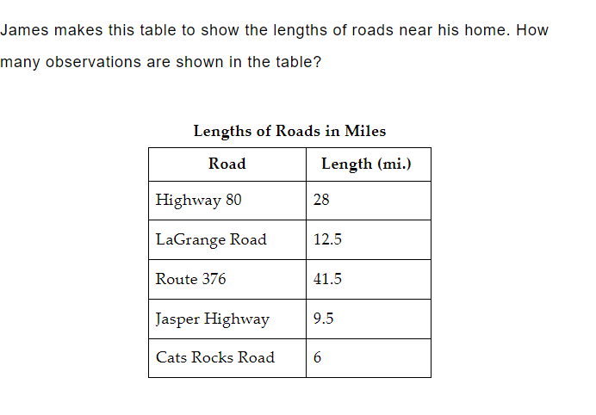
Practice

Slide 13

Answer

Slide 14
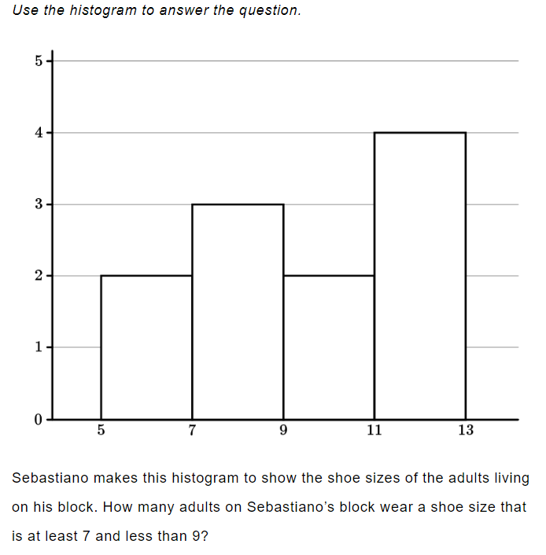
Practice

Slide 15

Answer

Slide 16
GeoGebra Practice
Visualizing Data Using Dot Plots: https://www.geogebra.org/m/axccj6df
Dot Plot Maker: https://www.geogebra.org/m/BxqJ4Vag
Histogram with GeoGebra; https://www.geogebra.org/m/xbq43Sfm
Interpreting Histograms: https://www.geogebra.org/m/hj3ckxmv
Using Histograms to Answer Statistical Questions: https://www.geogebra.org/m/qegfm85j

Slide 17
Key Points
Data can be visualized using dot plots and histograms
Observations are individual data points
The number of observations in a data set is also known as its size
To report the size of a data set, count the number of observations
A dot plot is a visual representation of numerical data
Each observation in the data set is represented by a dot on a number line
The number of dots above each value on the number line represents the frequency of that value in the data set
Histograms are especially useful for large data sets
Choosing the right visual representation is important
Practice exercises can help reinforce learning
GeoGebra can be used to create visualizations

