Slide 1
Compare Measures of Variation
Math 6B Unit 8 Lesson 8

Slide 2
Key Words
interquartile range (IQR) – measure of variability of a dataset that is the difference between the first quartile and third quartile
mean absolute deviation (MAD) – measure of variability of a dataset that is the average distance between each data point and the mean
range – measure of variability of a dataset that is the difference between the minimum and maximum values
variability – measure of how spread out the values of a dataset are

Slide 3
Measures of Variation
Measures of variation are used to describe how spread out a set of data is.
The three measures of variation are range, interquartile range, and mean absolute deviation.
Notes:
Each of these measures gives us different information about the data set, and we can use them to compare different sets of data.

Slide 4
Range vs. Interquartile Range
Range is the difference between the largest and smallest values in a data set.
Interquartile range is the range of the middle 50% of the data, ignoring the highest and lowest values.
Notes:
Range is useful when we want to quickly summarize the spread of a data set, but it can be affected by outliers. Interquartile range is more robust to outliers, and gives us a better sense of the typical spread of the data.

Slide 5
Interquartile Range vs. Mean Absolute Deviation
Mean absolute deviation is the average distance of each data point from the mean of the data set.
Interquartile range only considers the middle 50% of the data, ignoring the highest and lowest values.
Notes:
Mean absolute deviation gives us a more precise measure of spread, but it can be affected by outliers. Interquartile range is again more robust to outliers, and also gives us information about the shape of the data set.

Slide 6
Choosing the Best Measure of Variation
The best measure of variation depends on what you want to know about the data set.
If you want a quick summary of the spread, use the range. If you want a more detailed measure, use interquartile range or mean absolute deviation.
Notes:
It's important to consider what information you want to get from the data set before choosing a measure of variation.

Slide 7
Real-World Examples of Measures of Variation
The range can be used to compare the heights of buildings in a city.
Interquartile range can be used to compare the salaries of employees in a company.
Mean absolute deviation can be used to compare the accuracy of different measuring devices.
Notes:
Real-world examples help us understand how we use measures of variation in our daily lives. They allow us to make informed decisions and compare different data sets.

Slide 8
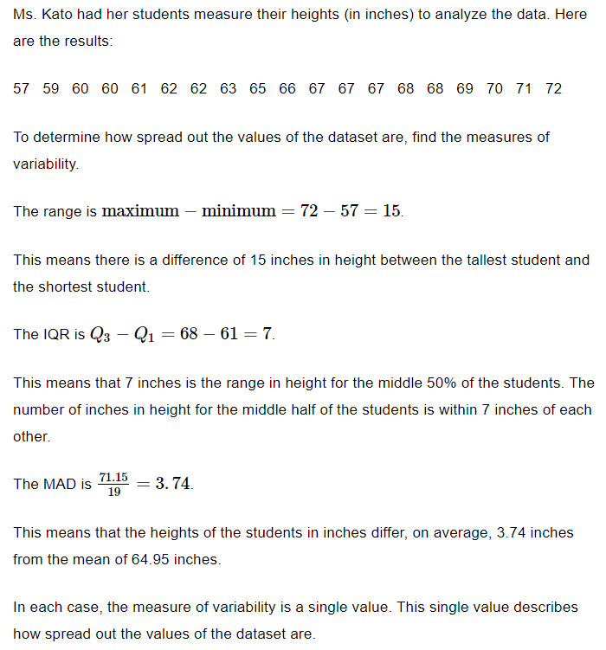
Example

Slide 9
Time to practice!
Calculate each of the three measures of variation for the following data set: 2, 4, 6, 8, 10.
Range
Interquartile Range
MAD

Slide 10
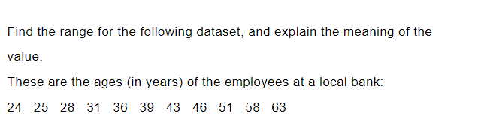
Practice

Slide 11

Answer

Slide 12
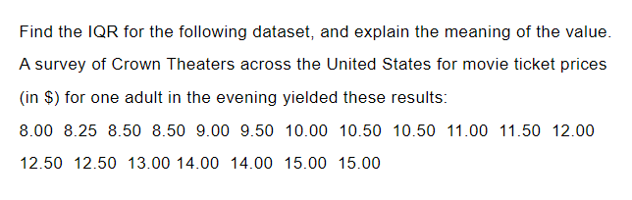
Practice

Slide 13
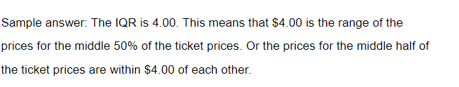
Answer

Slide 14
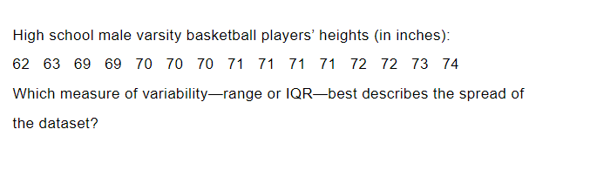
Practice

Slide 15
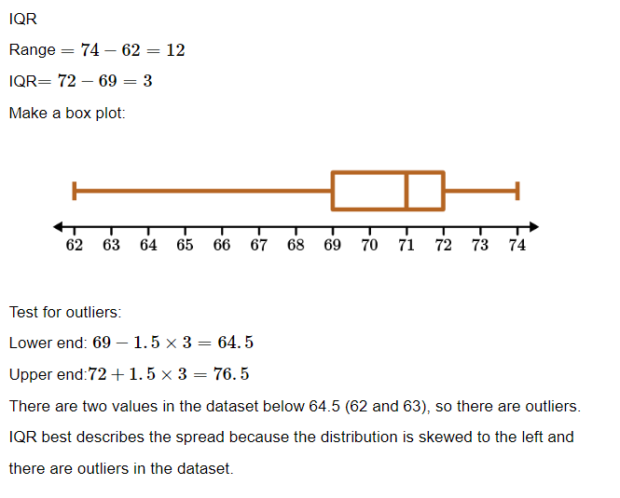
Answer

Slide 16
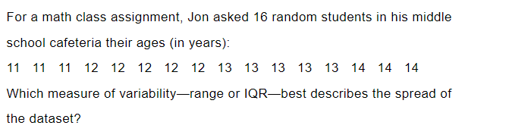
Practice

Slide 17
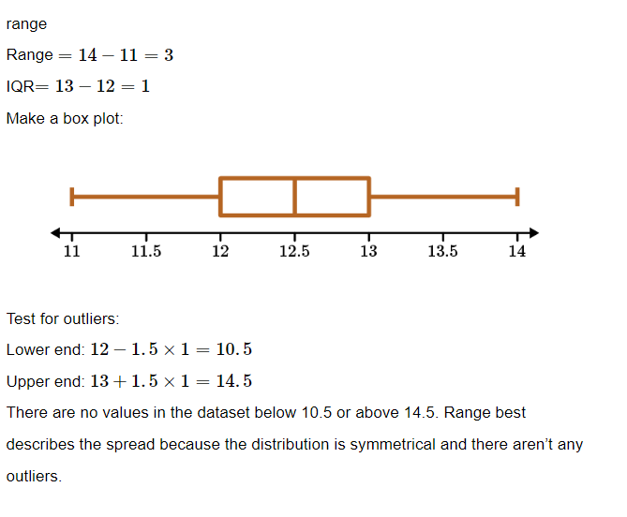
Answer

Slide 18
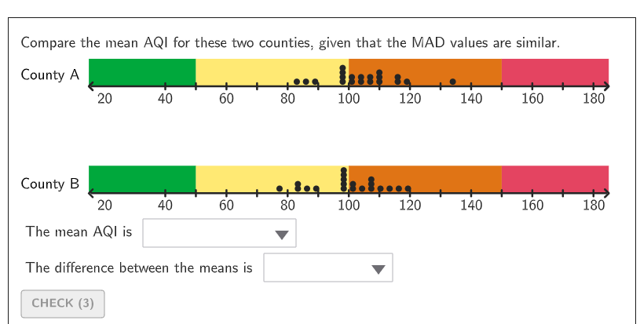
GeoGebra Practice
Calculate Inter quartile range: https://www.geogebra.org/m/TZXc9FJf
Median and Interquartile Range: https://www.geogebra.org/m/NRuhZn4M
Investigating Data Using MAD: https://www.geogebra.org/m/actbqhcj

Slide 19

Measures of Variation
Variation is a measure of how spread out the values of a dataset are.
The three measures of variation are range, interquartile range, and mean absolute deviation.
If you want a quick summary of the spread, use the range. If you want a more detailed measure, use interquartile range or mean absolute deviation.
Real-world examples of measures of variation are building heights, employee salaries, and device accuracy.

