Slide 1
Writing Inequalities in Mathematical and Real-World Problems
Math 6B Unit 5; Lesson 4
Notes:
Welcome to this presentation on how to write inequalities in mathematical and real-world problems. Inequalities help us describe relationships between quantities in terms of their relative size or value. We will be learning how to write inequalities of the forms x > c and x < c to represent a constraint or condition in problems.

Slide 2
Key Words
constraint – a limit given to a set of solutions when solving real-world problems
inequality – a statement that one value is less than, greater than, less than or equal to, greater than or equal to, or not equal to another value

Slide 3

Introduction to Inequalities
Inequalities are mathematical expressions that compare two quantities using symbols such as >, <, ≥, and ≤.
Inequalities are used to represent constraints, conditions, and relationships between quantities.
Inequalities can be used to describe situations like the number of students in a class, the weight of an object, and the temperature outside.
Inequalities can be written using variables, constants, and inequality symbols.
Notes:
Inequalities are mathematical expressions that compare two quantities using symbols such as >, <, ≥, and ≤. They are used to represent constraints, conditions, and relationships between quantities. For example, if we wanted to describe the number of students in a class, we could use an inequality like 'x > 20', where x represents the number of students and 20 represents the minimum number of students in the class. Similarly, if we wanted to describe the temperature outside, we could use an inequality like 'y < 30', where y represents the temperature in degrees Celsius and 30 represents the maximum temperature allowed.

Slide 4
Writing Inequalities x > c
The form of an inequality x > c indicates that x is greater than a constant c.
The variable x is the quantity that we are comparing to the constant c.
The inequality x > c can be used to represent situations like the length of a line segment or the price of a product.
Notes:
The form of an inequality x > c indicates that x is greater than a constant c. The variable x is the quantity that we are comparing to the constant c. For example, if we want to represent the length of a line segment that is greater than 5 centimeters, we would write 'x > 5', where x represents the length of the segment in centimeters. Similarly, if we want to represent the price of a product that is greater than $10, we would write 'p > 10', where p represents the price of the product in dollars.

Slide 5
Writing Inequalities x < c
The form of an inequality x < c indicates that x is less than a constant c.
The variable x is the quantity that we are comparing to the constant c.
The inequality x < c can be used to represent situations like the height of a person or the temperature in a room.
Notes:
The form of an inequality x < c indicates that x is less than a constant c. The variable x is the quantity that we are comparing to the constant c. For example, if we want to represent the height of a person that is less than 5 feet, we would write 'h < 5', where h represents the height of the person in feet. Similarly, if we want to represent the temperature in a room that is less than 25 degrees Celsius, we would write 't < 25', where t represents the temperature in degrees Celsius.

Slide 6
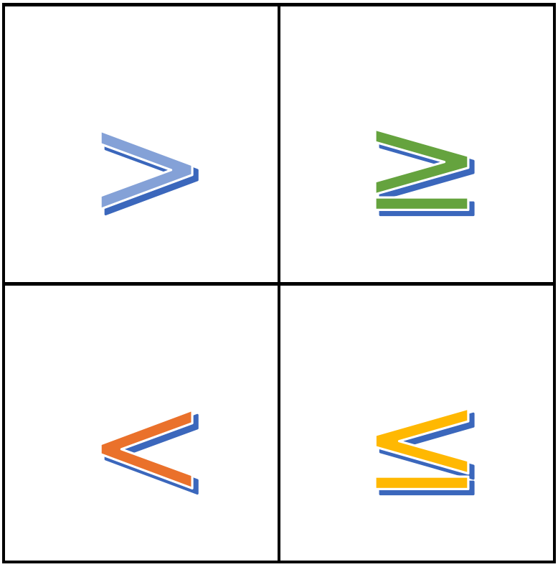
Examples of Writing Inequalities
Writing an inequality requires identifying the problem constraints, variables, and relationship between them.
Inequalities can be used to solve problems like determining the range of possible values of a variable.
Examples of writing inequalities include constraints on age, distance, time, area, and volume.
Notes:
Writing an inequality requires identifying the problem constraints, variables, and relationship between them. Inequalities can be used to solve problems like determining the range of possible values of a variable. Examples of writing inequalities include constraints on age, distance, time, area, and volume. For example, if we want to represent the age of a person who is younger than 18 years old, we would write 'a < 18', where a represents the age of the person in years. Similarly, if we want to represent the area of a rectangle that is less than 50 square centimeters, we would write 'A < 50', where A represents the area of the rectangle in square centimeters.

Slide 7

Practice Writing Inequalities
Writing inequalities takes practice and understanding problem constraints and variables.
Try writing inequalities for different problems and check if they make sense.
Inequalities can be used to model real-world situations and help us make decisions based on constraints and conditions.
Notes:
Writing inequalities takes practice and understanding problem constraints and variables. Try writing inequalities for different problems and check if they make sense. Inequalities can be used to model real-world situations and help us make decisions based on constraints and conditions. For example, if we want to represent the number of tickets sold for a movie that is less than 100, we would write 't < 100', where t represents the number of tickets sold. Similarly, if we want to represent the distance traveled by a car that is greater than 50 kilometers, we would write 'd > 50', where d represents the distance traveled by the car in kilometers.

Slide 8
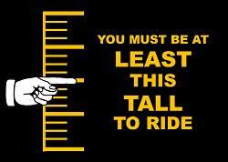
Real-World Examples of Inequalities Representing Constraints
Inequalities can be used to model real-world situations and help us make decisions based on constraints and conditions.
Examples of writing inequalities include constraints on age, distance, time, area, and volume.
Writing an inequality requires identifying the problem constraints, variables, and relationship between them.
Notes:
Inequalities can be used to solve a variety of problems in the real world, such as determining the maximum and minimum values of a variable subject to a set of constraints. For example, if you have a rectangular garden that you want to enclose with 100 feet of fencing, you can write an inequality to represent the maximum area that the garden can have. Another example is setting age limits for certain activities or products, such as the minimum age for purchasing alcohol or the maximum age for participating in a children's toy program.

Slide 9
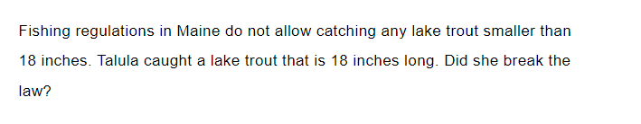
Practice

Slide 10
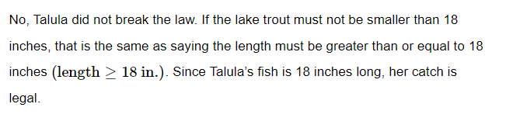
Answer

Slide 11
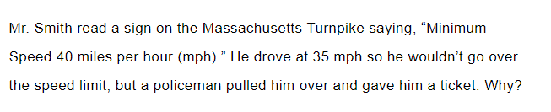
Practice

Slide 12
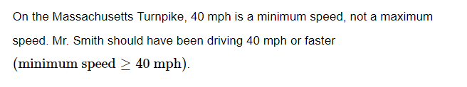
Answer

Slide 13
GeoGebra Practice
Writing Word Problems for One-Step Inequalities: https://www.geogebra.org/m/ehb88cec
Translating and Solving Real World Inequalities: https://www.geogebra.org/m/wv79hecy

Slide 14
Summary of Writing Inequalities
Inequalities are mathematical expressions used to compare two quantities using symbols such as >, <, ≥, and ≤.
1
Inequalities are used to represent constraints, conditions, and relationships between quantities.
2
Inequalities can be written using variables, constants, and inequality symbols.
3
Writing inequalities requires identifying the problem constraints, variables, and relationship between them.
4

