Slide 1
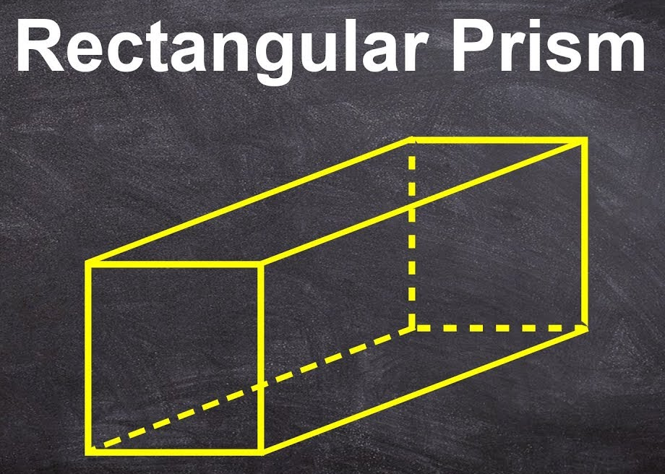
Welcome to Surface Area of Rectangular Prisms!
Math 6B Unit 7 Lesson 5
Notes:
Welcome to this presentation about surface area of rectangular prisms. In this presentation, you will learn how to find the surface area of these 3D shapes. Let's get started!

Slide 2
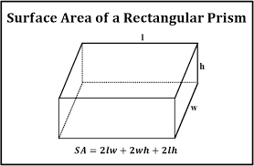
What is Surface Area?
Surface area is the total area of all the faces or surfaces of a 3D shape.
In rectangular prisms, the surface area can be found by adding up the area of all the faces.
Notes:
Before we begin, let's define what surface area is. Surface area is the sum of the areas of all the faces of a 3D shape. In a rectangular prism, we can calculate the surface area by adding up the area of each of its faces.

Slide 3
Calculating Surface Area of Rectangular Prisms
To find the surface area of a rectangular prism, we need to determine the area of each face and then add them together.
The formula for the surface area of a rectangular prism is 2(lw + lh + wh), where l is the length, w is the width, and h is the height.
Notes:
Now, let's learn how to calculate the surface area of a rectangular prism. First, we need to determine the area of each face. Then, we add the areas of all the faces together. The formula for surface area of a rectangular prism is: 2(lw + lh + wh), where l is the length, w is the width, and h is the height.

Slide 4
Example: Finding Surface Area of a Rectangular Prism
Let's find the surface area of a rectangular prism with length 5 cm, width 3 cm, and height 4 cm.
Area of bottom face = lw = 5 * 3 = 15 sq cm
Area of top face = lw = 5 * 3 = 15 sq cm
Area of front face = lh = 5 * 4 = 20 sq cm
Area of back face = lh = 5 * 4 = 20 sq cm
Area of right face = wh = 3 * 4 = 12 sq cm
Area of left face = wh = 3 * 4 = 12 sq cm
Total surface area = 2(lw + lh + wh) = 2(15 + 15 + 20 + 20 + 12 + 12) = 148 sq cm
Notes:
Let's work through an example to see how to apply the formula. If we have a rectangular prism with length 5 cm, width 3 cm, and height 4 cm, we can calculate the surface area by finding the area of each face, and then adding them together. The total surface area of this rectangular prism is 148 square centimeters.

Slide 5
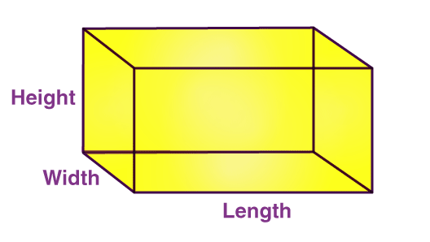
Practice Problems
Find the surface area of a rectangular prism with length 6 cm, width 4 cm, and height 8 cm.
Notes:
Great job! Now it's your turn to practice. Try these two problems to reinforce your understanding of surface area of rectangular prisms. Don't forget to use the formula we learned today!

Slide 6
Practice Problems
Find the surface area of a rectangular prism with length 10 cm, width 2 cm, and height 3 cm.
Notes:
Great job! Now it's your turn to practice. Try these two problems to reinforce your understanding of surface area of rectangular prisms. Don't forget to use the formula we learned today!

Slide 7
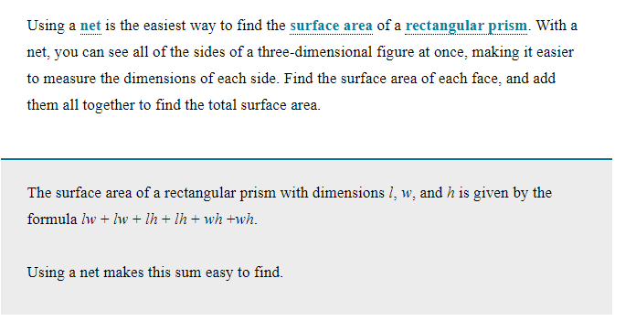
Using a Net

Slide 8
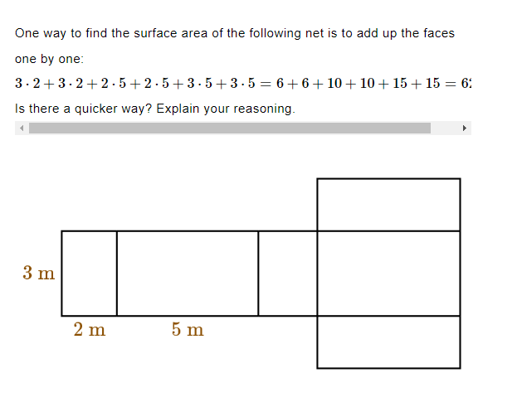
Practice

Slide 9
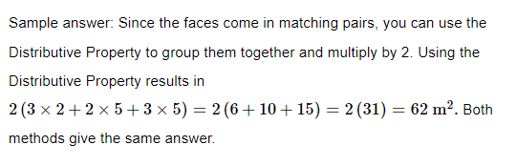
Answer

Slide 10
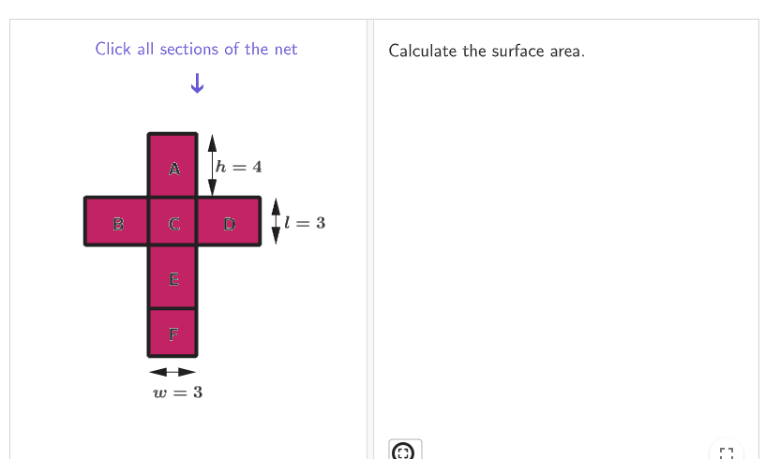
Practice - GeoGebra
Calculating the Surface Area of Prisms Using Nets: https://www.geogebra.org/m/vsqpg8se

Slide 11
Surface Area of Rectangular Prisms - Key Points
Surface area is the total area of all the faces or surfaces of a 3D shape
In rectangular prisms, the surface area can be found by adding up the area of all the faces
Formula for the surface area of a rectangular prism is 2(lw + lh + wh), where l is the length, w is the width, and h is the height
To find the surface area of a rectangular prism, we need to determine the area of each face and then add them together
Surface area is measured in square units
Practice problems help in understanding the topic better

